Slide 1
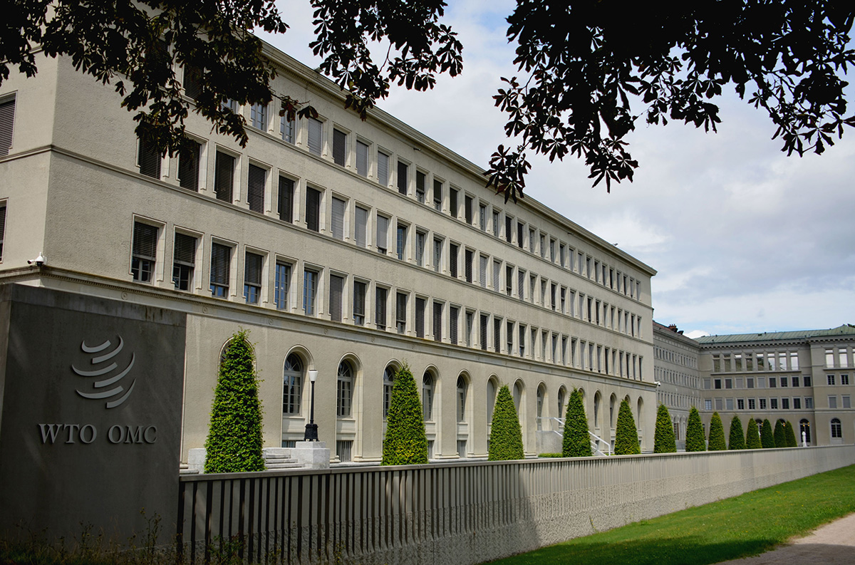

Climate Change @ WTO, an update
15 September 2026
Ms. Ludivine Tamiotti
Head, Environment Section, Trade and Environment Division, WTO Secretariat
Ludivine.tamiotti@wto.org
This presentation has been prepared in my personal capacity and is without prejudice to the positions of Members or to their rights and obligations under the WTO.

Slide 2
THE CTE: A BROAD WORK PROGRAMME
MEA and WTO rules
Environ-mental policies
Taxes, technical regulations, labelling
Dispute settlement and MEAs
Trans-parency
Market access
Domes-tically prohibited goods
Intellectual property rights
NGO arrange-ments
Services

Slide 3
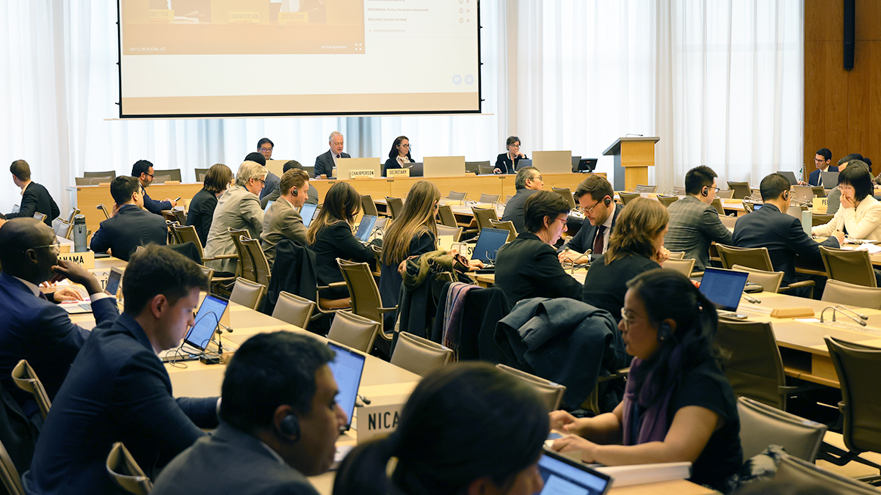
RECENT DEVELOPMENTS IN THE CTE
CTE
CTE Thematic Sessions
Interactive Sessions
Voluntary trade and climate measures information exchange exercise
Trade’s role in the clean energy transition
Trade-related climate measures
Technology transfer
Sustainable agriculture
TrCMs, interoperability and development
Voluntary sharing of information on trade and climate measures, including in relation to embedded carbon emissions measurement, using a template (WT/CTE/W/271)

Slide 4
CTE Thematic Sessions (2023-2025)
An innovative, Member-driven “reform by doing” approach to deepen dialogue, improve transparency, and facilitate experience-sharing on emerging trade and environment issues.
A practical shift in CTE work demonstrating Members’ dedication to exploring new avenues for progressing mutual interests.
Complement CTE’s regular work and bring together Members, experts, international organizations, business, and academia.
Date | Topic
November 2023 | Energy transition and climate adaptation/mitigation
April 2024 | Energy transition and climate adaptation/mitigation
October 2024 | Trade-related climate measures
February 2025 | Trade-related climate measures
April 2025 | Technology transfer
November 2025 | Sustainable agriculture
Forthcoming, 28 September 2026, Trade-related Climate Measures, including Interoperability and Development Aspects
Notes:
Since 2023, WTO Members have used CTE thematic sessions as an innovative "reform by doing" approach to deepen dialogue, improve transparency, and facilitate experience-sharing on emerging trade and environment issues. The sessions complement the Committee's regular work and bring together Members, experts, international organizations, business, and academia.

Slide 5
CTE Thematic Sessions on Trade-Related Climate Measures
Objective: Improve WTO Members’ understanding of the rapidly expanding landscape of TrCMs and identify areas for further work to reduce trade frictions, support cooperation, and address development concerns
 | Topics covered | Key insights
Session 1 | Mapping the TrCMs landscape | Rapid proliferation of TrCMs across sectors and jurisdictions; growing concern about fragmentation, trade costs and divergent approaches.
 | Fostering a Better Understanding of TRCMs | Traditional WTO-type measures (standards, subsidies, tariffs) and newer (related to decarbonization, carbon measurement, etc.); WTO can support dialogue, transparency and experience-sharing.
Session 2 | Climate-related Sustainability Standards – Implications and resources for developing countries and MSMEs | Sustainability requirements are increasingly shaping market access; developing countries and MSMEs face capacity and compliance challenges, highlighting the need for technical assistance and targeted support.
 | Inter-operability Issues in relation to carbon intensity and emissions measurement | Emerging as a central priority; greater alignment of carbon accounting, emissions measurement and MRV methodologies can reduce compliance costs, improve environmental credibility and limit trade fragmentation.
 | Carbon markets and linkages | Carbon markets are expanding and becoming increasingly relevant for trade; enhanced transparency, comparability and cooperation can facilitate market linkages and support decarbonization while reducing trade frictions.
Notes:
Emerging priorities for future work
Transparency: Improve visibility of TrCMs through notifications, the EDB, Trade Policy Reviews and information-sharing.
Policy Design: Share experiences on the development and implementation of TrCMs, promote good regulatory practices, and explore voluntary guidance to reduce unnecessary complexity and compliance costs.
Interoperability & Coherence: Advance dialogue on carbon accounting, emissions measurement methodologies, MRV frameworks, standards, equivalence and recognition approaches.
Development Support: Strengthen technical assistance, capacity building and research to help developing countries, LDCs and MSMEs engage with and comply with TrCMs.
Cooperation: Enhance coordination with other WTO bodies and relevant international organizations to leverage expertise and avoid duplication.

Slide 6





Interactive sessions
Following the thematic sessions, the CTE undertook “interactive sessions” to dive deeper into the trade and climate measures discussions.
Following opening plenaries with background presentations, delegations discussed guiding questions in break-out groups, reconvening in closing plenaries where moderators reported back.
Three initial sessions (October and December 2025, January 2026), covered three topics:
transparency approaches
development dimension
interoperability and coherence
These discussions have confirmed sustained interest on this topic, in particular on transparency.

Slide 7
Voluntary information sharing exercise
WT/CTE/W/271, Example A
Responding to sustained WTO Member interest, the CTE agreed to launch a pilot voluntary information sharing exercise, starting at the CTE meeting last week.
Elements contained in the draft template in WT/CTE/W/271 were referred to by many delegations as a useful tool for such information sharing.
Member providing information | Member X
Name of relevant measure | Measure Y
Implementing authority | Ministry of ABC
Objective of relevant measure
Timeline for adoption, implementation and review
Covered sectors/goods | Steel
Scope of emissions | Scope 1
Methodologies for measuring emissions (including any alternative approaches allowed) | e.g. ISOxxx
Relationship with relevant international measurement standards | [Methodologies for measuring emissions for this measure ] is based on ISOxxx・・・・ which facilitates・・・
Notifications to WTO bodies
Supporting documentation | Official documents can be accessed from: ・・・
Processes for stakeholder feedback (including public consultations)
Contact point
Other information

Slide 8

Other trade and environment work streams undertaken by groups of WTO Members
Three coordinated initiatives were launched by groups of Members in Nov. 2020:
  TRADE AND ENVIRONMENTAL SUSTAINABILITY STRUCTURED DISCUSSIONS (TESSD)
79 co-sponsors seek to intensify work on trade and environmental sustainability. Discussions have taken place in plenary meetings and in four Working Groups on (i) Trade-related Climate Measures; (ii) Environmental Goods and Services (EGS); (iii) Circular Economy – Circularity; and (iv) Subsidies.
  DIALOGUE ON PLASTICS POLLUTION AND ENVIRONMENTALLY SUSTAINABLE PLASTICS TRADE (DPP)
83 co-sponsors explore how cooperation in the WTO can contribute to global, regional and domestic efforts to reduce plastics pollution and promote sustainable trade in plastics, non-plastic substitutes, plastics alternatives and related technologies.
  FOSSIL FUEL SUBSIDY REFORM (FFSR) INITIATIVE
48 co-sponsors seek to achieve rationalization, phase out or elimination of harmful fossil fuel subsidies through use of existing mechanisms or the development of new pathways to reform.
Co-sponsors of all three initiatives are regularly sharing information on their work at meetings of the Committee on Trade and Environment; and as part of their updates, they always recall that the initiatives are open to all WTO Members.

Slide 9
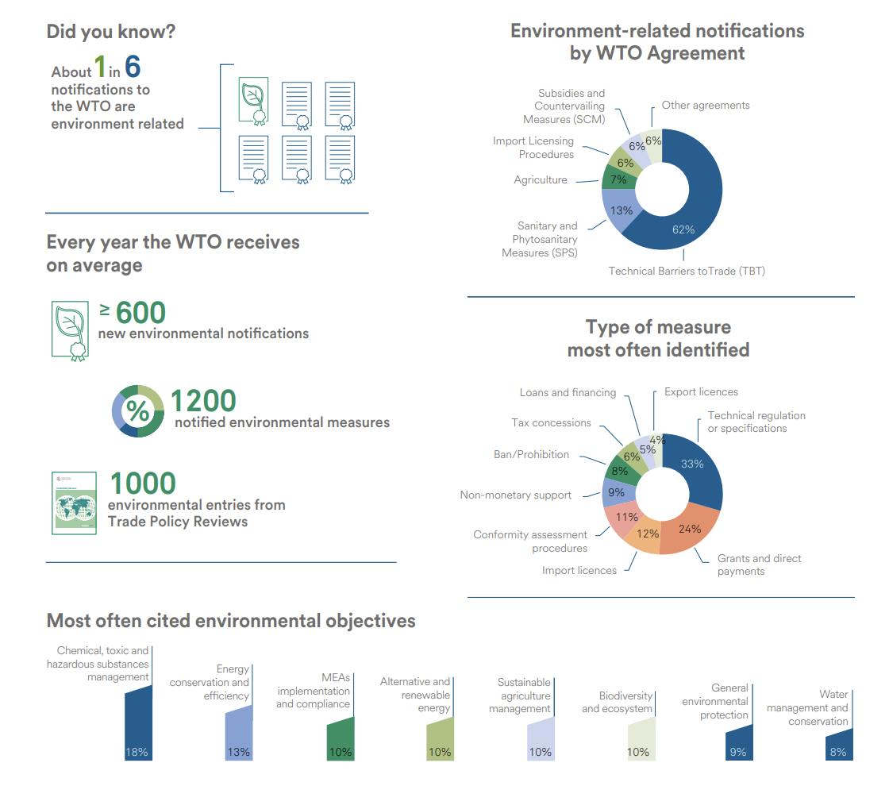
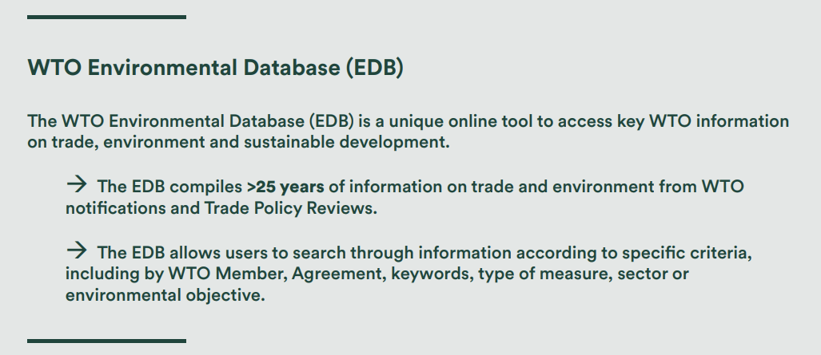
WTO Environmental Database (EDB)

