Slide 1
Andrei Marcu
Launch Event
Review of the EU ETS:
Issues & Levers
April 23, 2026
Brussels

Slide 2
Objective
This paper is not intended as a technical analysis, or search for solutions to individual issues, but to provide ideas on how the agenda for the review
Should be set and organized.
Define elements that need to be considered in response of problems identified.

Slide 3
Organization of paper
This paper is organized along the following logic:
Paint a picture of the current background in which the EU ETS functions
Identify the issues that are being raised in the context of the EU ETS discussions, and categorize into several “buckets”:
Political vs technical issues (a somewhat subjective classification as all issues when it comes to CO₂ have a political angle to them)
Nature of the “levers”
Temporary measures vs measures that address the issues structurally
Measures within the EU ETS itself vs those that complement the EU ETS.

Slide 4
Relevant questions
1. How different is the EU ETS that is profiling post 2030, the environment in which it exists, and what are the issues and levers.
2. Is the EU ETS fit-for-purpose, and what are the KPIs that define that. How do we define EU ETS “fit for purpose”:
Environmental delivery
Socio economic dimension.
Does the EU ETS provide sufficient incentive for investment in the low carbon economy?
Does it lead to decreasing the CO₂ intensity of the economy or to deindustrialization?
Market functioning
3. Does the EU ETS create in 2040 a functional EU economy if other jurisdictions do not essentially decarbonize to the same degree? Will the EU be competitive with low carbon products or will it become an island? Is there an end game under certain conditions - is there a need to define a moment when a plan B needs to be envisaged?

Slide 5
EU ETS: current perspective
Role of the EU ETS in decarbonization
EU ETS continues to be the tool of choice, so far, barring a change in climate change policy, and in the absence of credible alternatives being offered.
EU ETS review in the context of the EU climate change regulatory environment
The upcoming review is taking place in a very changed context, one which tries to recognize competitive and energy security concerns, without visibly modifying the direction of travel
EU ETS sectors: different circumstances
The sectors covered under the EU ETS are in very different circumstances both in terms of costs and competitive pressures

Slide 6
EU ETS: current perspective
ETS in the decarbonization journey
Currently, the situation has changed significantly with the EU ETS having been short year-on-year since 2021, is expected to be short in the future, and run out of allowances around 2039. Prices have also increased significantly.
EU ETS in a global context
The overall geopolitical situation has changed significantly
Fossil fuel price increase
Increase in carbon price and cost
Scarce public money
Reaction from other jurisdictions

Slide 7
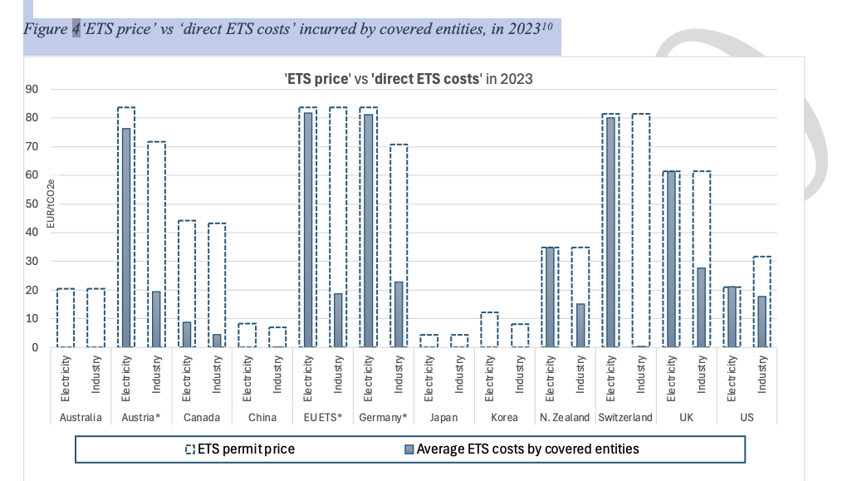
EU ETS: current perspective

Slide 8
Issues & levers
Energy prices
Carbon price & cost
Competitiveness in EU & global markets
Energy security
Technology neutrality
Demand for low carbon products
Burden on EU ETS and other sectors
Flexibility
Funding for decarbonization
Market functioning
Accompanying conditions

Slide 9
Carbon price & cost
Price & cost are different and have different roles
Direct and indirect cost
The issue is cost, but price is important
Carbon prices levers
LRF
MSR design: invalidation; absorption rate; release trigger; re examine cancelled EUAs
International credits
Price management

Slide 10
Carbon price & cost
Carbon costs leavers
LRF
MSR design
Free allocation/auction split
CBAM curve
Benchmarks
Role of free allocation vs CBAM
CSCF

Slide 11
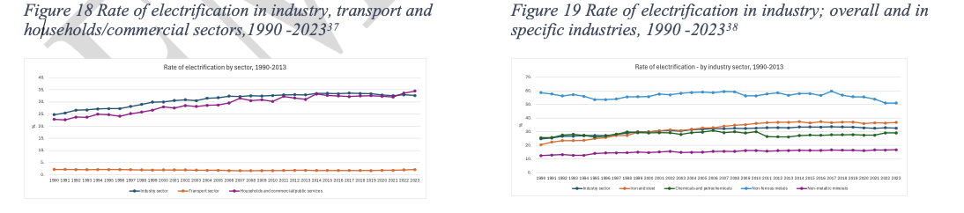
Accompanying conditions: issues
The availability of competitively-priced low carbon energy and other products such as H₂
Increased electrification
Demand for low carbon products
Deployment of infrastructure of alternative options for the production and transportation of low carbon options

Slide 12
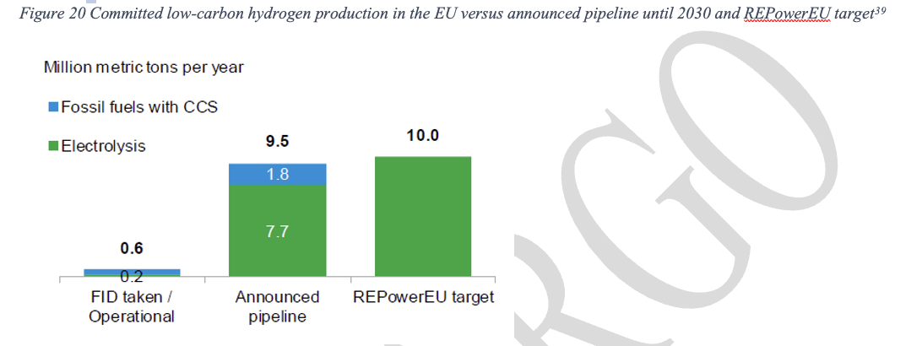
Accompanying conditions: issues

Slide 13
Accompanying conditions: Levers
The EU ETS does not exist in a vacuum and as such its contribution cannot be seen in isolation.
It cannot drive decarbonization on its own. Its role is to provide a price signal for decarbonization and to produce low carbon products – but other things that need to be in place for the EU ETS contribution to be valuable and useful.
These accompanying conditions/issues are not an EU ETS matter, but an EU policy matter and need to be addressed through other policy instruments.
For illustration purposes the need to create a market for low carbon products needs product standards and product accounting – neither of which are available.

Slide 14
Takeaways
Short of altering stance on climate change policy or coming up with an alternative instrument that is better, the EU ETS is the EU’s best choice
The EU ETS must evolve to ensure that the transition is sustainable – that is, the environmental, economic and social axis must move together.
The speed of decarbonization and accompanying conditions. The surrounding conditions are not an afterthought, they are not a “nice to have” – they are essential, and their importance cannot be emphasized enough. Conditionality works in many directions.
The EU ETS that emerges needs to take into account current conditions: financial firepower of the EU, geopolitical circumstances, and the competitive stance of EU industry vis a vis its main trade competitors.

Slide 15
Takeaways
The review must also consider the end game – what is the place and role of an EU decarbonized society in the world close to mid-century (which is not very far away)?
The review should ask all the hard and unpopular questions:
Is the EU the right instrument in the second half of the 2030s and if not, what is the after-EU ETS solution?
Can CBAM, the guarantor of the EU ETS and industry competitiveness deliver, or do we need to look at more tailored CBAM solutions?
The number of EUAs is declining, but the number of CBAM permits is infinite – is this right from an environmental, ethical and competitive points of view? And what are the market implications?
Is the MSR still needed in its current function?

Slide 16
Takeaways
To a large degree the EU ETS has always kicked the ball downfield (i.e. the measures put in place have always been designed with the assumption that it was waiting for others to join the same level of effort and through similar means). While there has been movement, the EU is still far in front which implies an increased focus on climate diplomacy and giving serious consideration that the outcome of the review factors in what others do relative to the EU.
The world is moving faster-and-faster and to be able to adapt, and respond, the governance of the EU ETS is critical, especially now when the easy, low hanging fruit have been picked.

Slide 17
Thank you!

