Slide 1

Launch event
Carbon Leakage under CBAM and Free Allocation
Brussels, 13 May 2026
Notes:
It is a long slide show, so we’ll go quickly over background etc to have time to focus on the core issues!

Slide 2
Agenda
10:30 – 10:40 Welcome and introduction
10:40 – 11:30 Presentation of the paper
11:30 – 12:00 Discussion guided by selected speakers
            Miles Perry, European Commission
            Marc Löning, Government of France
            Nicolas de Warren, UNIDEN
            Lidia Tamellini, Carbon Markets Watch
            Antoine Hoxha, Fertilizers Europe
            Adina Georgescu, European Metals
12:00 – 12:30 Q&A
12:30 End of the meeting

Slide 3
Objective & Context
Objective:
  Study on the long-term effects of free allocation versus full auctioning on industry value chain, and investment signals.
    Develop an analytical model that explicitly integrates international trade and carbon leakage, including the interplay between free allocation and CBAM.
    Review of carbon leakage approaches in other cap and trade ETSs
Context:
  Start of CBAM on several key industrials sectors (Aluminum, Steel, Cement, Fertilizers, H2)
  Extension of CBAM to other sectors
  EU ETS 2026 revision
  EU Industry competitiveness back on the political agenda (Omnibus, Draghi report…)
  With rising carbon prices and costs, ex-post studies start to detect stronger evidence of carbon leakage (e.g. Teusch et al., 2024)

Slide 4
Carbon price vs. carbon costs

Slide 5
‘ETS price’ vs ‘ETS costs incurred by covered entities’
* The EU ETS is considered without Austria and Germany, which also have national ETSs. Austrian and German ETS coverage is meant as coverage by EU ETS and national ETSs which cover transport and buildings that will be moved under EU ETS2.
** Covered systems by country or jurisdiction: Australia: Safeguard Mechanism; Austria: Austrian national ETS (NEHS) and EU ETS coverage; Canada: Alberta Technology Innovation and Emissions Reduction (TIER) Regulation, Canada Federal Output-Based Pricing System (OBPS), New Brunswick Output-Based Pricing System, Newfoundland and Labrador Performance Standards System (PSS), Nova Scotia Output-Based Pricing System for Industry, Ontario Emissions Performance Standards (EPS), Québec Cap-and-Trade System, Saskatchewan Output-Based Performance Standards; China: Chinese national ETS, the Chinese Pilot ETSs (Beijing, Chongqing, Fujian, Guangdong, Hubei, Shanghai, Shenzhen, Tianjin); EU ETS: considered without Austria and Germany, which also have their own national ETSs; Germany: German national ETS (nEHS) and EU ETS coverage; Japan: the Japanese subnational ETSs (Saitama Target Setting ETS and Tokyo Cap-and-Trade System); Korea: Korean Emissions Trading System; New Zealand: New Zealand ETS; Switzerland: Swiss ETS; United Kingdom: UK ETS; United States: all US subnational ETSs, i.e. California Cap-and-Trade, the Regional Greenhouse Gas Initiative (RGGI), Massachusetts Limits on Emissions from Electricity Generators, Washington Cap-and-Invest
Source: ERCST, based on OECD (2025)
In most ETSs, covered entities receive emission allowances for free to reduce the risk of carbon leakage and to protect firms against competitiveness losses.
EU leads the way, in terms of having one of the highest ‘ETS visible price’, and ‘incurred direct ETS costs by covered entities’ in the industry and electricity sectors after adjusting for free allocation.
A considerable number of systems imply zero or close to zero ‘incurred costs by covered entities’, namely Australia, China, Japan, Korea, but also Switzerland for the industrial sector.

Slide 6
The role of carbon price and carbon cost
Under the EU ETS, prices of EUAs and decarbonization costs may differ and play different roles:
Costs resulting from complying with the EU ETS, direct and indirect, will impact the competitiveness of covered installations, and sectors overall.
  EU ETS direct cost of compliance has been partially muted with free allocation, while indirect cost partially muted with state aid. Both direct and indirect costs expected to increase as free allocation declines, and price of EUAs increase and electrification increases, thus impacting (if temporarily) the competitiveness of EU industry.
  Costs are fundamental to economic decision-making and determine the competitiveness of European industries in international markets. EU industries facing global competition may struggle if they are subject to higher costs than their counterparts in other countries.
While EUA prices are impacted by the EUA scarcity, and ultimately by the cost of decarbonization, this is not a direct relationship as the overall cap provides the long-term visibility and market participants’ behaviour determines prices. This sends a decarbonisation signal but is not always predictable.
  EUA prices not only to disincentivise carbon intensive approaches, but also incentivise the development/ deployment of low carbon technologies. The two are not the same and at current levels latter is not happening.
High visible/explicit prices not to be confused with high costs (effective price) – aim for high visible prices but for costs that can be sustained by those that need to undertake decarbonization.

Slide 7
Carbon leakage measures & allowance allocation methods in ETSs of other jurisdictions considering BCAs

Slide 8
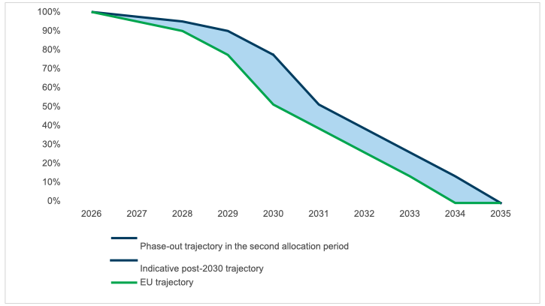
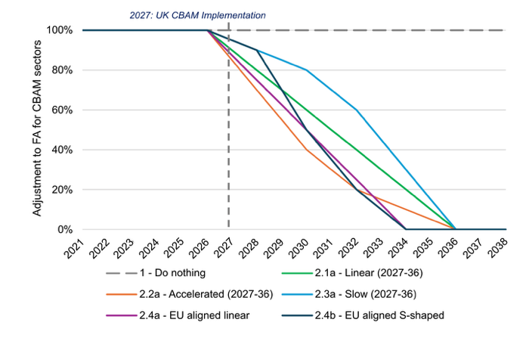
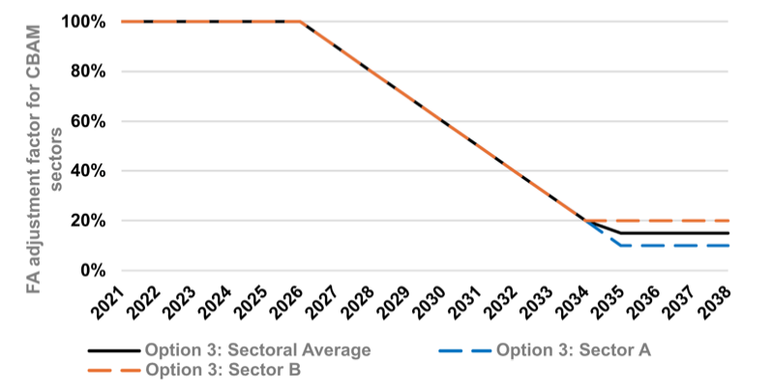
Carbon leakage measures & allowance allocation methods in ETSs of other jurisdictions considering BCAs
1. Countries with concrete BCA plans
Country | Carbon pricing mechanism type | Free allocation or other carbon leakage provisions | Adjustment of free allocation trajectory or other carbon leakage provisions with the introduction of a BCA
United Kingdom | Cap & trade ETS UK CBAM legislated, to be introduced in January 2027 | Free allocation | Nov. 2025 decision to gradually phase out free allocation for UK CBAM covered sectors between 2027-2035 (closely mirroring EU CBAM). Explored options during the legislative process: No adjustment of free allocation; Top-down free allocation adjustment to zero; Top-down adjustment to non-zero (phase-down).
Figure 1 Free allocation phase out trajectory for sectors covered by UK CBAM
Figure 2 Illustration of ‘no adjustment’ & ‘phase out’ options
Figure 3 Illustration of ‘phase-down’ option
Source: figure 7 in UK Emissions Trading Scheme: Free Allocation Review Main Authority Response, November 2025
Source: figures 3 and 7 in Analytical Annex: Free Allocation for CBAM Sectors - Analytical Annex to the Free Allocation for CBAM Sectors Chapter of the UK Government, the Scottish Government, the Welsh Government and the Department of Agriculture, Environment and Rural Affairs for Northern Ireland Consultation on Carbon Leakage as part of the Free Allocation Review, December 2024,

Slide 9
Modelling of two sectors

Slide 10
Background to modelling framework
The combined effects of CBAM and free allocation on firms’ production choices, cost structures, and market outcomes are complex and not fully captured by existing analytical approaches.
A key point is that CBAM and free allocation operate through different economic channels:
  CBAM primarily affects relative prices and trading conditions by narrowing the marginal cost gap between EU production subject to carbon pricing and imports. This holds even when verified embedded emissions for imports are adjusted to reflect the free allocation granted to EU producers: as long as the net embedded emissions remain positive, CBAM continues to affect marginal unit pricing and, therefore, the marginal competitiveness of imports.
  Free allocation, by contrast, primarily affects firms’ inframarginal compliance costs, profitability, and balance-sheet constraints.
In that light, CBAM and free allocation can be seen more as complements rather than substitutes in addressing leakage over the long run. The coexistence of CBAM with free allocation is provided for by Art. 31 of the CBAM Regulation.
Assessing the interaction between CBAM and free allocation requires a framework able to represent both marginal incentives and inframarginal cost relief, and to trace their implications along value chains.
We have developed such a unified partial equilibrium modeling framework for tracing how CBAM and free allocation affect firm behavior, market structure, and leakage, both at the border and along value chains.
We then run the model for two value chains, namely steel and fertilizers. We model a full value chain rather than a single sector, that allows us to capture the different channels of carbon leakage. We distinguish:
  an upstream sector, which is covered by carbon pricing;
  a downstream sector, which is not directly covered and uses the upstream good as an input.

Slide 11
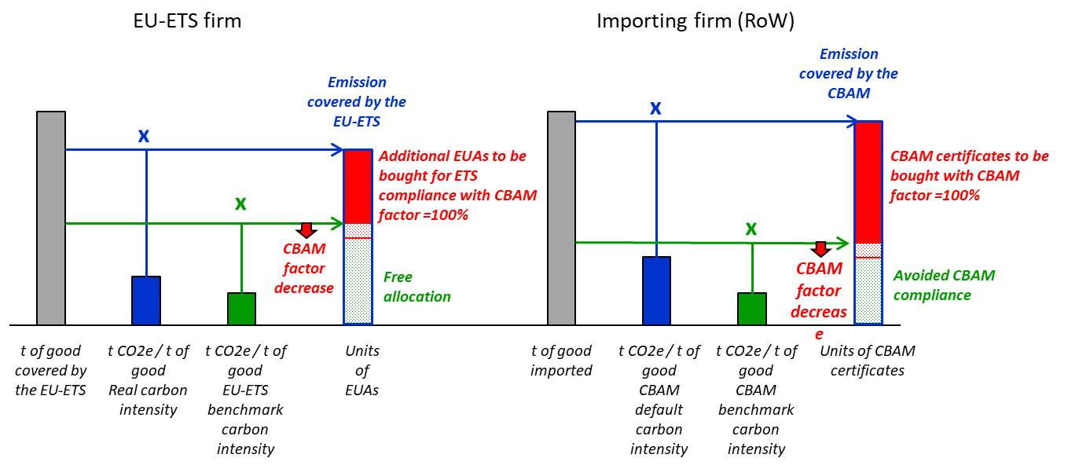
Scenarios
Scenario 1 – CBAM + phase-out of free allocation
This represents the official policy path.
The CBAM factor decreases over time. This declining factor is used both:
to calculate the carbon content of imports covered by CBAM;
and to calculate the amount of free allocation under the EU ETS.
Parallel between CBAM phase in and free allocation phase out in scenario 1
Source: Climate Economics Chair
Scenario 2 – CBAM + maintained free allocation
In this alternative scenario, the CBAM factor still decreases for imports, but free allocation is not phased out.

Slide 12
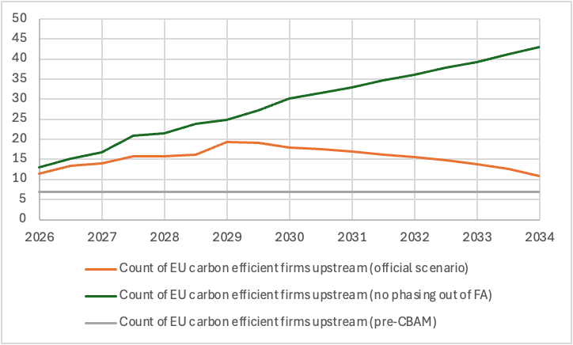
Results – Steel value chain
The model is calibrated for the steel value chain as follows:
flat steel production is the upstream sector, more specifically the Blast Furnace – Basic Oxygen Furnace (BF-BOF) route;
automotive production is the downstream sector.
Impact on EU carbon efficient sites of the upstream good (flat steel)
Number of carbon-efficient upstream sites in the EU
When free allocation is maintained, EU carbon-efficient upstream sites benefit strongly. Their production increases as they partly absorb the production of carbon-inefficient sites that are forced to close (“decarbonize or die” effect).
The reason is straightforward:
  CBAM improves the relative position of EU producers compared with foreign competitors;
  if free allocation is preserved, these efficient sites keep this competitive advantage without facing a rising carbon bill.
In the official scenario, the outcome is more mixed. Efficient sites still benefit from CBAM, but this effect is partly offset by the gradual loss of free allocation. Their number rises only moderately at first, then falls back toward the initial level as the free allocation phase out reduces their profitability.
Units: count of operating sites
Legend: the number of efficient EU upstream sites increases sharply when CBAM is introduced, without phasing out free allocation. In the official scenario, the initial benefit is gradually offset, and the number of sites returns toward its initial level.
Source: Climate Economics Chair

Slide 13
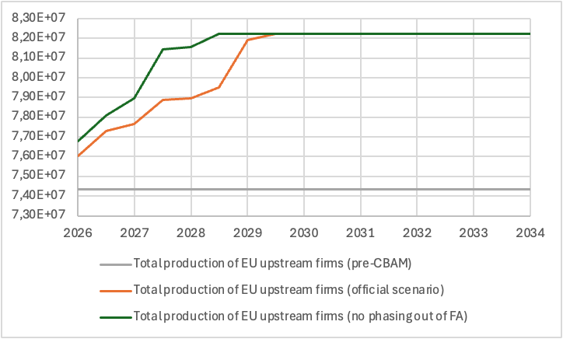
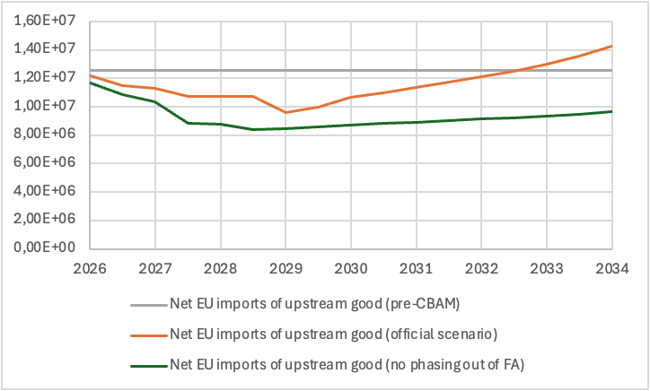
Results – Steel value chain
Impact on production, and imports of the upstream good (flat steel)
Total EU production of the upstream good
Net EU imports of the upstream good
Units: tons of flat steel
Legend: CBAM boosts total EU upstream production in both scenarios. The increase is more significant when free allocation is preserved.
Source: Climate Economics Chair
Units: tons of flat steel
Legend: net imports of the upstream product decrease in both scenarios, especially when CBAM isn't combined with the phase-out of free allocation.
Source: Climate Economics Chair
Total EU production in the upstream sector increases in both scenarios. This effect shows that CBAM achieves one of its core objectives: strengthening EU production in the covered sector.
Net EU imports of the upstream product decrease, again more strongly when free allocation is not phased out.

Slide 14
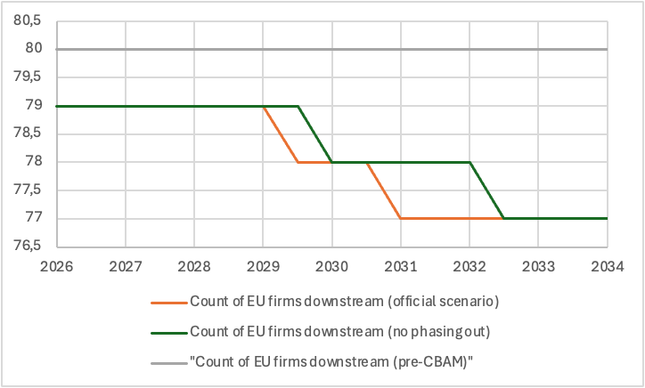
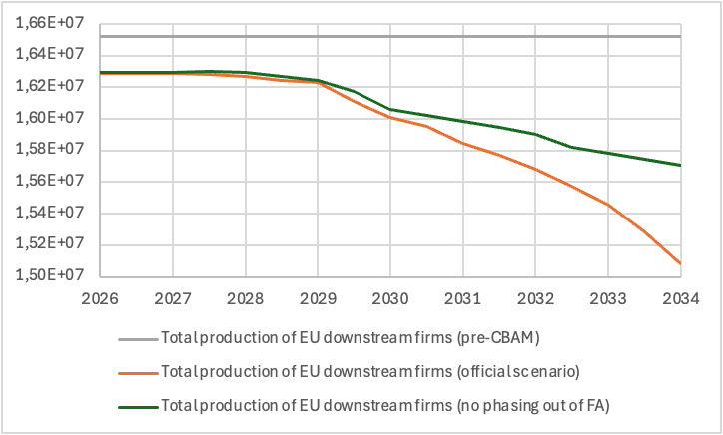
Results – Steel value chain
Impact on production of the downstream good (automotive production)
Number of downstream sites in the EU
Total EU production in the downstream sector
Units: count of operating sites
Legend: the downstream sector loses sites in both scenarios. Maintaining free allocation in the upstream sector mitigates this decline, but only partially.
Source: Climate Economics Chair
Units: number of passengers vehicles
Legend: in both scenarios, downstream EU production decreases. This reflects the higher cost of the upstream input.
Source: Climate Economics Chair
CBAM helps reduce leakage in the upstream sector, but part of the problem reappears in the downstream sector through higher input costs. As input costs rise, downstream production in the EU becomes less competitive.
Maintaining free allocation reduces the downstream damage, but does not eliminate it. If free allocation is maintained, more efficient upstream sites remain active in the EU. Competition within the upstream sector is stronger, and the price increase of the upstream product is smaller. But the relief is only partial.

Slide 15
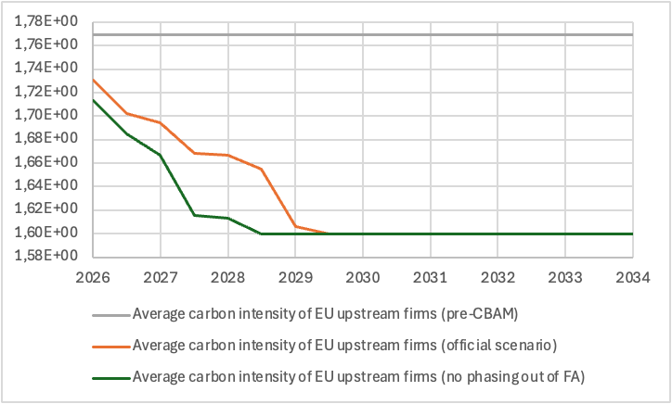
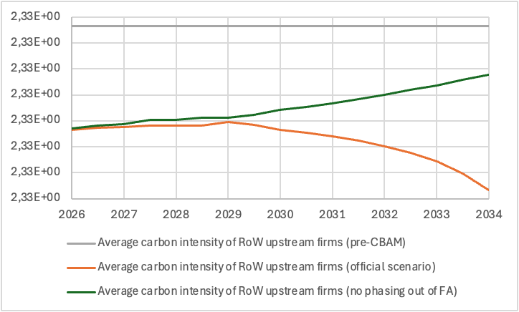
Results – Steel value chain
Impact on carbon intensity
Average carbon intensity of EU upstream production
Average carbon intensity of non-EU upstream production
Units: tons of CO2 equivalent per ton of flat steel
Legend: average carbon intensity drops in both scenarios. This reduction is larger when free allocation remains, as cleaner sites expand more.
Source: Climate Economics Chair
Units: tons of CO2 equivalent per ton of flat steel
Legend: CBAM reduces the average carbon intensity of non-EU production as foreign companies relocate output to cleaner locations to remain competitive in the EU market.
Source: Climate Economics Chair
In the EU, the average carbon intensity drops in both scenarios. This reduction is larger when free allocation remains, as cleaner sites expand more
CBAM lowers carbon intensity outside the EU. CBAM not only promotes cleaner production within the EU but also encourages non-EU producers to shift output toward their cleaner facilities to stay competitive in the EU market.

Slide 16
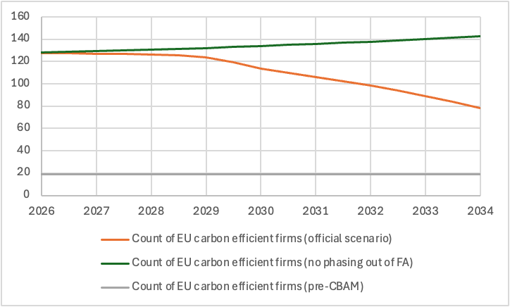
Results – Fertilizers value chain
The model is calibrated for the fertilizers value chain as follows:
AN fertilizers production is the upstream sector, with vertically integrated production being the reference as it is more carbon efficient and explicitly promoted through the EU-ETS benchmarks, non-integrated production is also considered without explicitly separating the ammonia production step;
agricultural production is the downstream sector, more specifically staple grain production
Impact on EU carbon efficient sites of the upstream good (AN fertilizers)
Number of carbon-efficient upstream sites in the EU
The CBAM is expected to significantly expand the number of lower-emission AN fertilizers production sites within the EU. In contrast, more carbon-intensive sites are entirely excluded from the EU, whereas they accounted for the majority in the pre-CBAM period.
With a parallel phasing out of free allocation that counteracts increased price competitiveness, the CBAM reduces the profitability of even the most efficient sites, so that in 2034 the total number of sites is lower (80) than in the pre-CBAM period (109).
Without the phase-out of free allocation of allowances, the total number of sites is roughly one third higher than in the pre-CBAM period.
Units: count of operating sites
Legend: the number of efficient EU upstream sites drastically increases when CBAM is introduced, without phasing out free allocation. In the official scenario, the initial benefit is gradually offset, but the number of sites remains much higher than its initial level.Source: Climate Economics Chair

Slide 17
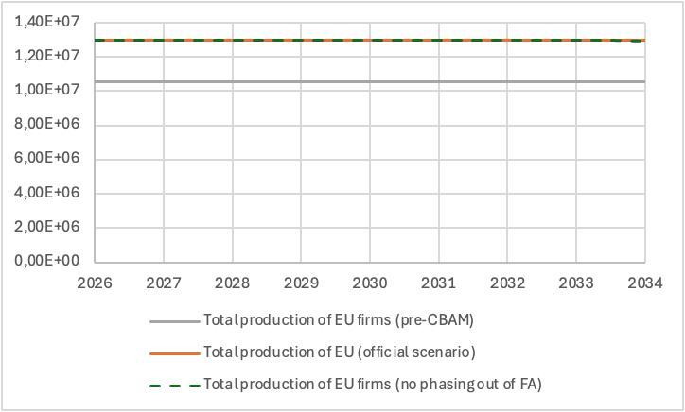
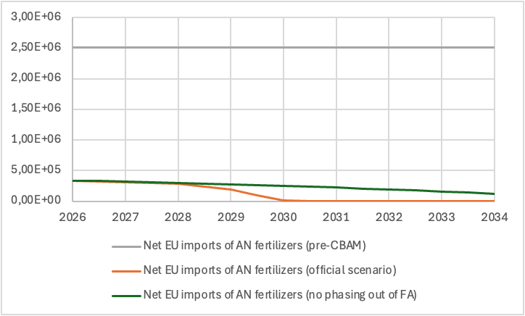
Results – Fertilizers value chain
Impact on production, and imports of the upstream good (AN fertilizers)
Total EU production of the upstream good
Net EU imports of the upstream good
Units: tons of AN fertilizers
Legend: CBAM adds about 20% to total EU upstream production in both scenarios. The total production does not vary because production is entirely by carbon efficient firms, their carbon intensity is fixed, so that the cap on emissions is also a cap on production
Source: Climate Economics Chair
Units: tons of AN fertilizers
Legend: net imports of the upstream product are sharply cut off in both scenarios, especially when CBAM is combined with the phase-out of free allocation which makes net imports fall to zero from 2030 onwards.
Source: Climate Economics Chair
Results are qualitatively consistent with those for flat steel but are quantitatively more pronounced.
In the case of AN fertilizers, when their production is vertically integrated (which corresponds to carbon-efficient EU producers in the model), the CBAM regulation abruptly levels the playing field and not only results in the total exit of other production sites from the EU market but also in the ousting of imported AN fertilizers. The most carbon-efficient non-EU producers remain more carbon-intensive than EU producers and cannot compete with them in the EU market.
Some imports remain when the CBAM is not combined with the phase-out of free allocation because the size of the EU market is larger compared to when the CBAM is coupled with the auction of allowances.

Slide 18
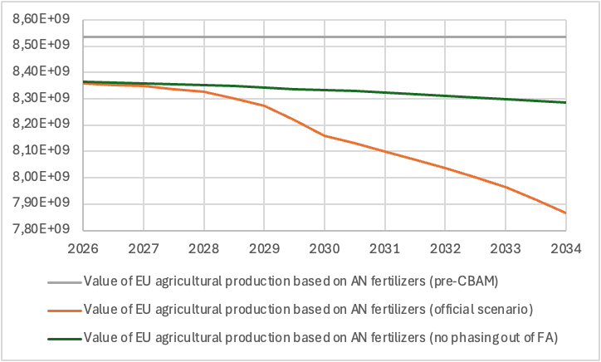
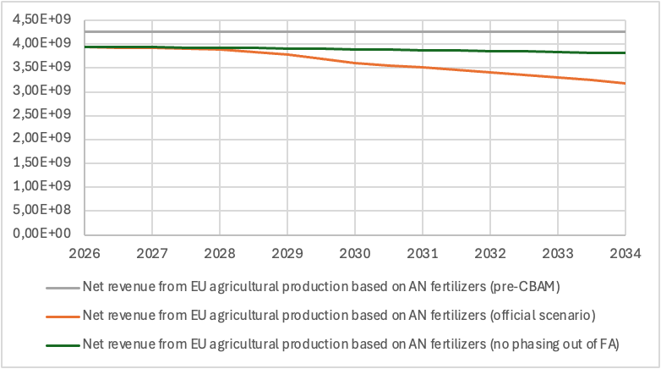
Results – Fertilizers value chain
Impact on production of the downstream good (staple grain)
Value of the production of staple grains in the EU
Revenue from the production of staple grains in the EU
Units: constant 2026 Euros
Legend: the downstream sector value of production drops in both scenarios. Maintaining free allocation in the upstream sector dampens this decline, more specifically for latter years associated with a low CBAM factor.
Source: Climate Economics Chair
Units: constant 2026 Euros
Legend: in both scenarios, revenue in the downstream EU sector decreases. This reflects both the decrease in production due to a lower use of AN fertilizers and the higher cost of that upstream input
Source: Climate Economics Chair
Results show a decrease in the production of the EU downstream sector, both in terms of value and volume.
Without the phase-out of FA, the decrease is limited to 2,5% of the pre-CBAM production. Coupling CBAM with the phase-out of FA results in a larger drop in downstream production, amounting to 7,5% of pre-CBAM production at the end of the period.
The main explanatory factor of the difference between the two scenarios is the much larger total number of upstream EU production sites under free allocation of allowances, which helps maintain significant competitive pressure in the EU upstream sector.
The impact on the revenues of EU staple grain farmers is more pronounced because it compounds the decrease in production value with the increase in input costs. The decrease in revenues amounts to roughly 11% compared to the pre-CBAM period when FA is not phased out for the upstream sector. It amounts to roughly 25% when phasing out FA in parallel to the CBAM implementation.

Slide 19
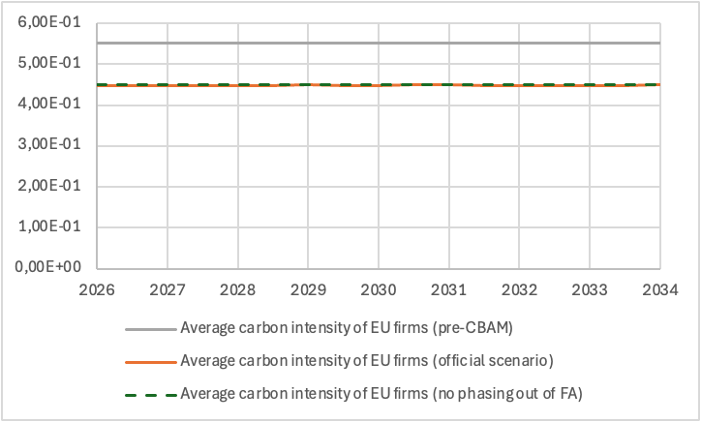
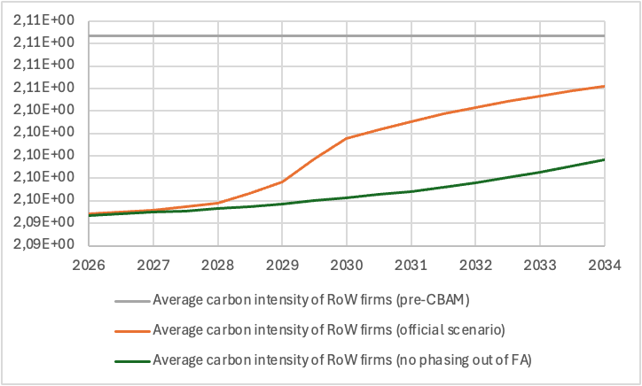
Results – Fertilizers value chain
Impact on carbon intensity
Average carbon intensity of EU upstream production
Average carbon intensity of non-EU upstream production
Units: tons of CO2 equivalent per ton of AN fertilizer
Legend: average carbon intensity drops in both scenarios to the same constant level. This is because only carbon-efficient sites produce and their carbon intensity is constant.
Source: Climate Economics Chair
Units: tons of CO2 equivalent per ton of AN fertilizer
Legend: CBAM reduces the average carbon intensity of non-EU production as foreign carbon-efficient companies reroute their production to the foreign market and take market shares from carbon-intensive firms.
Source: Climate Economics Chair
As all carbon-intensive sites within the EU close due to CBAM implementation in both scenarios, carbon intensity within the EU falls to a low, constant level of vertically integrated producers.
The impact on the carbon intensity of non-EU producers is the sole outcome of the model that qualitatively departs from the one observed for the steel value chain. The impact remains downward, but it weakens if the CBAM factor is reduced year by year, and the gap compared to the pre-CBAM period narrows when free allocation is phased out in parallel.

Slide 20
Insights from the modelling
The following insights are drawn from the modelling results:
CBAM can both protect and decarbonize EU upstream production. However, when CBAM is combined with the phase-out of free allocation, the adjustment becomes more concentrated, more inflationary, and more costly for downstream industries. Maintaining free allocation does not remove this trade-off, but it substantially attenuates it.
CBAM achieves its primary objective in the covered upstream sector: strengthening EU production and reducing reliance on imports. It also drives decarbonization both inside and outside the EU.
However, with CBAM as currently designed early gains for carbon efficient EU firms upstream are eventually offset by the financial strain of losing free permits and rising compliance carbon costs that erode their profitability.
In contrast, when maintaining free allocation efficient firms thrive long-term while gaining market share from closing inefficient sites.
A main drawback is the impact on downstream activities. Regardless of the free allocation regime, higher upstream input prices erode the competitiveness of EU downstream production, leading to lower domestic output and higher net imports of downstream/finished goods.
The official phase-out scenario amplifies these effects. By 2030, the effective carbon cost rises sharply, exceeding pre-CBAM levels, which accelerates the exit of carbon-intensive upstream sites. This exit increases production concentration and strengthens market power among the remaining upstream producers, pushing upstream prices further upward and intensifying inflationary pressures for downstream sectors. By contrast, maintaining free allocation softens the trade-off: it allows carbon-efficient EU sites to expand more strongly, preserves competitive pressure among upstream producers, keeps upstream prices lower, and reduces the overall cost burden transmitted to downstream firms.

Slide 21
Takeaways
Carbon leakage and the preservation of industrial competitiveness remain a central preoccupation for policymakers and industrial stakeholders alike.
The EU carbon leakage policy shift from grandfathering, to performance-based benchmarks, and finally to the EU CBAM reflects the initial vision and expectation of an evolving global climate policy outlook, involving linked carbon markets and a global carbon price. However, in hindsight, this perspective was overly optimistic.
With the continued asymmetry in climate policies and carbon pricing globally, the risk of industrial offshoring is becoming an even greater preoccupation for the EU. As domestic carbon prices and most importantly costs escalate, the risk of carbon leakage is no longer theoretical.
The EU leads the way in terms of having the highest ‘ETS visible price’, but also the highest ‘incurred carbon costs’ by covered entities. Most systems in other jurisdictions rely heavily on free allocation or equivalent measures that imply zero or close to zero carbon costs for the industrial sector.
Effective decarbonization under the EU ETS requires a distinction between the market price of allowances and the actual carbon costs borne by industry.
  High visible (explicit) EUA prices are a necessary market signal to drive decarbonisation investments.
  Costs are fundamental to economic decision-making and determine the competitiveness of EU industries.
  To incentivise decarbonisation while preventing deindustrialisation, policy should aim for a high explicit price, while ensuring that the effective cost remains sustainable for companies currently undergoing transition rather than erode their profitability.

Slide 22
Takeaways
The policy takeaways from this study can be summarized in a few points:
1. What CBAM helps achieve:
It supports EU production in the covered sector.
It reduces import dependence in that sector.
It encourages cleaner production both inside and outside the EU.
2. What remains difficult:
Rising carbon costs erode the profitability of carbon efficient EU firms upstream:
  The financial strain from the phase out of free allocation eventually offsets any early gains for carbon efficient EU firms.
  In contrast, when free allocation is maintained carbon efficient firms thrive long-term as they gain market share from closing inefficient sites.
It increases costs for downstream sectors.
  It shifts part of the competitiveness problem from the upstream sector to the downstream sector.
  This effect is stronger when free allocation is phased out at the same time.
3. When CBAM is combined with maintaining free allocation:
It makes the adjustment less severe for the upstream sector.
It reduces the inflationary effect on the upstream product.
It contains the negative impact on downstream industries, but does not reverse it.
It leads to a comparable or greater reduction in the EU average carbon intensity, as cleaner sites expand more.

Slide 23
Thank you

Slide 24
Appendix

Slide 25
Evolution of visible ETS prices across jurisdictions
Visible carbon prices are significantly different between different economic jurisdictions worldwide where ETSs exist.
The EU ETS is the highest-priced carbon market globally.
  In 2024, the EU ETS price was 1.5 times that of the UK ETS and almost double that in the New Zealand ETS and California CaT
Source: ERCST, based on data from World Bank Group, State and Trends of Carbon Pricing Dashboard

Slide 26
‘ETS price’ vs ‘ETS costs incurred by covered entities’
ETS permit price’, is the respective system’s visible price.
‘ETS costs by covered entities’, provides an estimate of the direct costs incurred by covered entities in the industry and electricity sectors, by adjusting for free allocation.
‘Average ETS costs at the sector level’, provides an estimate of (direct) ETS costs incurred on average by all firms in the sector rather than by covered entities only. In addition to adjusting for free allocation, this estimate takes into account system coverage, i.e. the share of sector-wide emissions priced through the system.
Source: ERCST, based on OECD (2025)
Some systems with non-zero ‘avg. incurred costs by covered entities’, demonstrate negligible (close to zero) ‘avg. incurred costs at the sector level’, because they only cover a small part of the jurisdiction’s sectoral emissions.

Slide 27
Carbon leakage measures & allowance allocation methods in ETSs of other jurisdictions considering BCAs
2. Countries with advanced discussions or political commitments on BCAs
Country | Carbon pricing mechanism type | Free allocation or other carbon leakage provisions | Adjustment of free allocation trajectory or other carbon leakage provisions with the introduction of a BCA
Taiwan | In place: carbon fee (launched in 2025) Planned cap & trade ETS + CBAM: Pilot ETS in 2026, Full mandatory ETS in 2028 Taiwan CBAM under development, with plans to implement it as of 2027. | Carbon fee: Lower carbon fee rates on industries at risk of carbon leakage Planned ETS: n/a | Given that both the national ETS and CBAM regulations are under development, it is not possible to foresee whether there will be free allocation and how a possible free allocation trajectory over time would be impacted by the introduction of a CBAM.
Thailand | Planned carbon pricing framework according to Dec 2025 draft Climate Change Act: carbon tax; mandatory cap & trade ETS Thai CBAM Full implementation of Thai ETS and CBAM foreseen in early 2030s. | Planned ETS: Free allocation (tbc) | Detailed ETS allocation rules and details of the Thai CBAM will be determined in the phase of secondary legislation drafting that is expected to follow the formal approval of the Climate Change Act by the Thai Senate.

Slide 28
Carbon leakage measures & allowance allocation methods in ETSs of other jurisdictions considering BCAs
2. Countries with advanced discussions or political commitments on BCAs
Country | Carbon pricing mechanism type | Free allocation or other carbon leakage provisions | Adjustment of free allocation trajectory or other carbon leakage provisions with the introduction of a BCA
Australia | Intensity-based baseline and credit ETS Government reviewing feasibility of a BCA that would likely initially cover cement and clinker; Political commitment in 2023 to work towards introducing a BCA | Facilities facing an elevated risk of carbon leakage can receive a slower annual baseline decline rate | Preliminary findings of Australia’s Carbon Leakage Review, mentions three options of 1) removing; 2) gradually phasing out; or 3) retaining reduced baseline decline rates for sector covered by a BCA.
Canada | Federal-level: output-based carbon pricing system. Quebec: cap & trade ETS Liberal Party BCA commitment in its election manifesto (2025). Govt. consultation on a BCA in 2021. | Federal-level: carbon price due on emissions above sectoral standards. Quebec: free allocation, similar to EU ETS. | Federal-level: no provisions on whether there would be a rollback of sectoral standards in case of a BCA. This aspect was not part of the 2021 govt. consultation. Quebec: the interaction between Quebec’s ETS and a potential BCA at the federal level is unclear and subject to speculation (no concrete/ proposed BCA design).

Slide 29
Carbon leakage measures & allowance allocation methods in ETSs of other jurisdictions considering BCAs
3. Countries exploring or beginning to research the potential of a BCA
Country | Carbon pricing mechanism type | Free allocation or other carbon leakage provisions | Adjustment of free allocation trajectory or other carbon leakage provisions with the introduction of a BCA
New Zealand | Cap & trade ETS Note: The cap limits the volume of net emitted emissions, without a limit on gross emissions (i.e. no limit on NZ allowances generated from removal activities). BCA broadly under consideration/ examined but not yet at a granular level of detail. | Free allocation to EITE sectors Planned phase out of FA by 2050 and 2060 for moderately and highly emissions intensive sectors respectively. | No concrete discussions on a BCA design incl. on how it might impact free allocation. Irrespective of the discussion on a potential BCA, the ongoing NZ ETS reform is expected to review and accelerate the phase out of free allocation to EITE sectors.
South Korea | Cap & trade ETS | Free allocation | The Climate Ministry starts researching the introduction of a BCA, with a study launched in October 2025. No concrete discussions on a BCA design incl. on how it might impact free allocation.
Türkiye | Planned: expected to be an intensity-based baseline and credit ETS. (Türkiye’s ETS design and legislation still being developed). | Free allocation | Türkiye’s Climate Law reference to potential establishment of a BCA; No concrete discussions on a BCA design incl. on how it might impact free allocation.

Slide 30
Modelling framework’s key assumptions
1. Firms do not all pass carbon costs through to prices in the same way. The degree of pass-through depends on the price of the good. This matters because firms with different market positions react differently to carbon costs.
2. We model a full value chain rather than a single sector, that allows us to capture the different channels of carbon leakage. We distinguish:
  an upstream sector, which is covered by carbon pricing;
  a downstream sector, which is not directly covered and uses the upstream good as an input.
3. Production technologies are assumed to be given.
4. The analysis is conducted within a partial equilibrium framework.
5. Firms’ heterogeneity is represented by distinguishing between production units that are more or less carbon-intensive.
6. Public policy rules are introduced in a stylized manner, distinguishing between the CBAM, which affects competition between EU production and imports, and free allowances, which directly affect the costs borne by EU producers.
7. The distinction between short-term and long-term depends on the ability to adjust the number of production sites. In the short term, production structures are fixed, whereas in the longer term, entry and exit decisions capture more structural effects on the sector's organization. The modelling results in this presentation focus on long-term effects.

