Slide 1
16 July 2025
OMNIBUS CSRD, CSDDD – Where do we stand?

Slide 2
Background
In its 2025 work programme, the EU Commission unveiled a set of initiatives aimed at tackling duplicative, excessive, or unjustified regulations that hinder businesses in the EU. These efforts are part of a broader vision outlined in the Competitiveness Compass, which sets the direction for enhancing the EU’s competitiveness and fostering a more prosperous economy. Through these actions, the Commission aims to cut administrative burdens by 25% overall and by 35% specifically for small and medium-sized enterprises by the conclusion of its mandate in 2029.
In February 2024, 73 business leaders signed the Antwerp Declaration, a call for a European Industrial Deal to complement the EU Green Deal and ensure a competitive and sustainable industrial sector in Europe.
Omnibus Regulation proposed to streamline EU Taxonomy Regulation, CSRD, CSDDD and CBAM.
Goal: Reduce bureaucratic burdens while maintaining core policy content.

Slide 3
CSRD - Comparison
 | EC Proposal | EP Rapporteur Draft Report | Council Position
CSRD scope | ≥1000 employees and either 50 million turnover or 25 million total assets | ≥3000 employees and 450 million turnover | ≥1000 employees and 450 million turnover worldwide
Sector-specific EU Sustainability Reporting standards (ESRS) | Deletes mandate to develop sector-specific standards | Maintains deletion | Maintains deletion
Value chain, Voluntary Standards for Small and Medium-sized Enterprises (VSME) | Cap of information requests tied to VSME | Cap of information requests tied to VSME + replaces ‘value chain’ for ‘chain of activities’ + deletes 3-year transition period for Value Chain information | Cap of information requests tied to VSME + specification if any requests go beyond + right to decline by out-of-scope
Transition plans | Required to be adopted; implementation no longer mandatory | Voluntary disclosure of “any” plan, deleting reference to implementing actions, 1.5, Paris Agreement. | Same as EC

Slide 4
CSDDD - Comparison
 | EC Proposal | EP Rapporteur Draft Report | Council Position
CSDDD scope | No changes proposed: ≥1000 employees, 450 million turnover | ≥3000 employees and 450 million turnover | ≥5000 employees and €1.5 billion net turnover
Due diligence scope | Limited to the companies' own operations, those of their subsidiaries and Tier 1 suppliers (eg. direct business partners). Reporting obligations further down the supply chain are required only if the company has plausible information about adverse impacts. Remove the duty to terminate the business relationship as a last resort in the case of actual and potential adverse impacts. | Narrowing the identification of impacts to Tier 1 + further limitation added to “plausible information” and information gathering + introduces ‘risk-based’ approach | Narrowing the identification of impacts to Tier 1 + further limitation added to “plausible information” + introduces ‘risk-based’ approach. Only in case of ‘objective and verifiable’ info on indirect partners the company must extend the risk assessment.
Civil liability | Removes common civil liability regime across the EU and the 5% turnover penalty floor (EC will develop guidelines on penalties) | Removes common civil liability regime in the EU | Removes common civil liability regime in the EU
Stakeholders | Clarifies the meaningful engagement with stakeholders limiting it to “relevant” ones that have a link to the specific stage of the DD process + further restricts the stage of the DD process that require stakeholder engagement | Not specifically addressed | Supports EC proposal
Climate transition plans | Companies must adopt a plan, but no longer required to “put into effect”. Adoption includes plans + described actions planned and taken. | Full deletion of transition plans from the Directive. | Obligation to adopt with no reference to “put into effect”. Adoption includes plans + described actions planned and taken.

Slide 5
Reactions
On June 27, S&D, Greens/EFA, and Renew tabled 95 amendments to the EPP draft position. The suggested amendments show that those political groups disagree on CSRD and CSDDD scope criteria, climate transition plans, and the tier-1 limitation of due diligence.

Slide 6
Stop-the-clock Directive
CSRD: Proposes a 2-year delay for companies not yet reporting and listed SMEs. To be more specific:
No change for Wave 1 and Wave 4 (non-EU companies) due to report in 2025 and 2029 respectively.
Wave 2 (large EU companies): will now report in 2028 in respect of the 2027 financial year (i.e. a 2 year delay).
Wave 3 (SMEs): will now report in 2029 in respect of the 2028 financial year (i.e. a 2 year delay).
CSDDD: 1-year postponement for both the transposition deadline and the initial application phase of the CS3D for the largest companies. Therefore,
the MS transposition deadline for CS3D is postponed from 26 July 2026 to 26 July 2027.
the first phase of application of the CS3D to in-scope companies is postponed from 26 July 2027 to 26 July 2028
On 17 April 2025, the “Stop-the-Clock” Directive entered into force. Member States must transpose this Directive into national law by 31 December 2025.

Slide 7
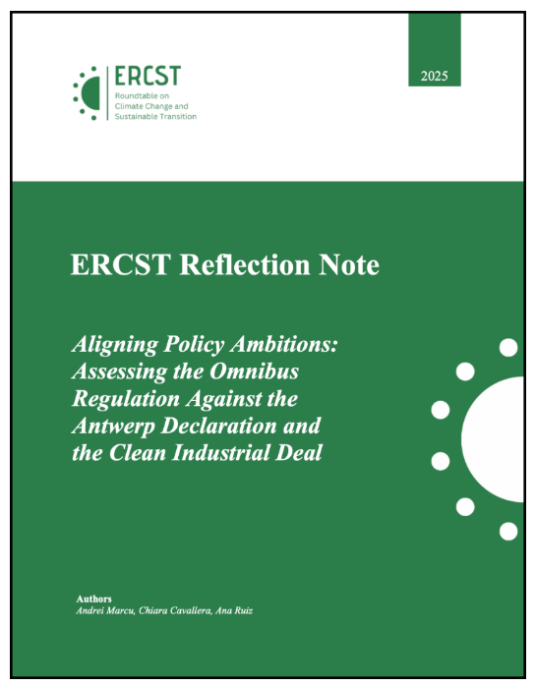
Key issues for consideration in the Omnibus package
Assessing the Omnibus Regulation Against the Antwerp Declaration and the Clean Industrial Deal (CID)
While the Omnibus focuses on reducing red tape, the CID targets support for clean tech → both are complementary and must be aligned to effectively drive EU industrial and climate goals.
The Omnibus aligns in spirit and direction with the Antwerp Declaration by aiming to streamline regulations and boost EU competitiveness. However, the key question remains whether the suggested modifications to existing regulations are sufficient to significantly enhance competitiveness. Cosmetic changes that fail to address the real challenges faced by EU economic sectors will not deliver the level of simplification needed to ensure that the EU and its businesses can truly thrive. At the same time, reforms that aim to enhance competitiveness should also safeguard environmental integrity, be coherent with international law and deliver tangible benefits for the society.
Link to source

Slide 8
Key issues for consideration in the Omnibus package
• Approach: The EU has enacted extensive regulations and constraints to meet its ambitious climate targets and align its regulatory framework with the European Climate Law. While these measures reflect a commitment to addressing climate change, achieving these goals should rely on a market-based and technology-neutral approach that encourages innovation and entrepreneurship.
• Extraterritoriality: Greater legal clarity and interpretive guidance will be essential to ensure that cross-border obligations are coherent, and consistent with international law (eg. UN Charter as well as Common but Differentiated Responsibilities and Respective Capabilities, UNFCCC)
• Paris Agreement-transition plans: The Paris Agreement is an international treaty that binds its Parties, which are sovereign states, to collective climate action. Its primary goals, including reaching net zero emissions and achieving temperature targets, are intended as global objectives to be pursued through coordinated efforts at the national level. Disaggregating these targets to individual enterprises (Transition Plans) risks undermining the spirit of the Agreement and creating burdens to private entities. This might harm their competitiveness.

Slide 9
NEXT STEPS
July 15:
  JURI (Legal affairs) Committee started negotiations on the final Parliament position.
  4 Parliamentary Committees voted their opinions on CSDDD and CSRD:
It is expected that the European Parliament Committee on Legal Affairs (JURI) will conduct a final vote on the proposed amendments on October 13, 2025, with a plenary vote expected later in the month.
Once Parliament negotiating position is finalized, the trilogues will start (most likely in the fall).
A common final agreement is expected not earlier than end of 2025 or later in 2026.
ENVI: reviewing the climate transition plans
INTA: reviewing business relationship termination
DROI: reviewing definition of ‘stakeholder’
ECON: focusing on CSRD and Taxonomy

