Slide 1
Andrei Marcu Olivier Imbault Chiara Cavallera
European Hydrogen Bank – Second Auction and Next Steps
June 19, 2025

Slide 2
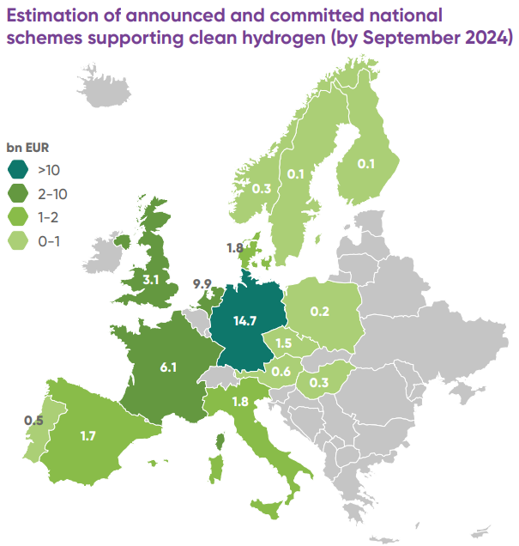
STATE OF PLAY
2021 – 2027 → the EU has allocated EUR 125.6 bn for climate initiatives. However, clean hydrogen has received only EUR 5 bn (including H2 Bank 1st Auction) since 2021, 56% of which is provided by the Innovation Fund and 21% by Horizon Europe.
IPCEIs: up to €18.9 bn State aid, expected to unlock more than €27.1 bn of additional private investment
National funding: shift from R&I to market-making support covering CAPEX and OPEX. While EUR 37 bn has been committed across national schemes, most funds remain undisbursed due to delayed implementation or insufficient support to reach FID
H2 Bank
1st Auction + 2nd Auction: allocated around 1.7 bn
Auction as Service scheme (DE, ES, LT, AU): allocated almost €1.2 bn
IPCEI | AMOUNT
Hy2Tech | Up to €5.4 bn in public funding, anticipated to unlock an additional €9 bn in private investments
Hy2Use | Up to €5.2 bn in public funding, expected to stimulate an additional €7 bn in private investments
Hy2Infra | Up to €6.9 bn in public funding, anticipated to attract an additional €5.4 bn in private investments
Hy2Move | Up to €1.4 bn in public funding, expected to leverage an additional €3.3 bn in private investments
Main EU-level funds spending in clean H2 (by Sept 2024)
Source: Hydrogen Europe Clean H2 Monitor (link)

Slide 3
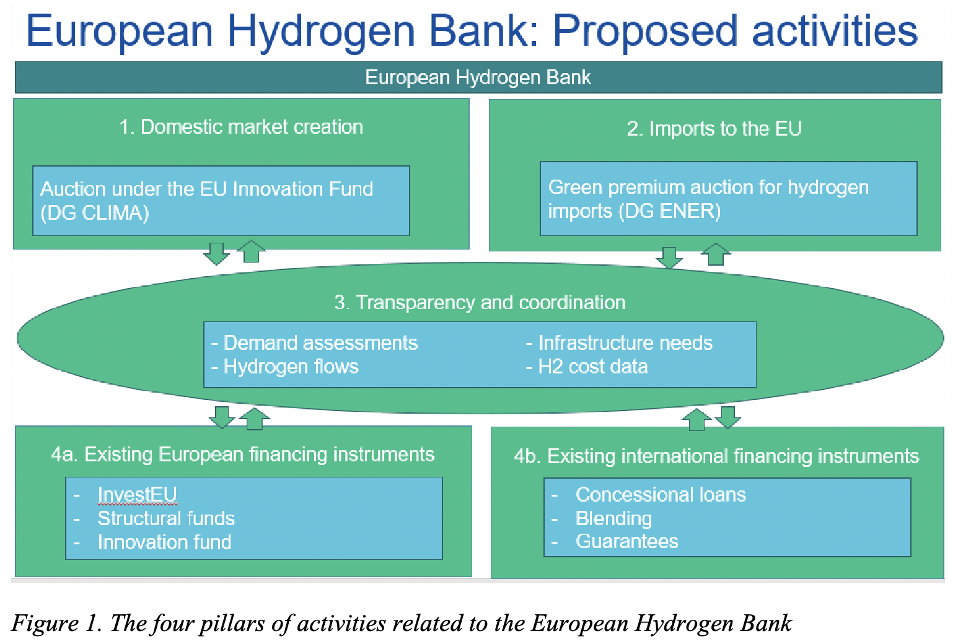
HYDROGEN BANK STRUCTURE
The four pillars of activities related to the European Hydrogen Bank (EHB)
Notes:
the H2 Bank has four pillars.
Two of them are financing mechanisms - for creating the EU domestic market, and for stimulate international imports into the EU.
The third pillar is linked to transparency and coordination – so it focuses on assessing demand, infrastructure needs, hydrogen flows, and H2 cost data.
Finally, the last pillar is streamlining existing financial instrument - coordinating and blending these instruments with new public and private funding, both in the EU and internationally and it also focuses on giving guarantees. H2 projects are capital intensive and in order to secure funding and partnerships you need to be able to have / provide guarantees.

Slide 4
Domestic Pillar
Goal:
- supporting the scale-up of the hydrogen market within the EU, striving to bridge the cost gap between the higher production costs of renewable hydrogen and the lower price buyers are currently willing to pay
- connecting the EU RNFBO hydrogen supply with demand.
Funding
is awarded as a fixed premium in €/kg of verified and certified RFNBO hydrogen produced
channelled through the Innovation Fund (EHB financed by revenues from the EU ETS)
The selected projects will receive the awarded subsidy on top of the market revenues that they generate from hydrogen sales, for up to 10 years.
Cumulative support from Member States will not be allowed. This will ensure a level playing field and avoid market fragmentation.

Slide 5
Domestic Pillar
Hydrogen Bank “Auctions-as-a-Service” scheme :
Allows Member States to finance additional projects on their territory after allocating the Innovation Fund's budget. Competitive projects that have not secured EU funding can therefore receive support without the need of separate national auction process.
Member States’ participation is voluntary, and project developers that express interest in using the "Auctions-as-a-Service" in their bid are eligible for selection.
The support provided by Member States through this service will be considered as State aid.
First Auction: Germany allocated €350 million
Second Auction: Austria allocated €400 million, Spain €400 million, Lithuania €36 million
Notes:
Second Auction Spain is allocating between €280 and €400 million for the Auctions-as-a-Service scheme, using funds from its Recovery and Resilience Plan (RRP). The total support available will depend on the amount of funds used in the country’ existing State aid scheme for hydrogen clusters and valleys, which is also funded from RRP resources. The exact amount of support will be confirmed by spring 2025.
Lithuania is dedicating around €36 million for the Auctions-as-a-Service scheme, from their Modernisation Fund budget. The country’s participation in the Auctions-as-a-Service scheme will help reach its national target of 1.3 gigawatts of electrolysis capacity and 129 kilotonnes of renewable hydrogen production annually by 2030.
Austria is committing €400 million from its national budget to the Auctions-as-a-Service scheme. Hydrogen producers will be eligible for a maximum grant of €200 million per project, with a maximum capacity of 300 megawatts of production to be supported in this auction.
The Commission is also offering a new “Auctions-as-a-service” mechanism under the Hydrogen Bank.
This will enable Member States to finance projects which have bid in the auction, but weren’t selected for Innovation Fund support due to budget limitations.
Thanks to this mechanism, Member States can identify and support competitive projects on their territory without the need to run a separate auction at national level, reducing the administrative burden and cost for all parties.
Participation is voluntary, and project developers need to express interest in using this service. Support provided through this mechanism is considered State aid.

Slide 6
International pillar (under development)
The EU Commission is developing:
The design of the international part of the European Hydrogen Bank to promote a coordinated EU strategy for renewable hydrogen imports.
The concept of joint European auctions.
The Hydrogen Bank has the potential to serve as a key platform for managing the aggregation of hydrogen demand and coordinating joint purchasing efforts.
In this setup, hydrogen producers would submit their supply bids to a centrally managed collective demand pool.
This approach is expected to enhance purchasing terms, leading to increased affordability and efficiency in the hydrogen market.
The H2 Bank could play a significant role in ensuring the security of hydrogen imports.

Slide 7
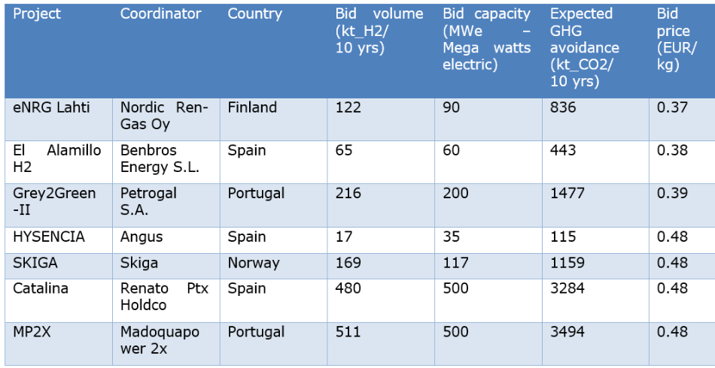
First Auction – Results
The first Hydrogen Bank auction was launched in November 2023 and closed in February 2024, awarding nearly €720 million to 7 renewable H2 projects across Europe, selected from 132 bids. 6 of the 7 projects signed their grant agreements in October 2024.
The bids submitted ranged between 0.37 and 0.48 €/kg of renewable hydrogen produced
Projects are required to begin producing renewable H2 within 5 years.
Collectively, they are expected to generate 1.52 million tonnes of renewable H2 during their first decade of operation, potentially avoiding over 10 million tonnes of CO₂ emissions.
Notes:
(Buget €800 million)
The premium requested by the awarded project promoters ranged between €0.37 and €0.48 per Kg/H2 – well below the €4.5 ceiling price

Slide 8
LEARNINGS AND CONSIDERATIONS – 1st AUCTION
The first Hydrogen Bank’s auction represented a test for the EU Commission, introducing a novel funding mechanism based on competitive bidding.
Geographical distribution: All awarded projects were located in the Iberian Peninsula and in the Nordic region, reflecting the importance of access to low-cost renewable electricity for project viability.
Bid prices: Winning bids ranged from 0.37 to 0.48 €/kg of renewable hydrogen, well below current market prices of approximately 4 - 6 €/kg.
Technology: PEM electrolysers were the most common choice among selected projects, followed by Alkaline electrolysers.
Scalability: The Auctions-as-a-Service model provides a flexible, scalable framework for future hydrogen deployment across the EU.
Overall, the first H2 Bank auction represented a constructive development in the context of the EU hydrogen framework. However, the funding volume remains limited relative to the scale required to meet Union-wide hydrogen deployment targets. Additionally, the H2 Bank provides funding to RFNBO hydrogen projects only. A more technology-neutral approach that includes low-carbon hydrogen would enhance the scheme’s effectiveness by supporting a broader range of decarbonisation pathways and accelerating market ramp-up.
Notes:
The first Hydrogen Bank’s auction represented a test for the EU Commission, introducing a novel funding mechanism based on competitive bidding.
The geographical distribution of awarded projects, all located in the Iberian Peninsula and in the Nordic region, demonstrates the critical role of access to low-cost renewable electricity in project viability.
The bid prices submitted by the winners ranged between 0.37 and €0.48 €/kg of renewable hydrogen produced. These prices are significantly lower than …market prices (4-.. Euros)
Polymer Electrolyte Membrane (PEM) electrolysis, followed by Alkaline electrolysis, emerged as the predominant technology choices among selected projects.
The Auctions-as-a-Service mechanism represents a scalable mechanism potentially supporting broader deployment of hydrogen technologies.
Overall, the first Hydrogen Bank auction represented a constructive development in the context of EU hydrogen policy. However, the funding volume remains limited relative to the scale required to meet Union-wide hydrogen
The EHB’s current budget falls far short of EU hydrogen targets: Even if all projects go ahead and future bids are similarly low, the €3 billion endowment is projected to support only about 0.7 Mt of renewable hydrogen annually by 2030—well below the 10 Mt target in the EU Hydrogen Strategy and the estimated 4 Mt needed to meet binding sectoral targets in RED III.

Slide 9
Second Auction – New Terms and Conditions
New resilience requirements: The auction prioritized projects that demonstrate greater resilience to supply chain disruptions and geopolitical risks, likely focusing on domestic production and sourcing of key components.
Evaluation based on industrial competitiveness: Projects assessed on their environmental impact AND on their contribution to European industrial leadership and competitiveness, aligning with the goals of the Net-Zero Industry Act.
Higher maturity level requirements: Applications needed to demonstrate a higher level of technological maturity and readiness for commercialization compared to the first auction.
Revised price ceiling: Ceiling price reduced from 4.5 € (first auction) to 4 €/kg.
Dedicated maritime budget: A portion of the auction funds (€200 million) are specifically allocated to projects supplying renewable hydrogen to the maritime sector.
Total Buget: €1.2 billion
Notes:
Disclosed c
Resilience: projects have to limit the sourcing of electrolyser stacks with surface treatment or cell unit production or stack assembly carried out in China to not more than 25% (in MWe). eiling price: 4 EUR /kg of hydrogen produced as a maximum bid price. The same ceiling price applies to both the general topic and the maritime topic. Proposals will be first ranked according to their bid price from lowest to highest.

Slide 10
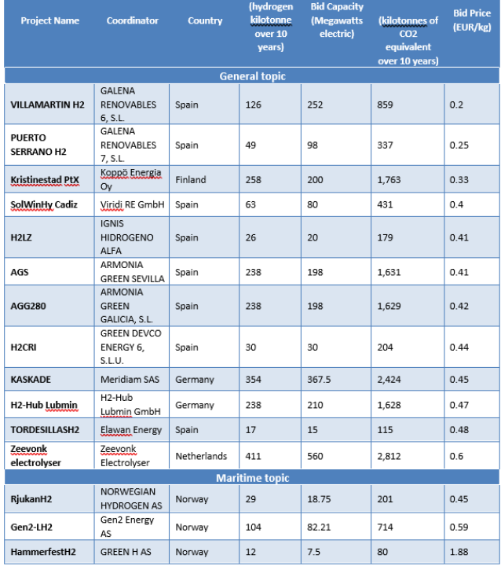
Second Auction - Results
The second Hydrogen Bank auction was launched in December 2024 and closed in February 2025, awarding €992 million to 15 renewable hydrogen projects across the European Economic Area (EEA), selected from 61 bids.
12 projects will produce renewable hydrogen, and the bids submitted ranged from 0.20 to 0.60 €/kg.
The dedicated budget for maritime off-takers led to the selection of 3 projects, receiving €96.7 million in grants, with bids between 0.45 and 1.88 €/kg.
Subsidies across all 15 selected projects range from €8 million to €246 million, covering a period of up to 10 years.
Collectively, they are expected to generate nearly 2.2 million tonnes of renewable H2 over 10 years, avoiding more than 15 million tonnes of CO₂ emissions.

Slide 11
LEARNINGS AND CONSIDERATIONS – 2nd AUCTION
The results of the second Hydrogen Bank auction mirror those of the first auction.
Geographical distribution: Most of the projects are located in the Iberian Peninsula and in the Nordic region (+ 2 projects in Germany and 1 in The Netherlands).
Bid prices: Winning bids ranged from 0.20 to €0.60 €/kg of renewable hydrogen, significantly below current market prices.
Technology: not disclosed for all projects yet.
Scalability: 3 Member States are participating to the Auctions-as-a-Service scheme vs 1 for the first Auction.
→ funding volume still remains limited relative to the scale required to meet Union-wide hydrogen deployment targets. Funding provided to RFNBO hydrogen projects only.
Notes:
The EHB’s current budget falls far short of EU hydrogen targets: Even if all projects go ahead and future bids are similarly low, the €3 billion endowment is projected to support only about 0.7 Mt of renewable hydrogen annually by 2030—well below the 10 Mt target in the EU Hydrogen Strategy and the estimated 4 Mt needed to meet binding sectoral targets in RED III.

Slide 12
WHAT’S NEXT?
A third European Hydrogen Bank auction is planned for end 2025 with a budget of up to €1 billion.
The Commission will soon also launch the Hydrogen Mechanism under the European Hydrogen Bank.
Online platform that will bring together buyers and sellers and enable market participants to share information and find potential commercial partners.
The mechanism will cover renewable and low-carbon hydrogen and derivatives such as ammonia and methanol. It will enable EU buyers to connect with international and European hydrogen supplies
The success of the Hydrogen Bank hinges on whether it can effectively boost demand from hard-to-abate industry sectors in the next auctions. These sectors are the major potential consumers of renewable/low carbon hydrogen in terms of quantity and environmental impact. This boost is crucial for allowing the market to achieve an effective critical mass.

Slide 13
Key questions to be addressed
How can the Hydrogen Bank be a key tool for creating an EU hydrogen market?
Which are your main ‘learnings’ from the first and second auction?
Should low-carbon hydrogen be included in the scope of the Hydrogen Bank and its future auctions?
Should the Hydrogen Bank keep providing a separate basket for specific sectors? If yes, which ones?
According to the Second Auction’s T&C, projects have to limit the sourcing of electrolyser stacks with surface treatment or cell unit production or stack assembly carried out in China to not more than 25% (in MWe). Should this ‘resilience requirement’ be expanded to other countries in addition to China?

Slide 14
ANNEX

Slide 15
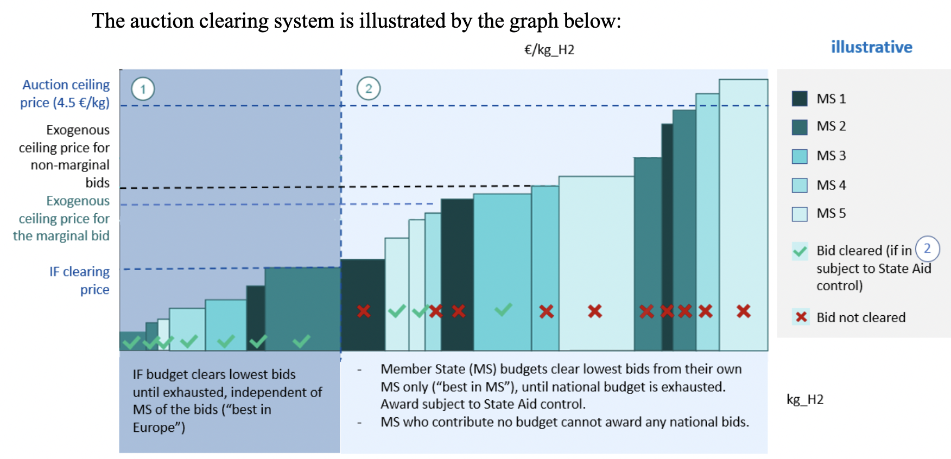
Auction clearing system (Domestic Pillar)
4 €/kg Second auction
Notes:
The Bank is a ‘pay-as-bid’ auction where producers bid for a fixed subsidy per kilogramme of renewable hydrogen produced.
Auction Design and Clearing Mechanism
1. Sealed Bids
Project developers submit confidential bids specifying:
The amount of renewable hydrogen they will produce (in kg/year).
The support level they request, expressed as a €/kg premium.
2. Pay-as-Bid Model
Unlike a uniform-price auction (where everyone gets the clearing price), this is pay-as-bid:
Each winning project receives exactly the premium they bid, not the highest accepted bid or a market-clearing price.
3. Clearing the Auction
Bids are ranked from lowest to highest €/kg requested and Projects are selected until the budget envelope is exhausted.

