Slide 1
Andrei Marcu Michael Mehling Aaron Cosbey
CBAM: Understanding Circumvention
May 18, 2022
Notes:
It is a long slide show, so we’ll go quickly over background etc to have time to focus on the core issues!

Slide 2
CBAM Circumvention: Definition
Broadly defined as intentional changes to trade patterns, product characteristics or policies that lower the CBAM compliance obligation for foreign producers…
… without reducing the carbon intensity of their goods or increasing the carbon price imposed on those goods – also implies that the focus is on product not producer
Article 27 of the proposed CBAM regulation applies a narrower definition: “Practices of circumvention include situations where a change in the pattern of trade in relation to goods included in the scope of this Regulation has insufficient due cause or economic justification other than avoiding obligations as laid down in this Regulation and consist in replacing those goods with slightly modified products”
Note the General Approach of the Council released on 15 March 2022 proposes expanding the definition of circumvention to include resource shuffling and splitting shipments

Slide 3
Different Forms of Circumvention
Resource shuffling: Low-carbon goods substitute for high-carbon goods exported to the EU; the latter are instead sold and consumed outside the EU
Transshipment: Covered goods enter the EU indirectly via exempted countries by onward export, or displace goods in exempted country that are then sold to EU
Policy-related circumvention: Trade partners introduce a carbon price but: i) fail to enforce it, find ways to refund producers; ii)only apply them to exports etc.
Product modification: A covered good is processed just enough to fall outside the coverage threshold of the CBAM (cf. Art. 27 CBAM Regulation)
Splitting shipments: Splitting goods shipments to fall under de minimis threshold
Cost absorption by foreign producers is not circumvention strictu sensu, yet it enables them to absorb the cost of the CBAM for goods exported to the EU by spreading the cost across their entire production, essentially cross-subsidizing

Slide 4
CBAM Definition/Objectives
Objectives of CBAM that have been mentioned since 2019
avoid carbon leakage;
ensure that the same price is paid for a ton of embedded CO₂
address competitiveness concerns;
allow the EU to increase its level of ambition;
motivate and nudge other countries to increase their pledges under the Paris Agreement to match that of the EU;
eliminate free allocation;
and generate revenue.

Slide 5
Is Circumvention a Problem?
Whether circumvention is considered a problem depends on the definition of (legitimate) objectives of the CBAM
The answer also changes for different types of circumvention.

Slide 6
Is Circumvention a Problem ...
A matter of principle: e.g. resource shuffling & carbon price only on exports
Consider:
CBDR
Paris Agreement
What is a legitimate objective to level the playing field at the border for:
Product level (prevent leakage)?
Broader level (equalize carbon cost paid at producer, sector, country levels)?
Resource shuffling: Is it legitimate to prevent a clean foreign producer from diverting clean products toward the EU in response to CBAM?
Carbon price on exports only: Is it legitimate to deny credit to an export-only carbon price?

Slide 7
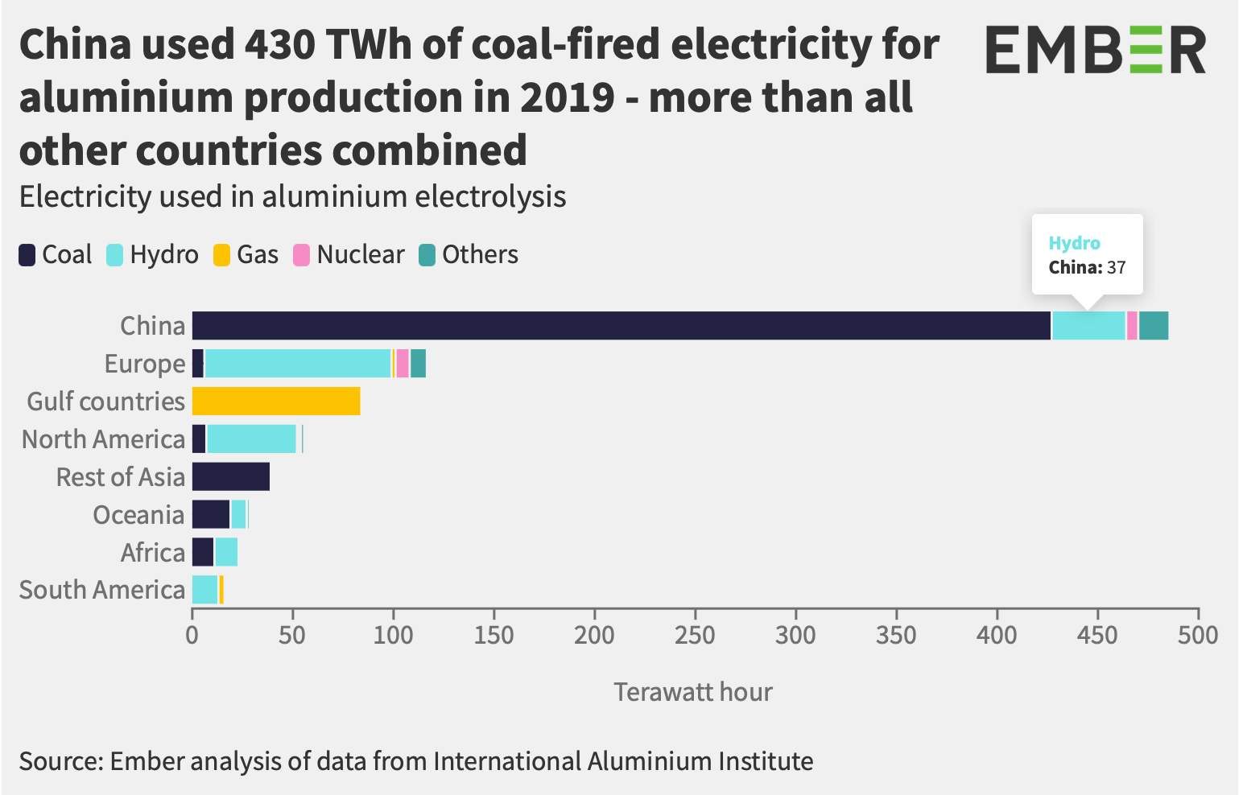
Resource Shuffling potential – e.g. aluminium production in China
37 TWh hydro-generated electricity used in aluminium electrolysis in 2019 China vs 427 TWh coal-fired.
Hydro accounted for an estimated ~2.5 million tons of aluminium produced in China in 2019 (assuming electricity intensity of ~15MWh/ton of aluminium).
HS code - aluminium product | 2019 EU27 imports from China (tons) | Total 2019 EU27 imports (tons)
7601 - Unwrought aluminium | 5.842 | 5.899.416
7603 - Powder and flakes, of aluminium (excl. pellets of aluminium, and spangles) | 1.131 | 19.965
7604 - Bars, rods and profiles, … | 123.402 | 408.745
7605 - Aluminium wire … | 3.601 | 213.689
7606 - Plates, sheets and strip, of aluminium, of a thickness of > 0,2 mm … | 291.276 | 1.197.615
7607 - Aluminium foil, "whether or not printed or backed with… | 138.833 | 317.626
7608 - Aluminium tubes and pipes … | 17.311 | 47.622
7609 - Aluminium tube or pipe fittings … | 5.139 | 8.049
Total 7601, 7603-7609 (CBAM proposal) | 586.535 | 8.112.727
This compares to ~0.6 million tons of EU27 imports from China in 2019 of aluminium products included in Annex I of the CBAM proposal; and ~ 8 million tons of total EU27 imports.
Source: Eurostat, ‘EU trade since 1988 by HS2,4,6 and CN8’ dataset

Slide 8
Resource Shuffling in California (1)
California launched an emissions trading system in 2013
Aims to reduce emissions by 40% below 1990 levels by 2030
Covers 85% of California‘s emissions: large industry, electricity, fuel suppliers
First jurisdictional deliverers placing electricity onto the California grid – both in-state generators and importers – are covered by the ETS and must report emissions based on physical delivery by source
Western grid (WECC) is comprised of 17 subnational jurisdictions in the U.S., Canada and Mexico; power is exchanged through bilateral agreements and wholesale electricity markets
Electricity imports constitute a significant share of California’s electricity demand (34% in 2015) and electricity-related emissions (40% in 2015)
Specified imports: require proof of direct delivery and a written contract or ownership stake; California’s Air Resources Board (CARB) calculates emissions rate based on U.S. EPA/EIA data
Unspecified imports: no or insufficient emissions reporting; these imports are therefore assigned a default unspecified source emissions rate equal to 0.428 MtCO₂e/MWh, similar to a single-cycle natural gas plant

Slide 9
Resource Shuffling in California (2)
Initial ETS program design included a prohibition of resource shuffling, requiring annual written attestations confirming importers did not engage in resource shuffling under penalty of perjury
Resource shuffling defined as “any plan, scheme, or artifice to receive credit based on emissions reductions that have not occurred, involving the delivery of electricity to the California grid.”
Replaced with a whitelist of 13 safe harbors due to pressure by FERC over legal risk/uncertainty
Resource shuffling” now defined as “any plan, scheme, or artifice undertaken by a First Deliverer of Electricity to substitute electricity deliveries from sources with relatively lower emissions for electricity deliveries from sources with relatively higher emissions to reduce its emissions compliance obligation.”
Research has suggested that these safe harbors enabled “facility swapping”, “cherry picking” and “laundering/relabeling” practices, avoiding between 74 and 319 MtCO₂e from being priced between 2013 and 2020 (Borenstein et al. 2014; Cullenward and Weiskopf, 2013; Pauer, 2018)
California’s entire ETS only expected to reduce emissions between 18 and 27 Mt CO₂eq. by 2020
Bushnell, Chen and Zaragoza-Watkins (2014) and Caron, Rausch and Winchester (2015) estimate that, without effective provisions to prevent resource shuffling, the BCA will lead to no further emission reductions than a program design that only covers domestic electricity

Slide 10
Article 27 of the Proposed CBAM Regulation
Narrow definition of circumvention focused on product modification, although Council March 2022 ”General Approach” suggests adding splitting of shipments
Definition still leaves ample uncertainty about what exactly would trigger consequences (“insufficient due cause or economic justification”, “significant decrease in the volume of imported good”), and leaves door open to including further types of circumvention (“include situations”)
Compare experience in California, where legal uncertainty and risk prompted the Californian ARB to change circumvention prohibition to a (generous) whitelist instead
CBAM proposal empowers Commission to monitor trade patterns and adopt – if deemed necessary – delegated acts to include slightly modified products under CBAM
Member States and other stakeholders can trigger such an assessment, but when and how Commission will determine the need to take action is left unclear for now
Proposed CBAM regulation offers no solutions to the other types of circumvention, such as resource shuffling, transshipment or policy circumvention, discussed above

Slide 11
Thank you

