Slide 1



State of the EU ETS Report 2020
Presentation accompanying the Report

Slide 2
State of the EU ETS 2020– Outline
Chapters
  Background
  An EU ETS “fit for purpose”
  Impact of COVID-19 on the EU ETS
  Changes in regulatory environment
  Sentiment Market Survey
  Environmental delivery
  Economic delivery
  Market functioning
  The European Green deal
  Issues to monitor in the future

Slide 3
Background
2020 State of the EU ETS Report is meant to be a “snapshot”, providing policymakers and stakeholders with an overview of how the EU ETS is doing by April of each year, based on previous year data.
Context:
  Phase 4 review concluded in 2018
  Climate ambition momentum 2018-2019
    ‘Clean Planet for All’ communication
    Popular green movement
    ‘European Green Deal’ communication
    Climate neutrality by 2050 goal
  2020: COVID-19
    Resources are finite: priorities will have to be set, and choices to be made

Slide 4
EU ETS ‘fit for purpose’
What do we expect the EU ETS to deliver?
3 key deliveries
Environmental delivery. Does it deliver against absolute environmental targets?
Economic delivery. Macro-economic efficiency and cost effectiveness for compliance. Does it provide effective, and proportional, protection against the risk of carbon leakage? Is it a driver for change?
Market functioning. It is worth having a market only if it functions well and leads to good price discovery.

Slide 5
EU ETS ‘fit for purpose’
2 additional, implicit deliveries:
1. A long-term (competitive) advantage for Europe
Incentivize investments to accelerate the transition;
Address the socio-economic impacts associated with the transition to a low-GHG economy through revenue-recycling;
Contribute to the creation of a market for low-carbon products;
Incentivizing behavioural and system change.
--> Has become more explicit with the European Green Deal:
“new growth strategy” to transform the EU into a fair and prosperous society
“this upfront investment is also an opportunity to put Europe firmly on a new path of sustainable and inclusive growth”
2. A role for the EU ETS in being a pioneer and promoting carbon markets as a tool for addressing climate change
Leading by example; Carrot; Stick.
More ‘explicit’
Less ‘mature’

Slide 6
State of the EU ETS 2020– Outline
Chapters
  Background
  An EU ETS “fit for purpose”
  Impact of COVID-19 on the EU ETS
  Changes in regulatory environment
  Sentiment Market Survey
  Environmental delivery
  Economic delivery
  Market functioning
  The European Green deal
  Issues to monitor in the future

Slide 7
Impact of COVID-19 on the EU ETS
Severe economic implications …
  IMF projections: European Union -7.1%
… which will be accompanied by the largest drop in emissions on record
  CarbonBrief: -5.5% (2000 MtCO2)
  Global Carbon Project: -6.8% (2500 MtCO2)
2 uncertainties:
  Duration of the health crisis
  ’shape’ of the recovery (v-shaped?)

Slide 8
Impact of COVID-19 on the EU ETS
Short- to medium-term implications
Sharp drop in emissions and lower prices in the coming years. (more on this later)
First real ‘test’ for the Market Stability Reserve – changes to the intake will be seen from September 2021 onwards.
Implications for Free Allocation post-2025 – calculation of ‘historical activity level’ impacted.

Slide 9
Impact of COVID-19 on the EU ETS
Long term implications…
… will largely depend on how the economic stimulus currently under preparation by the governments and central banks will be developed and used.
Many have called for the European Green Deal to be at the heart of the EU’s recovery plan (e.g. op-ed by Climate minsters; the ‘alliance for green recovery’)
Others have called for delays of the implementation of the EGD, and some even for the abandonment of current climate policy.
Resources are finite: priorities will have to be set, and choices to be made.

Slide 10
State of the EU ETS 2020– Outline
Chapters
  Background
  An EU ETS “fit for purpose”
  Impact of COVID-19 on the EU ETS
  Changes in regulatory environment
  Sentiment Market Survey
  Environmental delivery
  Economic delivery
  Market functioning
  The European Green deal
  Issues to monitor in the future

Slide 11
1 – European Parliament elections
2019 : a popular green movement sweep through Europe
EU elections saw the number of green-leaning MEPs rise, and one could argue that the parliament as a whole has ‘moved’ towards a greener stance
The European Green Deal: communication issued on December 11th, 2019 is presented as a new growth strategy by the Commission, aimed at transforming the EU’s economy towards net zero emissions.
2020 : a test year for the green deal with the quest of a strong support of Member States
As a first pillar, the Climate law has been presented by the EU Commission on 4th March;
Climate neutrality will be on the agenda of various ministerial meetings, including an informal gathering of environment ministers in Croatia in April.
Achieving an agreement on a final version of the Climate law will then pave the way for the EC to propose changes to more specific laws such as the EU ETS Directive.

Slide 12
2 – Secondary legislation related to the EU ETS
2018
2019
2020
2021
2023
2025
Revised rules for free allocation
Carbon Leakage list
Start of P4
Innovation Fund
Amended Auctioning Regulation
MSR Review
LRF review
EU Registry for P4
Draft Jan 2020
EU ETS Directive for P4
Amended Monitor and Reporting Regulation
State Aid Guidelines
Aviation review
Amended Verification and Accreditation Regulation
Free allocation adjustment rules
Update benchmarks
PA Stocktake
Data collection via MSs
12
Auctioning regulation
Modernisation Fund
Draft Feb
2020

Slide 13
2 – Secondary legislation related to the EU ETS
2019 main developments
The revision of the Free Allocation adjustment rules for 2021-2030 was adopted, aiming to create a closer link between changes in production levels and free allocation compared with Phase 3
Auctioning regulation amended
  Monetization of allowances for the Innovation Fund and Modernisation Fund
  Template for voluntary cancellation
  Alignment with the financial market legislation and market oversight regime (MiFID2)
Decisions made by the 10 CEE Member States regarding the use of Article 10c and the Modernisation Fund:
  The use of Article 10c, transitional free allocation, will decrease substantially compared to P3
Draft state aid guidelines for indirect costs compensation published

Slide 14
2 – Secondary legislation related to the EU ETS
EU ETS issues to monitor in 2020
The benchmark values for free allocation for 2021-2025
Draft state aid guidelines for indirect costs compensation
The modernization fund
The innovation fund
The two game changers on the EU ambition to monitor in 2020 will be :
The Green Deal : the EC plans to set ambitious target in summer/autumn 2020
The Paris agreement : it pushes the EU to raise its climate ambition before the global stock take in 2023.
Beyond 2020, several policy milestones are already scheduled :
MSR and LRF reviews, CORSIA.

Slide 15
3 – Brexit – three years of negotiations
2019 : the certainty of an unclear impact on the EU ETS
EU Withdrawal Agreement passed – transition period until the end of 2020 = together with the end of Phase 3 ETS
EC Contingency Action plan: Free allocation and auctioning of EUAs by the UK was suspended
  2020 : the clarification of a transition period.
There is now a transition period until the end of 2020 while the UK and EU negotiate additional arrangements. New rules will take effect on 1st January 2021.
The EU ETS will continue for the 2019 and 2020 compliance years during the transition period from 1st February 2020 to 1st January 2021. UK remains a full participant in the EU ETS and compliance obligations apply for 2019 and 2020 emissions.
UK operators will continue to be able to access their accounts in the Union Registry.

Slide 16
3 – Brexit – the transition period
2020 : The operational agenda for UK operators compliance during the transition period
The deadlines for UK operators during the transition period are:
  submit Verified Annual Emissions Report for 2019/2020 emissions - 31 March 2020/2021
  surrender equivalent allowances to 2019/2020 verified emissions - 30 April 2020/2021
Auction calendar for the UK :
  123,4 Mt of general allowances will be auctioned over 2020. The first auction took place on 04 March.
  1,64 Mt of aviation allowances will be auctioned over 2020. The first aviation auction to be on 25 March.
UK operators will also regain the ability to use their entitlement in the Union Registry to exchange international credits for EU ETS allowances.

Slide 17
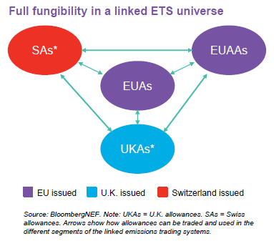
3 – Brexit – towards a linked UK-ETS ?
2020 : a year to design a future UK carbon pricing scheme
Four options were on the table: a carbon tax, stand-alone U.K. emission-trading scheme, U.K. scheme linked to the EU ETS; and staying in the EU ETS least through Phase 4 (2021-30).
But the UK government prefers a linked UK-ETS and intends to implement a UK ETS like the EU ETS to link them from 2021.
The EU likely prefers this UK-ETS option as it would not have a disruptive effect on the EU ETS;

Slide 18
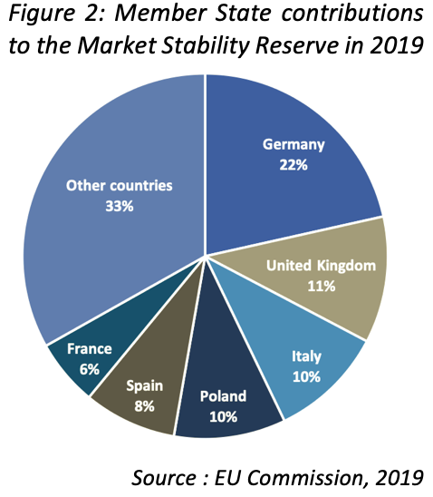
4 – MSR implementation
2019 : the first year of operation
2019 was the first year of operation of the MSR
24% of the TNAC placed in the MSR = In total, 397m allowances.
2020 and beyond
2020: 265m allowances between 1st of January and 31st August 2020.
The remaining volume to be added to the MSR in 2020 will be determined by the 2020 publication of the TNAC
This is an important piece of the EU ETS : need to have an efficient review. The review in 2021 should look at both the track-record of the MSR until 2021, as well it expected performance in the period to 2030.
Source : ERCST, 2019

Slide 19
5 – National Energy and Climate Plans (NECPs) and changes in MS ambition
Regulation on the Governance of the Energy Union requires MS to submit NECPs for the period 2021-2030 : in March 2020, 23 MS have submitted their final NECPs
EU countries were also required to develop national long-term strategies by 1st January 2020: in March 2020, 15 MS have submitted their national long-term strategies
Potential impact on EU ETS for those MS who might take additional actions in sectors covered by the EU ETS - highly dependent on how the EU ETS will be reviewed
  Coal phase –out policies will have an impact on the EU ETS by cutting the EUA demand: Germany
  But consequences on EUA demand and then on EUA prices are unclear because actions plans and what are the offset parts are not always specified to quantify the impact on the EU ETS.
More Member States are announcing more ambitious national

Slide 20
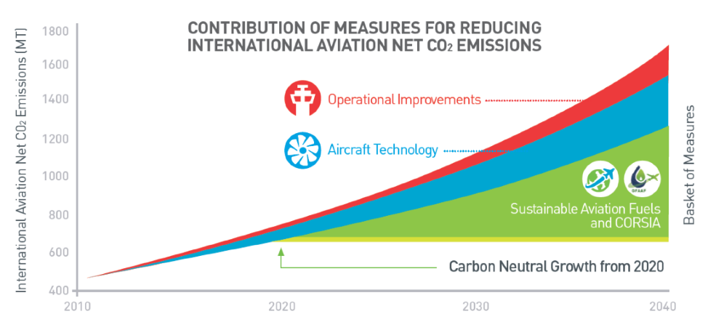
6 – Aviation under the EU ETS and CORSIA
The EU ETS for aviation will be subject to a new review in the light of the development of CORSIA.
CORSIA is a market-based measure, requiring the civil aviation to offset operator’s annual emissions that are above the 2020 baseline for international flights.
It will be implemented in three phases :
Pilot phase 2021-2023, First Phase 2024-2026 and Second phase (2027-2035).
2019
In 2019, operators monitor, report and verify their emissions from international flights.
In the Green deal, the EU Commission has announced the intention to reduce the amount of free allowances for aviation over time.
  2020
  CORSIA’s offsets rules were decided by the ICAO Council in March 2020 :
  The EU Commission is preparing a report on how the two schemes could function together and whether the CORSIA ambition is in line with the EU ambition.
Source : ICAO, 2016

Slide 21
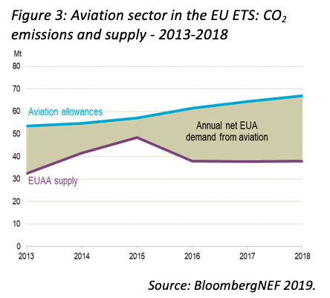
6 – CORSIA – Aviation key figures in the EU ETS
Over the 2013-2018 period :
Total verified emissions: 358MtCO2
Verified emissions from airlines grew by 20,17% from 2013 to 2018
The aviation sector was in a shortfall position of 122 MtCO2
Aviation represents 3,33% of the total ETS surrendered units
14,6% of its EUAA allowances came from auctions

Slide 22
7– Article 6 of the Paris Agreement
  Main developments in 2019
  The SG Climate Summit urged countries to enhance their NDCs, but no (large) countries have done this so far.
  COP 25 also did not deliver on Ambition, which was expected by some, nor did negotiators agree on a rulebook for Article 6 (the ‘markets’ article)
  However, increasingly more countries are pledging to cut GHG emissions to zero by 2050, including larger countries such as Canada, Chile New Zealand, Mexico and South Korea
  2020 : uncertainty due to COVID-19
COP 26 has been postponed

Slide 23
State of the EU ETS 2020– Outline
Chapters
  Background
  An EU ETS “fit for purpose”
  Impact of COVID-19 on the EU ETS
  Changes in regulatory environment
  Sentiment Market Survey
  Environmental delivery
  Economic delivery
  Market functioning
  The European Green deal
  Issues to monitor in the future

Slide 24
‘Sentiment’ Market Survey
Survey Questions 2020
In its current architecture, including the revision for Phase 4
  The EU ETS governance will provide a stable and predictable framework for an investment signal.
  The EU ETS Phase 4 parameters will lead to price patterns in 2020-2030 which are commensurate with an investment trajectory necessary towards net zero emissions by 2050.
  The EU ETS will provide a first mover advantage for the EU business community.
  The EU ETS will require significant changes to the MSR in the 2021 review.
  The mechanisms in place in the EU ETS can address the impacts of MS policies that will overlap with the EU ETS.
  The EU ETS can drive EU climate change policy post 2030.

Slide 25
‘Sentiment’ Market Survey
The EU ETS governance will provide a stable and predictable framework for an investment signal.

Slide 26
‘Sentiment’ Market Survey
The EU ETS Phase 4 parameters will lead to price patterns in 2020-2030 which are commensurate with an investment trajectory necessary towards the updated 2050 climate target.

Slide 27
‘Sentiment’ Market Survey
The EU ETS will provide a first mover advantage for the EU business community.

Slide 28
‘Sentiment’ Market Survey
The EU ETS will require significant changes to the MSR after the 2021 review.

Slide 29
‘Sentiment’ Market Survey
The mechanisms in place in the EU ETS are able to address the impacts of Member State policies that will overlap with the EU ETS.

Slide 30
‘Sentiment’ Market Survey
The EU ETS can drive EU climate change policy post-2030

Slide 31
State of the EU ETS 2020– Outline
Chapters
  Background
  An EU ETS “fit for purpose”
  Impact of COVID-19 on the EU ETS
  Changes in regulatory environment
  Sentiment Market Survey
  Environmental delivery
  Economic delivery
  Market functioning
  The European Green deal
  Issues to monitor in the future

Slide 32
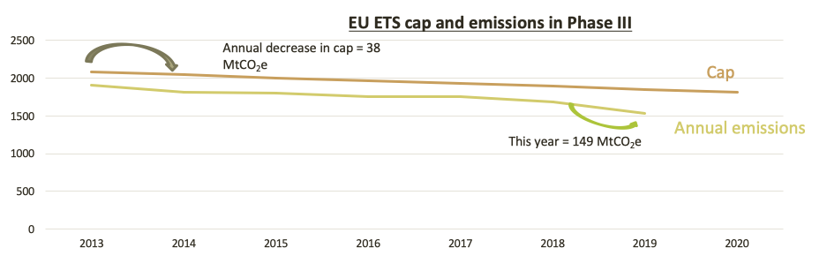
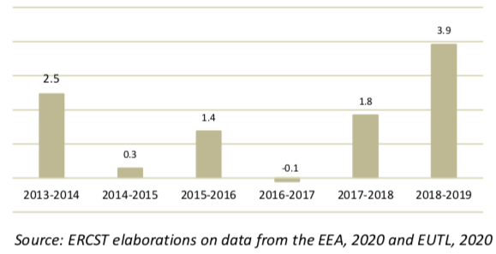
Delivery against the trading period
Comparison of the rate of decarbonisation with the decrease of the EU ETS cap
Verified emissions are 17.8% below the cap in 2019
Between 2018 and 2019, emissions decreased 3.9 times faster than the cap
Interpretation of the graph: between 2013 and 2014, the decrease in emissions was equivalent to 2.5 the decrease in the cap

Slide 33
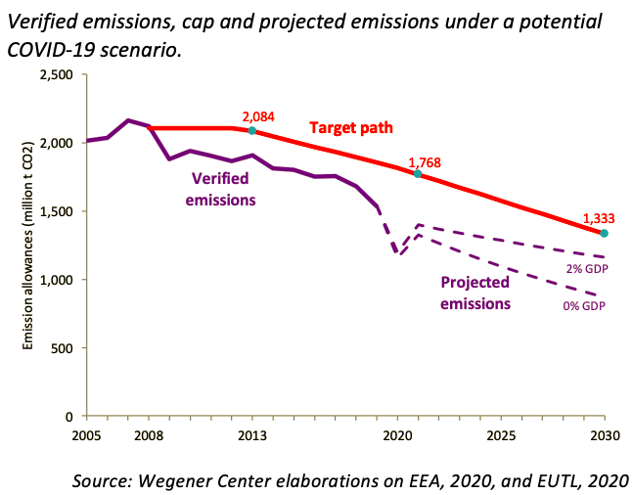
Delivery against the trading period
Comparison of emissions against the target cap
2019 estimates
-8.9% Total emissions
-13.9% Power
-5% Industrial Heat
-1.8% Industry
Actual emissions have been far below the target path.
COVID-19 Scenario: -20% drop in emissions in 2020, followed by a 95% recovery in 2021
Projected corridor based on GDP growth rates: emissions will stay well below the (current) cap
33

Slide 34
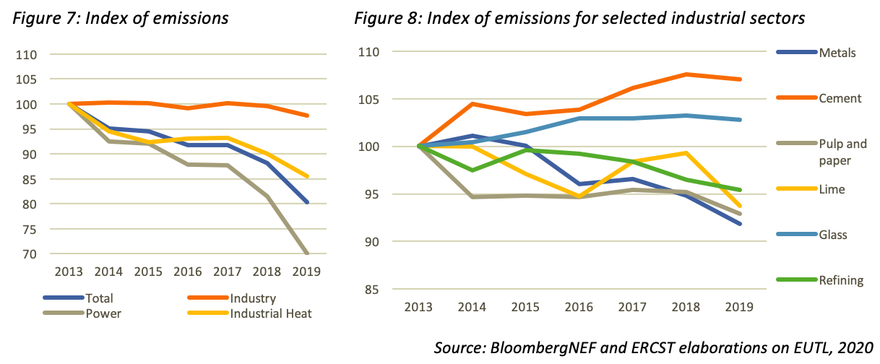
Emission and decarbonization trends
Emissions Index
Phase 3 – average yearly emissions reductions:
Power: -5.6%
Industrial heat: -2.5%
Industry: -0.4%

Slide 35
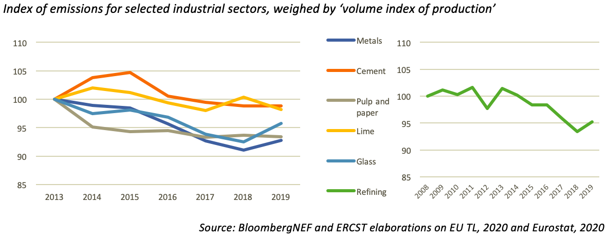
Emission and decarbonisation trends
Proxy for intensity
While intensity data is hard to come by, our proxy indicates that most industrial sectors are improving the carbon intensity of their production.
Current pace of improvements is not fast enough to reach the long-term objectives.

Slide 36
Environmental delivery
Conclusion
EU ETS is delivering against trading period target
Emissions are under target path since 2009
Emissions decreased considerably in 2019, down by an estimated 8.9% compared to 2018
Decarbonisation trends vary significantly in the different sectors
36

Slide 37
State of the EU ETS 2020– Outline
Chapters
  Background
  An EU ETS “fit for purpose”
  Impact of COVID-19 on the EU ETS
  Changes in regulatory environment
  Sentiment Market Survey
  Environmental delivery
  Economic delivery
  Market functioning
  The European Green deal
  Issues to monitor in the future

Slide 38
Economic efficiency
Is the EU ETS a driver for change?
  Interaction with other policies;
  Decarbonization in the power sector;
  Deployment of new low-carbon technologies;
  Use of auction revenues.
Monetary impacts and carbon leakage
  Direct costs
  Indirect costs

Slide 39
Interaction with other policies
The effects of policy overlap create negative impacts on the economic efficiency of EU ETS
RES/EE targets set at the EU level have implications on the decarbonisation of EU ETS sectors. The EU ETS also interacts with the effort sharing regulation (ESR) and other EU policies for GHG emissions reduction
Similar implications stemming from national policies, as in the case of coal-phase outs
The MSR was put in place to partially reconcile the effects of policy overlaps and the EU ETS

Slide 40
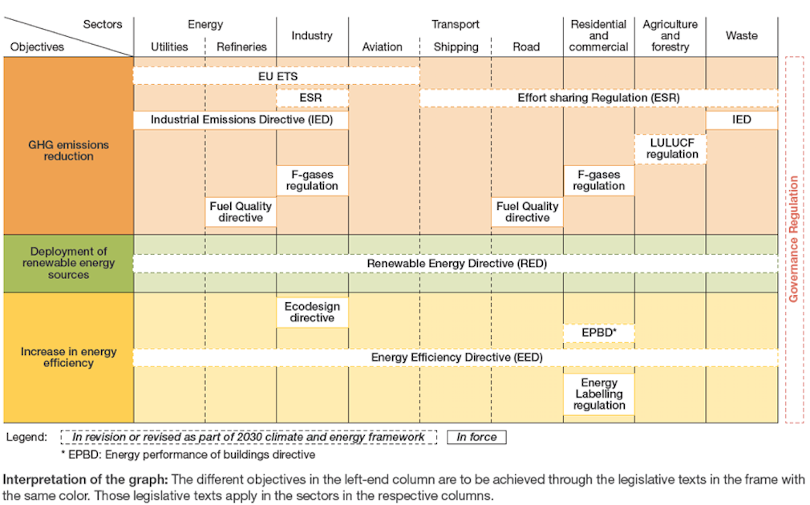
Interaction with EU-level policies
Source: I4CE and Enerdata, 2018, based on a visual concept by Ecologic
Notes:
Add some notes on new policy initiatives being communicated – box with future measures

Slide 41
Decarbonisation in the power sector
CO₂ emissions from the power sector and carbon content of power generation (2005-2019)
Source : ERCST based on data from BNEF, Eurostat, EU TL
Between 2005 and 2019, CO₂ emissions from the power sector decreased by an estimated 460 MtCO₂ (36.5%).
In the same period, the carbon intensity of power generation decreased by 35%.

Slide 42
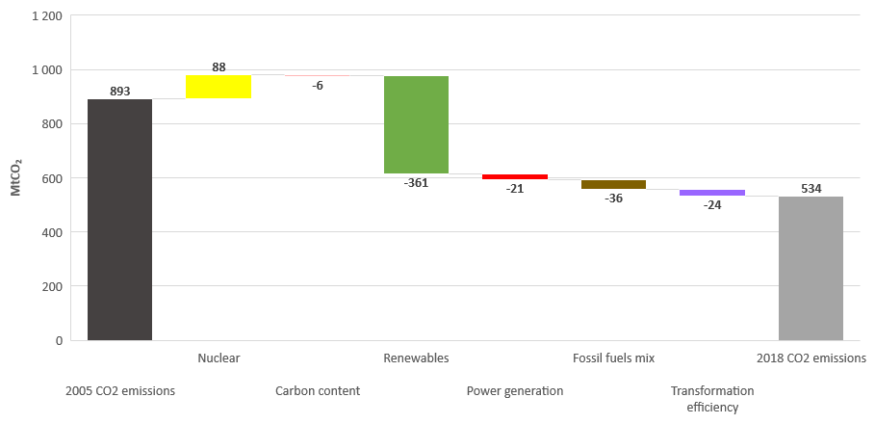
Decarbonisation in the power sector
Drivers of emissions variations in the power sector in the EU (2005-2018)
The deployment of renewable sources of energy was the most important driver in decreasing CO₂ emissions in the power sector over 2005-2018: -359 MtCO₂e over the period 2005-2018 (for electricity producers whose main activity is electricity producer).
Source : I4CE based on data from Eurostat

Slide 43
Decarbonisation in the power sector
Annual drivers of emissions variations in the power sector in the EU (2005-2018)
Source : I4CE based on data from Eurostat

Slide 44
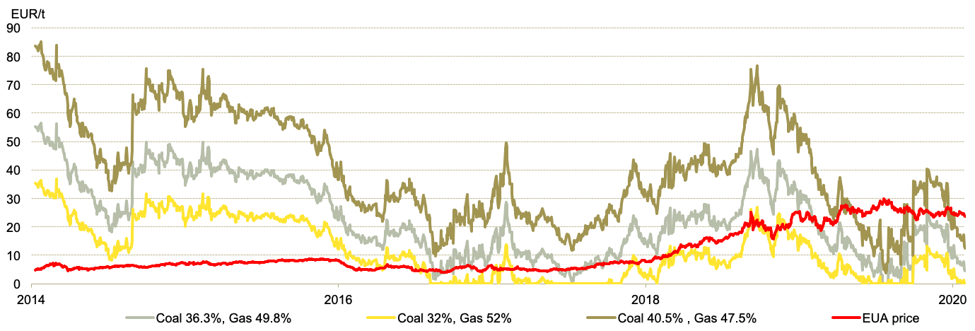
Is the EU ETS a driver for change?
Fuel switching

Slide 45
Is the EU ETS a driver for change?
Evidence of fuel-switching
-22%
Pattern fill = 2018
Solid fill = 2019
-33%
+84%
+19%
-66%

Slide 46
Economic efficiency
Power sector emission covered by EU ETS have so far decreased by almost 30% during Phase 3.
The rate of decarbonisation between 2018 and 2019 was more pronounced to the one we observed in recent years.
Of course, it is hard to. attribute this evolution to the EUA price – renewables penetration mainly happened due to other policies
The strong decrease in emissions seen in 2019 can be attributed to:
  Fuel switching due to higher carbon pricing together with lower gas prices.
  A continuation of renewable penetration in the EU power mix;
  A strong output for renewable sources;
  A rather “warm” year, resulting in a decrease in overall consumption.
46

Slide 47
Is the EU ETS a driver for change?
More revenues from auctions = more money for climate action?
In 2018, total revenues from the auctioning of allowances reached 14.6 billion €
2018 saw a large increase due to the increasing EUA price
Revenues in 2019 remain at similar levels to 2018, despite the the fact that the amount of allowances auctioned decreased significantly (MSR functioning + no UK auctions)
X 2.5
Source: ERCST, with data from EEX and ICE
* Without UK

Slide 48
Is the EU ETS a driver for change?
More revenues from auctions = more money for climate action?
Total EU ETS 2019 auction revenues breakdown amoung Member States
Each Member State decides the use of their EU ETS revenues : climate and energy purposes, national budget or others.
Over 2013-2018, around 80% of auction revenues were spent for climate and energy purposes, mainly in the EU.
€ 14,6 billion
Source: data from EEX

Slide 49
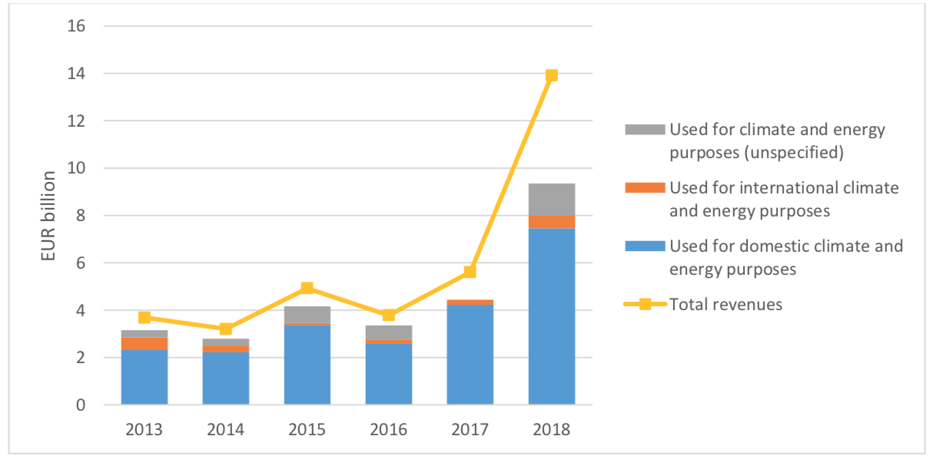
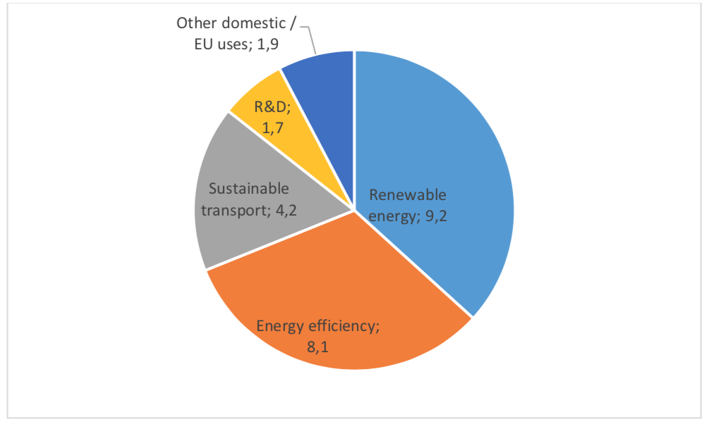
Is the EU ETS a driver for change?
More revenues from auctions = more money for climate action?
Revenues from the auctioning of EU ETS allowances 2013-2018
Use of revenues for domestic climate and energy purposes from auctioning of ETS allowances, 2013-2018 (EUR billion)
Source: Report From The Commission To The European Parliament And The Council (2019)

Slide 50
Monetary impacts and carbon leakage
Direct costs
Indirect costs

Slide 51
Overall free allocation vs emissions in EU ETS
Source: Wegener Center elaborations on EEA, 2019 and EU TL, 2019
Net supply of free allowances, defined as (free allowances/emissions – 1)*100
measures the stringency of sectors and installations

Slide 52
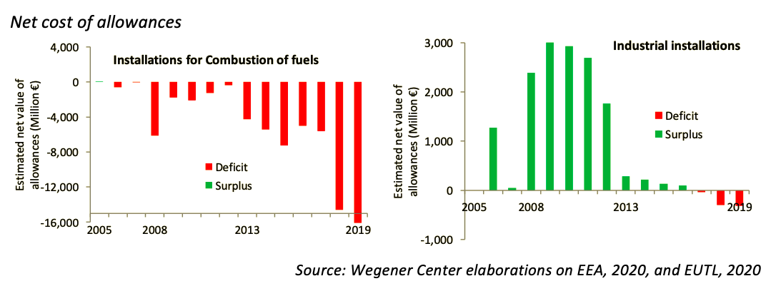
Monetary impacts and carbon leakage
Direct costs
Industrial installations historically received more free allocation than their verified emissions.
This trend has steadily been reversed over Phase 3.
In 2018 and 2019 free allocation covered 96.8% and 97,5% of industrial emissions, respectively, down from 98.8% in 2017.

Slide 53
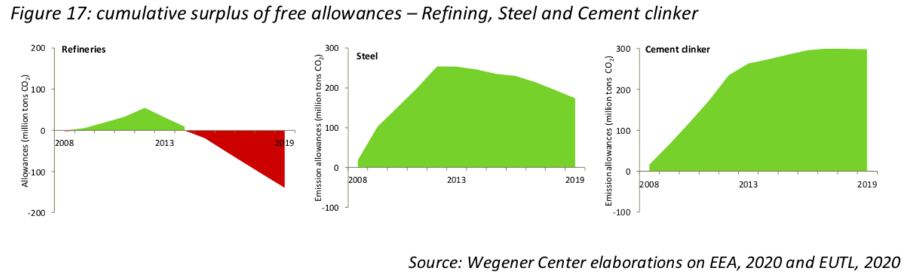
Monetary impacts and carbon leakage
Direct costs

Slide 54
Monetary impacts and carbon leakage
Direct costs
Indirect costs

Slide 55
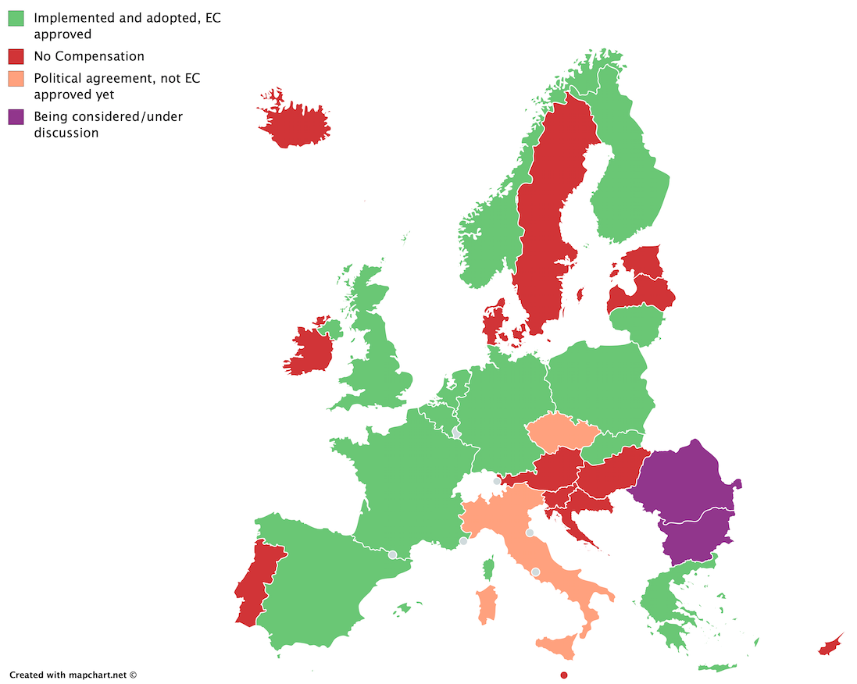
Indirect Costs
No harmonized approach – risk for market distortion
Subject to ’state aid guidelines’
Distortion was a real concern in the beginning of Phase 3: only a handful of MS had a scheme in place.
This amount has increased steadily over the last few years, and continues to increase
  2017: 10 Schemes in place
  Luxembourg and Wallonia (Belgium): 2018
  Poland: 2019
  Czech Republic and Italy: political agreement
  Romania and Bulgaria: under discussion

Slide 56
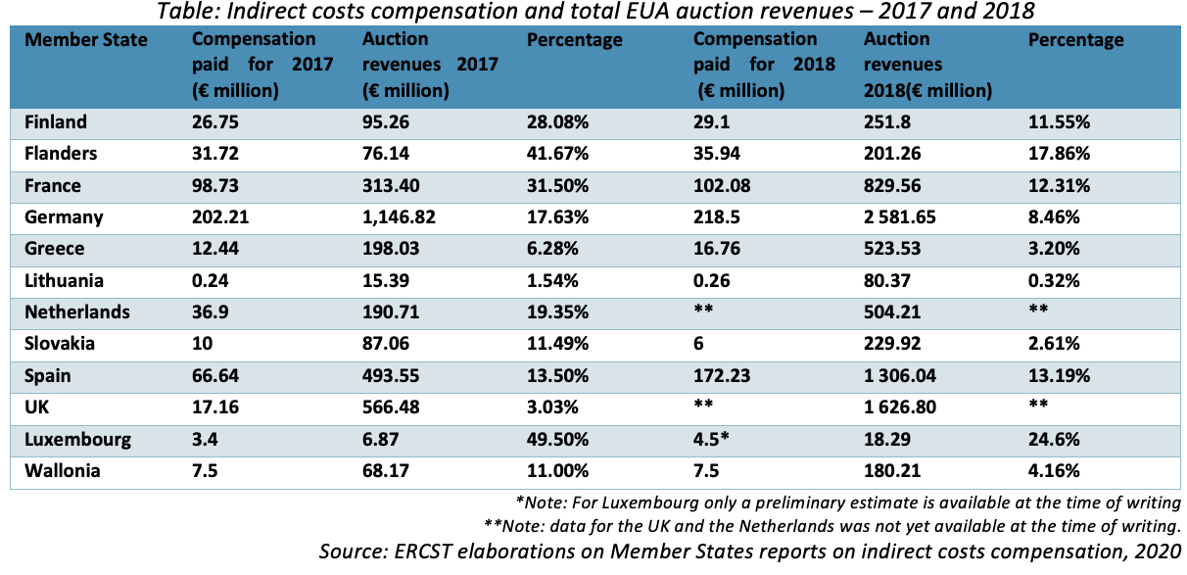
Monetary impacts and carbon leakage
Indirect costs

Slide 57
Indirect Costs
2020 situation
  ETS Emissions covered: 73%
  Energy use by industry: 69%
+ Italy & Czech Republic
  ETS Emissions covered: 85%
  Energy use by industry : 83%
+ Romania & Bulgaria
  ETS Emissions covered: 89%
  Energy use by industry : 86%

Slide 58
Indirect Costs
Draft guidelines for indirect costs compensation in Phase 4 were published on January 8 2020
  Stricter eligibility criteria result in fewer sectors being eligible - from 13 sectors and 7 subsectors to 8 sectors (and 4 eligible for qualitative assessment)
  Conditionality to aid received: Energy efficiency improvements, renewables or direct investments towards direct emission reductions.
  Aid intensity constant at 75% of costs incurred (vs. digressive in Phase 3)
  Dynamic compensation: actual output levels; annual decreasing benchmarks
A changed narrative on the risk of Carbon Leakage?
  Risk of carbon leakage vs. genuine risk of carbon leakage – towards tiered risk assessment?
  Additional support can be given for those sectors that face the highest costs as a percentage of their GVA – towards tiered costs compensation?

Slide 59
State of the EU ETS 2020– Outline
Chapters
  Background
  An EU ETS “fit for purpose”
  Impact of COVID-19 on the EU ETS
  Changes in regulatory environment
  Sentiment Market Survey
  Environmental delivery
  Economic delivery
  Market functioning
  The European Green deal
  Issues to monitor in the future

Slide 60
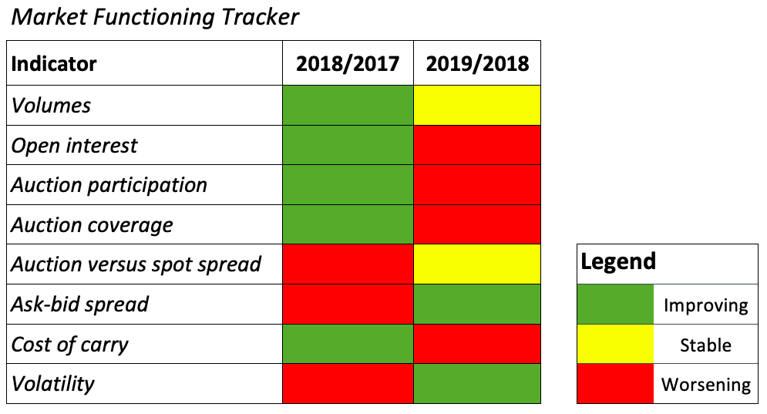
Market Functioning Tracker

Slide 61
Market functioning: volumes
Traded volume up 6% despite lower emissions and alleged exit of speculators

Slide 62
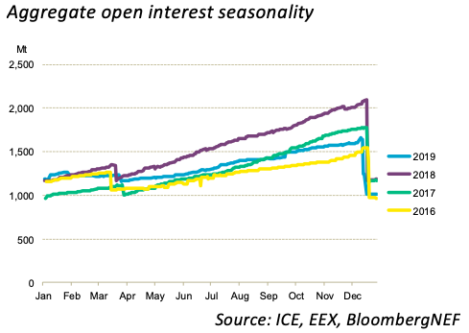
Market functioning: open interests
Open interest down year-on-year despite strong start to the year.
Utilities likely less active due to lower emissions. Allows them to roll hedges over into the future rather than entering the market
Lower open interest combined with higher traded volume hints that speculators with a shorter time-horizon have increased while compliance market actors might have limited their buying

Slide 63
Market functioning: Auction cover ratio

Slide 64
Market functioning: Monthly average auction participation

Slide 65
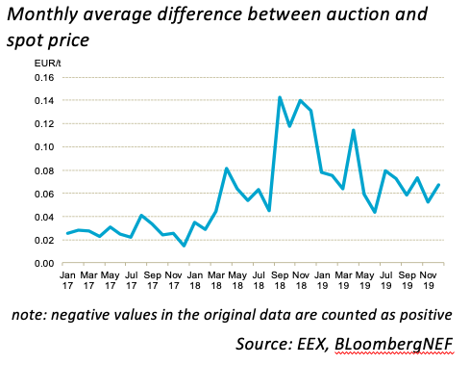
Market functioning: auction-spot differential

Slide 66
Market functioning: day-to-day volatility

Slide 67
Market functioning: cost of carry vs. EU 5y bonds
Source: ICE, BloombergLP

Slide 68
Market Functioning Tracker

Slide 69
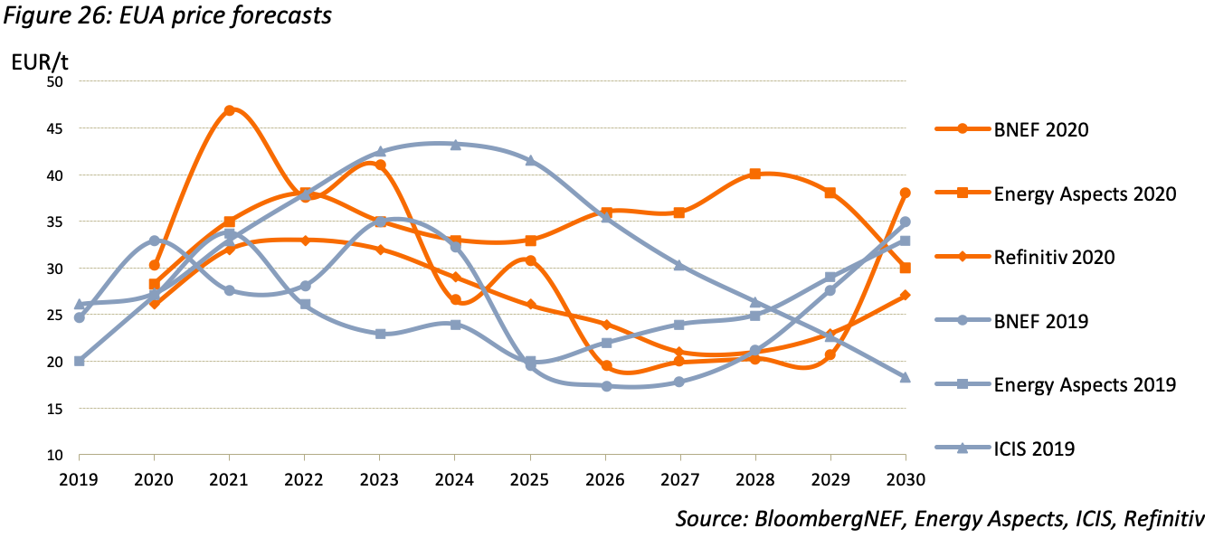
Price forecasts: pre-COVID19

Slide 70
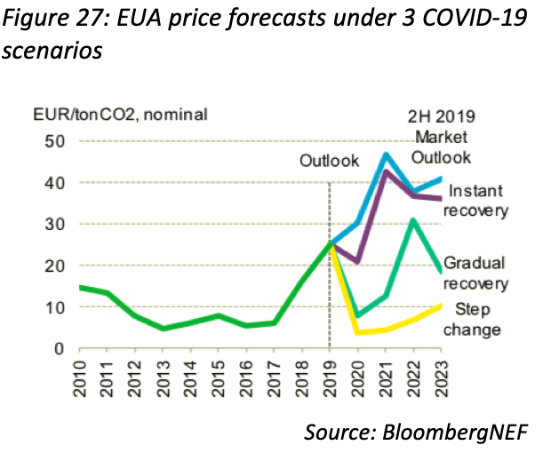
Price forecasts: post-COVID19
Three scenarios: a swift recovery to baseline emissions by October 2020, a gradual recovery to baseline by January 2023, and a “step-change” scenario with no recovery to baseline emissions.
These divergent scenarios underline the degree of uncertainty we are currently facing, and that the future outlook is unclear.

Slide 71
State of the EU ETS 2020– Outline
Chapters
  Background
  An EU ETS “fit for purpose”
  Impact of COVID-19 on the EU ETS
  Changes in regulatory environment
  Sentiment Market Survey
  Environmental delivery
  Economic delivery
  Market functioning
  The European Green deal
  Issues to monitor in the future

Slide 72
The European Green Deal
The EGD can be seen as an outline of the new Commission’s commitment to tackling climate and environmental-related challenges.
It is presented as a new growth strategy aimed at transforming the EU’s economy and lists measures and legislative initiatives aimed at achieving net-zero emissions by 2050.
The European Green Deal can be seen as a collection of priorities, principles and areas where legislative proposals will be produced in the coming years. At this stage, it is very broad and all-encompassing, and still lacking much detail.

Slide 73
The European Green Deal
1. Increased 2030/2050 ambition – implications for the EU ETS?
Net-zero emissions by 2050 is a target backed by all three European institutions.
A 50% target by 2030 is envisaged for the EU as a whole, with 55% being explored;
How will this be translated in a target for the EU ETS?
  Effort-sharing between ETS and ESR?
When will the target/LRF be revisited?
  At the start of Phase 4 seems unlikely, as a proposal is only expected in June 2021
    European Commission will have to propose a start date for the LRF in order to reach the updated 2030 target
  How long will it take to reach an agreement? – last revision took 2.5 years of negotiations. This will have to be taken into account by the Commission in its proposal:
  For simplicity reasons: new LRF to start in second half of Phase 4 (2026)

Slide 74
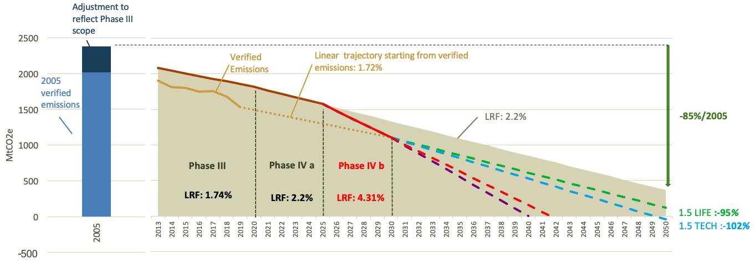
The European Green deal – targets
LRF necessary for reaching a 50% target + possible scenarios beyond 2030
 | 50% scenario LRF after 2030
LRF maintained after P4 | 4.31%
Net-zero by 2040 | 5.01%
1.5 LIFE | 2.33%
1.5 TECH | 2.61%

Slide 75
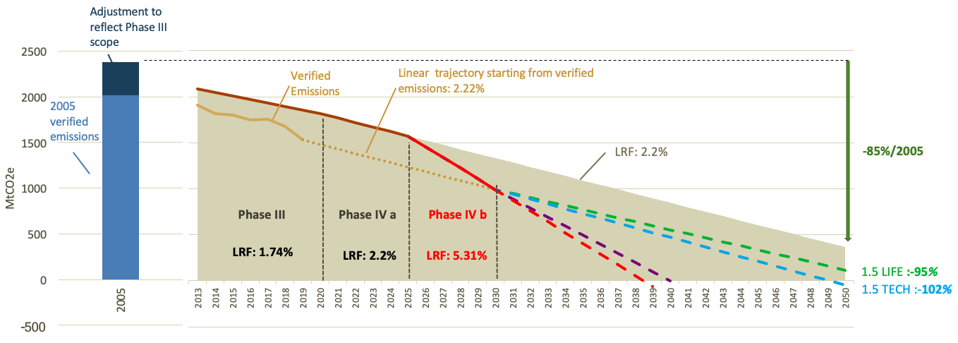
The European Green deal – targets
LRF necessary for reaching a 55% target + possible scenarios beyond 2030
 | 50% scenario LRF after 2030
LRF maintained after P4 | 5.31%
Net-zero by 2040 | 4.51%
1.5 LIFE | 1.98%
1.5 TECH | 2.36%

Slide 76
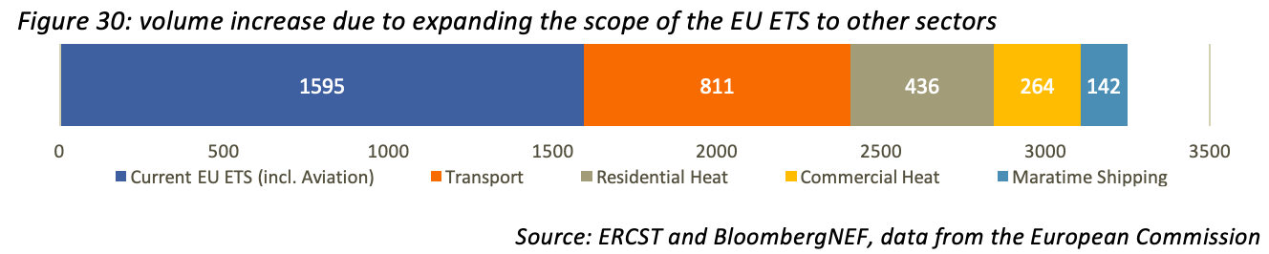
The European Green deal – Scope increase?
The European Green Deal opens the door for inclusion of a number of sectors:
  Maritime transport
  Road transport
  Buildings
Inclusion of maritime shipping seems most likely:
  Repeatedly mentioned by the European Commission;
  Currently being considered by the European Parliament (ENVI committee) as an amendment to the maritime shipping MRV regulation.

Slide 77
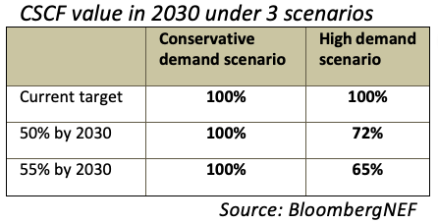
The European Green deal – Free Allocation
Under certain scenario’s, free allocation is to run out by the end of this decade.
One of the main policy initiatives announced in the EGD was a CBAM
Many questions remain to be answered:
  Which (ETS) sectors will be covered by the BCA? Some Basic Materials (EITEs) & Electricity seem probably
  Which form might a BCA take? E.g. The EU ETS could be extended to imports
    Would these allowances be taken from the current CAP, will the CAP be extended or might a ‘virtual pool’ of allowances be created?
  BCA has been announced as an ‘alternative’ to free allocation
    Could be a way to avoid the triggering of the CSCF
    How would the transition from Free allocation to a BCA happen?

Slide 78
The European Green deal – Auctioning revenues
Several options being considered:
  EC proposed to allocate 20% of auctioning revenues to its own budget in the European Green Deal;
  Council draft conclusions of 14 Feb 2020 included a proposal to have a new source of ’own revenues’: any revenues generated by the EU ETS exceeding the average annual revenue per Member State generated by allowances auctioned over the period 2016-2018 → significantly more than 20%
  Commission has repeatedly mentioned its intention to strengthen the role of the Modernisation and Innovation Funds.
  The revenues generated by a BCA could also be earmarked to climate action, e.g. the Innovation and/or Modernisation funds.

Slide 79
The European Green deal – MSR
Implementation of the EGD could simultaneously decrease (tighter cap) and increase (additional overlapping policies) the risk of oversupply in the market;
The official review of the MSR is scheduled in 2021, and will take place before the EU ETS directive will be revisited (EC proposal only expected by the summer of 2021).
How is one to review the MSR parameters when many of the EU ETS parameters can be expected to change?
Will the 2021 MSR review become an “empty shell”? More likely that any adjustments to the MSR will be proposed together with the whole EU ETS package in the summer of 2021

Slide 80
The European Green deal – Beyond 2030
What role will the EU ETS still play after 2030?
  What will the ETS target be after 2030?
  Will there still be enough liquidity for proper market functioning? Expanding the scope of ETS could be one way of ensuring sufficient liquidity.
Incentivising negative emission technologies – not much wording on this in the EGD but it is an issue that is becoming increasingly important, and is increasingly being discussed in the EU – what role can the EU ETS play?
In a world where the EU has increasingly higher ambition levels, and a world where BCAs get introduced, assessing and comparing climate efforts by other countries is becoming increasingly important → effective operationalisation of Article 30 of the directive?
Increase flexibility / cost-efficiency – revisit the possibility to use credits generated by EU domestic projects and/or international projects (link to Article 6 of PA)

Slide 81
State of the EU ETS 2020– Outline
Chapters
  Background
  An EU ETS “fit for purpose”
  Impact of COVID-19 on the EU ETS
  Changes in regulatory environment
  Sentiment Market Survey
  Environmental delivery
  Economic delivery
  Market functioning
  The European Green deal
  Issues to monitor in the future

Slide 82
Main EU ETS policy issues in 2020 and beyond
The EU Green Deal
Proposal on a European ‘Climate Law’ enshrining the 2050 climate neutrality objective – March 2020
Industrial Strategy – March 2020
Proposal for a carbon border adjustment mechanism for selected sectors – 2021
Review the EU climate 2030 target by September 2020
Assessment by September 2021 on how the EU legislation implementing the EU’s 2030 target would need to be amended in order to enable the achievement of 50 to 55 % GHG emission reductions
EU ETS
Benchmark value updates
EU ETS State Aids guidelines
Preparation of the MSR review for 2021
Innovation and modernization funds
Just transition
International level :
CORSIA decision in March 2020 and its implication on the EU ETS
China-EU summit in September 2020 and its implication on the carbon border tax adjustment.
COP26 in December 2020 and its implication on the EU climate ambition and the article 6.
Climate-neutrality objective
  EU strategy to enhance carbon removals by natural or other sinks : forests, soils, agricultural lands and wetlands, carbon removal technologies : CCS, CSU ?
  Prospective : exploring the role of using domestic offsets through operationalising Article 24a of the EU ETS ;

