Slide 1
Andrei Marcu Antonio A. Fernández
HYDROGEN: Taking Stock of the “Fit for 55”
Brussels, September 16th, 2021
Notes:
It is a long slide show, so we’ll go quickly over background etc to have time to focus on the core issues!

Slide 2
Presentation Structure
Fit for 55 Package and H₂
Renewable Energy Directive
ETS Directive
CO2 Standards for cars and vans
Alternative fuels infraestructure Regulation
Missing pieces
Additionality principle for renewable H2

Slide 3
Preliminary considerations & Backdrop
The fit for 55 package within the framework of the EC H₂ strategy
Does the Fit for 55 package provide the right regulatory framework to fulfill the strategy goals? Are the newly propossed targets aligned with the strategy 2030 ambition? Are they implementable?
Balance between regulation and markets
Green hydrogen: Balance tilted towards regulation.
Low Carbon hydrogen: Markets supported by the price signal of the ETS will lead.
Technology neutrality
Does the package adopt a technology neutral approach towards hydrogen?

Slide 4
Fit for 55 package and H₂

Slide 5
Renewable Energy Directive Revision
The definition of renewable fuels of non-biological origin has been extended beyond the transport sector. (Removal of Art. 27.3)
Avoiding double counting: Energy from RFNBO must be accounted in the sector in which it is consumed.
The renewable electricity used to produce renewable fuels of non-biological origin is not included in the calculation of final consumption of electricity from renewables in a MS. Binding target for Industry
Binding target (2030) of 50 % RFNBOs of the hydrogen used for final energy and non-energy purposes.
Binding target for Transport
Renewable fuels and renewable electricity supplied to the transport sector leads to GHG intensity reduction of at least 13 % by 2030
Share of RFNBOs is at least 2,6% in 2030.
Certification System
The EU-wide certification system for renewable fuels has been extended to include hydrogen.
Notes:
What are the implications, that the definition for RFNBOs has been extended beyond the transport sector. Does it have an impact on additionality.

Slide 6
Revision of the ETS Directive
EU ETS free allocation rules are amended to support the uptake of innovative decarbonisation technologies.
Efficient technologies below the benchmark receive more free allocation than they emit being able to sell the surplus on the market. Innovative installations can fall out of the EU ETS becouse they cahnge their production process so that investments in innovative technologies may be discouraged.
Example of a very efficient conventional fossil-fuel-based plant that produces hydrogen.
Innovation Fund: Propossed increase in the Innovation Fund.
50 ml allowances are added to the fund
Additional 150 mln allowances would come from the separate EU ETS for road transport and buildings.
The scope of the IF has been extended to provide support to projects through price-competitive tendering, such as CCfDs.
Modernization Fund: Propossed increase in the modernisation Fund.
Additional 2,5% of the cap to be auctioned to fund the transition in MSs with GDP pc below 65% of the avarage.
Prohibition of investment in any fossil fuels. (Instead of only solid fossil fuels).
Notes:
Separate slide and add data for Bruegel

Slide 7
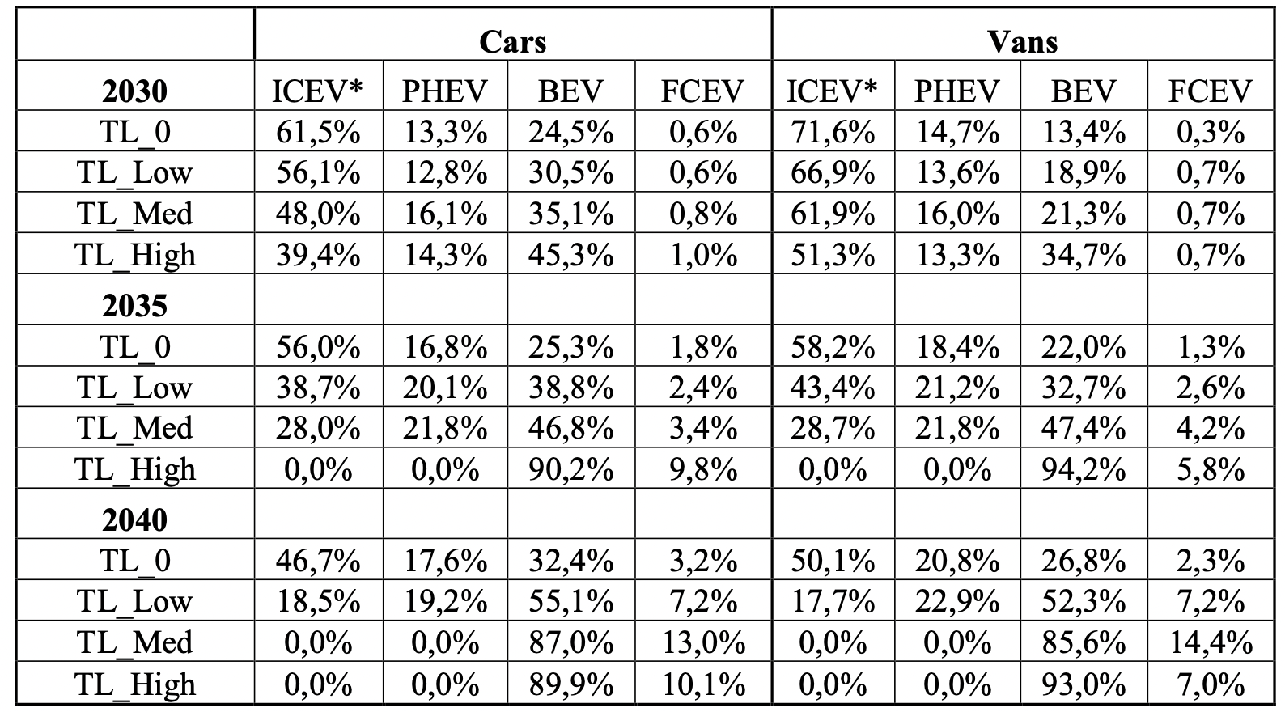
CO₂ Standards for Cars and Vans
Propossed targets: The strengthened CO₂ emission reduction requirements represent a technology neutral way to incentivise the uptake of Zero-emissions vehicles.
Source: European Commission Impact Assessment CO2 emissions vor cars and vans.
Source: European Commission Impact Assessment CO2 emissions for cars and vans.

Slide 8
Alternative Fuel Infrastructure Regulation
MS. Shall ensure that, a minimum number of publicly accesible hydrogen refuelling stations are put in placew by 31 December 2030.
MS shall ensure that hydrogen refuelling stations are deployed every 150 km along the TEN-T network.
Liquid hydrogen shall be made available at publicly accesible refuelling stations with a maximum distance of 450 km in-between them.
MS shall ensure at least one publicly accessible hydrogen refuelling station is deployed in each urban node.
The network of H2 infrastructure is concentrated in a reduced number of MS. 60% were located in Germany (76), followed by France (14). Just 10 MS had at least one filling station in operation at the end of 2019.
Source: European Commission Impact Assessment Alternative Fuel Infrastructure Regulation

Slide 9
Energy Taxation Directive
Rates have been stablished taking into acount the environmental performance of energy products and electricity:

Slide 10
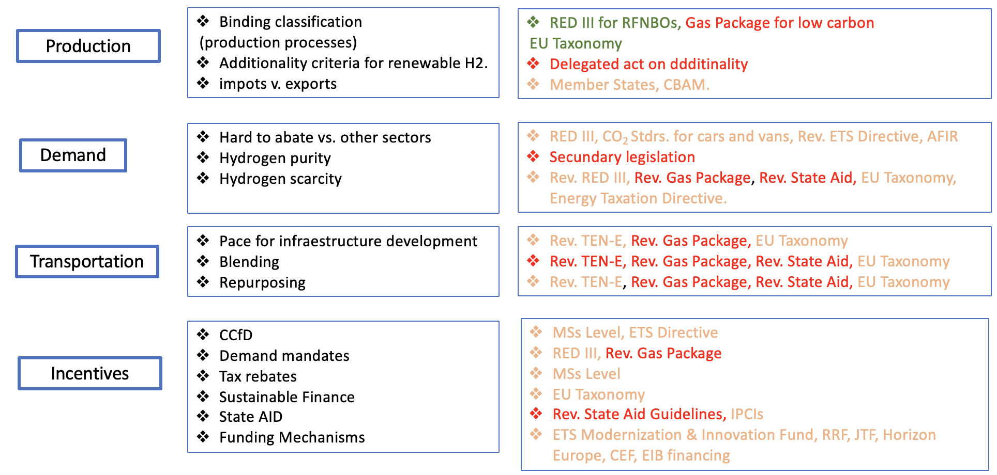
Mapping the key issues with the legislation

Slide 11
Production: Additionality principle for renewable
H2
A possible scenario under consideration by the European Commission, is to only allow hydrogen produced by new-build, additional renewables.
That would mean to produce hydrogen by electrolysers that are temprally and geograhically conected to a renewable plant, built with the purpose of hydrogen production.
Key questions: Is this principle going to cause scarcity? Is the additionality principle going to apply as it stands in the leaked draft? Is there going to be temporal exemptions to this principle?

