Slide 1
Andrei Marcu
Michael Mehling
Aaron Cosbey
Alexandra Maratou
ERCST Report on Treatment of Exports in the EU CBAM
March 18th, 2022
Notes:
It is a long slide show, so we’ll go quickly over background etc to have time to focus on the core issues!

Slide 2

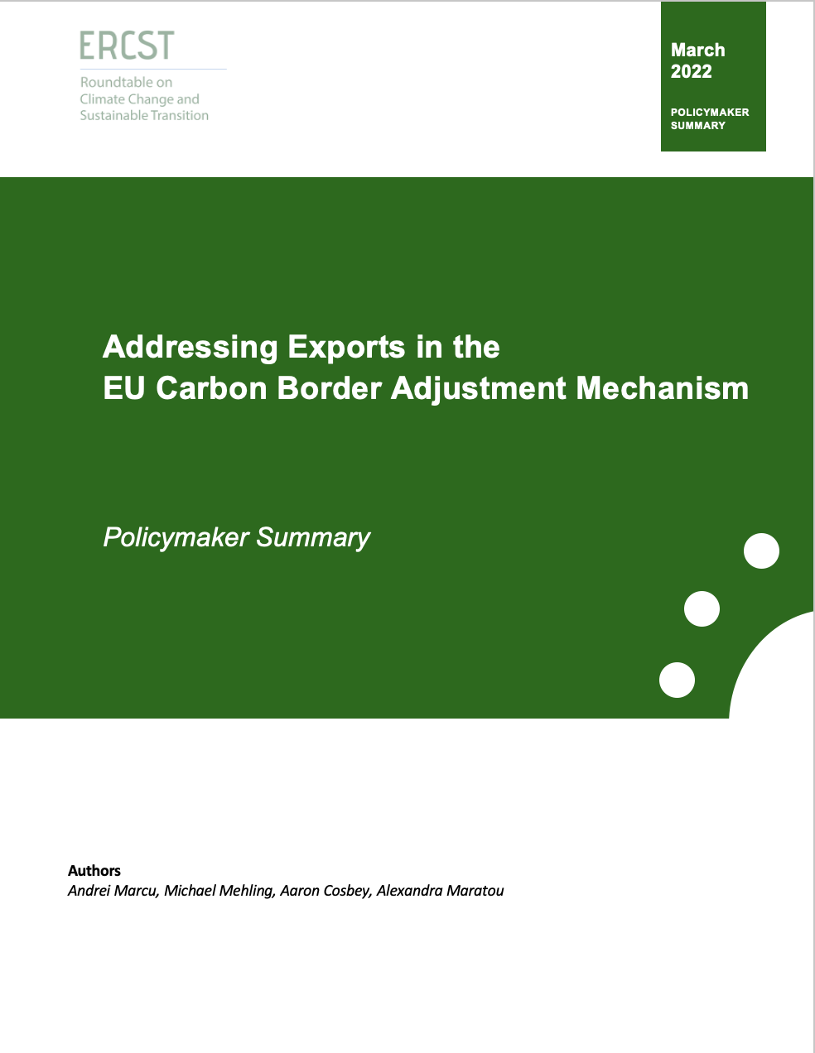
ERCST Report
Report of ~20 pages
Summary of ~2 pages

Slide 3
Table of Contents
Introduction
  Carbon Leakage Channels
  Do exports matter?
  Unintended Consequences
Legal Implications
Addressing Exports
  Strategic Choice
  Four Basic Options
The ERCST Proposal: Incentive-aligned Export Adjustment Certificates

Slide 4
Carbon Leakage Channels
3 channels for carbon leakage:
Production
Investment
Exports
EC proposal does not address the export channel.

Slide 5
Do exports matter?
To answer this question need information on:
Exports as a percentage of total EU production;
Absolute value of exports;
Impact of export competitiveness on the domestic EU market;
Destination for export of EU products covered by CBAM;
Competition in the respective markets;
Carbon intensity of EU products vs. foreign competition.
Sector | EU27 products covered by CBAM exported to non-EU27 countries (Euro) ^{(i)} | Sector production value (million Euro) ^{(ii)} | Share of EU27 exports of CBAM products, relative to production value (2018), in per cent
Fertilizers | 2.968.442.352 | 20.670 | 14%
Cement | 995.993.943 | 17.709 | 6%
Iron and steel | 45.306.429.730 | 210.321 | 22%
Aluminum | 8.968.505.098 | 50.625 | 18%
Table 1: Share of EU27 exports of CBAM products to sector-level production value, 2018

Slide 6
Do exports matter?
Yes, exports make up a significant percentage of EU production.
Yes, on average, the EU compares favorably to other jurisdictions on carbon intensity – with emissions intensity decreasing in the future.
Yes, failing to address exports results in a high likelihood of carbon leakage.
Yes, the politics of not including exports may impact overall political negotiations.

Slide 7
Unintended Consequences
Risk of reverse carbon leakage under some circumstances
Impact on carbon pricing signal
Probability of an event x consequences of said event
=> compelling case for including exports

Slide 8
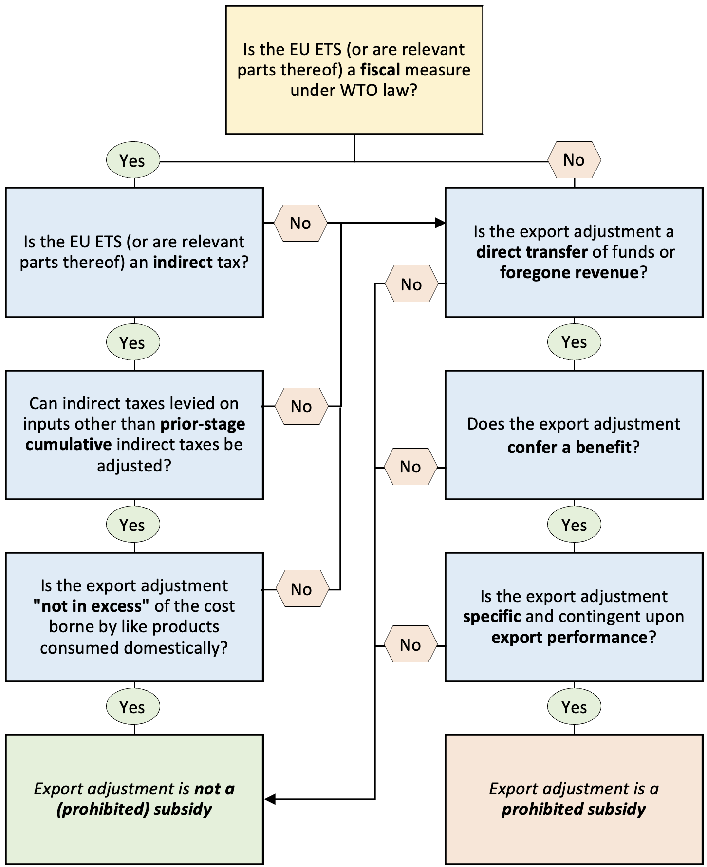
Legal Implications: Decision Tree

Slide 9
Strategic choice:
We have shown:
Exports matter environmentally – possibility for leakage.
Exports matter economically and politically – a red line issue.
There is no legal certainty about the status of proposed solutions (and there is also legal risk in the status quo).
Even if the EU is found in breach of WTO commitments, this does not necessarily mean repeal of CBAM.
Risk of CVDs is real, but circumscribed.
Strategic choice:
Find option that can be defended as legal, is effective, and risk challenge
Do not risk challenge, but rather risk the failure of CBAM as an instrument, or risk leakage and economic damage from export loss

Slide 10
Four basic options:
Exemption: domestic and foreign producers need to acquire CBAM certificates for all their production, based on carbon content. Exporters are exempt from this requirement.
Monetary rebate: Monetary rebate for exporters equivalent to the amount paid for EUAs for those goods under the ETS.
Non-monetary rebate: while free allowance shrinks for other EU production, it does not shrink for the exports in covered sectors – maintained at high levels.
Extend timeline for phase-out of free allocation: allow risk of leakage to diminish over time before implementing phase out of FA and phase-in of CBAM.

Slide 11
Incentive-aligned Export Adjustment Certificates
European producers of covered goods annually declare the embodied emissions and volumes of covered goods exported to third countries during the preceding calendar year
These producers are issued non-tradable export adjustment certificates:
  Based on the average emissions intensity of the 10% least carbon-intensive producers in the EU, or – for those exceeding the benchmark level – actual emissions
  Prorated to reflect any remaining free allocation obtained by producers
For the next compliance period, producers holding export adjustment certificates can exchange these for EUAs used towards compliance with their obligation to surrender EUAs for emissions from covered activities

Slide 12
Incentive-aligned Export Adjustment Certificates
European producers of covered goods annually declare the embodied emissions and volumes of covered goods exported to third countries during the preceding calendar year
These producers are issued non-tradable export adjustment certificates:
  Based on the average emissions intensity of the 10% least carbon-intensive producers in the EU, or – for those exceeding the benchmark level – actual emissions
  Prorated to reflect any remaining free allocation obtained by producers
For the next compliance period, producers holding export adjustment certificates can exchange these for EUAs used towards compliance with their obligation to surrender EUAs for emissions from covered activities
Retains an incentive to decarbonize with increasingly stringent benchmark
Lowers risk of overcompensating exporters

Slide 13
Incentive-aligned Export Adjustment Certificates
European producers of covered goods annually declare the embodied emissions and volumes of covered goods exported to third countries during the preceding calendar year
These producers are issued non-tradable export adjustment certificates:
  Based on the average emissions intensity of the 10% least carbon-intensive producers in the EU, or – for those exceeding the benchmark level – actual emissions
  Prorated to reflect any remaining free allocation obtained by producers
For the next compliance period, producers holding export adjustment certificates can exchange these for EUAs used towards compliance with their obligation to surrender EUAs for emissions from covered activities
EUAs are drawn from under the cap, i.e. no cap increase
Non-tradable certificates reduce the risk of being considered a direct transfer of funds, goods or services
Alternative: exemption from compliance obligation, with commensurate cancellation of EUAs

