Slide 1
Andrei Marcu Michael Mehling Aaron Cosbey Alexandra Maratou
Treatment of Indirect Emissions in CBAM
July 5, 2022 Virtual meeting
Notes:
It is a long slide show, so we’ll go quickly over background etc to have time to focus on the core issues!

Slide 2
Policy Context and Evolution of the Debate
2020-2021: Feasibility study, public consultations favour inclusion of indirect emissions, but acknowledge challenges
July 2021: EC proposal only covers direct emissions*
  Mirrors the current EU ETS design
  Indirect carbon cost addressed with indirect cost compensation
  EC proposes assessing future inclusion of indirect emissions
Dec. 2021-June 2022: EP ENVI Committee and Plenary endorse inclusion of indirect emissions from the outset
June 2022: Council follows EC approach in its “General Approach”
* and indirect (Scope 3) emissions embodied in covered raw material inputs

Slide 3
Should CBAM cover Indirect Emissions?
Objectives of CBAM : a) carbon leakage; b) charge same amount; c) eliminate muting of carbon prices; d) incentivise reading partners
Arguments for:
  Significant amount of electricity used by some CBAM covered sectors
  Significant cost pass-through by electricity from EU ETS
  Emissions associated with electricity higher than direct emissions (84% vs 16% for aluminium)
  Significance of indirect emissions will increase until decarbonization of electricity

Slide 4
Should CBAM cover Indirect Emissions?
Arguments against
  There is already a system to protect against carbon leakage – true for direct emissions as well. It is at MS discretion
  Impact of electricity market structure
  CBAM will not cover all indirect costs
  Will increase the risk of resource shuffling
  Legal risks to have importers buy allowance associated with indirect costs
  Complexity in operationalization and administration
  Cost of compensation will increase while carbon is on the margin diverting resources from decarbonization efforts

Slide 5
Assessing the Options
Baseline – CBAM with no indirect emissions covered. Retain compensation for indirect costs.
Basic inclusion: CBAM covers indirect emissions, requesting facility-level data. No compensation for indirect costs.
Basic inclusion, plus reform of marginal cost pricing of electricity
Basic inclusion, plus use of grid averages in country of export.
Basic inclusion, plus reform of compensation for indirect costs.

Slide 6
Option 1: Baseline
Commission proposal: CBAM does not cover indirect emissions. Retain compensation for indirect costs.
  Pro: Reduces risk of resource shuffling
  Pro: Less administratively complex
  Con: Existing compensation costly, will get more so as EUA prices increase and industry decarbonizes via electrification
  Con: Foreign firms have no incentives to reduce indirect emissions
  Con: Existing compensation shields EU firms, consumers, from full carbon cost

Slide 7
Option 2: Basic Inclusion
CBAM covers indirect emissions, requesting facility data. No compensation for indirect costs.
  Problem 1: Doesn’t cover indirect costs. Marginal pricing regime for electricity imposes carbon costs that importers would not have to pay
  Problem 2: Resource shuffling risks are acute when facility-level data is used for indirect emissions.

Slide 8
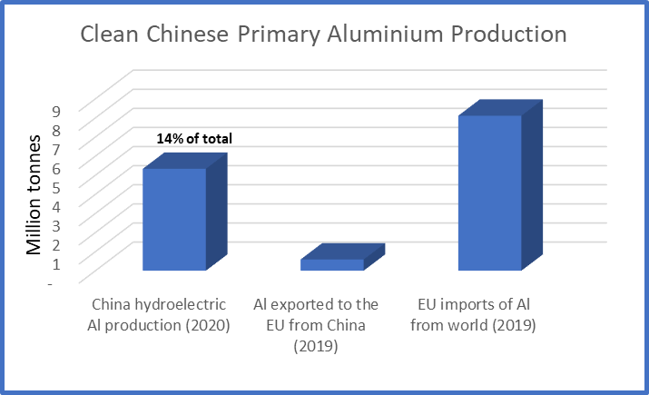
Potential for resource shuffling

Slide 9
Option 2: Basic Inclusion
CBAM covers indirect emissions, requesting facility data. No compensation for indirect costs.
  Problem 1: Doesn’t cover indirect costs. Marginal pricing regime for electricity imposes carbon costs that importers would not have to pay
  Problem 2: Resource shuffling risks are acute when facility-level data is used for indirect emissions.
  Problem 3: WTO law - discrimination. Puts a requirement on imported goods to pay for indirect emissions, but there’s no such requirement on domestic goods under the ETS.

Slide 10
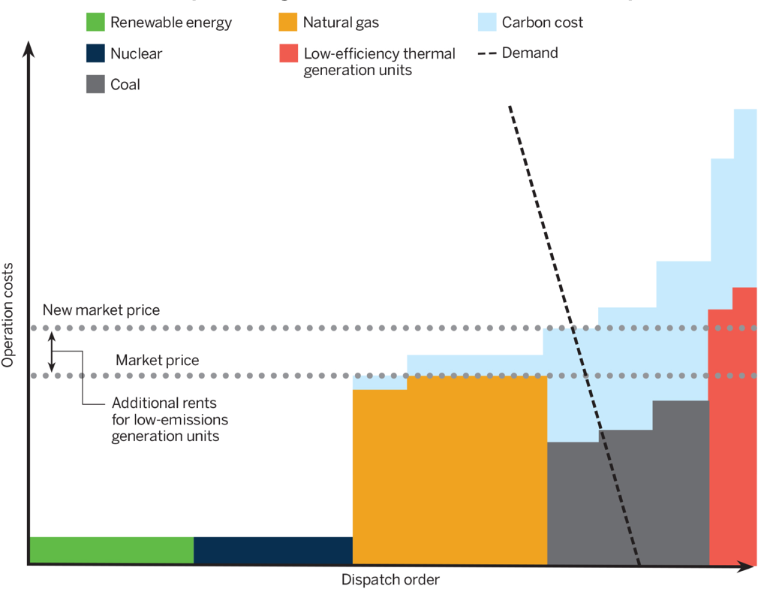
Option 3: Basic inclusion, plus reform of marginal cost pricing of electricity
In a wholesale electricity market design with marginal cost pricing and a “pay-as-clear” model, electricity users face an indirect cost in the presence of high-carbon marginal electricity generation that does not reflect the actual carbon intensity of consumed power.
Since pass-through rates differ regionally and temporally across Europe, these indirect costs would be difficult to quantify for adjustment under the CBAM.
An alternative solution to the problem of indirect cost could consist in reforming the current electricity market design so that pricing is based on average rather than marginal cost, but such a reform would be politically challenging and incur numerous trade-offs.
(Source: Dupuy et al., 2020)

Slide 11
Option 4: Basic inclusion, plus use of grid averages from country of export
CBAM covers indirect emissions, uses default grid averages to calculate embedded indirect emissions in imports. (Similar to Commission proposal for electricity imports).
  Greatly reduces risks of resource shuffling
  But might have to allow use of actual data for directly purchased electricity (via, for example, a power purchase agreement).
  WTO law is a concern: there is case law that suggests it is illegal to make importers use a default while domestic producers can use actual data. But the unique physical characteristics of electricity may justify aggregation and use of average values.

Slide 12
Option 5: Basic inclusion, plus reform of compensation for indirect costs
CBAM covers indirect emissions, regime for compensation of indirect costs is reformed.
  CBAM would make importers pay the cost of indirect emissions embedded in imported goods. Compensation mechanism would only pay EU firms for the rest of the indirect costs they bear – costs due to the marginal cost pricing regime for electricity. (No double protection.)
  Compensation mechanism applied consistently across all Member States.
    Con: Costly budget line for the Commission, if centralized
    Pro: Probably closer to accurate compensation for costs than existing formulas.

Slide 13
Recommendations
Indirect emissions should only be included in the CBAM as part of the policy option packages described below:
Covering indirect emissions through the CBAM is one option, but others should continue to be explored as the energy matrix changes in the EU and outside.
The CBAM’s coverage of indirect emissions should not start immediately on its entry into force. This allows more analysis of options, and allows the EU grid to further decarbonize, defusing challenges.
The tensions between the CBAM’s need to cover indirect costs and the EU’s electricity market design will need to be examined. But the electricity market has an evolution and momentum far beyond CBAM.

Slide 14
Recommendations (continued)
The basis for calculating indirect emissions in imported goods should be the average GHG intensity of all generating sources in the grid of origin. Exceptions only for direct purchase/production.
The regime of compensation for indirect costs should be reformed in two ways: consistent application across Member States, and only compensate for the effects of EU marginal cost pricing regime for electricity.
The EU should show political courage in the face of potential WTO challenges. A reasonable argument can be made for the legality of using grid average default values for emissions intensity of imports.

