Slide 1
Andrei Marcu
Olivier Imbault
Antonio A. Fernández
HYDROGEN and decarbonised gas market package
Brussels, January 28th, 2022
Notes:
It is a long slide show, so we’ll go quickly over background etc to have time to focus on the core issues!

Slide 2
Presentation Structure
Fit for 55 Package and H_{2,} completing the regulatory puzzle
Background to the discussions state of play of the hydrogen and gas market in Europe
What is in the revision of the package for hydrogen
Additionality principle for renewable hydrogen
Key questions for the discussions:
Is the regulatory framework for hydrogen complete? What are the missing pieces?
Is there a comprehensive definition for low carbon hydrogen that provides certainty and supports investments in this technological landscape?
What are those elements of the regulation that despite being included may act as a regulatory bottle neck?
Are we making an excessive use of regulation? Additionality?

Slide 3
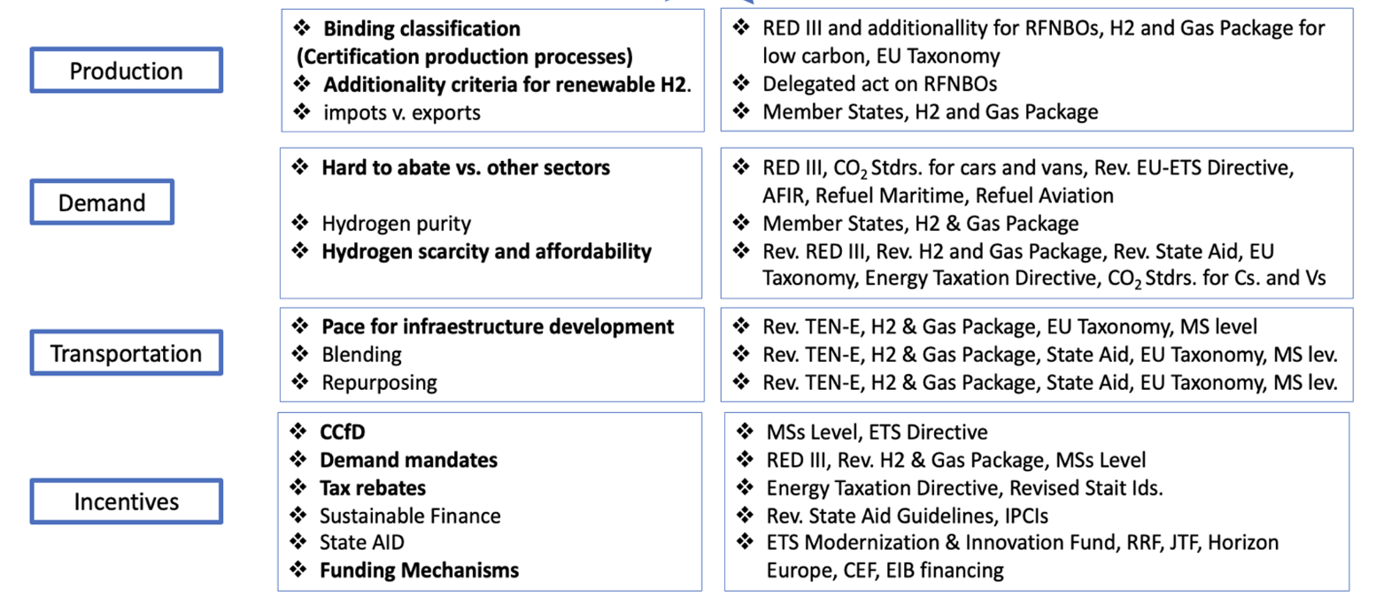
H2 regulatory puzzle

Slide 4
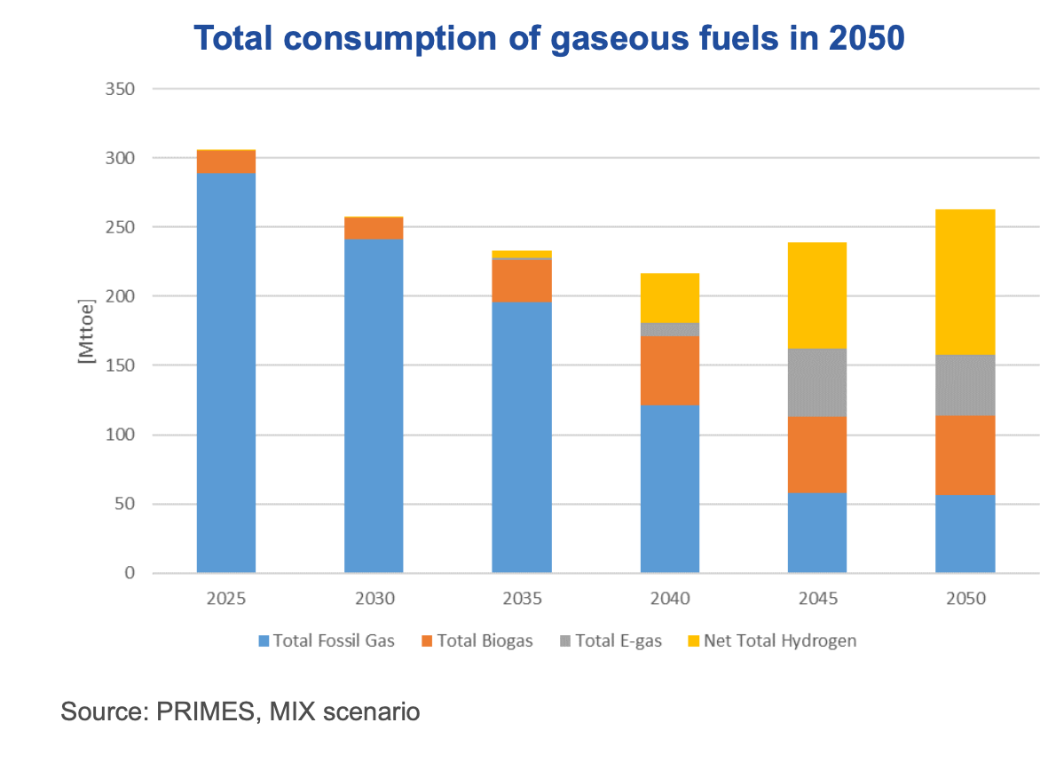
Renewable and low carbon gases in the exisiting gas infrastructure an markets
  Gaseous fuels will represent approximately 20% of final energy consumption in 2050.
  Decarbonizing current gas consumption will be key.
  EC focus on: biogas, biomethane, renewable and low-carbon hydrogen as well as synthetic methane.
  Problem: Decarbonised gases have significantly higher levelized costs of energy compared to natural gas.
Source: Impact assessment EU Commission
Notes:
Separate slide and add data for Bruegel

Slide 5
The package in a nutshell
The package in a nutshell
Definition for low-carbon hydrogen Non Renewable meets a GHG reduction threshold of [70%].”
EU-wide certification of low carbon gases for domestically produced and imported gases.
Grandfathering of licences when repurposing natural gas pipelines
EU-wide blending threshold of natural gas with hydrogen set at 5% as of 1 October 2025 (no obligation)
75% tariff discount for the injection of renewable and low- carbon gases to the grid and 100% at interconnectors.
Separate regulated asset base for gas and hydrogen. Cross-subsidization still possible
Negotiated TPA until 2030
Vertical and Horizontal unbundling with nuances
Notes:
Separate slide and add data for Bruegel

Slide 6
A definition for Low-Carbon Hydrogen in the package
  The EC hydrogen strategy acknowledges that while renewable hydrogen is the priority it will not be enough to achieve the strategy targets.
  Other forms of low-carbon hydrogen are needed at least in the transition.
  Colours will come with money or in other words, definitions are needed as the basis for the development of support mechanisms/incentives. They are also important from an State Aid perspective.
  Low Carbon hydrogen definition: low-carbon hydrogen means hydrogen the energy content of which is derived from non-renewable sources, which meets a greenhouse gas emission reduction threshold of [70%].”
    The exact methodology to assess emissions for low-carbon hydrogen will be developed through a Delegated Act adopted by the end of 2024.
Notes:
Separate slide and add data for Bruegel

Slide 7
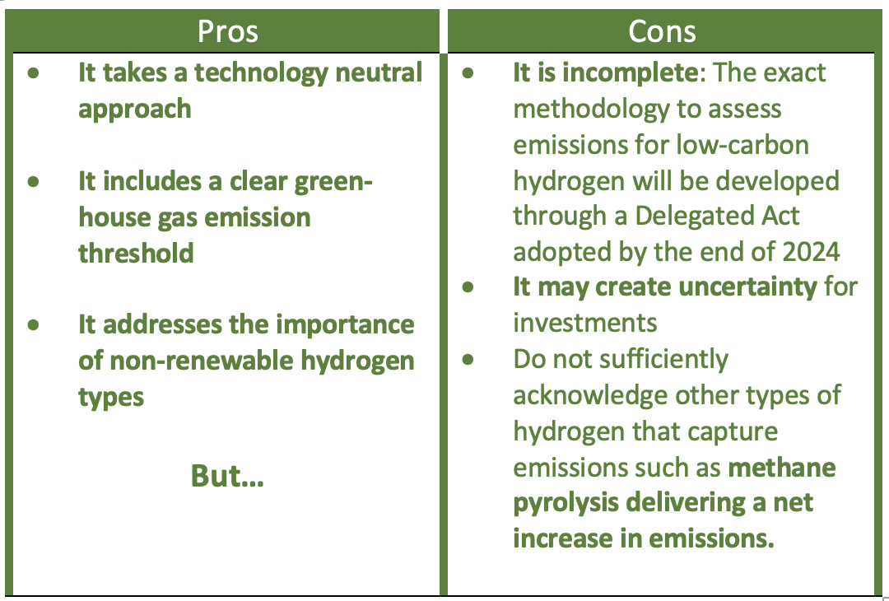
Pros and cons of the proposed low-carbon hydrogen definition
Notes:
Separate slide and add data for Bruegel

Slide 8
A Certification system for Low-Carbon hydrogen (Art. 8 Directive)
Renewable gases shall be certified in accordance with Article 29 and 30 of Directive (EU) 2018/2001 (RED).
Certification based on a life-cycle emissions approach.
The exact methodology to assess emissions for low-carbon hydrogen will be developed through a Delegated Act adopted by the end of 2024. (Art. 8.5. D)
Notes:
Separate slide and add data for Bruegel

Slide 9
Third party access and vertical unbundling
  The proposal provides that access to the hydrogen transmission networks should be subject to regulated Third Party Access and provide flexibility until 2030 (Art. 31 D).
  Vertical unbundling: VU addresses the question whether a hydrogen TSO should be allowed to own and operate a hydrogen production facility as well as the grid.
  Member States shall ensure that by 31 December 2024, hydrogen network operators are unbundled.
  There is however, some flexibility (Art. 62 D): if the hydrogen network belongs to a vertically integrated company, MS may implement an ownership unbundling model but also have the option to choose ISO or ITO.
Notes:
Separate slide and add data for Bruegel

Slide 10
Horizontal unbundling, RAB and cross-subsidisation
  If a network operator provides regulated services for gas, hydrogen and/or electricity, it will need to have separate regulated asset bases (RAB). (Art. 4 R)
  However, MS can allow financial transfers from one RAB to another after compliance with some pre-defined requirements. (Art. 4.2 R)
  Cross-subsidization: The proposal acknowledges that it could bring benefits in particular during earlier phases of network development and contribute to an investment climate supportive with the EU decarbonisation objectives. (Recital 47 R)
Notes:
Separate slide and add data for Bruegel

Slide 11
Blending and repurposing
  Blending: The proposed Regulation allows some flexibility to Member States as to whether they would allow blending of hydrogen into their natural gas system.
  Introduction of a 5% cap (no obligation) for hydrogen blends at interconnection points between Member States. Voluntary agreements for higher blends still possible.
  Repurposing: Gas network operators shall include information on infrastructure that can or will be decommissioned (and could potentially be repurposed for transport of hydrogen).
  Hydrogen network operators shall include information on the extent to which repurposed natural gas pipelines will be used for the transport of hydrogen.
Notes:
Separate slide and add data for Bruegel

Slide 12
Network planing and ENNOH
  The proposed Directive encourages a single network development plan at national level for all network operators aligned with: (Art. 51 D)
    NECPs (National Energy and Climate Plans) and
    Union TYNDP (Ten Year Network Development Plan)
  ENNOH: The proposed Regulation provides for the establishment of an European Network of Network Operators for Hydrogen (ENNOH) following the creation of a temporary platform led by the EC for support. (Art 40, 41 42 R)
Notes:
Separate slide and add data for Bruegel

Slide 13
Additionality principle for renewable hydrogen
In short, the additionality principle is a measure intended to ensure that renewable electricity is not re-directed from the power grid, to be used for the decarbonization of other sectors.
Delegated act on RFNBOs will shed more light on this issue and complete the definition for renewable hydrogen.
Latest leaked version of the delegated act provides wider leeway but probably not enough to avoid a bottle neck effect?
Notes:
Separate slide and add data for Bruegel

Slide 14
Key questions for the discussion
Is the regulatory framework for hydrogen complete? What are the missing pieces?
Is there a comprehensive definition for low carbon hydrogen that provides certainty and supports investments in this technological landscape?
What are those elements of the regulation that despite being included may act as a bottle neck?
Are we making an excessive use of regulation vis a vis market-based instruments such as carbon pricing?
More specifically, could the upcoming delegated act on Renewable Fuels of Non Biological Origin (RFNBO) act as a bottleneck/barrier for the deployment of a hydrogen economy?
Notes:
Separate slide and add data for Bruegel

