Slide 1
Wednesday May 20th, 2026
2026 State of the EU ETS Report
Public Launch Event
CEC, Avenue de la Joyeuse Entrée 17

Slide 2
2026 Table of Contents (ToC)
Key takeaways
Background
- CDR integration
- Linkage discussion
- COP outcome
- US
- Competitiveness
- Regulatory stability (CBAM fertilizers)
- ETS 2 postponement
- 2040 Target
- International credits
- IMO
- Plastics
- Maritime in ETS
2. An EU ETS ‘fit for purpose’
3. Regulatory developments
3.1. Secondary legislation
3.2. Other policies impacting the EU ETS
- CISAF
- 2040 Target
- CBAM
- Omnibus (CSRD, CSDDD)
- ETS State Aid Guidelines for indirect cost compensation
- Member State Policies
3.3. International carbon price developments
3.3.1. Impacts of the UK ETS on the EU ETS
  UK and EU ETS allowance price evolution
  UK CBAM
  Possibility of linking the UK ETS with the EU ETS
3.3.2. Linking with other markets
  Linking with other emission trading systems
  Linking with International Credits
  Impact of EU ETS linkage with the Swiss ETS
3.3.3. Article 6 of the Paris Agreement
Environmental delivery
4.1. Delivery against Phase 4 target
4.1.1. 2025 data (year-on-year impacts)
4.1.2. Impact on Phase 4
4.2. Delivery against EU long-term domestic environmental commitments
4.3. Evolution of Power Sector Emissions
5. Competitiveness and socio- economic delivery
5.1. Economic impacts
5.1.1. Balance of allowances
5.1.2. Emission intensities in selected industrial sectors
5.1.3. Level of carbon price of EU ETS compared to other jurisdictions
5.1.4. ETS compliance costs, trade & production volumes )
5.1.5. Carbon compliance cost premium in unit production costs

Slide 3
2026 Table of Contents (ToC)
5.2. Auction revenues income
5.3. Measures to address competitiveness
5.3.1. Member States auction revenues and use
5.3.2. Modernisation Fund
5.3.3. Innovation Fund
5.3.4. Indirect cost compensation
6. Market functioning
6.1. Market functioning trackers
6.1.1. Volume
6.1.2. Open interest
6.1.3. Auction participation
6.1.4. Auction coverage
6.1.5. Auction-spot differential
6.1.6. Cost of carry
6.1.7. Ask-bid spread
6.1.8. Volatility
6.1.9 Hedged holdings
6.2. Supply-demand balance and evolution of TNAC
6.3. Price forecasts
6.4. Market participation
6.5 REPowerEU
7. Looking forward

Slide 4
Key Takeaways
Overview
The 2026 State of the EU ETS Report assesses whether the EU ETS remains “fit for purpose” in delivering emissions reductions, supporting industrial competitiveness, and maintaining effective market functioning.
The report concludes that the EU ETS continues to meet its core environmental objectives, but it is facing difficulties due to geopolitical uncertainty, industrial competitiveness concerns, evolving climate policy, and increasing pressure to support long-term industrial transformation.
Key Findings
1. Environmental Delivery Remains Strong
The EU ETS continues to reduce emissions effectively, with verified emissions remaining below the cap and more than half of the system’s 2030 target already achieved.
The power sector remains the main driver of emissions reductions, accounting for roughly 75% of total stationary installation reductions since 2008.
Notes:
ERCST

Slide 5
Key Takeaways
Key Findings
2. Competitiveness Has Become Central
The power sector now faces very high exposure to auctioning, with less than 10% of emissions effectively covered by free allocation.
Energy-intensive industries have shifted from historical allowance surpluses to structural deficits.
Average annual compliance costs in Phase IV exceeded €35 billion for the power sector and €7.6 billion for energy-intensive industries.
CBAM is designed to replace free allocation and shield EU industry from unfair competition, but the phase-out alone cannot build a business case for industrial decarbonisation; public support, cheaper technology, or further policy measures will also be needed.
3. Carbon Prices Remain Globally High
The EU ETS continues to operate at substantially higher carbon prices than other global carbon markets (USD 85/tCO₂e).
Comparisons should focus not only on visible carbon prices but also on the effective carbon costs borne by industry after free allocation and compensation mechanisms.
Notes:
ERCST

Slide 6
Key Takeaways
Key Findings
4. Market Functioning Remains Robust
The EU ETS market continues to function effectively, and the MSR continues to play a central role in tightening supply and supporting market stability. International developments will increasingly shape future market evolution.
5. Complex and Intertwined Policy Architecture
There is an unsynchronized timing of the legislative agenda coming up, as 2026 will see a number of important legislation under review, such as CBAM Directive, or Energy Union Governance.
Strategic Conclusion
The EU ETS remains one of the world’s most effective carbon markets and continues to deliver on its environmental mandate. However, the system is transitioning from being primarily a power-sector decarbonization tool into a central pillar of Europe’s industrial transformation strategy.
Future reforms will need to balance three objectives simultaneously:
Maintaining environmental integrity and emissions reductions;
Preserving industrial competitiveness and limiting carbon leakage;
Providing long-term regulatory predictability to support investment in low-carbon technologies.
Notes:
ERCST

Slide 7
1. Background
State of the EU ETS Report is meant to be a “snapshot”
Provides policymakers and stakeholders with an overview of how the EU ETS is doing by each year, based on previous year data. 2026 State of the EU ETS Report is based on 2025 data.
2025 Context:
  Change in international context (i.e. USA outside of the Paris Agreement and not participating in COP30)
  COP30 outcome
  IMO’s delay on the Net-Zero Framework to 2026
  Discussion on the integration of CDR into the ETS
  Linkage talks with the UK ETS formally started
  Commission’s shift from Green Agenda to Competitiveness Agenda
Notes:
ERCST

Slide 8
1. Background
2025 Context, continued:
  Regulatory framework is not stable, see the possible exemption of fertilizers from CBAM
  Agreement on 90% 2040 Climate Target, with 5% of international credits from 2036 and additional flexibilities for sectors
  Postponement of ETS2 to 2028 as part of the deal to pass the 2040 Climate Target
  First maritime ETS allowances surrendered
  Global Plastics Treaty
  New approach to address data limitations, that distinguishes 2026 report from past editions:
  Consortium has undertaken a categorization of all EU ETS installations to specific sectors.
  ~17,000 installations categorized based on: i) EUTL main activity codes, ii) industry data and iii) sector-specific information from EC 2015 and 2020 carbon leakage lists.
  This has enabled the sectoral disaggregation of "combustion" installations, yielding a more granular representation of both energy-intensive industries and the power sector.
Notes:
ERCST

Slide 9
2. An EU ETS “fit for purpose”
What do we expect the EU ETS to deliver?
3 key deliveries:
Environmental delivery. Does the EU ETS deliver against absolute environmental targets? (Chapter 4)
Competitiveness and socio-economic delivery. (Chapter 5)
  Does compliance with the EU ETS deliver macroeconomic efficiency and cost-effectiveness?
  Does it provide effective and proportional protection against the risk of carbon leakage?
  Is it a driver for change without destroying EU industrial competitiveness?
  Is the ETS allowed to provide a price signal?
Market functioning (Chapter 6). Is it worth having a market only if it functions well and leads to good price discovery?
Notes:
ERCST

Slide 10
3. Regulatory Developments
International carbon price developments
Article 6 of the Paris Agreement
Article 6 has now largely completed its rule book, and while there have been some transactions, the global uptake has been largely slow.
In the EU, international markets still elicit a bad reaction. Politically, Member States’ positioning on international credits is not as clear, and whether international credits in the EU are an option is still too early to tell, in the face of opposition from some of the EU institutions.
International credits could impact the EU ETS should they be allowed as an instrument of compliance, or by easing the burden if other sectors could do more on the back of Article 6 credits. It is likely that supply of international credits may be a bigger problem than anticipated, if CORSIA is an example of the supply-demand balance.

Slide 11
3. Regulatory developments
International carbon price developments
EU and UK ETS
Developments in linking the EU and UK ETS
In May 2025, in a Common Understanding the EU and UK agreed to work towards linking their ETS.
In July 2025, the European Commission published a draft Council Recommendation, inviting the Council to authorise formal negotiations with the United Kingdom to link the EU ETS with the UK ETS. The Council Recommendation included e.g.:
  EU and UK CBAM should not be applied to each others imported goods
  Sector scope should include, among others: electricity generation, industrial heat generation (excluding the individual heating of houses), industry, domestic and international maritime transport and domestic and international aviation; procedure to further expand the list of sectors to be covered
  UK should dynamically align to the relevant acquis, notably Directive 2003/87/EC and derived legislation, incl. all the provisions of the EU financial regulatory and supervisory framework applicable to trade in EUAs and derivatives thereof
  Defined UK cap and reduction pathway should be at least as ambitious as that of the EU
On 12 November, the European Council approved the linking mandate.
A request to temporarily exempt UK goods from the EU CBAM until both systems are linked has been rejected by the EU.
UKA price volatility (and potentially to a lesser extent EUA price volatility) may increase once negotiations between the UK and the European Commission pick up.
Developments in the UK ETS/UK CBAM
In November 2025, UK authorities decided to retain the EU ETS Phase IV carbon leakage list for the second UK ETS allocation period (2027-2030), following stakeholder consultations, reviews of data robustness and alignment with decarbonisation objectives.
Authorities further decided to maintain the existing trajectory for phasing out free allocation of allowances to sectors not deemed at risk of carbon leakage. Under this approach, installations operating in sectors not on the carbon leakage list will continue to receive a reduced level of free allocation until 2030, at which point it will be fully phased out.
Source: EU-UK cooperation Common Understanding (2025); Recommendation for a Council Decision (2025); UK ETS Free Allocation Review Main Authority Response (2025)
EUA and UKA price evolution
OLD
EU and UK allowance prices have been following an increasing trend in 2025.
EUA prices remain above UKA prices, but price difference has been decreasing.
UKA price volatility (and potentially to a lesser extent EUA price volatility) may increase once negotiations between the UK and the European Commission pick up.
Notes:
COMPASS
https://www.spglobal.com/energy/en/news-research/latest-news/energy-transition/121725-no-cbam-exemption-for-uk-before-definitive-phase-begins-Hoekstra
https://www.reuters.com/sustainability/cop/eu-rules-out-uk-exemption-carbon-border-levy-until-markets-link-2025-12-17/

Slide 12
3. Regulatory developments
International carbon price developments
EU and Swiss ETS
The EU ETS and the Swiss ETS have been linked since 2020, meaning that allowances issued under one system can be surrendered for emissions generated in either of the two systems.
Since 2024, the linking arrangements allows for daily transfers between the two systems, compared to only twice a week in 2023. This has led to a significantly increase in daily transactions from about 156 in 2023 to about 800 allowances per day in 2024, indicating an increased liquidity in the linked market.
In total, EU ETS-regulated entities (installations and aircraft operators) used c. 1.6 million allowances issued under the Swiss ETS for compliance in 2024. This marks a significant increase compared to prior years (c. 440 000 allowances more compared to 2023, c. 605 000 allowances more compared to 2022). This development underlines the flexibility provided by linked systems as well as consistently growing acceptance of the link.
Swiss ETS allowances made up only 0.14% of allowances surrendered in the EU ETS in 2024. In the Swiss ETS, they accounted for 31.5%.
Aviation operators in the Swiss ETS significantly increased their use of EU ETS allowances in 2024 (79.6%) compared to 2023 (51.08%). On the other hand, installations used a lower share of the EU ETS allowances for compliance in 2024 (5.19%) compared to 2023 (11.6%). In both years, installations in the Swiss ETS did not use the EU ETS aviation allowances for compliance.
Source: EC report on the functioning of the EU ETS in 2024
Note: The Swiss ETS allowances are not considered in the calculation of the TNAC (total number of allowances in circulation) of the EU ETS.
Allowances used for 2024 compliance (% of total surrendered units)
 |  | EU ETS allowances |  | Swiss ETS allowances
 |  | General allowances | Aviation allowances | General allowances | Aviation allowances
Units used for compliance with the EU ETS | By stationary installations | 99.59% | 0.31% | 0.07% | 0.03%
 | By aviation operators | 70.24% | 28.92% | 0.08% | 0.76%
Units used for compliance with the Swiss ETS | By stationary installations | 5.19% | - | 93.35% | 1.46%
 | By aviation operators | 65.30% | 14.24% | 0.17% | 20.22%
Allowances used for 2024 compliance (% of total surrendered units)
 |  | EU ETS allowances |  | Swiss ETS allowances
 |  | General allowances | Aviation allowances | General allowances | Aviation allowances
Units used for compliance with the EU ETS | By stationary installations | 99.58% | 0.37% | 0.04% | 0.01%
 | By aviation operators | 64.14% | 34.72% | 0.10% | 1.04%
Units used for compliance with the Swiss ETS | By stationary installations | 11.6% | - | 87.57% | 0.83%
 | By aviation operators | 7.26% | 43.82% | 1.09% | 47.83%
Notes:
COMPASS

Slide 13
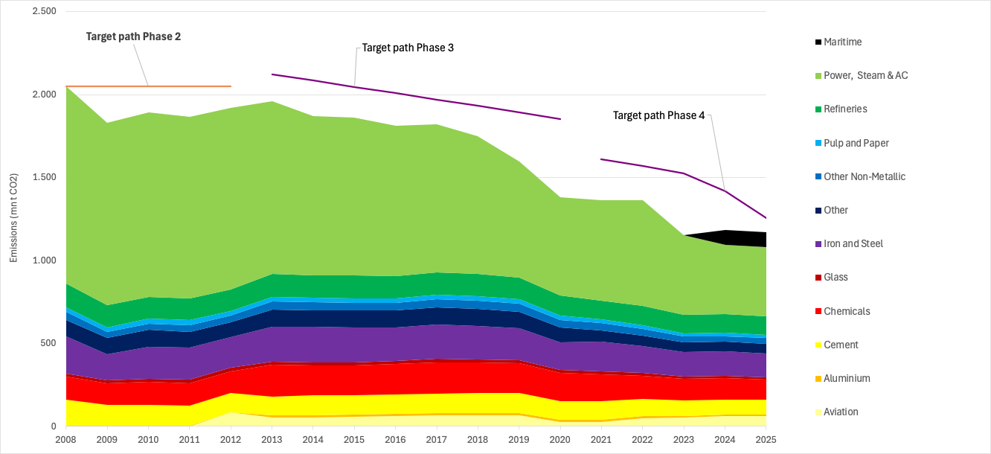
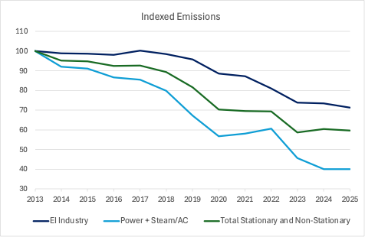
4. Environmental delivery
Delivery against Phase 4 target
KPI 1D: Verified emissions and sector composition
KPI 2: Indexed emissions and sector composition
Source: ERCST, based on EUTL data
.
Notes:
*EI industry includes: Aluminium, Cement, Chemicals, Fertilizers, Glass, Steel, Other non-metallic, Pulp and Paper, Refineries
** EUTL verified emissions for 2025 adjusted to account for incomplete reporting using ‘carrying forward’ techniques.

Slide 14
4. Environmental delivery
Delivery against Phase 4 target
Year-on-year change in emissions
Table: Year-on-year change in emissions (%), 2023-2024 and 2024-2025
Sector | 2023-2024 Y-o-Y % change in emissions | 2024-2025 Y-o-Y % change in emissions
Maritime | - | -2.0%
Aviation | +15% | +0.5%
Power, Steam & AC | -12.1% | 0.0%
EI industry | -0.7% | -2.9%
Total stationary | -5.8% | -1.3%
Total EU ETS | +3.1% | -1.3%
Source: ERCST, based on EUTL data
Notes:
* EUTL verified emissions for 2025 adjusted to account for incomplete reporting using ‘carrying forward’ techniques.
** EI industry includes: Aluminium, Cement, Chemicals, Fertilizers, Glass, Steel, Other non-metallic, Pulp and Paper, Refineries
.

Slide 15
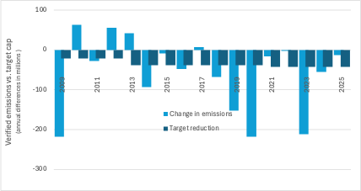
4. Environmental delivery
Delivery against Phase 4 target
KPI 3: LRF vs. actual change in emissions
Since 2008, except for a few years, emissions reductions have exceeded the intended target reductions defined by Linear Reduction Factors (LRF).
The emissions reductions reflect economic slowdowns, improvements in the emissions intensities of products and processes, and, recently, the expansion of renewable energies.
Source: ERCST, based on EUTL data
Notes:
* EUTL verified emissions for 2025 adjusted to account for incomplete reporting using ‘carrying forward’ techniques.
The change in emissions reflects the difference between current and the previous year's emissions.
The change in target reductions shows this difference for the target path, i.e., the Linear Reduction Factor (LRF).
Notes:
Taking into account perimtere of eu ets. For 2025 LRF same as in previous years, emissions to be updated once 2025 emissions data is available. For previous years need table with data.

Slide 16
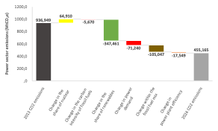
4. Environmental delivery
Evolution of power sector emissions
Figure: Drivers of variation in EU power sector GHG emissions (2013-2024)
Source: Compass Lexecon analysis based on Eurostat and IPCC data.

Slide 17
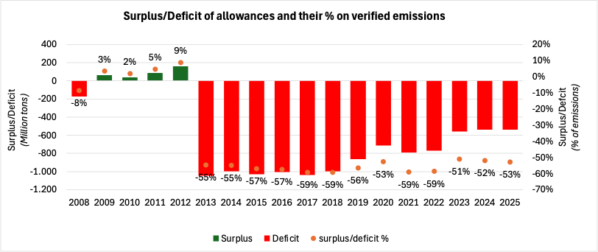
5. Competitiveness and Socio-economic
delivery
Economic Impacts
KPI 5: Net supply volume of free allowances (free allocation – verified emissions) - all stationary sectors
Absolute volume (primary axis) and % of verified emissions (secondary axis)
Source: ERCST. Based on EUTL data.
Notes:
* EUTL verified emissions for 2025 adjusted to account for incomplete reporting using ‘carrying forward’ techniques.
Notes:
Jean Yves & Stefan

Slide 18
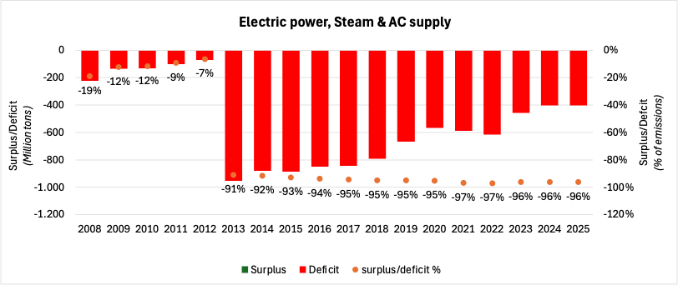
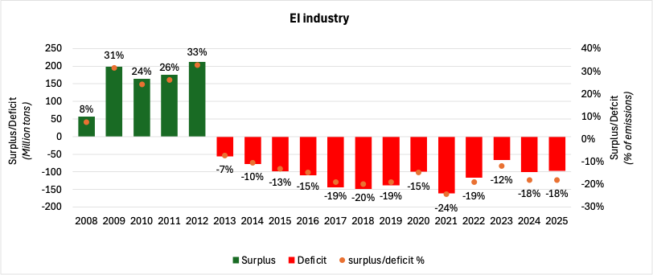
5. Competitiveness and Socio-economic
delivery
Economic Impacts
Net supply volume of free allowances (free allocation – verified emissions)
KPI 5A Net supply volume of free allowances - Electric power, Steam & AC supply
KPI 5B Net supply volume of free allowances - EI industry*
Source: ERCST. Based on EUTL data.
Notes:
*EI industry includes: Aluminium, Cement, Chemicals, Fertilizers, Glass, Steel, Other non-metallic, Pulp and Paper, Refineries
** EUTL verified emissions for 2025 adjusted to account for incomplete reporting using ‘carrying forward’ techniques.
Notes:
Jean Yves & Stefan

Slide 19
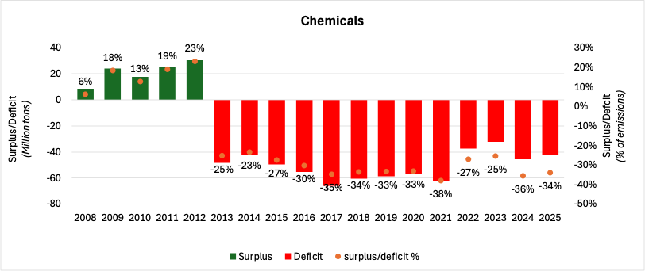
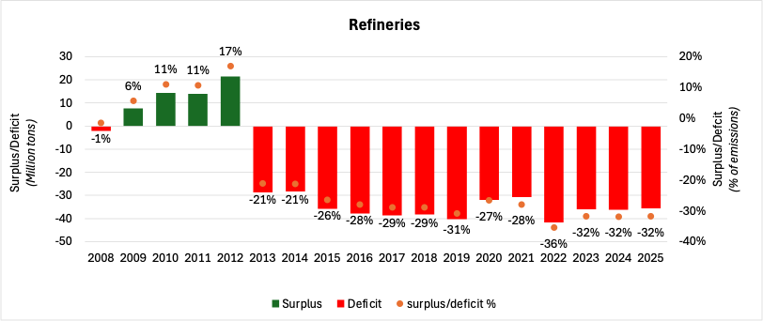
5. Competitiveness and Socio-economic
delivery
Economic Impacts
Net supply volume of free allowances (free allocation – verified emissions) for selected sectors
KPI 5E Net supply volume of free allowances (Chemicals)
KPI 5F Net supply volume of free allowances (Refineries)
Source: ERCST. Based on EUTL data.
Notes:
* EUTL verified emissions for 2025 adjusted to account for incomplete reporting using ‘carrying forward’ techniques.
Notes:
Jean Yves & Stefan

Slide 20
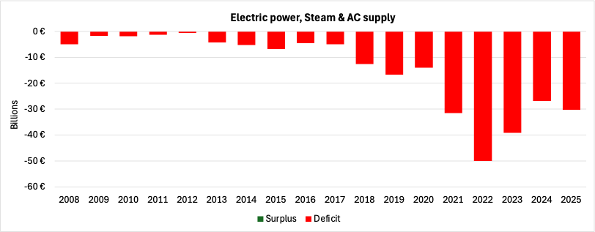
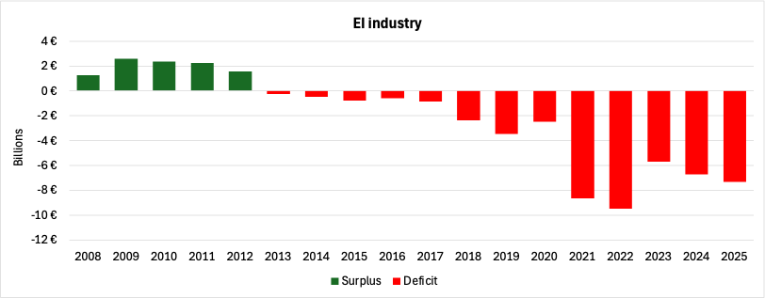
5. Competitiveness and Socio-economic
delivery
Economic Impacts
KPI 6 Net supply value of free allowances
KPI 6A Net supply value of free allowances (Electric power, steam & AC supply )
KPI 6B Net supply value of free allowances (EI industry*)
Source: ERCST. Based on EUTL verified emissions and free allocation data, and annual average EU carbon price data by BloombergNEF (2015-2025) and SENDECO₂ (2008-2014).
Notes:
*EI industry includes: Aluminium, Cement, Chemicals, Fertilizers, Glass, Steel, Other non-metallic, Pulp and Paper, Refineries
** EUTL verified emissions for 2025 adjusted to account for incomplete reporting using ‘carrying forward’ techniques.
Notes:
Jean Yves & Stefan

Slide 21
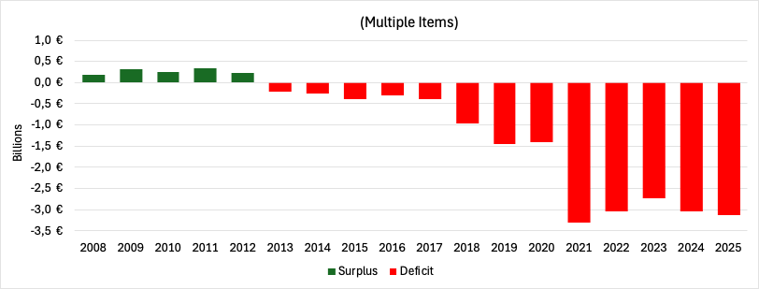
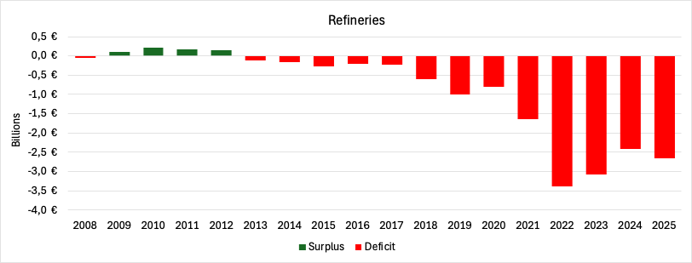
5. Competitiveness and Socio-economic
delivery
Economic Impacts
KPI 6 Net supply value of free allowances (selected sectors)
KPI 6E Net supply value of free allowances (Chemicals)
KPI 6F Net supply value of free allowances (Refineries)
Source: ERCST. Based on EUTL verified emissions and free allocation data, and annual average EU carbon price data by BloombergNEF (2015-2025) and SENDECO₂ (2008-2014).
Notes:
* EUTL verified emissions for 2025 adjusted to account for incomplete reporting using ‘carrying forward’ techniques.
Notes:
Jean Yves & Stefan

Slide 22
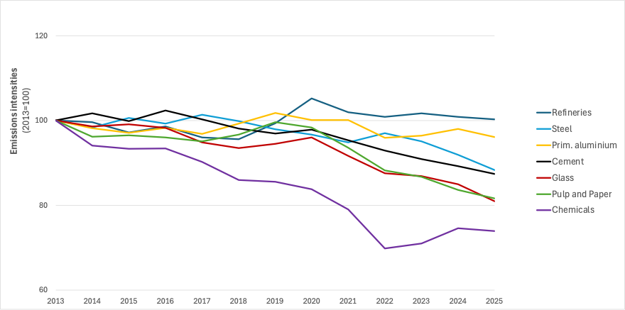
5. Competitiveness and Socio-economic
delivery
Economic Impacts
Emissions intensity in selected industrial sectors
KPI 8A Emissions intensities for selected activities
Source: ERCST. Based on EUTL data.
Notes:
* EUTL verified emissions for 2025 adjusted to account for incomplete reporting using ‘carrying forward’ techniques.
Notes:
ERCST

Slide 23
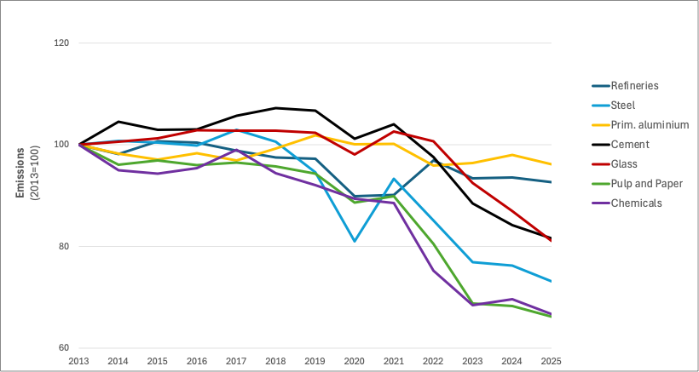
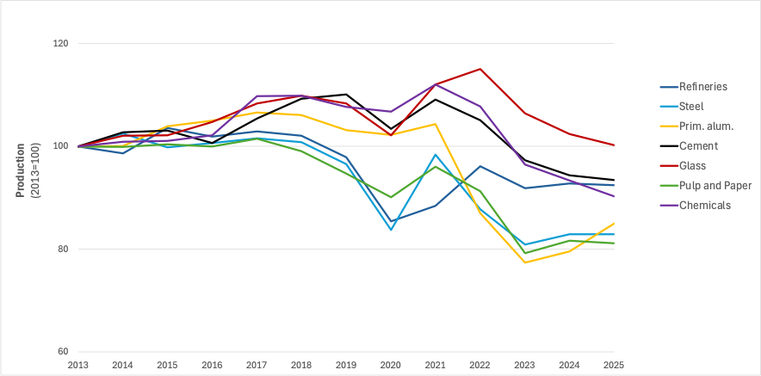
5. Competitiveness and Socio-economic
delivery
Economic Impacts
Sectoral emissions and production
KPI 8B Emissions index
KPI 8C Sectoral production index
Source: ERCST. Based on EUTL data.
Notes:
* EUTL verified emissions for 2025 adjusted to account for incomplete reporting using ‘carrying forward’ techniques.
Notes:
ERCST

Slide 24
5. Competitiveness and Socio-economic
delivery
Economic Impacts
Visible carbon price in the EU and other jurisdictions
Evolution of prices of selected ETSs – 2013-2025 (USD/t CO2-eq)
  The combination of a progressively more stringent cap, high EU emission reduction targets, and mature market structure makes the EU ETS the highest-priced carbon market globally.
  In 2025, the EU ETS price is about 1.3 times that of the UK ETS, and 2.5 times the price of allowances in the New Zealand ETS and almost 3 times that of allowance prices in the Californian CaT.
  Allowance prices in Chinese, Beijing and Korean systems are significantly lower compared to the other systems, with averages prices in 2025 ranging between 6.6 and 14.5 USD/tCO2eq.
  In 2025, China expanded the sector scope of its ETS to newly include steel, cement and aluminium smelter sectors. The scope expansion is expected to cover more than 3,700 entities, representing c. 5% of global emissions.
 | Start year | Sector coverage | 2025 Average Price (USD/t CO2-eq)
EU ETS | 2005 | Industry, Power, Aviation | 84.7
New Zealand ETS | 2008 | Industry, Power, Waste, Transport, Buildings | 33.8
California CaT | 2012 | Industry, Power, Transport, Buildings | 29.5
Beijing pilot ETS | 2013 | Industry, Power, Transport, Buildings | 14.5
China ETS | 2021 | Industry, Power | 10
Korea ETS | 2015 | Industry, Power, Waste, Transport, Buildings | 6.6
UK ETS | 2021 | Industry, Power, Aviation | 66.5
  Sources: Compass Lexecon analysis based on ICAP, price data from the International Carbon Action Partnership (ICAP) Allowance Price Explorer for California, New Zealand, Korea, Beijing and China, price data from Bloomberg for the UK and EU.
  Notes: New Zealand ETS is the combination of its pre-2024 and post-2024 ETS. Illustration shows prices on secondary markets for all ETSs. 2025 data for the California and New Zealand systems not complete yet.
Notes:
COMPASS

Slide 25
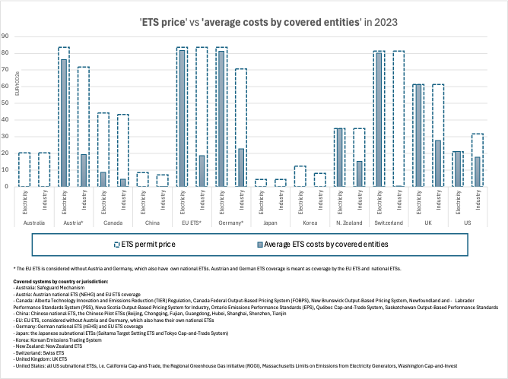
5. Competitiveness and Socio-economic
delivery
Economic Impacts
‘ETS price’ vs ‘costs’ in the EU and other jurisdictions
‘ETS price’ is the respective system’s visible permit price.
‘Average ETS costs by covered entities’, provides an estimate of the costs incurred on average by covered entities in the industry and electricity sectors, by adjusting for the free allocation of allowances .
Source: ERCST, based on data by OECD, Table 2.A.1. in OECD (2025), Effective Carbon Rates 2025: Recent Trends in Taxes on Energy Use and Carbon Pricing,

Slide 26
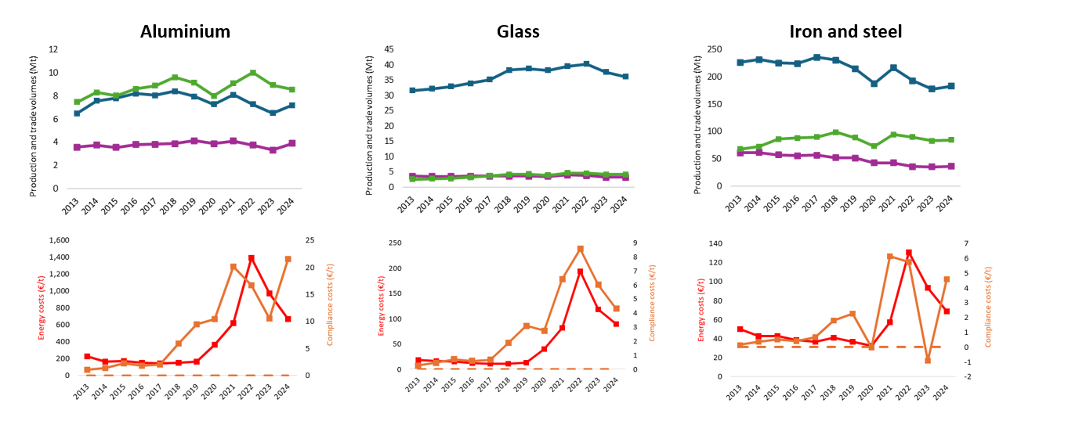
5. Competitiveness and Socio-economic
delivery
Economic Impacts
KPI 9 ETS compliance costs, trade & production volumes
(1) Industrial production, trade, unitary energy and direct ETS costs 2013-2024
Source: Compass Lexecon analysis based on data from Eurostat, EUTL, and industry associations

Slide 27
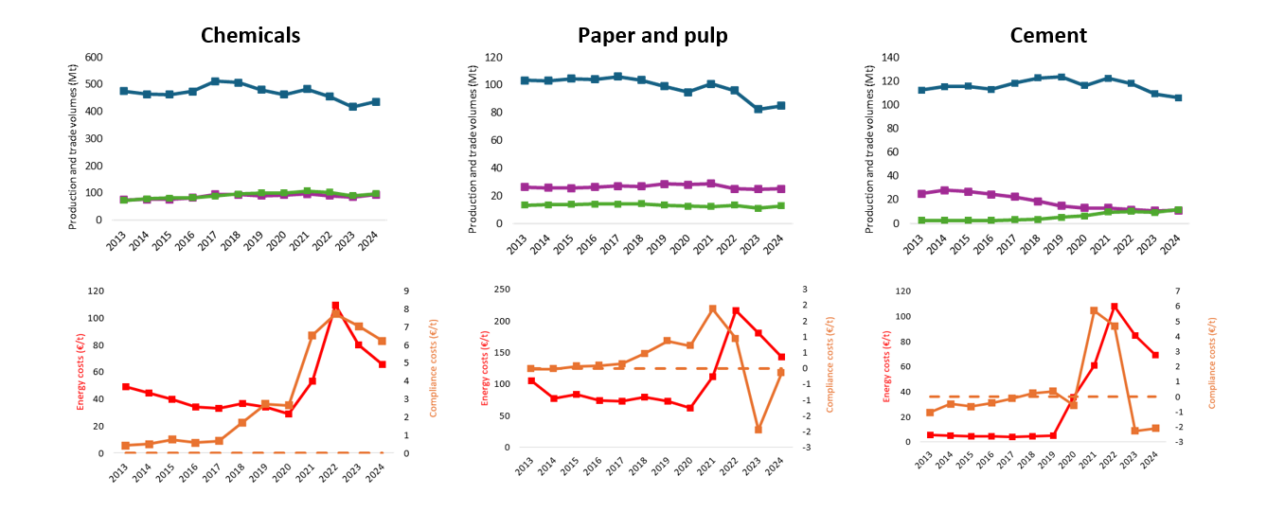
5. Competitiveness and Socio-economic
delivery
Economic Impacts
KPI 9 ETS compliance costs, trade & production volumes
(2) Industrial production, trade, unitary energy and direct ETS costs 2013-2024
Source: Compass Lexecon analysis based on data from Eurostat, EUTL, and industry associations

Slide 28
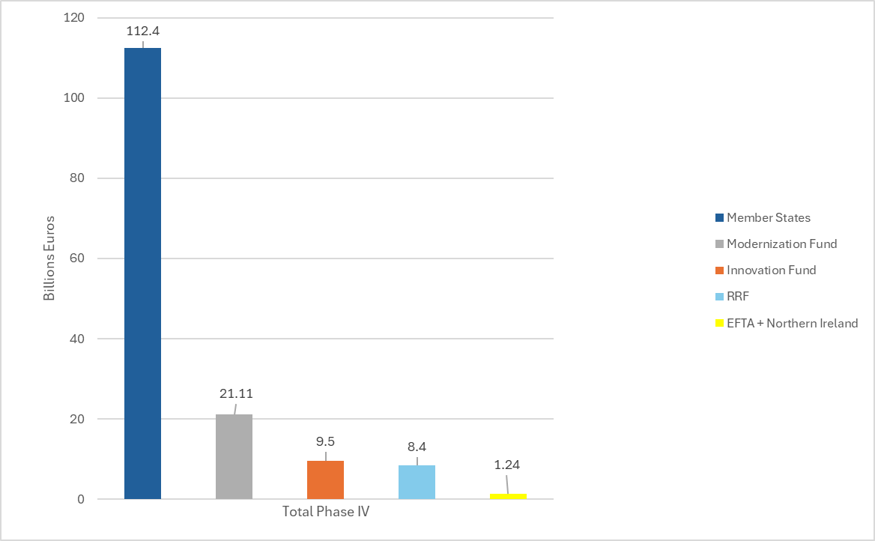
5. Competitiveness and Socio-economic
delivery
Economic Impacts
Auction revenue income
In Phase IV, the total EU ETS revenue income amounted to EUR 152.65 billion.
Of this, EUR 112.4 billion went directly to the EU Member States national budgets.
EUR 21.11 billion the ETS Modernisation Fund,
EUR 9.5 billion supplied the ETS Innovation Fund.
EUR 8.4 billion supplied the Recovery and Resilience Facility (RFF) up to 2024, to contribute to the EUR 20 billion objective, following the adoption of REPower EU in 2022.
The remaining EUR 1.24 billion went to Iceland, Liechtenstein, Norway and Northern Ireland*.
Total EU ETS generated income in Phase IV and distribution between budgets (2021-2024)
Source: ERCST, based on Commission reports on the functioning of the European carbon market (2022-2024)
* As of 2022, EEX also auction allowances for electricity generation plants in Northern Ireland, which are part of the EU ETS as from 2021.

Slide 29
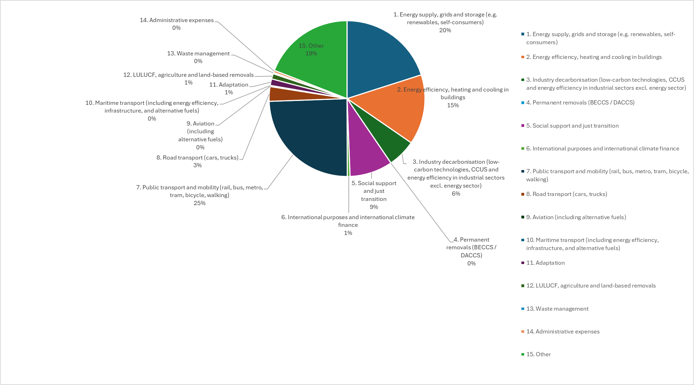
5. Competitiveness and Socio-economic
delivery
Measures to address Competitiveness
Member State auction revenues and use
EU ETS reported MS auction revenues EU 27 per category (2025 reporting, 2024 data) (%)
Following the 2023 revision of the EU ETS (Art 10 (3)) and in line with Regulation (EU) 2024/1281 (Annex I), Member States reported the use of their auction revenues following new harmonised categories (1-15).
In 2024, more than half of EU ETS reported revenues, was spent on ‘Energy supply, grids and storage’, ‘Energy efficiency, heating and cooling in buildings, ‘Industry decarbonization’ and ‘Public Transport’.
Source: ERCST, based on the use of EU ETS auction revenues (2025 reporting, 2024 data ), GovReg, EEA Table 3
*Reporting data restricted from public view in Germany.
**Examples of others include Climate Leap Programme for non-EU ETS sectors (SE), support to local authorities (BE), biodiversity (ES, HR), reported indirect carbon cost compensation (FI,SI,SK,RO,PT ), geographical and territorial information (PT), Sustainable Development Fund (MT), biogas (LT), R&D in Green Technologies (DE, EE).
Notes:
Art 10 (3) EU ETS Directive )
to finance research and development in energy efficiency and clean technologies in the sectors covered by this Directive;

Slide 30
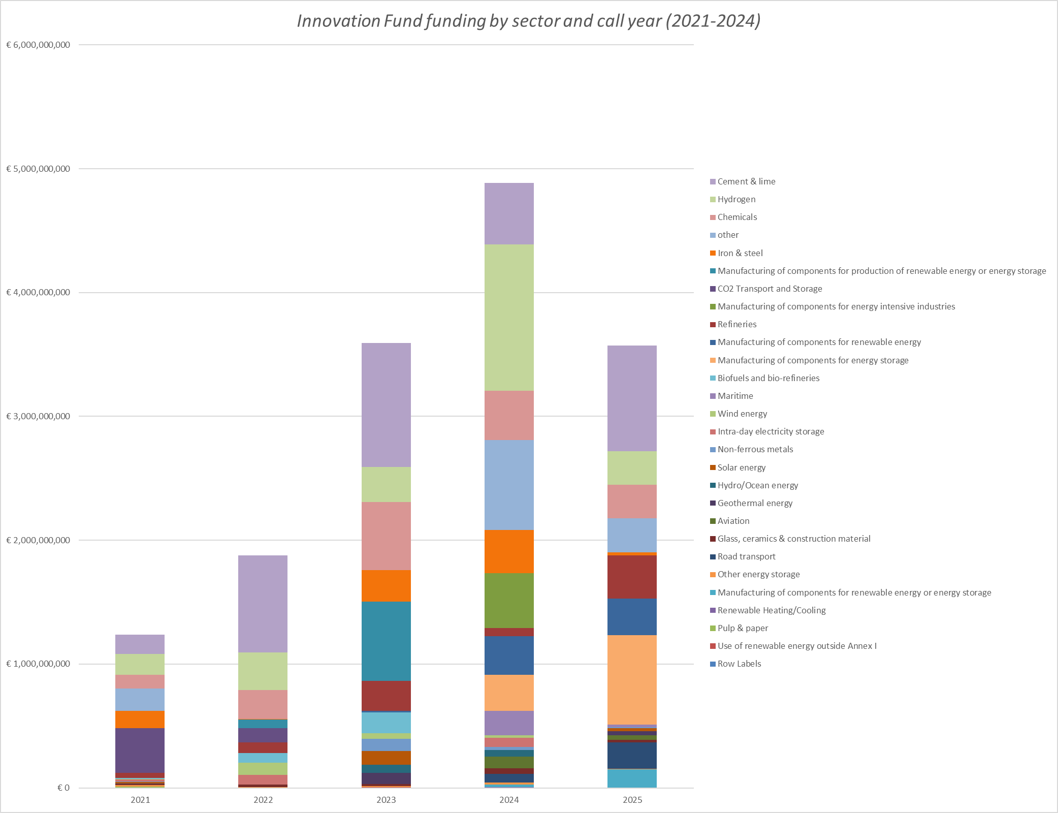
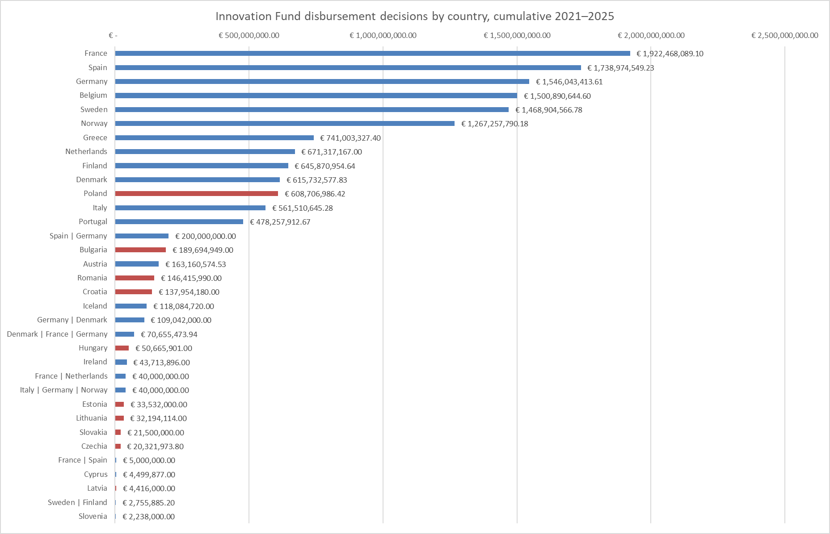
5. Competitiveness and Socio-economic
delivery
Measures to address Competitiveness
Innovation Fund
Innovation Fund funding by sector and call year (2021-2025)
Innovation Fund funding by EU ETS country and geographical division
*
Source: ERCST, based on disbursement decisions
**
***
Source: ERCST, based on Innovation Fund project portfolio dashboard, 2026
Notes:
Funding: 40 billion EUR 2020-2030 (530 million EUAs.).
Innovation Fund status:
On 23 November 2023, the European Commission launched the Innovation Fund 2023 Call, with a total budget of €4 billion.
General: Large-scale projects €1.7 billion
General: Medium-scale projects €500 million
General: Small-scale projects €200 million
Cleantech manufacturing €1.4 billion
Pilots €200 million
Deadline date: 9 April 2024,
New categories:
Large-scale projects - CAPEX > €100 million
Medium-scale projects - €100 million > CAPEX > €20 million
Small-scale projects €20 million > CAPEX > €2.5 million
New category: Cleantech manufacturing for components:
Renewable energy installations
Electrolysers and fuel cells
Energy storage solutions
Heat pumps

Slide 31
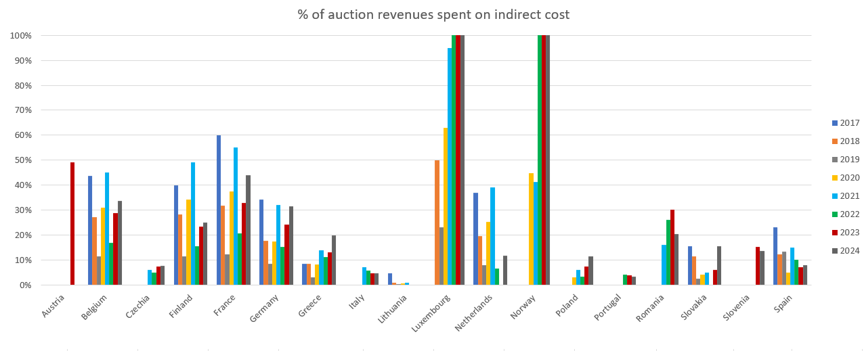
5. Competitiveness and Socio-economic
delivery
Measures to address Competitiveness
Indirect Cost Compensation
KPI 12 % of MS auction revenues spent on indirect cost compensation EU 27 + Norway (2017-2024)
*Luxembourg over share of auction revenues spent on indirect costs in 2022, 2023 and 2024, was above 100%, due to a drop in the country’s auction volume caused primarily by its use of ETS allowances for offsetting emissions in ESR, while in Norway, indirect cost is partly financed by the Norwegian government’s revenues from EU ETS and from the general budget.
* Norway did not join the European ETS auction platform until June 2019 and therefore EUAs auctioned were reported as zero in 2017-2019. Source EEA (2019) Trends and projections in the EU ETS in 2019. Pp 49.
Source: ERCST, based on reports from the European Commission on the functioning of the European carbon market. Data for Norway are provided by Veyt (2024) Miljødirektoratet, “CO₂-kompensasjon,” Norwegian Environment Agency, accessed 11 May 2026, https://www.miljodirektoratet.no/ansvarsomrader/klima/co2-kompensasjon/
Notes:
.

Slide 32
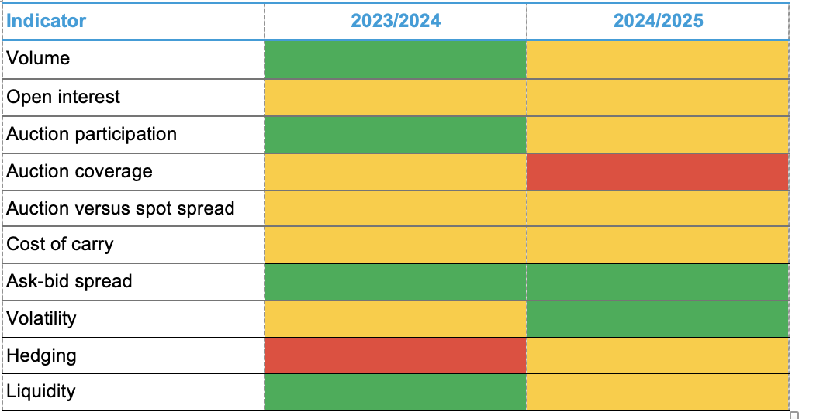
6. Market functioning
Market functioning trackers
Source: BloombergNEF. Note: Green indicates improving, red worsening, amber stable.
Notes:
Bloomberg

Slide 33
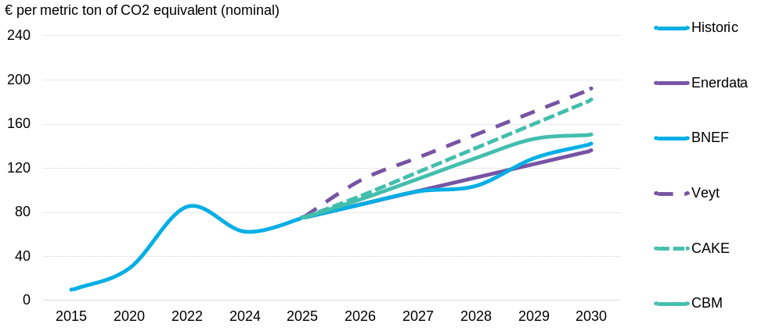
6. Market functioning
EUA Price forecasts
Source: Ariadne Project (2025), based on data from BloombergNEF, Veyt, Enerdata, CAKE/KOBIZE, and ClearBlue Markets.
Notes:
Bloomberg

Slide 34
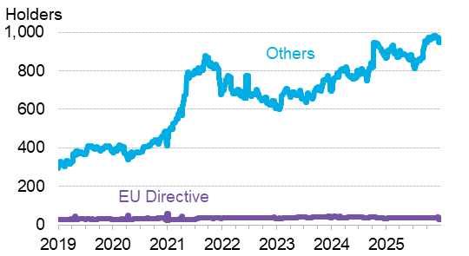
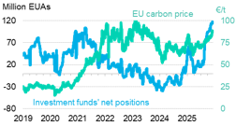
6. Market functioning
KPI 23 Net position holders
KPI 24 Investment funds' net position
Source: ICE, EEX, BloombergNEF. Note: Data is from Commitment of Traders (CoT) database.
Notes:
Bloomberg
Holders of EUAs by non-compliance entities has steadily grown, averaging over 900 which is up around 10% y/y from close to 815 in 2024. Meanwhile net position holders of EUAs by EU directives is relatively stable at around 37.
Towards the end of the year investment funds piled into the market and investment fund’s net positions in the market grew to its highest level, just shy of 120 million allowances by year-end. This bolstered EU carbon prices, largely due to expectations for tight supply-demand balance for the year ahead.

Slide 35
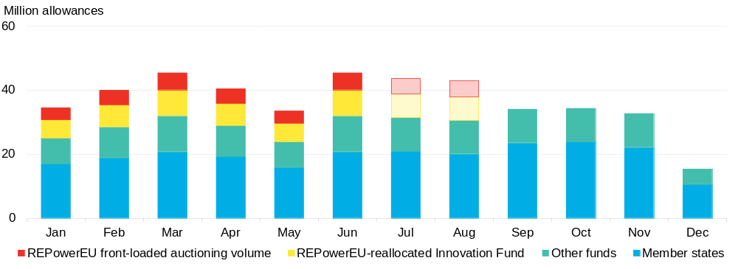
6. Market functioning
KPI 25 REPowerEU
Source: European Commission, BloombergNEF. Note: Volumes from September onwards are adjusted by BNEF’s estimate of Market Stability Reserve injections.
Notes:
Bloomberg

