Slide 1
Wednesday May 20th, 2026
2026 State of the EU ETS Report
Full slide deck

Slide 2
2026 Table of Contents (ToC)
Key takeaways
Background
- CDR integration
- Linkage discussion
- COP outcome
- US
- Competitiveness
- Regulatory stability (CBAM fertilizers)
- ETS 2 postponement
- 2040 Target
- International credits
- IMO
- Plastics
- Maritime in ETS
2. An EU ETS ‘fit for purpose’
3. Regulatory developments
3.1. Secondary legislation
3.2. Other policies impacting the EU ETS
- CISAF
- 2040 Target
- CBAM
- Omnibus (CSRD, CSDDD)
- ETS State Aid Guidelines for indirect cost compensation
- Member State Policies
3.3. International carbon price developments
3.3.1. Impacts of the UK ETS on the EU ETS
  UK and EU ETS allowance price evolution
  UK CBAM
  Possibility of linking the UK ETS with the EU ETS
3.3.2. Linking with other markets
  Linking with other emission trading systems
  Linking with International Credits
  Impact of EU ETS linkage with the Swiss ETS
3.3.3. Article 6 of the Paris Agreement
Environmental delivery
4.1. Delivery against Phase 4 target
4.1.1. 2025 data (year-on-year impacts)
4.1.2. Impact on Phase 4
4.2. Delivery against EU long-term domestic environmental commitments
4.3. Evolution of Power Sector Emissions
5. Competitiveness and socio- economic delivery
5.1. Economic impacts
5.1.1. Balance of allowances
5.1.2. Emission intensities in selected industrial sectors
5.1.3. Level of carbon price of EU ETS compared to other jurisdictions
5.1.4. ETS compliance costs, trade & production volumes )
5.1.5. Carbon compliance cost premium in unit production costs

Slide 3
2026 Table of Contents (ToC)
5.2. Auction revenues income
5.3. Measures to address competitiveness
5.3.1. Member States auction revenues and use
5.3.2. Modernisation Fund
5.3.3. Innovation Fund
5.3.4. Indirect cost compensation
6. Market functioning
6.1. Market functioning trackers
6.1.1. Volume
6.1.2. Open interest
6.1.3. Auction participation
6.1.4. Auction coverage
6.1.5. Auction-spot differential
6.1.6. Cost of carry
6.1.7. Ask-bid spread
6.1.8. Volatility
6.1.9 Hedged holdings
6.2. Supply-demand balance and evolution of TNAC
6.3. Price forecasts
6.4. Market participation
6.5 REPowerEU
7. Looking forward

Slide 4
Key Takeaways
Overview
The 2026 State of the EU ETS Report assesses whether the EU ETS remains “fit for purpose” in delivering emissions reductions, supporting industrial competitiveness, and maintaining effective market functioning.
The report concludes that the EU ETS continues to meet its core environmental objectives, but it is facing difficulties due to geopolitical uncertainty, industrial competitiveness concerns, evolving climate policy, and increasing pressure to support long-term industrial transformation.
Key Findings
1. Environmental Delivery Remains Strong
The EU ETS continues to reduce emissions effectively, with verified emissions remaining below the cap and more than half of the system’s 2030 target already achieved.
The power sector remains the main driver of emissions reductions, accounting for roughly 75% of total stationary installation reductions since 2008.
Notes:
ERCST

Slide 5
Key Takeaways
Key Findings
2. Competitiveness Has Become Central
The power sector now faces very high exposure to auctioning, with less than 10% of emissions effectively covered by free allocation.
Energy-intensive industries have shifted from historical allowance surpluses to structural deficits.
Average annual compliance costs in Phase IV exceeded €35 billion for the power sector and €7.6 billion for energy-intensive industries.
CBAM is designed to replace free allocation and shield EU industry from unfair competition, but the phase-out alone cannot build a business case for industrial decarbonisation; public support, cheaper technology, or further policy measures will also be needed.
3. Carbon Prices Remain Globally High
The EU ETS continues to operate at substantially higher carbon prices than other global carbon markets (USD 85/tCO₂e).
Comparisons should focus not only on visible carbon prices but also on the effective carbon costs borne by industry after free allocation and compensation mechanisms.
Notes:
ERCST

Slide 6
Key Takeaways
Key Findings
4. Market Functioning Remains Robust
The EU ETS market continues to function effectively, and the MSR continues to play a central role in tightening supply and supporting market stability. International developments will increasingly shape future market evolution.
5. Complex and Intertwined Policy Architecture
There is an unsynchronized timing of the legislative agenda coming up, as 2026 will see a number of important legislation under review, such as CBAM Directive, or Energy Union Governance.
Strategic Conclusion
The EU ETS remains one of the world’s most effective carbon markets and continues to deliver on its environmental mandate. However, the system is transitioning from being primarily a power-sector decarbonization tool into a central pillar of Europe’s industrial transformation strategy.
Future reforms will need to balance three objectives simultaneously:
Maintaining environmental integrity and emissions reductions;
Preserving industrial competitiveness and limiting carbon leakage;
Providing long-term regulatory predictability to support investment in low-carbon technologies.
Notes:
ERCST

Slide 7
1. Background
State of the EU ETS Report is meant to be a “snapshot”
Provides policymakers and stakeholders with an overview of how the EU ETS is doing by each year, based on previous year data. 2026 State of the EU ETS Report is based on 2025 data.
2025 Context:
  Change in international context (i.e. USA outside of the Paris Agreement and not participating in COP30)
  COP30 outcome
  IMO’s delay on the Net-Zero Framework to 2026
  Discussion on the integration of CDR into the ETS
  Linkage talks with the UK ETS formally started
  Commission’s shift from Green Agenda to Competitiveness Agenda
Notes:
ERCST

Slide 8
1. Background
2025 Context, continued:
  Regulatory framework is not stable, see the possible exemption of fertilizers from CBAM
  Agreement on 90% 2040 Climate Target, with 5% of international credits from 2036 and additional flexibilities for sectors
  Postponement of ETS2 to 2028 as part of the deal to pass the 2040 Climate Target
  First maritime ETS allowances surrendered
  Global Plastics Treaty
  New approach to address data limitations, that distinguishes 2026 report from past editions:
  Consortium has undertaken a categorization of all EU ETS installations to specific sectors.
  ~17,000 installations categorized based on: i) EUTL main activity codes, ii) industry data and iii) sector-specific information from EC 2015 and 2020 carbon leakage lists.
  This has enabled the sectoral disaggregation of "combustion" installations, yielding a more granular representation of both energy-intensive industries and the power sector.
Notes:
ERCST

Slide 9
2. An EU ETS “fit for purpose”
What do we expect the EU ETS to deliver?
3 key deliveries:
Environmental delivery. Does the EU ETS deliver against absolute environmental targets? (Chapter 4)
Competitiveness and socio-economic delivery. (Chapter 5)
  Does compliance with the EU ETS deliver macroeconomic efficiency and cost-effectiveness?
  Does it provide effective and proportional protection against the risk of carbon leakage?
  Is it a driver for change without destroying EU industrial competitiveness?
  Is the ETS allowed to provide a price signal?
Market functioning (Chapter 6). Is it worth having a market only if it functions well and leads to good price discovery?
Notes:
ERCST

Slide 10
3. Regulatory Developments
Secondary Legislation
Legislation | Revised elements | Relevance to EU ETS | Adoption date
Commission Implementing Regulation (EU) 2025/1192 | Regulation (EU) 2018/2067 is modified as regards certain aspects on the verification of data and on the accreditation of verifiers. It adds harmonization in what verifiers must check for climate-neutrality reports (the progress report some installations must have), conditional to getting free allocations, and calls for more verification requirements. Airlines must now report also non-carbon effects, and stricter checks for fuels. It calls for more evidence checks around “zero-rated” biomass fuels and CO2/N2O transfers/subtractions (Verifiers must check operators’ evidence that zero-rated biomass fuels meet the applicable sustainability and greenhouse-gas-savings criteria, and they must carry out specific checks where CO₂ is transferred or subtracted, including where zero-rated carbon is involved.) | Despite not being relevant for emitters (besides for airlines that now must report also non-CO2 aviation effects), this implementing regulation has direct effects on how reporting is conducted by checkers, tightening some of the rules and putting some conditionality in getting free allocations. | 18 June 2025
Commission Implementing Decision (EU) 2025/1162 | Commission Decision 2025/381/EC is modified as regards the questionnaire for reporting on the application of Directive 2003/87/EC of the European Parliament and of the Council. The questionnaire is now aligned with post 2023 ETS reforms and it cuts duplicated paperwork. | An updated questionnaire that is in line with the post 2023 ETS reform helps streamlining the process and extends the scope (maritime) and cuts duplicated paperwork making it more efficient. | 5 June 2025
Notes:
ERCST

Slide 11
3. Regulatory Developments
Secondary Legislation
Commission Delegated Regulation (EU) 2025/1253 | Regulation (EU) 2019/1122 supplementing Directive 2003/87/EC of the European Parliament and of the Council is changed: It updates Union Registry rules to reflect the revised ETS scope, including maritime and the exclusion of certain biomass-heavy installations It prepares the registry for ETS2 It strengthens compliance controls, including account blocking where the required allowances have still not been surrendered by 1 October. | Relevance for reporters stems from having new changes on the Union Registry, while also tightening reporting rules. | 11 February 2025
Commission Implementing Regulation (EU) 2025/772 | Regulation (EU) 2019/1842 is modified laying down rules for the application of Directive 2003/87/EC of the European Parliament and of the Council: It changes how FA is adjusted when there is a change in the activity level, and it adds “average of the expected activity level” and a common method for certain sub-installations It simplifies the annual reporting as it removes the need for a preliminary activity level report It adds and clarify rules on conditionality. | This change has a notable impact on FA, and it set steps in calculating how they are allocated. The “average of the expected activity level” can lead to having a more straightforward access to FA for industries that are facing oscillations in their production. | 16 April 2025
Notes:
ERCST

Slide 12
3. Regulatory Developments
EU policies impacting EU ETS
CISAF (Clean Industrial Deal State Aid Framework).
2040 Climate Target
CBAM Packages
Omnibus II Regulation
Amendment to ETS State Aid Guidelines for Indirect Cost Compensation
Notes:
ERCST

Slide 13
3. Regulatory Developments
Member State Policies
Member State | Name of the domestic policy | Description | Adoption date
Italy | DL Bollette | DL Bollette: article 3 specifics that the Indirect Cost Compensation for companies is now 600.000.000 EUR, compared to the 300.000.000 EUR in 2025. | 28 February 2025
Notes:
ERCST

Slide 14
3. Regulatory Developments
Member State Policies
Member State | Name of the domestic policy | Description | Adoption date
France | Indirect Carbon Cost Compensation | Advance payment for 2025 is set at 10%: “advance” quote for the mechanism for ICCC is fixed at 10% of the aid. Administrative rules update: the previous implementing order of Dec 20th 2022 is updated, with new management and information-publication procedure for the scheme.
Notes:
ERCST

Slide 15
3. Regulatory Developments
Member State Policies
Member State | Name of the domestic policy | Description | Adoption date
Spain | White Certificates | CAEs (White Certificates) are used as official proofs that upgraded industries are saving more energy. They can be bought by energy suppliers to meet energy-saving targets. Savings are calculated and verified under official rules, and once the CAE is issued, it can also be traded. | 2023, with yearly implementing acts
Notes:
ERCST

Slide 16
3. Regulatory developments
International carbon price developments
EU and UK ETS
Developments in linking the EU and UK ETS
In May 2025, in a Common Understanding the EU and UK agreed to work towards linking their ETS.
In July 2025, the European Commission published a draft Council Recommendation, inviting the Council to authorise formal negotiations with the United Kingdom to link the EU ETS with the UK ETS. The Council Recommendation included e.g.:
  EU and UK CBAM should not be applied to each others imported goods
  Sector scope should include, among others: electricity generation, industrial heat generation (excluding the individual heating of houses), industry, domestic and international maritime transport and domestic and international aviation; procedure to further expand the list of sectors to be covered
  UK should dynamically align to the relevant acquis, notably Directive 2003/87/EC and derived legislation, incl. all the provisions of the EU financial regulatory and supervisory framework applicable to trade in EUAs and derivatives thereof
  Defined UK cap and reduction pathway should be at least as ambitious as that of the EU
On 12 November, the European Council approved the linking mandate.
A request to temporarily exempt UK goods from the EU CBAM until both systems are linked has been rejected by the EU.
UKA price volatility (and potentially to a lesser extent EUA price volatility) may increase once negotiations between the UK and the European Commission pick up.
Developments in the UK ETS/UK CBAM
In November 2025, UK authorities decided to retain the EU ETS Phase IV carbon leakage list for the second UK ETS allocation period (2027-2030), following stakeholder consultations, reviews of data robustness and alignment with decarbonisation objectives.
Authorities further decided to maintain the existing trajectory for phasing out free allocation of allowances to sectors not deemed at risk of carbon leakage. Under this approach, installations operating in sectors not on the carbon leakage list will continue to receive a reduced level of free allocation until 2030, at which point it will be fully phased out.
Source: EU-UK cooperation Common Understanding (2025); Recommendation for a Council Decision (2025); UK ETS Free Allocation Review Main Authority Response (2025)
EUA and UKA price evolution
OLD
EU and UK allowance prices have been following an increasing trend in 2025.
EUA prices remain above UKA prices, but price difference has been decreasing.
UKA price volatility (and potentially to a lesser extent EUA price volatility) may increase once negotiations between the UK and the European Commission pick up.
Notes:
COMPASS
https://www.spglobal.com/energy/en/news-research/latest-news/energy-transition/121725-no-cbam-exemption-for-uk-before-definitive-phase-begins-Hoekstra
https://www.reuters.com/sustainability/cop/eu-rules-out-uk-exemption-carbon-border-levy-until-markets-link-2025-12-17/

Slide 17
3. Regulatory developments
International carbon price developments
EU and Swiss ETS
The EU ETS and the Swiss ETS have been linked since 2020, meaning that allowances issued under one system can be surrendered for emissions generated in either of the two systems.
Since 2024, the linking arrangements allows for daily transfers between the two systems, compared to only twice a week in 2023. This has led to a significantly increase in daily transactions from about 156 in 2023 to about 800 allowances per day in 2024, indicating an increased liquidity in the linked market.
In total, EU ETS-regulated entities (installations and aircraft operators) used c. 1.6 million allowances issued under the Swiss ETS for compliance in 2024. This marks a significant increase compared to prior years (c. 440 000 allowances more compared to 2023, c. 605 000 allowances more compared to 2022). This development underlines the flexibility provided by linked systems as well as consistently growing acceptance of the link.
Swiss ETS allowances made up only 0.14% of allowances surrendered in the EU ETS in 2024. In the Swiss ETS, they accounted for 31.5%.
Aviation operators in the Swiss ETS significantly increased their use of EU ETS allowances in 2024 (79.6%) compared to 2023 (51.08%). On the other hand, installations used a lower share of the EU ETS allowances for compliance in 2024 (5.19%) compared to 2023 (11.6%). In both years, installations in the Swiss ETS did not use the EU ETS aviation allowances for compliance.
Source: EC report on the functioning of the EU ETS in 2024
Note: The Swiss ETS allowances are not considered in the calculation of the TNAC (total number of allowances in circulation) of the EU ETS.
Allowances used for 2024 compliance (% of total surrendered units)
 |  | EU ETS allowances |  | Swiss ETS allowances
 |  | General allowances | Aviation allowances | General allowances | Aviation allowances
Units used for compliance with the EU ETS | By stationary installations | 99.59% | 0.31% | 0.07% | 0.03%
 | By aviation operators | 70.24% | 28.92% | 0.08% | 0.76%
Units used for compliance with the Swiss ETS | By stationary installations | 5.19% | - | 93.35% | 1.46%
 | By aviation operators | 65.30% | 14.24% | 0.17% | 20.22%
Allowances used for 2024 compliance (% of total surrendered units)
 |  | EU ETS allowances |  | Swiss ETS allowances
 |  | General allowances | Aviation allowances | General allowances | Aviation allowances
Units used for compliance with the EU ETS | By stationary installations | 99.58% | 0.37% | 0.04% | 0.01%
 | By aviation operators | 64.14% | 34.72% | 0.10% | 1.04%
Units used for compliance with the Swiss ETS | By stationary installations | 11.6% | - | 87.57% | 0.83%
 | By aviation operators | 7.26% | 43.82% | 1.09% | 47.83%
Notes:
COMPASS

Slide 18
3. Regulatory Developments
International carbon price developments
Article 6 of the Paris Agreement
Article 6 has now largely completed its rule book, and while there have been some transactions, the global uptake has been largely slow.
In the EU, international markets still elicit a bad reaction. Politically, Member States’ positioning on international credits is not as clear, and whether international credits in the EU are an option is still too early to tell, in the face of opposition from some of the EU institutions.
International credits could impact the EU ETS should they be allowed as an instrument of compliance, or by easing the burden if other sectors could do more on the back of Article 6 credits. It is likely that supply of international credits may be a bigger problem than anticipated, if CORSIA is an example of the supply-demand balance.

Slide 19
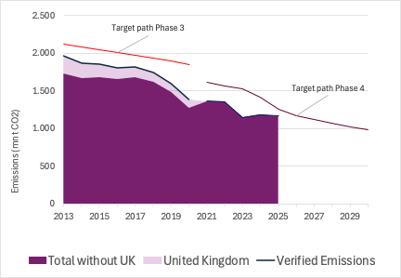
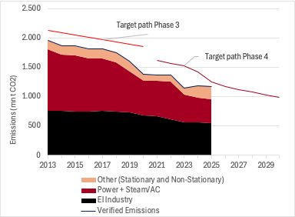
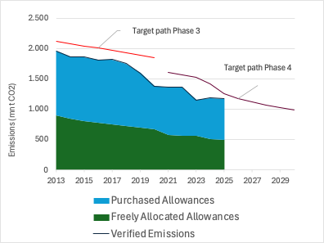
4. Environmental delivery
Delivery against Phase 4 target
KPI 1 EU ETS verified emissions vs adopted targets
KPI 1A: EU ETS verified emissions vs adopted targets – UK/Rest split
KPI 1B: EU ETS verified emissions vs adopted targets – sector group split
KPI 1C: EU ETS verified emissions vs adopted targets – allocation split
Source: ERCST, based on EUTL data
Notes:
*EI industry includes: Aluminium, Cement, Chemicals, Fertilizers, Glass, Steel, Other non-metallic, Pulp and Paper, Refineries
** EUTL verified emissions for 2025 adjusted to account for incomplete reporting using ‘carrying forward’ techniques.
Notes:
Jean-Yves & Stefan

Slide 20
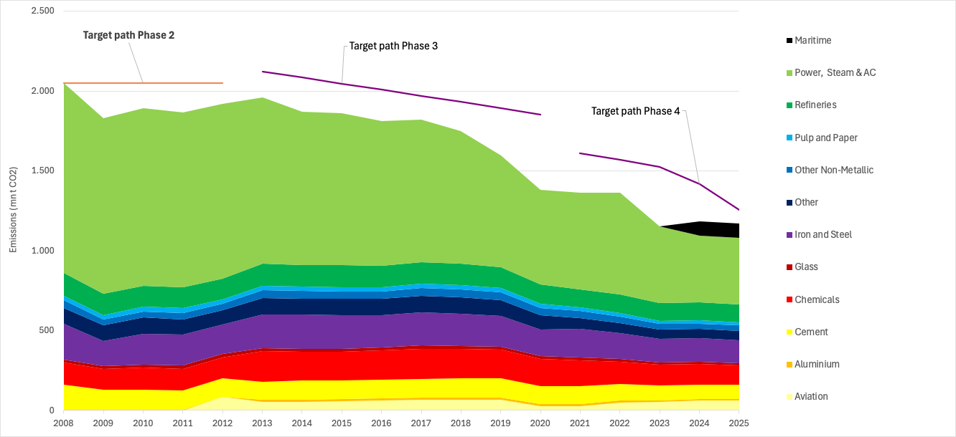
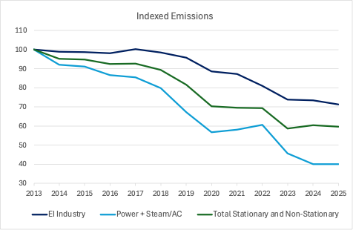
4. Environmental delivery
Delivery against Phase 4 target
KPI 1D: Verified emissions and sector composition
KPI 2: Indexed emissions and sector composition
Source: ERCST, based on EUTL data
.
Notes:
*EI industry includes: Aluminium, Cement, Chemicals, Fertilizers, Glass, Steel, Other non-metallic, Pulp and Paper, Refineries
** EUTL verified emissions for 2025 adjusted to account for incomplete reporting using ‘carrying forward’ techniques.

Slide 21
4. Environmental delivery
Delivery against Phase 4 target
Year-on-year change in emissions
Table: Year-on-year change in emissions (%), 2023-2024 and 2024-2025
Sector | 2023-2024 Y-o-Y % change in emissions | 2024-2025 Y-o-Y % change in emissions
Maritime | - | -2.0%
Aviation | +15% | +0.5%
Power, Steam & AC | -12.1% | 0.0%
EI industry | -0.7% | -2.9%
Total stationary | -5.8% | -1.3%
Total EU ETS | +3.1% | -1.3%
Source: ERCST, based on EUTL data
Notes:
* EUTL verified emissions for 2025 adjusted to account for incomplete reporting using ‘carrying forward’ techniques.
** EI industry includes: Aluminium, Cement, Chemicals, Fertilizers, Glass, Steel, Other non-metallic, Pulp and Paper, Refineries
.

Slide 22
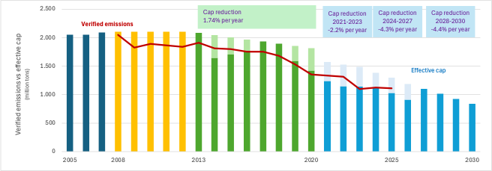
4. Environmental delivery
Delivery against Phase 4 target
Adopted vs effective emissions cap
Over the trading periods, the target path is adjusted to the updated climate policies.
The effective cap also reflects supply reductions for stabilizing the carbon market.
Source: ERCST, based on EUTL data and carbon market reports of the European Commission
Note: figures exclude aviation
Rebasing of the target path was necessary after the UK left the EU ETS.
According to the MSR mechanism, the MSR intake reduces the supply of allowances via auctions.
Finally, the supply of free allowances and the remaining auction volume determine the effective cap.

Slide 23
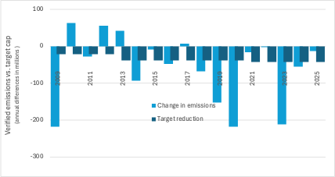
4. Environmental delivery
Delivery against Phase 4 target
KPI 3: LRF vs. actual change in emissions
Since 2008, except for a few years, emissions reductions have exceeded the intended target reductions defined by Linear Reduction Factors (LRF).
The emissions reductions reflect economic slowdowns, improvements in the emissions intensities of products and processes, and, recently, the expansion of renewable energies.
Source: ERCST, based on EUTL data
Notes:
* EUTL verified emissions for 2025 adjusted to account for incomplete reporting using ‘carrying forward’ techniques.
The change in emissions reflects the difference between current and the previous year's emissions.
The change in target reductions shows this difference for the target path, i.e., the Linear Reduction Factor (LRF).
Notes:
Taking into account perimtere of eu ets. For 2025 LRF same as in previous years, emissions to be updated once 2025 emissions data is available. For previous years need table with data.

Slide 24
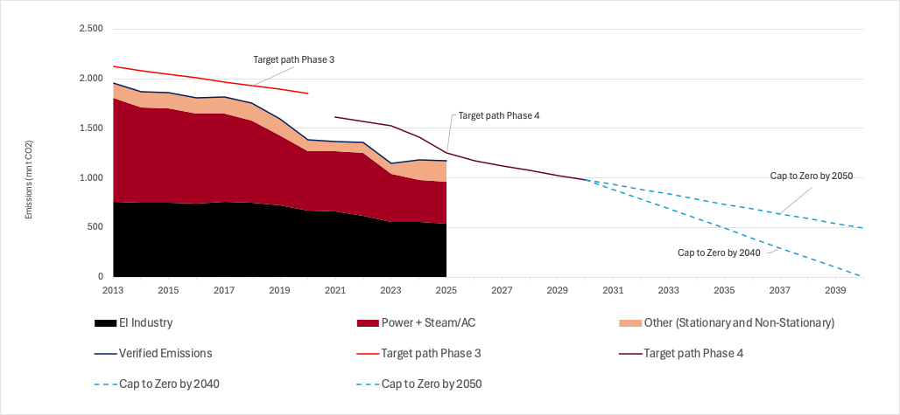
4. Environmental delivery
Delivery against EU long-term domestic environmental commitments
To what extent does the 2021-2030 trading period target contribute to 2030, 2040 and 2050 goals?
The EU intends to have net zero emission in 2050. It is not clear what will be the ambition level, and pace of reductions for EU ETS after 2030
EC has recently proposed a 90% reduction target for whole EU in 2040 compared to 1990.
It will be important to discuss how to design the right transition between the present "capped EU ETS regime" with an "EU ETS net zero regime“. This should include an assessment across all ETS sectors of the remaining potential of existing technologies as well as the likelihood of technological transformation, considering the short timeframe and lack of global climate action.
KPI 4: Possible long-term target paths for EU ETS after 2030
Source: ERCST. Based on EUTL data.
Notes:
*EI industry includes: Aluminium, Cement, Chemicals, Fertilizers, Glass, Steel, Other non-metallic, Pulp and Paper, Refineries
** EUTL verified emissions for 2025 adjusted to account for incomplete reporting using ‘carrying forward’ techniques.

Slide 25
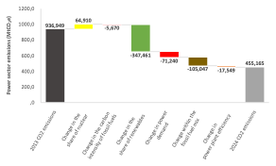
4. Environmental delivery
Evolution of power sector emissions
Figure: Drivers of variation in EU power sector GHG emissions (2013-2024)
Source: Compass Lexecon analysis based on Eurostat and IPCC data.

Slide 26
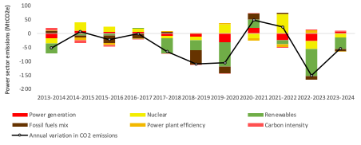
4. Environmental delivery
Evolution of power sector emissions
Figure: Energy source vs annual drivers of variation in EU power sector GHG emissions (2013-2024)
Annual emissions fell by around 480 MtCO2e between 2013 and 2024.
The decreased share of nuclear in the EU power mix compared to 2013 contributed to an overall increase in emissions over the period.
However, this increase was outweighed by other factors.
Source: Compass Lexecon analysis based on Eurostat and IPCC data.

Slide 27
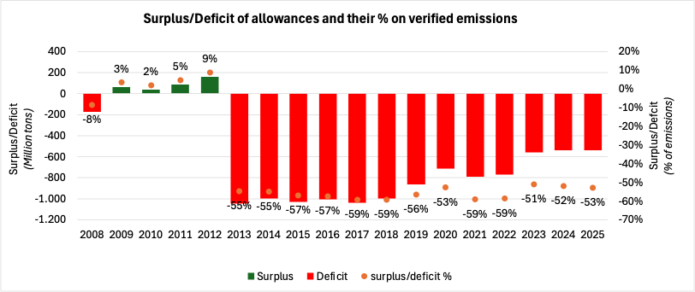
5. Competitiveness and Socio-economic
delivery
Economic Impacts
KPI 5: Net supply volume of free allowances (free allocation – verified emissions) - all stationary sectors
Absolute volume (primary axis) and % of verified emissions (secondary axis)
Source: ERCST. Based on EUTL data.
Notes:
* EUTL verified emissions for 2025 adjusted to account for incomplete reporting using ‘carrying forward’ techniques.
Notes:
Jean Yves & Stefan

Slide 28
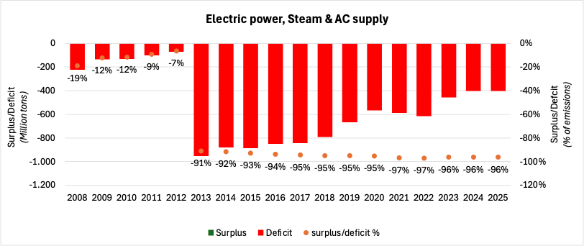
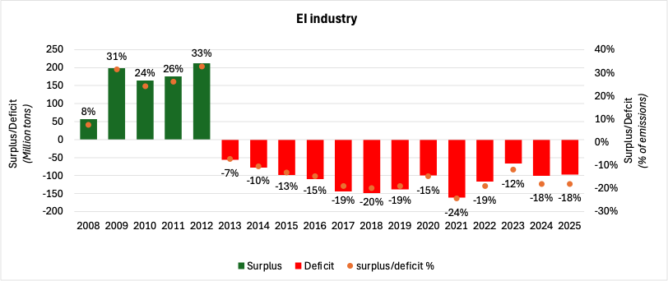
5. Competitiveness and Socio-economic
delivery
Economic Impacts
Net supply volume of free allowances (free allocation – verified emissions)
KPI 5A Net supply volume of free allowances - Electric power, Steam & AC supply
KPI 5B Net supply volume of free allowances - EI industry*
Source: ERCST. Based on EUTL data.
Notes:
*EI industry includes: Aluminium, Cement, Chemicals, Fertilizers, Glass, Steel, Other non-metallic, Pulp and Paper, Refineries
** EUTL verified emissions for 2025 adjusted to account for incomplete reporting using ‘carrying forward’ techniques.
Notes:
Jean Yves & Stefan

Slide 29
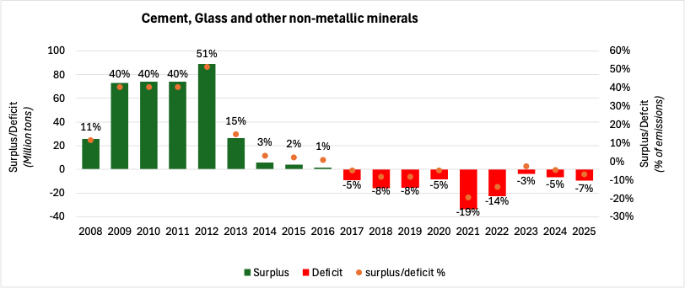
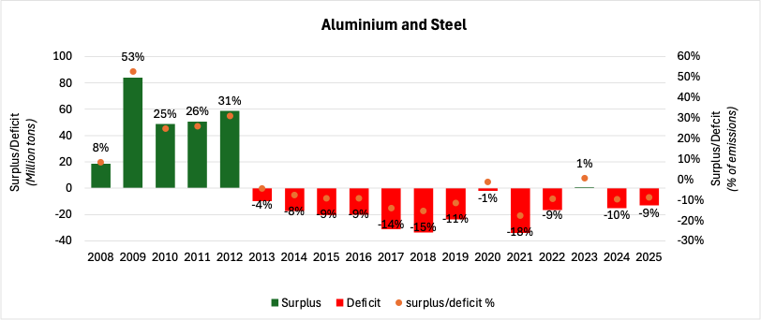
5. Competitiveness and Socio-economic
delivery
Economic Impacts
Net supply volume of free allowances (free allocation – verified emissions) for selected sectors
KPI 5C Net supply volume of free allowances
(Cement, Glass and other non-metallic minerals)
KPI 5D Net supply volume of free allowances
(Aluminium and Steel)
Source: ERCST. Based on EUTL data.
Notes:
* EUTL verified emissions for 2025 adjusted to account for incomplete reporting using ‘carrying forward’ techniques.
Notes:
Jean Yves & Stefan

Slide 30
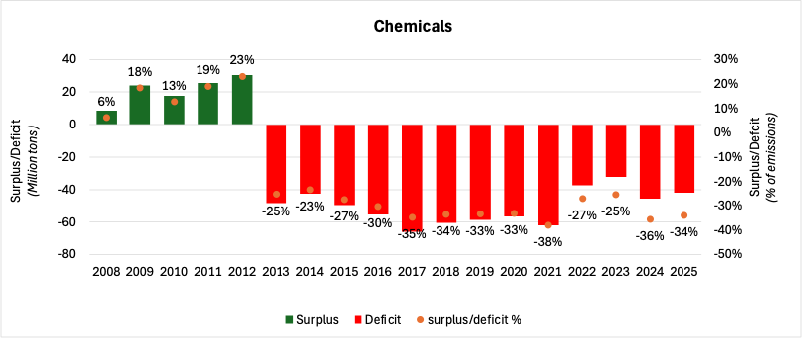
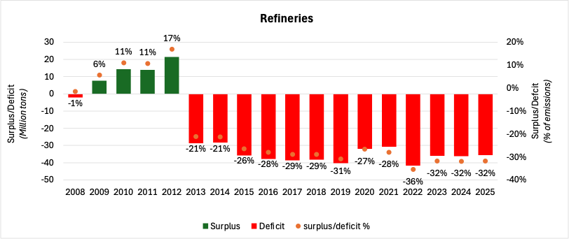
5. Competitiveness and Socio-economic
delivery
Economic Impacts
Net supply volume of free allowances (free allocation – verified emissions) for selected sectors
KPI 5E Net supply volume of free allowances (Chemicals)
KPI 5F Net supply volume of free allowances (Refineries)
Source: ERCST. Based on EUTL data.
Notes:
* EUTL verified emissions for 2025 adjusted to account for incomplete reporting using ‘carrying forward’ techniques.
Notes:
Jean Yves & Stefan

Slide 31
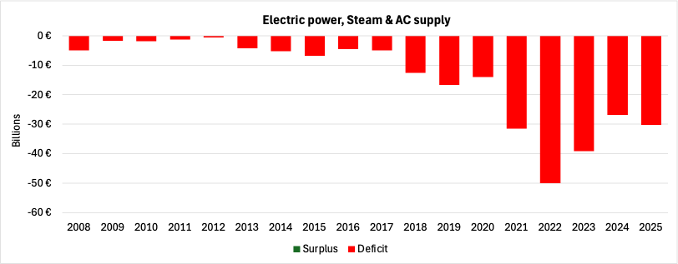
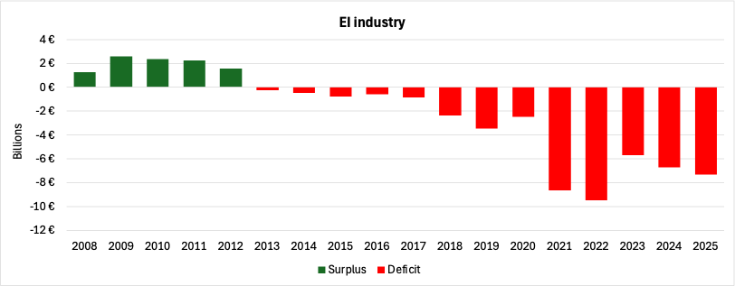
5. Competitiveness and Socio-economic
delivery
Economic Impacts
KPI 6 Net supply value of free allowances
KPI 6A Net supply value of free allowances (Electric power, steam & AC supply )
KPI 6B Net supply value of free allowances (EI industry*)
Source: ERCST. Based on EUTL verified emissions and free allocation data, and annual average EU carbon price data by BloombergNEF (2015-2025) and SENDECO₂ (2008-2014).
Notes:
*EI industry includes: Aluminium, Cement, Chemicals, Fertilizers, Glass, Steel, Other non-metallic, Pulp and Paper, Refineries
** EUTL verified emissions for 2025 adjusted to account for incomplete reporting using ‘carrying forward’ techniques.
Notes:
Jean Yves & Stefan

Slide 32
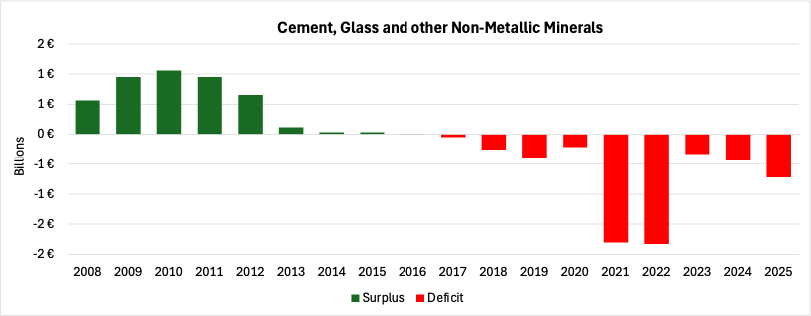
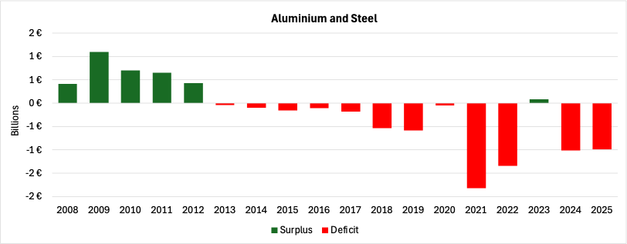
5. Competitiveness and Socio-economic
delivery
Economic Impacts
KPI 6 Net supply value of free allowances (selected sectors)
KPI 6C Net supply value of free allowances (Cement, Glass and other non-metallic minerals)
KPI 6D Net supply value of free allowances (Aluminium and Steel)
Source: ERCST. Based on EUTL verified emissions and free allocation data, and annual average EU carbon price data by BloombergNEF (2015-2025) and SENDECO₂ (2008-2014).
Notes:
* EUTL verified emissions for 2025 adjusted to account for incomplete reporting using ‘carrying forward’ techniques.
Notes:
Jean Yves & Stefan

Slide 33
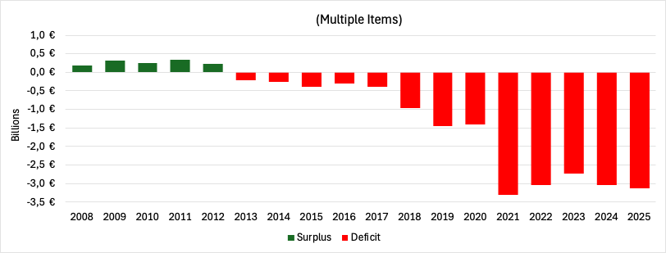
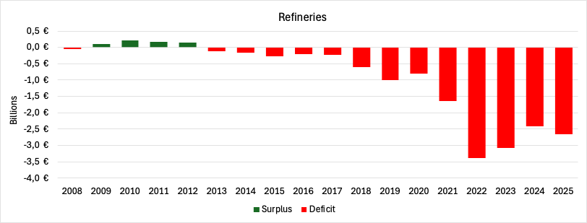
5. Competitiveness and Socio-economic
delivery
Economic Impacts
KPI 6 Net supply value of free allowances (selected sectors)
KPI 6E Net supply value of free allowances (Chemicals)
KPI 6F Net supply value of free allowances (Refineries)
Source: ERCST. Based on EUTL verified emissions and free allocation data, and annual average EU carbon price data by BloombergNEF (2015-2025) and SENDECO₂ (2008-2014).
Notes:
* EUTL verified emissions for 2025 adjusted to account for incomplete reporting using ‘carrying forward’ techniques.
Notes:
Jean Yves & Stefan

Slide 34
Shifts in the supply of allowances
Economic Impacts
KPI 7 Auction VS Free Allocation split
Source: ERCST, based on EC reports on the functioning of the European carbon market
Allowances are supplied to the market through either auctions or free allocations. The scheduled steady decline of freely allocated allowances contrasts with the fluctuations in auctioned allocations, which are used to stabilize market activity.
Notes:
Jean Yves & Stefan

Slide 35
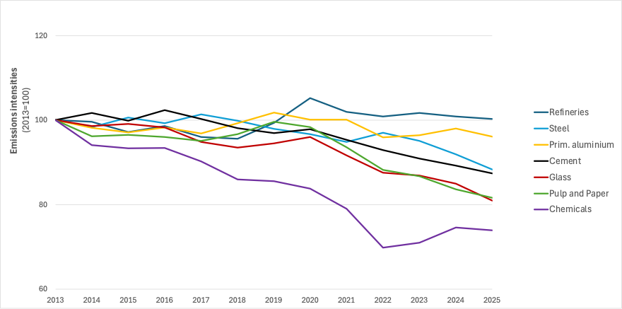
5. Competitiveness and Socio-economic
delivery
Economic Impacts
Emissions intensity in selected industrial sectors
KPI 8A Emissions intensities for selected activities
Source: ERCST. Based on EUTL data.
Notes:
* EUTL verified emissions for 2025 adjusted to account for incomplete reporting using ‘carrying forward’ techniques.
Notes:
ERCST

Slide 36
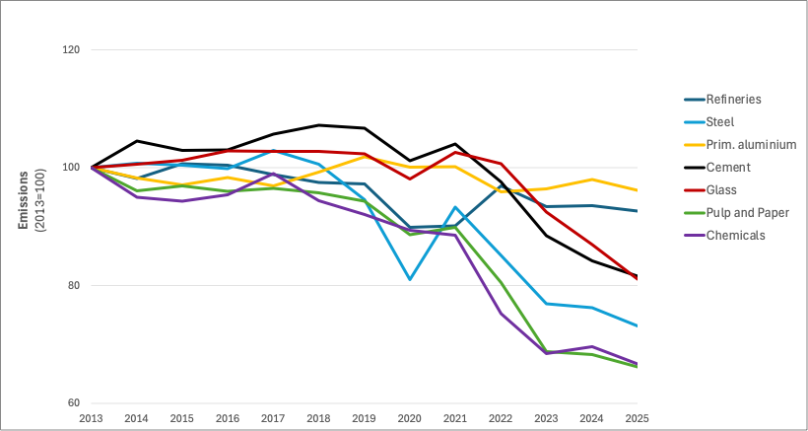
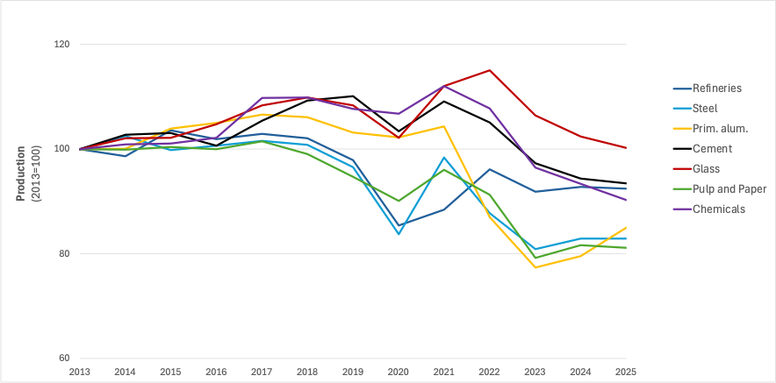
5. Competitiveness and Socio-economic
delivery
Economic Impacts
Sectoral emissions and production
KPI 8B Emissions index
KPI 8C Sectoral production index
Source: ERCST. Based on EUTL data.
Notes:
* EUTL verified emissions for 2025 adjusted to account for incomplete reporting using ‘carrying forward’ techniques.
Notes:
ERCST

Slide 37
5. Competitiveness and Socio-economic
delivery
Economic Impacts
Visible carbon price in the EU and other jurisdictions
Evolution of prices of selected ETSs – 2013-2025 (USD/t CO2-eq)
  The combination of a progressively more stringent cap, high EU emission reduction targets, and mature market structure makes the EU ETS the highest-priced carbon market globally.
  In 2025, the EU ETS price is about 1.3 times that of the UK ETS, and 2.5 times the price of allowances in the New Zealand ETS and almost 3 times that of allowance prices in the Californian CaT.
  Allowance prices in Chinese, Beijing and Korean systems are significantly lower compared to the other systems, with averages prices in 2025 ranging between 6.6 and 14.5 USD/tCO2eq.
  In 2025, China expanded the sector scope of its ETS to newly include steel, cement and aluminium smelter sectors. The scope expansion is expected to cover more than 3,700 entities, representing c. 5% of global emissions.
 | Start year | Sector coverage | 2025 Average Price (USD/t CO2-eq)
EU ETS | 2005 | Industry, Power, Aviation | 84.7
New Zealand ETS | 2008 | Industry, Power, Waste, Transport, Buildings | 33.8
California CaT | 2012 | Industry, Power, Transport, Buildings | 29.5
Beijing pilot ETS | 2013 | Industry, Power, Transport, Buildings | 14.5
China ETS | 2021 | Industry, Power | 10
Korea ETS | 2015 | Industry, Power, Waste, Transport, Buildings | 6.6
UK ETS | 2021 | Industry, Power, Aviation | 66.5
  Sources: Compass Lexecon analysis based on ICAP, price data from the International Carbon Action Partnership (ICAP) Allowance Price Explorer for California, New Zealand, Korea, Beijing and China, price data from Bloomberg for the UK and EU.
  Notes: New Zealand ETS is the combination of its pre-2024 and post-2024 ETS. Illustration shows prices on secondary markets for all ETSs. 2025 data for the California and New Zealand systems not complete yet.
Notes:
COMPASS

Slide 38
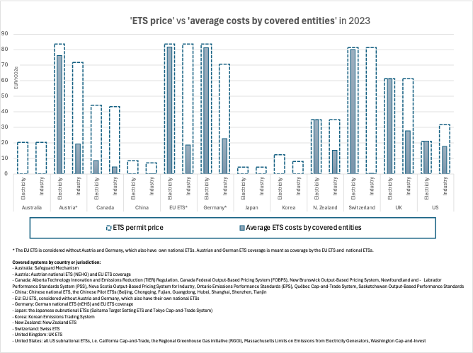
5. Competitiveness and Socio-economic
delivery
Economic Impacts
‘ETS price’ vs ‘costs’ in the EU and other jurisdictions
‘ETS price’ is the respective system’s visible permit price.
‘Average ETS costs by covered entities’, provides an estimate of the costs incurred on average by covered entities in the industry and electricity sectors, by adjusting for the free allocation of allowances .
Source: ERCST, based on data by OECD, Table 2.A.1. in OECD (2025), Effective Carbon Rates 2025: Recent Trends in Taxes on Energy Use and Carbon Pricing,

Slide 39
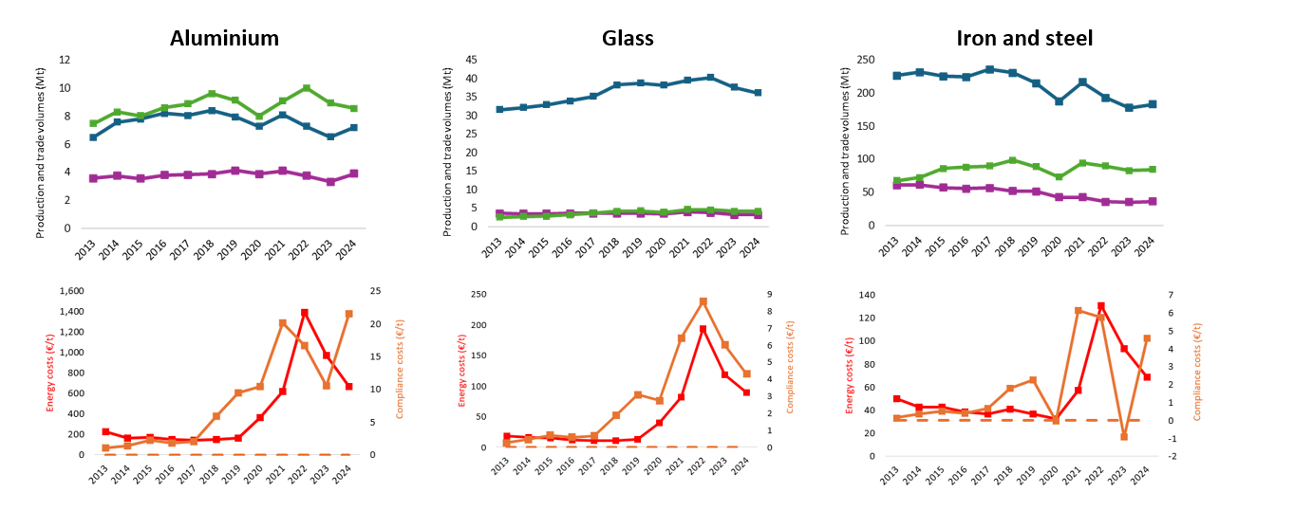
5. Competitiveness and Socio-economic
delivery
Economic Impacts
KPI 9 ETS compliance costs, trade & production volumes
(1) Industrial production, trade, unitary energy and direct ETS costs 2013-2024
Source: Compass Lexecon analysis based on data from Eurostat, EUTL, and industry associations

Slide 40
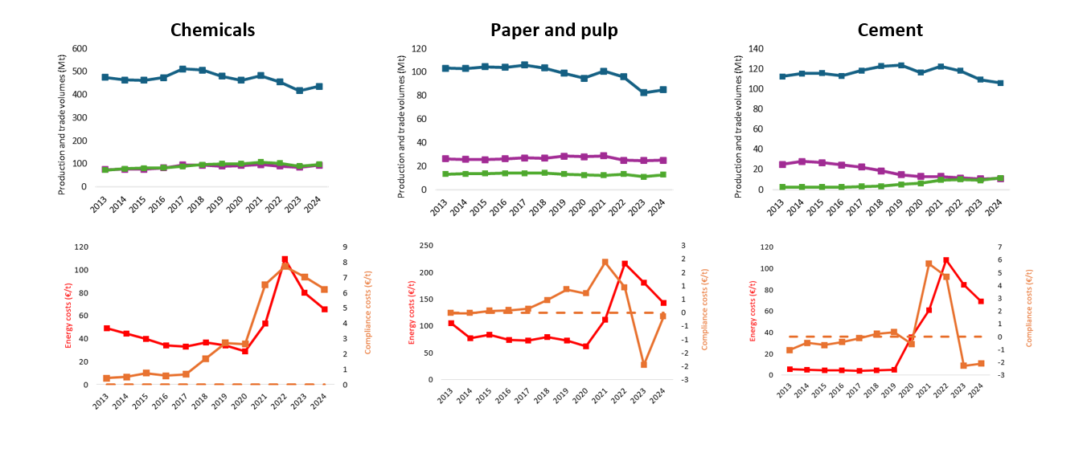
5. Competitiveness and Socio-economic
delivery
Economic Impacts
KPI 9 ETS compliance costs, trade & production volumes
(2) Industrial production, trade, unitary energy and direct ETS costs 2013-2024
Source: Compass Lexecon analysis based on data from Eurostat, EUTL, and industry associations

Slide 41
5. Competitiveness and Socio-economic
delivery
Economic Impacts
Carbon compliance cost in unit production costs
 | Aluminium | Glass | Iron and Steel | Chemicals | Paper and Pulp | Cement
Reliance on EU production to satisfy demand | 30% (average) 2013: 28% 2024: 28% | 90% (average) 2013: 92% 2024: 89% | 66% (average) 2013: 71% 2024: 63% | 81% (average) 2013: 85% 2024: 78% | 85% (average) 2013: 85% 2024: 83% | 95% (average) 2013: 97% 2024: 89%
Global trade position and evolution | Imports and production roughly double of exports | Shift from net exports to net imports (but low compared to production) | Increasing gap between imports and exports (double) | Shift to slightly net importer | Net exporter (with relatively constant gap) | Shift from net exporter to import/export parity
Increase in energy costs (2020à2024) | Almost doubled | More than doubled | More than doubled | More than doubled | More than doubled | Almost doubled
Average direct EU ETS costs | Net positive costs (>0) | Net positive costs (>0) | Net positive costs (>0) | Net positive costs (>0) | Net positive costs (>0) | No net positive costs (<0)
Eligible to compensation for indirect CO2 costs | Yes | Yes (but not all sub-sectors) | Yes | Yes (but not all sub-sectors) | Yes | No
  Sources: Compass Lexecon 2026

Slide 42
5. Competitiveness and Socio-economic
delivery
Economic Impacts
KPI 10 Carbon compliance cost in unit production costs
Production costs for ammonia and steel by cost component under different scenarios – 2030
  EU production of steel and ammonia is likely to face an increased competitiveness gap in EU domestic markets compared other jurisdictions, mainly due to carbon costs associated with the EU ETS.
    The phase-out of free allocation, combined with the expected increase in EUA prices, would increase costs for producers – which highlights the impact of EU ETS on EU competitiveness – as of 2030, the removal of free allocation would increase costs by (a) 20% for ammonia and (b) 40% for steel.
    Decarbonised production processes would be more expensive than carbon-intensive processes – as of 2030, even when assuming low green hydrogen costs, (a) green steel would be 40% (80%) more expensive while (b) green ammonia would be 50% (90%) more expensive, compared to fossil-based processes with no free allocations (with free allocations).
  Without public support or changes in the costs of low-carbon processes (whether for low-carbon energy inputs or CAPEX of new installations), free allocation phase-out alone does not provide a clear economic case for decarbonisation.
+50%
+20%
+40%
+40%
  Sources: Compass Lexecon analysis based on data from AgoraEnergiewende for Steel and BusinessEurope for Ammonia. The C-intensive Steel making facility is assumed to be a retrofit BF-BAF with coking coal. Grey Ammonia is produced based on SMR + Haber-Bosch synthesis.

Slide 43
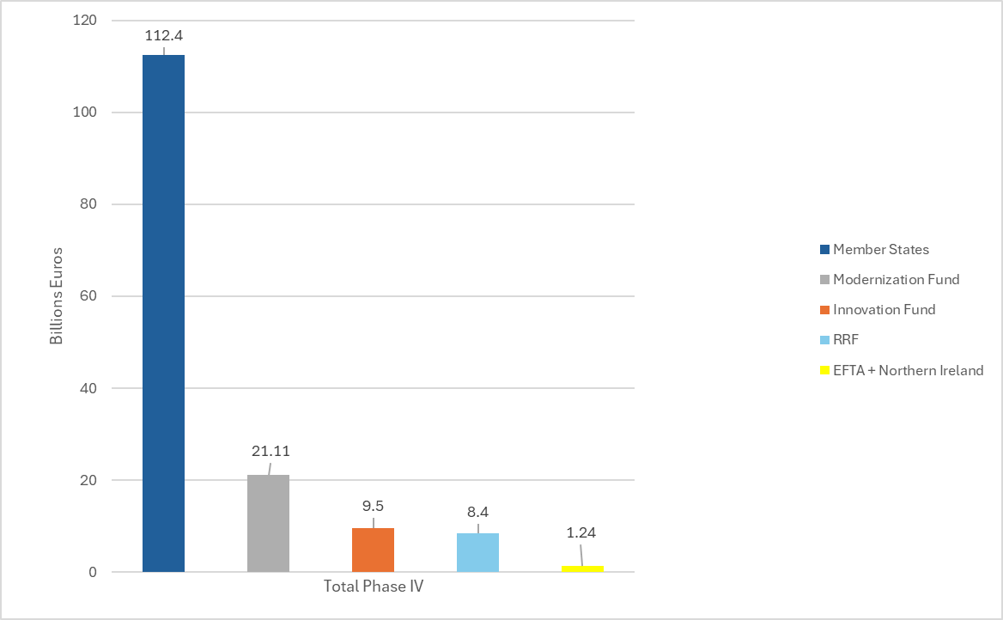
5. Competitiveness and Socio-economic
delivery
Economic Impacts
Auction revenue income
In Phase IV, the total EU ETS revenue income amounted to EUR 152.65 billion.
Of this, EUR 112.4 billion went directly to the EU Member States national budgets.
EUR 21.11 billion the ETS Modernisation Fund,
EUR 9.5 billion supplied the ETS Innovation Fund.
EUR 8.4 billion supplied the Recovery and Resilience Facility (RFF) up to 2024, to contribute to the EUR 20 billion objective, following the adoption of REPower EU in 2022.
The remaining EUR 1.24 billion went to Iceland, Liechtenstein, Norway and Northern Ireland*.
Total EU ETS generated income in Phase IV and distribution between budgets (2021-2024)
Source: ERCST, based on Commission reports on the functioning of the European carbon market (2022-2024)
* As of 2022, EEX also auction allowances for electricity generation plants in Northern Ireland, which are part of the EU ETS as from 2021.

Slide 44
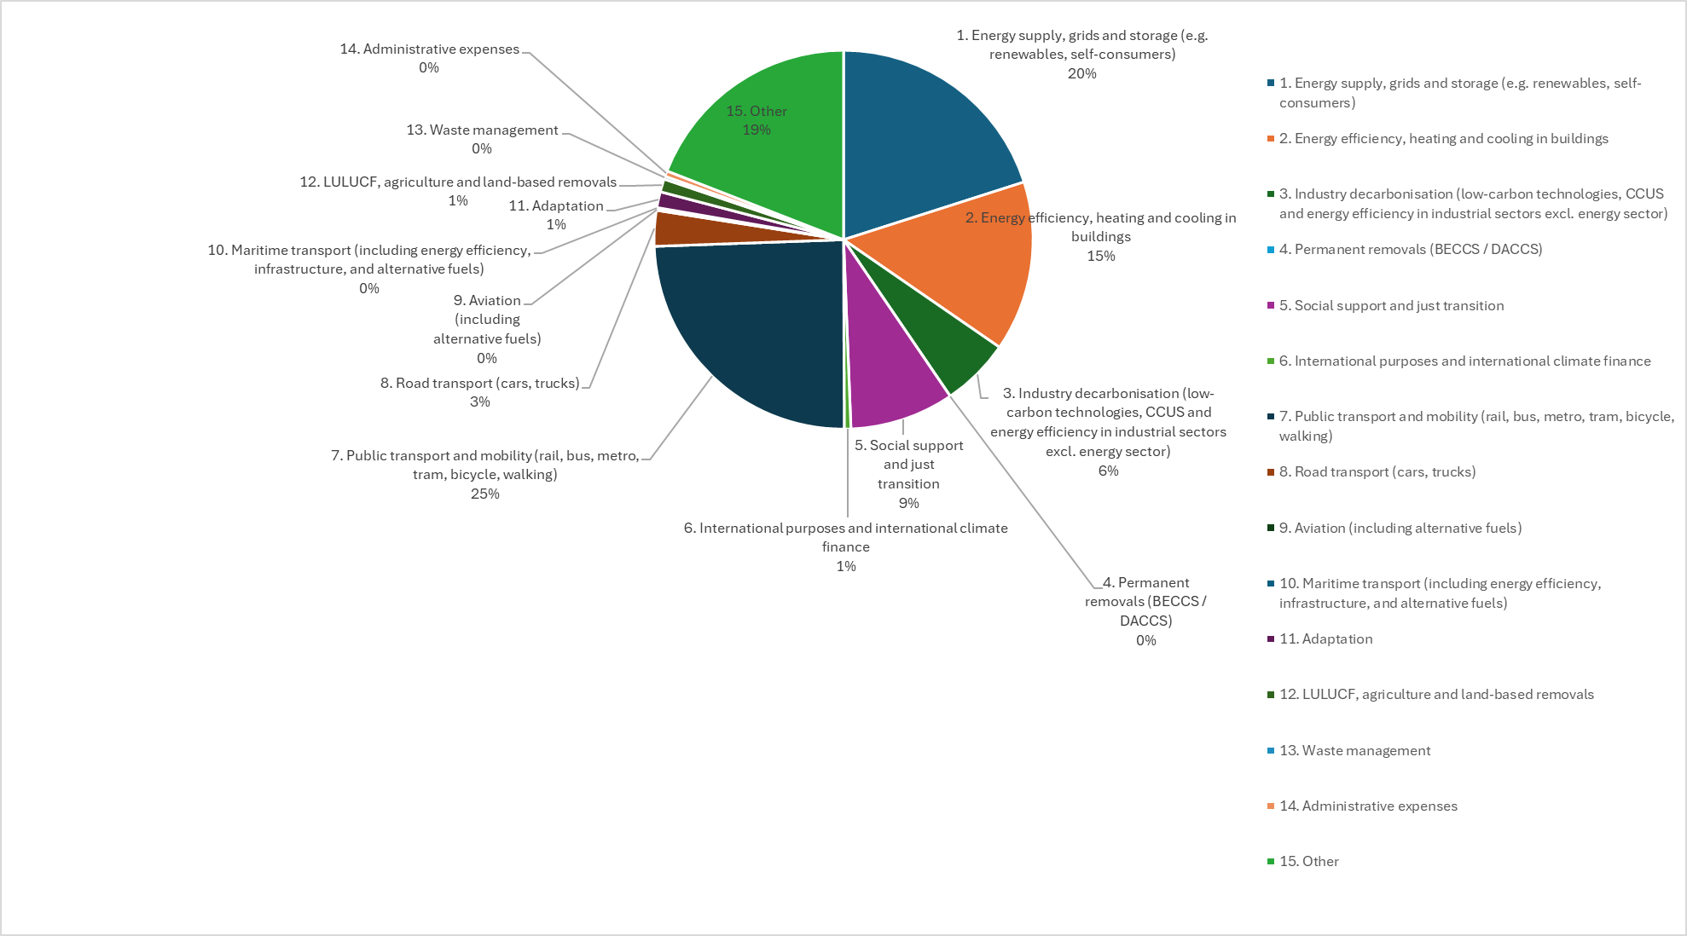
5. Competitiveness and Socio-economic
delivery
Measures to address Competitiveness
Member State auction revenues and use
EU ETS reported MS auction revenues EU 27 per category (2025 reporting, 2024 data) (%)
Following the 2023 revision of the EU ETS (Art 10 (3)) and in line with Regulation (EU) 2024/1281 (Annex I), Member States reported the use of their auction revenues following new harmonised categories (1-15).
In 2024, more than half of EU ETS reported revenues, was spent on ‘Energy supply, grids and storage’, ‘Energy efficiency, heating and cooling in buildings, ‘Industry decarbonization’ and ‘Public Transport’.
Source: ERCST, based on the use of EU ETS auction revenues (2025 reporting, 2024 data ), GovReg, EEA Table 3
*Reporting data restricted from public view in Germany.
**Examples of others include Climate Leap Programme for non-EU ETS sectors (SE), support to local authorities (BE), biodiversity (ES, HR), reported indirect carbon cost compensation (FI,SI,SK,RO,PT ), geographical and territorial information (PT), Sustainable Development Fund (MT), biogas (LT), R&D in Green Technologies (DE, EE).
Notes:
Art 10 (3) EU ETS Directive )
to finance research and development in energy efficiency and clean technologies in the sectors covered by this Directive;

Slide 45
5. Competitiveness and Socio-economic
delivery
Measures to address Competitiveness
Member State auction revenues and use
EU ETS reported MS auction revenues EU 27 (2025 reporting, 2024 data)
The top four recipients are Germany, followed by Poland, Italy and Spain.
*Although MS are now reporting specific categories, it still does not allow us to compare category spending across MS effectively as some MS, such as Germany , overreport their revenue spending, whilst other MS under-report, as direct attribution of revenues to specific purposes is not always possible. In Germany all revenues go to a fund for climate and energy projects, which is additionally co-funded from the general budget. Thus, reporting per category (20 Billion/EUR) is higher than EU ETS auction revenues.
Source: ERCST (2025), based on Table 7. Revenue from the auctioning of general allowances in the EU ETS (EU 27, 2024)..
Notes:
Art 10 (3) EU ETS Directive )
to finance research and development in energy efficiency and clean technologies in the sectors covered by this Directive;

Slide 46
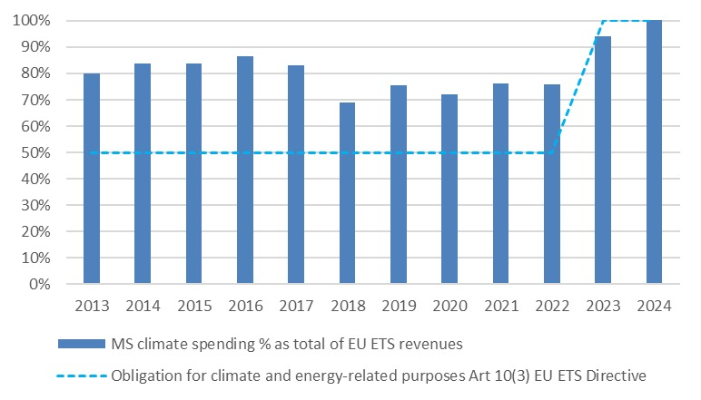
5. Competitiveness and Socio-economic
delivery
Measures to address Competitiveness
Member State auction revenues and use
Until the last revision of the EU ETS Directive, at least 50% of the auction revenues that goes directly to Member States, to climate- and energy-related purposes.
Following the revision of the EU ETS Directive in 2023, Member States are now obliged to use 100% (except revenue for indirect cost compensation (Art 10 (3) of the EU ETS Directive).
KPI 11 % of total MS auction revenues spent on climate, renewable energy and energy efficiency (2013-2024)
Source: ERCST, based on EEA date on revenues.
Notes:
Art 10 (3) EU ETS Directive )
to finance research and development in energy efficiency and clean technologies in the sectors covered by this Directive;

Slide 47
5. Competitiveness and Socio-economic
delivery
Measures to address Competitiveness
Modernisation Fund
EU ETS revenues to support 13 low-income EU Members in their transition to climate neutrality by helping to modernise their energy systems and efficiency.
From 60% to 75% below GDP per capita: Since 2023 revision Portugal, Greece and Slovenia can also ask for funding
So far 10 disbursements decisions, amounting to 21 billion €.
Overall, Romania (6.7 billion EUR) and Czechia (6.5 billion EUR) have been main beneficiaries, followed by Poland.
In 2025, Czechia was the main beneficiary (1.7 billion EUR).
Source: ERCST, based on disbursement decisions.

Slide 48
5. Competitiveness and Socio-economic
delivery
Measures to address Competitiveness
Modernisation Fund
Modernisation Fund investments by area, as reported by Member States (2021-2025)
*Investments in priority areas as aligned with Article 10d(2) of the ETS Directive.
Source: ERCST, based on Modernisation Fund Disbursement Decisions. https://modernisationfund.eu/investments/

Slide 49
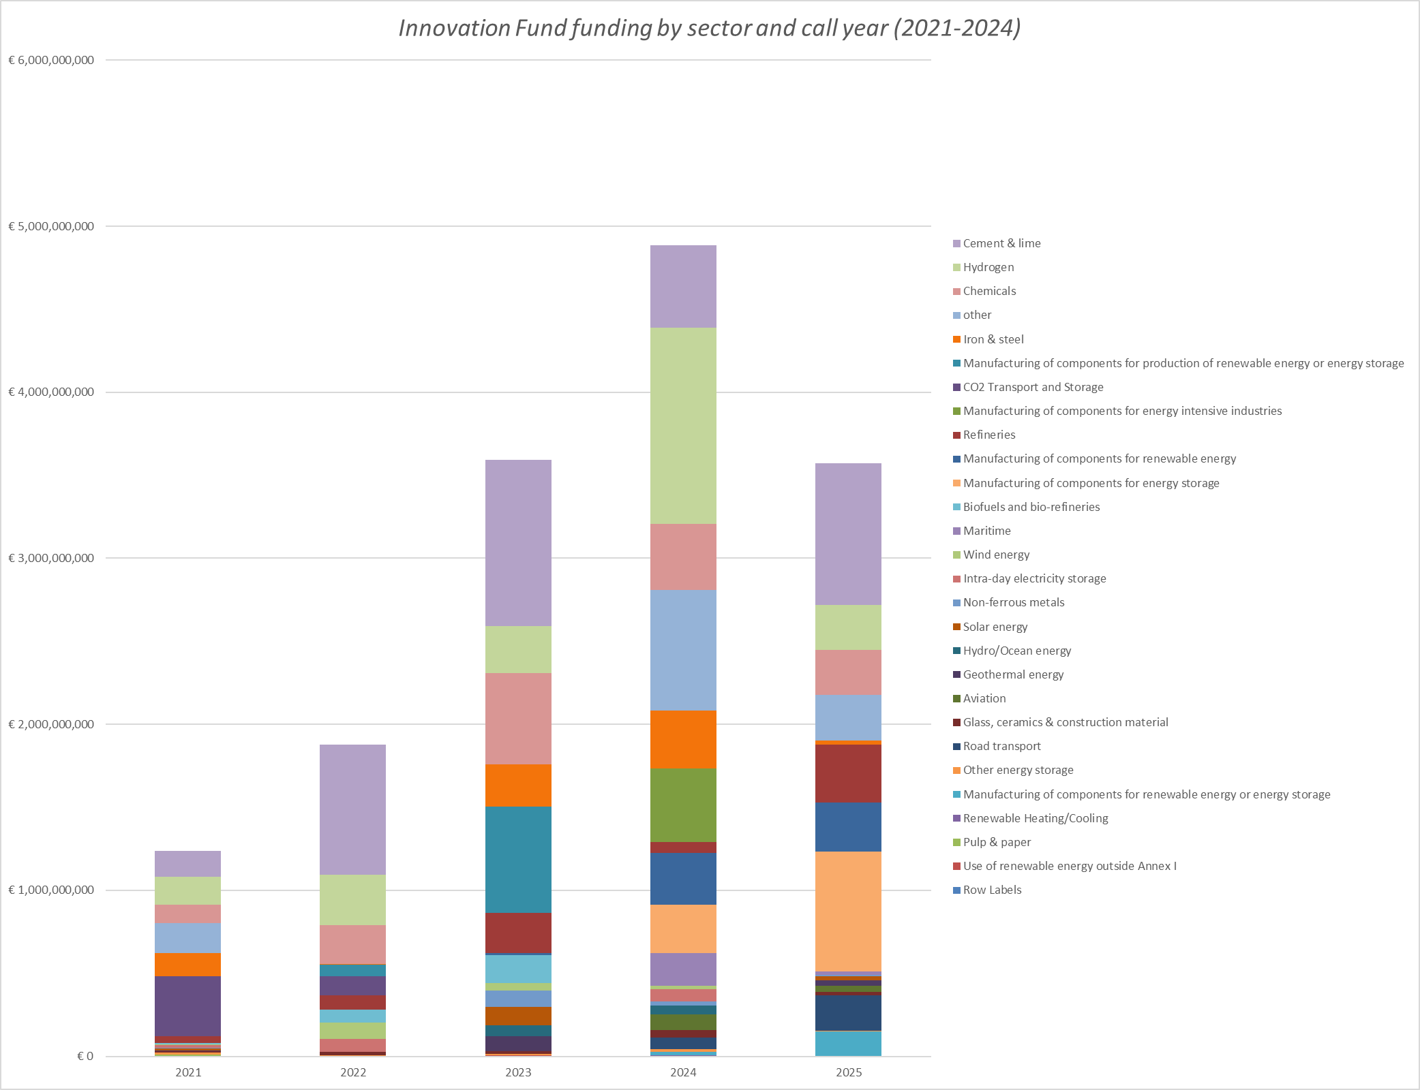
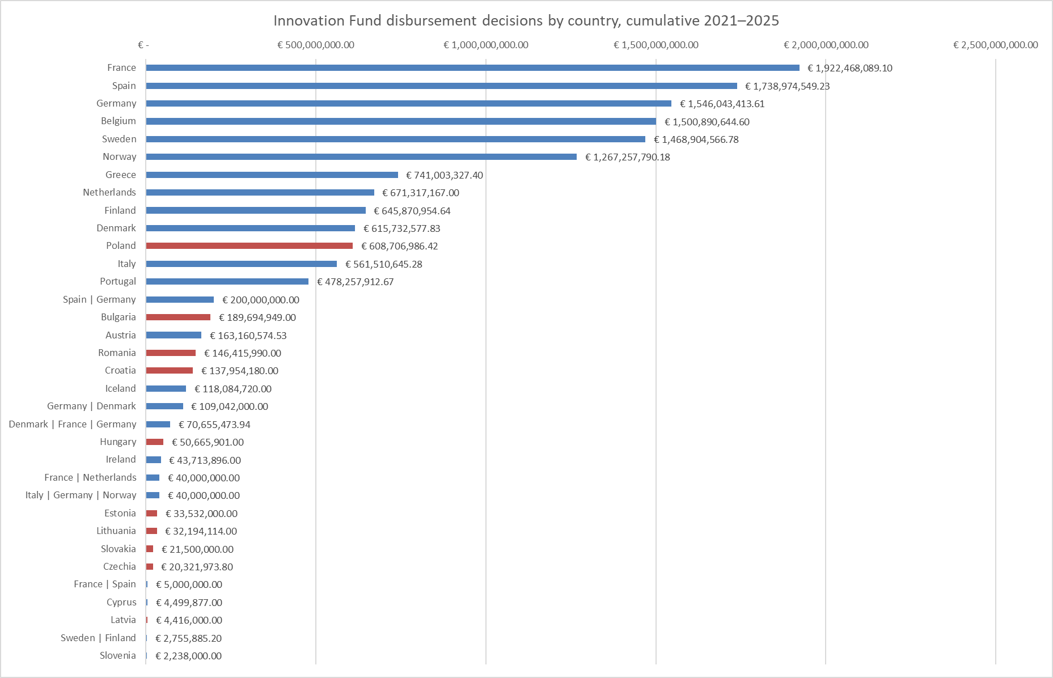
5. Competitiveness and Socio-economic
delivery
Measures to address Competitiveness
Innovation Fund
Innovation Fund funding by sector and call year (2021-2025)
Innovation Fund funding by EU ETS country and geographical division
*
**
***
Source: ERCST, based on disbursement decisions
Source: ERCST, based on Innovation Fund project portfolio dashboard, 2026
Notes:
Funding: 40 billion EUR 2020-2030 (530 million EUAs.).
Innovation Fund status:
On 23 November 2023, the European Commission launched the Innovation Fund 2023 Call, with a total budget of €4 billion.
General: Large-scale projects €1.7 billion
General: Medium-scale projects €500 million
General: Small-scale projects €200 million
Cleantech manufacturing €1.4 billion
Pilots €200 million
Deadline date: 9 April 2024,
New categories:
Large-scale projects - CAPEX > €100 million
Medium-scale projects - €100 million > CAPEX > €20 million
Small-scale projects €20 million > CAPEX > €2.5 million
New category: Cleantech manufacturing for components:
Renewable energy installations
Electrolysers and fuel cells
Energy storage solutions
Heat pumps

Slide 50
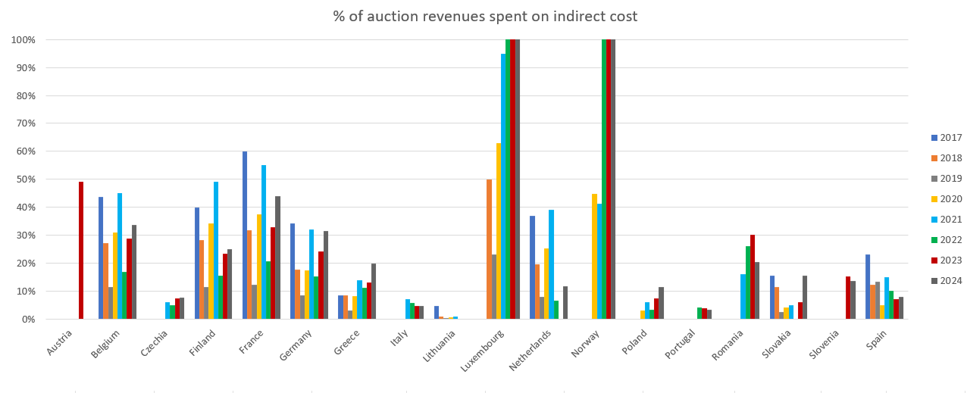
5. Competitiveness and Socio-economic
delivery
Measures to address Competitiveness
Indirect Cost Compensation
KPI 12 % of MS auction revenues spent on indirect cost compensation EU 27 + Norway (2017-2024)
*Luxembourg over share of auction revenues spent on indirect costs in 2022, 2023 and 2024, was above 100%, due to a drop in the country’s auction volume caused primarily by its use of ETS allowances for offsetting emissions in ESR, while in Norway, indirect cost is partly financed by the Norwegian government’s revenues from EU ETS and from the general budget.
* Norway did not join the European ETS auction platform until June 2019 and therefore EUAs auctioned were reported as zero in 2017-2019. Source EEA (2019) Trends and projections in the EU ETS in 2019. Pp 49.
Source: ERCST, based on reports from the European Commission on the functioning of the European carbon market. Data for Norway are provided by Veyt (2024) Miljødirektoratet, “CO₂-kompensasjon,” Norwegian Environment Agency, accessed 11 May 2026, https://www.miljodirektoratet.no/ansvarsomrader/klima/co2-kompensasjon/
Notes:
.

Slide 51
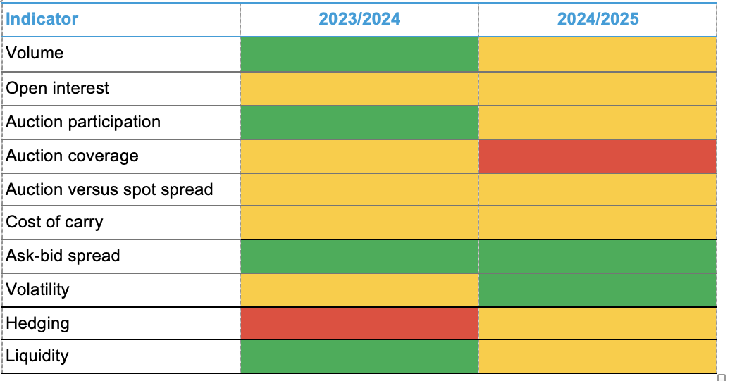
6. Market functioning
Market functioning trackers
Source: BloombergNEF. Note: Green indicates improving, red worsening, amber stable.
Notes:
Bloomberg

Slide 52
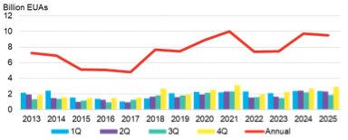
6. Market functioning
Market functioning trackers
KPI 13 Traded volume
Source: ICE, BloombergNEF.
Notes:
Bloomberg
Traded volumes was relatively stable, seeing a minor decrease of 2% y/y.

Slide 53
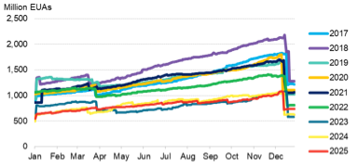
6. Market functioning
Market functioning trackers
KPI 14 Aggregate open interest
Source: ICE, EEX, BloombergNEF.
Notes:
Bloomberg
Open interest was relatively table with a small decrease of 3% y/y. It remains at a low level.

Slide 54
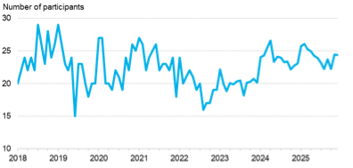
6. Market functioning
Market functioning trackers
KPI 15 Monthly average auction participation
Source: EEX, BloombergNEF.
Notes:
Bloomberg
Auction participation was relatively stable with a 1% increase y/y but say 9% above the 7-year historical average at 24.5. The first half of the year saw higher participation than 2H, which is typically the case.

Slide 55
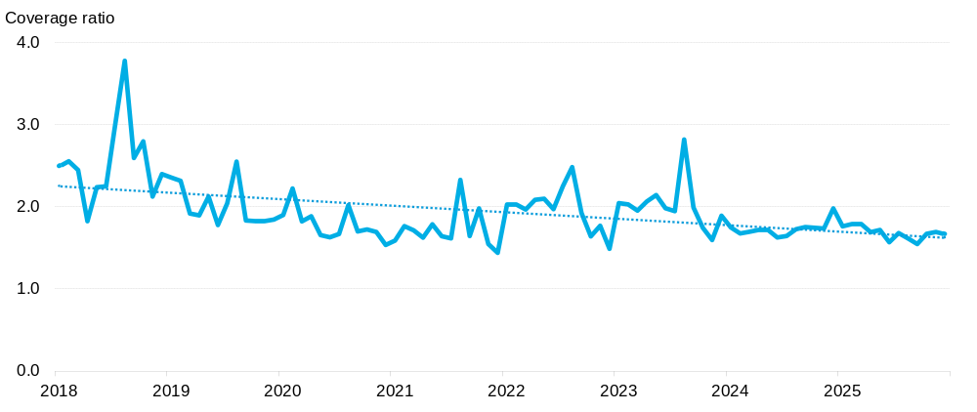
6. Market functioning
Market functioning trackers
KPI 16 EU ETS Auction coverage ratio
Source: BloombergNEF. Note: Coverage ratio is the total number of bids in an auction divided by the number of available EUAs.
Notes:
Bloomberg
Auction coverage ratio saw a small decrease of 3% y/y to 1.68 in 2025.

Slide 56
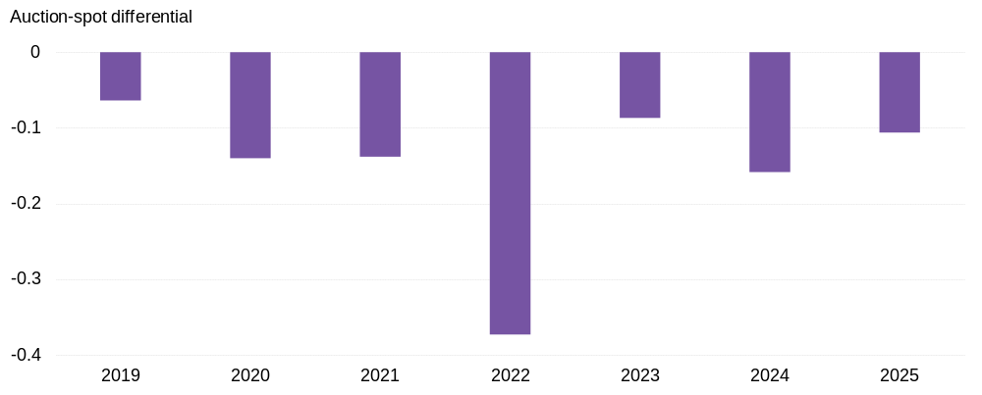
6. Market functioning
Market functioning trackers
KPI 17 Monthly average auction-spot differential
Source: EEX, BloombergNEF. Note: The auction-spot differential is the difference in the EUA price between auctions and on the secondary market.
Notes:
Bloomberg
No major shift in 2025

Slide 57
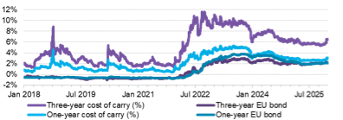
6. Market functioning
Market functioning trackers
KPI 18 Cost of carry: EUA versus EU bonds
Source: ICE, BloombergNEF. Note: Cost of carry here shows the difference between the one and three-years ahead December futures contracts and the front-year December futures contract.
Notes:
Bloomberg
Overall, cost of carry reduced but remains significantly above 2018-21 levels. There was a particularly pick up on the 3-year cost of carry towards the end of last year.

Slide 58
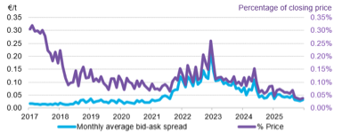
6. Market functioning
Market functioning trackers
KPI 19 Monthly average ask-bid spread on ICE
Source: ICE, BloombergNEF. Note: Ask-bid spread shows the difference between the lowest ask price and the highest bid price in the market at market close, in euros per metric ton and as a percentage of the closing price.
Notes:
Bloomberg
Decreased to €0.04/t from €0.06/t. Signals greater certainty in the market and lower risk.

Slide 59
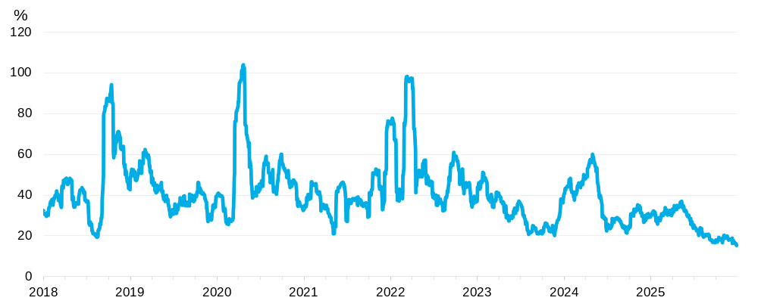
6. Market functioning
Market functioning trackers
KPI 20 Volatility
Source: ICE, BloombergNEF. Note: Volatility refers to the 30-day price volatility. It equals the annualized standard deviation of the relative price change for the 30 most recent trading days’ closing price, expressed as a percentage.
Notes:
Bloomberg
Volatility fell by close to 30% y/y in 2025, particularly in the second half of the year. Can be positive or negative depending on risk appetite

Slide 60
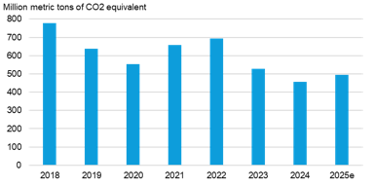
6. Market functioning
Market functioning trackers
KPI 21 Utilities’ hedged holdings
Source: BloombergNEF, various company reports. Note: Data as of August 2025.
Notes:
Bloomberg
Power sector hedging increased slightly, pulling up the net hedging holdings of EUAs by compliance entities. This was driven by emissions rising slightly y/y in 2025. (check if this was related to lower wind output/hydro?).

Slide 61
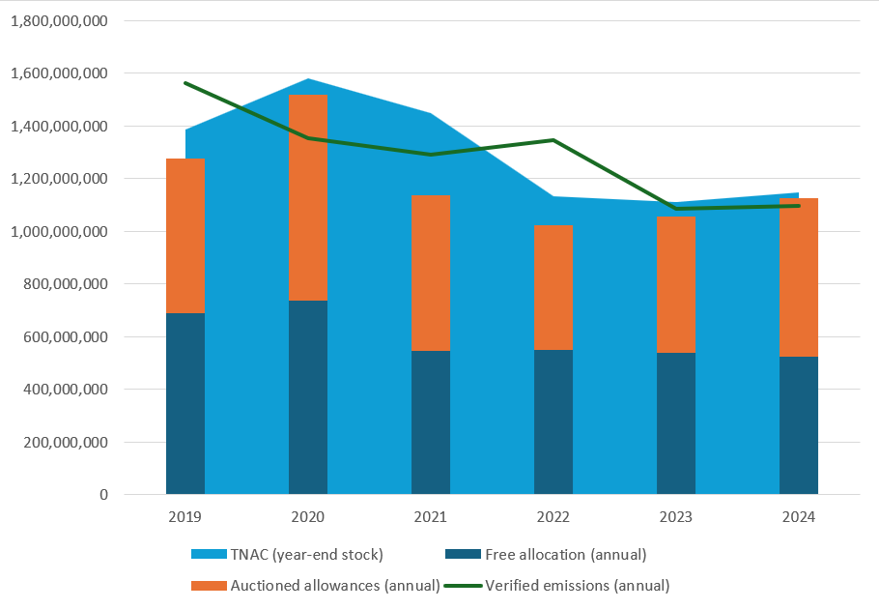
6. Market functioning
KPI 22 Supply-demand balance and evolution of TNAC
Source: ERCST, based on the carbon market reports and the MSR documents of the European Commission.

Slide 62
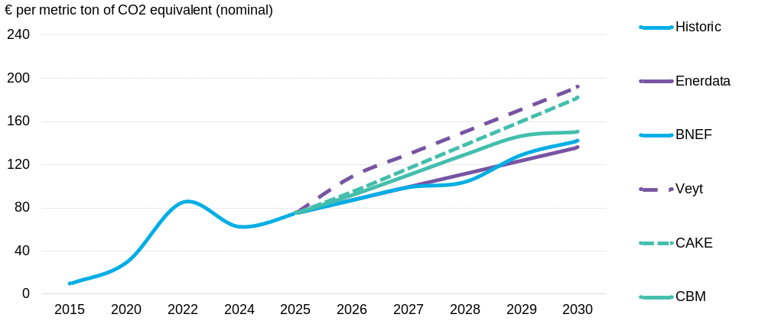
6. Market functioning
EUA Price forecasts
Source: Ariadne Project (2025), based on data from BloombergNEF, Veyt, Enerdata, CAKE/KOBIZE, and ClearBlue Markets.
Notes:
Bloomberg

Slide 63
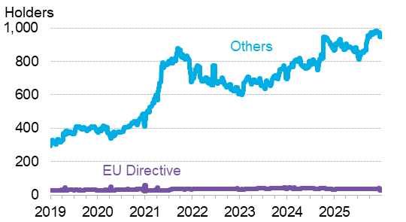
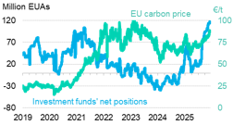
6. Market functioning
KPI 23 Net position holders
KPI 24 Investment funds' net position
Source: ICE, EEX, BloombergNEF. Note: Data is from Commitment of Traders (CoT) database.
Notes:
Bloomberg
Holders of EUAs by non-compliance entities has steadily grown, averaging over 900 which is up around 10% y/y from close to 815 in 2024. Meanwhile net position holders of EUAs by EU directives is relatively stable at around 37.
Towards the end of the year investment funds piled into the market and investment fund’s net positions in the market grew to its highest level, just shy of 120 million allowances by year-end. This bolstered EU carbon prices, largely due to expectations for tight supply-demand balance for the year ahead.

Slide 64
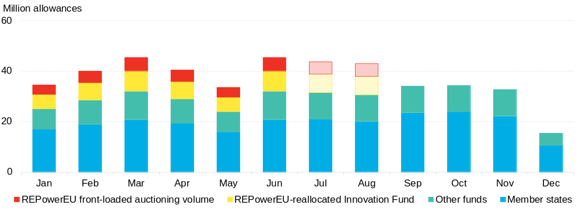
6. Market functioning
KPI 25 REPowerEU
Source: European Commission, BloombergNEF. Note: Volumes from September onwards are adjusted by BNEF’s estimate of Market Stability Reserve injections.
Notes:
Bloomberg

Slide 65
7. Looking forward
Policy | EU ETS 2026 Review
Details | 2026: The Commission is expected to review the EU ETS Directive, including: •⁠ ⁠The functioning of the EU ETS after the recent Phase 4 reforms and the alignment of the cap with the EU’s 2040 climate target. •⁠ ⁠The linear reduction factor and the future trajectory of the cap beyond 2030. •⁠ ⁠The scope of the system, including possible adjustments for sectors already covered by the EU ETS and the interaction with ETS2. •⁠ ⁠The role of free allocation, CBAM and carbon leakage protection for energy-intensive industries. •⁠ ⁠The use of auction revenues, Innovation Fund and Modernisation Fund support to drive industrial decarbonisation. •⁠ ⁠The impact on growth, jobs, affordability, industrial competitiveness and the EU’s ability to maintain a strong carbon price signal.
Impact? | It is difficult to predict at this stage what will be the impact of this review on the architecture, governance and functioning of the EU ETS. It will have to be a carefully crafted compromise to ensure that competitiveness is addressed while maintaining a price signal for decarbonization. It will also be largely dependent on what the time horizon to consider the EU ETS “fit for purpose” will be: until the next review, or if we take a 2040-time horizon. In the former, it becomes a technical review with fewer political choices. If the latter is the choice, then significant changes may be necessary, with the difficult political choices that it entails.
Notes:
Bloomberg

Slide 66
7. Looking forward
Policy | Carbon Border Adjustment Mechanism (CBAM)
Details | Q2 2026: Commission published the draft Implementing Act on the deduction of carbon prices paid in third countries (Article 9) in May 2026 for a four-week public feedback period, with adoption expected to follow. This was the last outstanding element from the December 2025 package. 2026–2027: Ordinary legislative procedure on downstream extension + anti-circumvention and on Temporary Decarbonisation Fund; Council and Parliament positions expected through 2026. Q3/4 2027: First annual CBAM declaration deadline (for 2026 imports). 2027: Commission report evaluating extension to indirect emissions and to further sectors such as chemicals. Q4 2027: Commission to review and evaluate progress in international climate negotiations. Q1 2028: First biennial Commission report on CBAM's impact on carbon leakage, including exports.
Impact? | The downstream extension is the central file to watch: if adopted, it would bring approximately 180 additional steel- and aluminium-intensive products into CBAM scope from 1 January 2028, capturing around 7,500 additional importers. The true impact will depend on the final scope agreed by co-legislators. On the export side, the Commission has not put forward a structural solution; the Temporary Decarbonisation Fund is the transitional answer for 2028–2029, drawing on 25% of CBAM revenues to partially compensate exposed EU producers. Given its limited size and duration, it functions as a bridge, with the durable export solution expected in the upcoming ETS review opening in July 2026. The Article 9 Implementing Act remains the most consequential near-term file for third-country carbon-pricing recognition, default carbon prices, and the treatment of taxes, subsidies and offsets. The Commission published the draft act in May 2026 for a four-week public feedback period, with adoption expected to follow. Looking further out, the 2027 CBAM review remains the main moment for a second wave of scope expansion, including the assessment of indirect emissions in current CBAM goods and the potential inclusion of new sectors such as chemicals and polymers, alongside a broader review of default values. Taken together with the downstream extension, these developments will reshape the interaction between CBAM and the EU ETS, and their net effects on EUA dynamics will need to be understood as the files take shape.
Notes:
Bloomberg

Slide 67
7. Looking forward
Policy | Permanent, and non-permanent removals (CCU)
Details | By July 31, 2026: Commission to publish a report on integrating negative emissions (including but not limited to BECCS and DACCS), into the EU ETS. Commission to review also whether double counting is avoided, and to assess ways to account for emissions that have been captured and utilised in a product, but risk entering the atmosphere during or after normal use.
Impact? | With current information available and pending substantial legislative developments, assessing the impact of including CCU in EU ETS is challenging. Impact will depend on final decisions, accounting methodology, and EU ETS expansion to new sectors (i.e. municipal waste incinerators). There may be an increase in EUA demand for products that were previously exempt from surrendering allowances, such as Precipitated Calcium Carbonate (PCC). Under the current revisions, part of PCC will have to bear the cost of CO₂ usage when its end application is not considered permanently chemically bound. Moreover, the decision regarding the inclusion of CCU has not yet been finalised, making it impossible to accurately assess the potential impact on EUA demand. An expansion of the list of permanently chemically bound products may lead to a decrease in demand for EUAs for these. This is unlikely to significantly impact the market if no substantial amounts are available. Conversely, if the list of permanent chemically bound products is reduced, these products will need to pay for the CO₂ they emit, resulting in increased demand for EUAs. From an environmental point of view, the wider the list of CCU products recognised as not emitting or partially emitting CO₂, the greater the incentive to reduce GHGs. This approach makes sense if permanently chemically bound products, which do not emit CO₂ under regular use, are exempt from surrendering certificates. The recognition of CCU (both permanent and non-permanent) in EU ETS could be a first step for the accounting of negative emissions as we approach net zero. If negative emissions are included in the EU ETS, in the long term, the increased supply of EUAs/CDRs could counterbalance the expected price increase of EUAs from a stricter cap and facilitate EU decarbonisation. Stricter environmental provisions should be in place to avoid mitigation deterrence.
Notes:
Bloomberg

Slide 68
7. Looking forward
Policy | Municipal Waste Installations (MWI)
Details | As part of the 2026 EU ETS Review, by July 31, 2026: Commission to release a report and if positive, legislation for the inclusion of MWI into the ETS by 2028. Q1 2028: Emissions from MWI installations would be included in ETS1. Q1 2030: Until 2030, Member States will have the possibility to opt out of MWI from the ETS1 (Art 30 (7)).
Policy | Aviation
Details | 2025 - 2026: Flights within the EEA area will lose 50% of free allowances, with a phased out by 2026. By July 31, 2026: The Commission reviews CORSIA as part of the 2026 EU ETS Review. Q1 2027: Possible inclusion of flights between the EEA and non-EEA airports into ETS1 in case CORSIA does not deliver.
Impact? | The inclusion of new sectors in EU ETS should not damage the functioning of the carbon market but instead increase the cap and bring additional supply of EUAs. The inclusion of municipal waste incinerators could have implications for the accounting of CCU, as the EU ETS value chain expands. An important question is who will benefit from claiming utilised CO₂, to avoid paying for carbon which is not emitted but utilised. The inclusion of international aviation in EU ETS could have implications for the relationship between CORSIA and EU ETS. From an environmental perspective, it is reasonable to consider that the higher the number of trips covered by EU ETS, the better the carbon footprint, as currently EU ETS is more ambitious than CORSIA. From a market perspective, it should enhance liquidity and demand for EUAs, as free allocation for aviation will end by 2026.
Policy | Maritime transport
Details | 2027 - 2028: To include offshore ships exceeding 5,000 gross tonnage and potentially incorporate smaller offshore ships. Q1 2028: Shipping 100% emissions on journeys between EU and non-EU ports if the IMO mechanisms are deemed not ambitious enough.
Impact? | The extension of ships covered by EU ETS should increase the demand for EUAs and bring market pressures. If additional trips are covered by EU ETS, this trend could be accentuated. Similar to aviation, the inclusion of international maritime voyages should improve their carbon footprint. It will be important to observe how IMO articulates with EU ETS in the future.
Policy | International Linking
Details | Q2 2026: Commission to review the possibility of linkages between the EU ETS and other carbon markets.
Impact? | Following the Swiss example, international linking should be a positive development for the EU ETS. it will increase the number of participants in EU ETS, increasing market size, trading and liquidity. If it is the same level of ambition, it should also reduce the risk of carbon leakage vis-à-vis linked jurisdictions. Impact will depend on linking conditions, sector coverage, and exchangeability of credits.
Notes:
Bloomberg

Slide 69
7. Looking forward
Policy | ETS for Road transport, buildings and other sectors not covered by ETS1 (ETS2)
Details | By July 31, 2026: Commission to decide whether to include installations below 20MW total rated thermal input (Annex I) in ETS1. If not, they will join ETS2. Q2 2027: Commission to review the ETS2, evaluating its effectiveness, administration, and practical application. Q1 2028: ETS2 commences. Before 2031: Commission to decide if EU ETS1 and ETS2 should be merged.
Impact? | The inclusion of ETS2 in ETS1 in the future could increase market size, reduce transaction costs and increase market supply. This development could be especially relevant to bringing market liquidity in EU ETS into a shorter market. Current ETS1 covered sectors are expected to decarbonise in the 40s and the availability of EUAs will be limited.
Policy | Benchmark update
Details | May 2026: Implementing Act updating, for the period 2026-2030, the benchmark values on the basis of 2021 and 2022 data, applying the annual reduction rate between 2008 and 2028 [Article 10a (2) (c) of the EU ETS Directive].
Impact? | More stringent benchmarks will reduce the amount of free allocation available to compliant entities. If CBAM is on top, the speed of free allocation phase-out will increase. By extension, it will increase the demand for EUAs to cover emissions, thus increasing carbon prices. From an environmental impact, the faster the phase-out of free allocation the higher the risk of carbon leakage, as long as no other effective instruments in place. In the end, this could impact not only the climate but also competitiveness of EU industries.
Notes:
Bloomberg

Slide 70
7. Looking forward
Policy | Industrial Decarbonisation Bank
Details | June 2026: EC legislative proposal aiming at EUR 100 billion funding to support industrial decarbonisation. Existing Innovation Fund: 20 billion (starting from 2025) 10% of Member States EUAs Auctioned in 2028-2037: EUR 33 billion. InvestEU: 2.5 billion (leverage factor of 10 to make total leveraged amount EUR 33 billion).
Impact? | On the Innovation Fund share, there is no indication that additional EUAs will be sold in the market thus no expected impact. The impact on the market related to auctioning shares will depend on the distribution of EUAs across periods (i.e. frontloading in REPower EU), otherwise, there will be no direct impact on EUA supply. An indirect impact could still happen on the EU ETS. If successful, the Bank could accelerate emission reduction in EU industry, leading to a lesser demand for EUAs. Still, many uncertainties remain until the legislative proposal in 2026.
Notes:
Bloomberg

