Slide 1
Andrei Marcu, Executive Director, ERCST
Pauline Nouallet, Senior Policy Analsyst, ERCST
Alexandra Maratou, Senior Policy Analsyst, ERCST
Mehtap Alper Saglam, Researcher, ERCST
EU Climate Policy and Electricity Market
Report launch - Electricity Market Design, Decarbonization, and Industries’ competitiveness

Slide 2
EU Climate Policy and Electricity Market
Concept
Framework for analyzing the European Commission (EC) proposal on electricity market reform through the lens of Climate Change Policy - provide stakeholders with a tool and means for examining /analyzing the proposal through a climate change perspective
Matrix including the following:
Electricity Market Design Provisions on the vertical axis
  Short-term Pricing Mechanisms ;
  Medium to Long-term instruments;
  Flexibility Options;
Desirable Outcomes on the horizontal axis
  Short term signals for decarbonisation
  Long term signals for decarbonisation
  EU Industries’ Competitiveness
  Affordability
  Security of Supply
Looking at how some of the Electricity Market Design Provisions, in interaction with EU-ETS and other climate policies, impact (positively or negatively) on the Desirable Outcomes.

Slide 3
EU Climate Policy and Electricity Market
Framework matrix
Desirable Outcomes EMD Provisions | A. Short-term signals for decarbonization | B. Long-term signals for decarbonization | C. Competitiveness | D. Affordability | E. Security of Supply
1. Short-term Pricing Mechanisms
1. i) Marginal Pricing
Marginal Pricing Mechanism | + | o | o | o | +
1. ii) Market Interventions
Iberian Exception | - | - | + | + | o
Inframarginal Revenue Cap | - | - | + | + | o
Windfall Profit Tax | o | - | + | + | o
2. Medium to Long-term Instruments
PPAs, CFDs, Forward Markets | o | + | + | + | +
Capacity Remuneration Mechanisms | + | + | + | + | +
3. Flexibility Options
Flexibility Options (Storage and Demand Side Management) | + | + | + | + | +

Slide 4
EU Climate Policy and Electricity Market
Framework matrix
Focus on interactions’ cells 1, 2, and 3
Desirable Outcomes EMD Provisions | A. Short-term signals for decarbonization | B. Long-term signals for decarbonization | C. Competitiveness | D. Affordability | E. Security of Supply
1. Short-term Pricing Mechanisms
1. i) Marginal Pricing
Marginal Pricing Mechanism | + | o | o | o | +
1. ii) Market Interventions
Iberian Exception | - | - | + | + | o
Inframarginal Revenue Cap | - | - | + | + | o
Windfall Profit Tax | o | - | + | + | o
2. Medium to Long-term Instruments
PPAs, CFDs, Forward Markets | o | + | + | + | +
Capacity Remuneration Mechanisms | + | + | + | + | +
3. Flexibility Options
Flexibility Options (Storage and Demand Side Management) | + | + | + | + | +
1
2
3

Slide 5
Electricity Market Design, Decarbonization, and Industries’ competitiveness
Overview of the Report
  Table of Contents
Introduction
1.1. Background to the electricity market design reform
1.2. Structural and emerging issues
Short-term pricing mechanisms, short-term market interventions, and their link to decarbonization.
2.1 Marginal pricing in wholesale electricity market ( Marginal pricing mechanism, merit order and ETS ; Cannibalization/Profile Risk)
2.2 Short-term market interventions (Iberian exemption; Inframarginal Revenue Cap; Emergency measures effects)
Medium- to long- term instruments, and their link to decarbonization
3.1 Power Purchase Agreements (PPAs)
3.2 Contracts for Differences (CfDs)
3.3 Complementary mechanisms enabling RES integration
Electricity Market Design Reform and industries’ competitiveness
4.1 Short-term market interventions
4.2 Long-term instruments (PPAs, CfDs)
4.3 Market design proposals for risk reduction
Takeways

Slide 6
Electricity Market Design, Decarbonization, and Industries’ competitiveness
1. Introduction
  1.1. Background to the electricity market design reform
The EU power system and market have undergone changes over the past two decades, prompting calls for electricity market redesign. The 2022 energy crisis has intensified the need for reform.
The EU wholesale market operates on a marginal pricing mechanism and merit order, encouraging, in the short-term emissions reduction when combined with the EU ETS.
However, it's recognized since the early 2000s that these mechanisms don't provide sufficient long-term signals for investments in renewables and low-carbon energy to meet 2050 decarbonization targets. The UK introduced complementary measures in 2014 to support this transition (auctioned CfDs),
Historically, the EU had excess power capacity, ensuring grid stability and lower electricity prices. But with liberalization, a shift to capacity shortages and market fragility emerged.
This shift made the EU energy market more vulnerable to disruptions and price fluctuations, necessitating measures to address growing electricity demand and ensure market stability.
The recent reduction in Russian gas supply triggered the 2022 EU energy crisis, revealing weaknesses in the EU electricity market design, including a lack of resilience, high price volatility, and inadequate incentives for long-term planning and investments.
Notes:
The EU power system and market have undergone a gradual transformation over the past two decades, prompting calls for a reconsideration of the electricity market design.
The 2022 energy crisis has intensified the urgency for reform in the EU's power system and market.
The wholesale market in the EU operates on the marginal pricing mechanism and merit order, which, when combined with EU ETS, encourages short-term emissions reduction by prioritizing cleaner energy sources.
Despite these mechanisms, there has been a recognition since the early 2000s that the short-term wholesale market and ETS do not provide adequate long-term signals to incentivize investments in renewables and low-carbon energy, necessary to achieve the 2050 decarbonization targets.
The UK government introduced complementary measures, such as auctioned Contracts for Difference (CfDs), in 2014 to support the transition to a low-carbon energy system.
Historically, the EU power system had excess capacity, which ensured grid stability and relatively low electricity prices.
Liberalization of electricity markets since the mid-2000s led to a transition from surplus capacity to capacity shortages and market fragility, driven by factors like economic growth, energy policy shifts, renewables' intermittency, and delays in infrastructure upgrades.
This shift made the EU energy market more vulnerable to disruptions and price fluctuations, necessitating measures to address growing electricity demand and ensure market stability.
The recent reduction in Russian natural gas supply to the EU triggered the 2022 energy crisis, resulting in record-high gas and electricity prices.
The crisis exposed weaknesses in the European electricity market's design, including a lack of resilience to supply shocks, high exposure to price volatility, and insufficient incentives for long-term planning and infrastructure investments

Slide 7
Electricity Market Design, Decarbonization, and Industries’ competitiveness
1. Introduction
  1.2. Structural and Emerging issues
The CO2 and electricity markets must align or not hinder each other, as they closely interact and actions in one can affect the other.
Both markets have worked together to provide short-term decarbonization signals and phase out fossil-fuel-based generation.
However, there is a shift towards renewables, leading to a need for market design adjustments to accommodate decentralization and intermittency.
The absence of long-term visibility in both markets hampers their ability to provide the necessary long-term signals for decarbonization.
Achieving 2050 decarbonization targets and meeting rising electricity demand requires significant investment in renewable energy (RE) capacity.
Longer-term visibility in the electricity market serves two critical purposes: protecting consumers from price volatility and attracting the necessary investments for a net-zero carbon emissions future.
The recent energy price spikes have adversely affected EU energy-intensive industries, necessitating access to renewable, non-fossil, and affordable power to enhance competitiveness and sustainability.
Longer-term visibility fosters a stable and predictable environment, benefiting both consumers and investors and supporting the sustainable, low-carbon energy transformation essential for achieving climate objectives.

Slide 8
Electricity Market Design, Decarbonization, and Industries’ competitiveness
2. Short-term pricing mechanisms, short-term market interventions and their link to decarbonization
  2.1. Marginal pricing in wholesale electricity market
Characteristics of Electricity Pricing:
Electricity cannot be economically stored, leading to constant production adjustments.
The EU's wholesale market uses marginal pricing based on the last, most expensive unit called on to meet demand.
Marginal pricing is determined by variable costs (fuel, maintenance) and is independent of fixed costs.
Renewable energies have low marginal production costs, while fossil fuels have higher costs, including CO2 emissions.
Implications of the Pricing System:
Electricity prices are set by the highest marginal cost, determining the market clearing price.
Carbon costs push fossil-fuel plants down the merit order.
Marginal pricing encourages using low-carbon sources and reducing emissions.
It supports innovation and allows renewable energy to recover some of their capital costs.
Energy consumers receive scarcity signals to adapt consumption.
Renewables can lower electricity costs, but oversupply can lead to "price cannibalization."
In the long-term, marginal pricing may not provide adequate signals for decarbonization.
Zero-variable cost technologies require scarcity pricing for efficient incentives.
Investors face risks and uncertainties in the absence of scarcity events.
Notes:
captures the main points about electricity pricing, its implications, and the challenges it poses, especially in the context of decarbonization and the growth of renewables in the energy market.

Slide 9
Electricity Market Design, Decarbonization, and Industries’ competitiveness
2. Short-term pricing mechanisms, short-term market interventions and their link to decarbonization
  2.2. Short-term market interventions
Overview of implemented measures
A total of 439 measures of 28 types were implemented during this period.
About two-thirds of the measures focused on affordability for end-consumers, and one-third aimed at broader security of supply objectives.
Half of the measures provided direct support to consumers, while the other half aimed at promoting energy efficiency and renewable generation.
Specific measures discussed (Iberian Exemption and Inframarginal revenue cap)
The Iberian Exemption:
Spain and Portugal implemented a temporary mechanism targeting marginal power plants. (extended to end of 2023)
It involves subsidies to thermal units (gas, coal, and CHP) as a mean to reducing wholesale electricity prices (generators submit lower bids into the power market).
However, it also contributed to increased power exports to France, higher gas demand in the Spanish power sector, no incentive to reduce power consumption, and a decrease in market liquidity.
Notes:
discusses various emergency measures implemented by countries in the energy sector between July 2021 and February 2023. These measures aimed to address issues related to electricity pricing, affordability, and security of supply, particularly in the context of decarbonization and the growth of renewables

Slide 10
Electricity Market Design, Decarbonization, and Industries’ competitiveness
2. Short-term pricing mechanisms, short-term market interventions and their link to decarbonization
  2.2. Short-term market interventions
The Inframarginal Revenue Cap:
The Council introduced a temporary revenue cap on 'inframarginal' electricity producers to address high energy prices.
The implementation of this cap varied across EU member states, resulting in a lack of harmonization.
Caps on market revenues can undermine renewable energy investments and decarbonization goals.
These caps also created policy uncertainty, impacting investments and climate policies.
Impacts and Consequences of Emergency Measures:
Emergency measures met short-term objectives but entailed significant costs and unintended impacts.
Some measures led to increased emissions and slowed down decarbonization efforts.
They eroded confidence in regulatory frameworks and investor trust in the EU's integrated electricity market.
Emergency measures could also pose risks in terms of international trade.
The passage of emergency measures shifted decision-making from the ordinary legislative procedure to crisis legislation, allowing more flexibility but sometimes leading to poorly designed interventions.
The EMD reform introduces criteria for declaring an electricity price crisis to manage future emergency measures more effectively. These criteria need to be well defined to be effective.

Slide 11
Electricity Market Design, Decarbonization, and Industries’ competitiveness
3. Medium to long-term instruments, and their link to decarbonization
  3.1. PPAs
Barriers in the EU PPA market involve price risk, creditworthiness, contract complexity, and limited access for SMEs and heavy industries, with the reform aiming to address these issues.
PPAs are essential for advancing decarbonization efforts, providing long-term signals for renewable and low-carbon projects, and positively interacting with the EU ETS.
Entities entering green PPAs commit to using decarbonized electricity, reducing emissions, and decreasing the need for carbon allowances.
Well-functioning PPAs can stabilize attract investments in low-carbon technologies and incentivize subsectors to engage in low-carbon PPAs to reduce emissions.
Challenges in PPA markets include dependence on fossil fuel-based power prices, which may limit corporate PPA activity and industry access to affordable low-carbon electricity.
Offshore renewable energy sources, like offshore wind, face hurdles due to high capital requirements, requiring additional support measures such as government guarantees and specific auctions to enable their deployment

Slide 12
Electricity Market Design, Decarbonization, and Industries’ competitiveness
3. Medium to long-term instruments, and their link to decarbonization
  3.2. CfDs
Public support schemes are crucial for renewable energy development when market-based approaches are insufficient.
They reduce investment risks and improve project bankability, aiding the achievement of renewable energy targets.
Power Purchase Agreements (PPAs) and Two-way CfDs have complementary roles, with PPAs offering revenue certainty and direct buyer relationships.
The design of two-way CfDs is largely left to Member States under the EMD reform, but clarity in design parameters is crucial for effectiveness.
Two-way CfDs can support innovative and capital-intensive technologies, like offshore wind, promoting diversification in low-carbon energy sources.
Technology-specific circumstances can be considered to provide long-term signals for decarbonization and a level playing field in renewable energy development.
Indexation of prices in CfD auctions is crucial to account for market price increases and inflation.
Two-way CfDs can support new investments in electricity generation from renewable energy sources or nuclear power, including repowering and extending existing facilities.
Even though there is a debate among EU Member States regarding using public funds to extend the lifetime of nuclear power facilities, nuclear energy can play a crucial role in achieving decarbonization goals by providing essential base load energy for phasing out carbon-intensive electricity production

Slide 13
Electricity Market Design, Decarbonization, and Industries’ competitiveness
3. Medium to long-term instruments, and their link to decarbonization
  3.3. Complementary mechanisms enabling RES integration
Instruments additional to the market i.e. Capacity Remuneration Mechanisms (CRMs) that create direct investment signals are needed to ensure security of supply in the presence of market imperfections
No “blueprint” or common framework in the EU for CRMs → their Implementation varies: some countries have quantity-based schemes (capacity obligations or auctions), some price-based schemes (capacity payments, strategic reserves).
CRMs initially implemented for fossil-based power plants
Growing need for flexibility adequacy with increased renewable energy integration.
To further provide medium to long term signals for decarbonization, CRMs can be geared towards providing additional revenues to new flexibility resources needed to integrate more renewable energy into the grid.
Forward looking, all countries can be envisaged to have some kind of remuneration mechanism for flexibility.
  In countries with CRMs in place this could be done by integrating flexibility in the participation criteria.
  Countries with no CRMs would need to develop dedicated mechanisms for flexibility.
  EMD proposal explicitly recognizes the role of demand side management and storage; It implicitly remains vague about the role of other flexibility sources that could potentially prove cheaper (e.g. hydrogen or biomethane gas turbine plants or other technologies that might emerge in the near future) and this could be a missed opportunity
Environmental criteria, such as emission limits, can be integrated into CRMs to prevent lock-in of high-emission technologies; keeping in mind however that giving up on technology neutrality comes with economic costs.

Slide 14
Electricity Market Design, Decarbonization, and Industries’ competitiveness
4. EU Industries’ Competitiveness
  4.1. Short-term interventions
    Interventions in the wholesale and/or the retail market in most EU countries; E.g. price or bid limits, revenue caps, windfall profit taxes, or regulation of retail tariffs.
    Several measures in the form of direct support to final consumers, incl. state aid to energy-intensive industry.
    Measures met their objective of shielding consumers from high prices in the short term, however they entailed significant spending, might have had unintended consequences (e.g. increased emissions)
    From an international trade point of view, measures involving governments subsidizing electricity prices for industry, might be defended as temporary/exceptional, but may run counter to principles of world trade if extended.
    Going forward,
      State aid: measures supporting decarbonisation investments by industry like CCfDs are more defendable compared to electricity price subsidies; they are also aligned with the Temporary Crisis and Transition Framework.
      Market design: can some of these measures be ex-ante integrated in the market design to provide a more predictable and uniform solution across EU?

Slide 15
Electricity Market Design, Decarbonization, and Industries’ competitiveness
4. EU Industries’ Competitiveness
  4.2. PPAs
Public guarantees to remove creditworthiness barrier: challenge of overcoming risk of moral hazard;
Heavy industry see a risk of price decline, which prevents them from contracting (a large share of) demand via PPAs (source: Baringa, 2022, study for the EIB/EC)
When retailers are the counterparties, what can be done to ensure that conditions/benefits are passed on to final users?
Low carbon generation developers ideally want PPAs covering the entire lifetime of assets, while industry offtakers might be reluctant to sign very long contracts. To bridge contract duration appetite, is there a role for a government intermediary (i.e. the regulator) that signs 15-20 years with developers and 2-3 year contracts with offtakers?
Is there a role for standardization of PPAs? If governments provide guarantees some form of standardization can reduce the risk of moral hazard. It could also reduce complexity and improve accessibility for smaller players.
Some governments have better capacity/experience in offering guarantees. Is there a role for the EU and financial institutions like EIB in leveling the playing field, through instruments enabling guarantees or work on standardisation?
An increased role for PPAs can be envisaged; Notwithstanding, other types of contracts and forms of government support will play an important role in delivering the scale of investment needed for achieving climate and energy goals.
  4.3. CfDs
    How will potential revenues be allocated? Should there be preferential treatment of certain users? The decision on how to allocate could become a tool for competitiveness.
    CfDs derisks the producer side but not the consumer. Is there a need for a ‘reverse’ CfD for consumers?
Notes:
How will potential revenues be allocated? Should there be preferential treatment of certain users? The decision on how to allocate could become a tool for competitiveness.
CfDs derisks the producer side but not the consumer. Is there a need for a ‘reverse’ CfD for consumers?

Slide 16
Electricity Market Design, Decarbonization, and Industries’ competitiveness
4. EU Industries’ Competitiveness
  4.3. Market design proposals for risk reduction
A potential departure from marginal pricing has been a recurring topic in academic circles (especially in the UK), and more recently in EU political circles.
EU countries divided on the topic. Some governments have in the past years gone to Brussels with the message that the current design does not work. Others have advocated against far-reaching reforms.
The marginal pricing model has been generally accepted by economists as best suited for liberalised electricity markets, as it (theoretically) provides efficiency, transparency and incentives to keep costs as low as possible.
However, this rests on an assumption that does not apply in practice: the free entry (and exit) condition.
Revisiting the current marginal pricing model, in the sense of assessing/comparing it to alternative setups, does not have to be a taboo topic.
Various proposals for a more profound reform have been put forward, ranging from adjusting the marginal pricing mechanism to completely doing away with it. (Annex 1 of the report with overview of proposals)
    E.g. split markets proposal, creating Green Power Pools or RE pools, having a government agency as the sole offtaker of power, integrating a temporary ‘relief valve’ mechanism in the market design triggered only under exceptionally high prices, “pay-as-bid”, etc
    Proposals to reduce the risk of price volatility for consumers or also investment risks for producers

Slide 17
Electricity Market Design, Decarbonization, and Industries’ competitiveness
5. Takeaways
Key takeaways:
The issues discussed in the report can be divided into short-to-medium term and long-term. The former can be seen as a matter of “survival”, while the latter as providing the signal for investment in decarbonized electricity, the only reasonable approach to ensure the survival of EU industry in the context of carbon prices and increasingly ambitious climate policy.
While solutions for long-term investment signals are presented, the challenge for solutions for the short term lies in ensuring that they do not conflict with climate objectives.
The balance between the short-term and long-term signals is missing from the debate. Having more of a sense of how much of the market would be navigating on long-term contracts and how much on marginal pricing, would allow carbon markets to better integrate long-term price signals into the carbon price.
Given the interconnectivity of the EU power system, coordination of investment planning at EU level is needed, if we are not to lose sight of the aspiration of having an efficient and resilient power system at the European level.
There are doubts whether the current marginal pricing system, which remains in place, applies itself well to a new decentralized and RE focused energy matrix resulting from the increasingly ambitious decarbonization policies.

Slide 18
Electricity Market Design, Decarbonization, and Industries’ competitiveness
5. Takeaways
After restructuring, the absence of long-term markets started to be felt, and investments largely came to a stall (except for subsidized ones).
Due to this prolonged period of underinvestment, electricity prices are likely to continue to remain a challenge
In the long-term, the solution that is clearly emerging is that of electrification and decarbonization of the power industry through renewables, and nuclear.
A significant amount of investment is required, and the signal from the electricity market, the carbon market and the interaction between these needs to ensure a good framework to incentivize these investments.
CfDs, cCfDs, and long-term PPAs, along with capacity and flexibility remuneration mechanisms are emerging as the solution for providing sufficient long-term investment signals.
Long-term contracts need to be available, but there also needs to be customer demand (i.e. for PPAs).
The relative contribution of short-term vs long-term pricing is missing from the debate.
    A sense of how much of the market would be navigating on long-term contracts and how much on marginal pricing, would allow carbon markets to better integrate long-term price signals into the carbon price.
The relative contribution of different long-term instruments, i.e. PPAs vs CfDs is also missing from the debate.
    Room for increased importance of PPAs, yet their contribution will remain restricted by the lack of substantial demand and difficulties with respect to containing the risk of moral hazard if there is government backing.
    Gvt. support incl. CfDs but also CCfDs likely to emerge as leading instruments in terms of contribution.

Slide 19
Electricity Market Design, Decarbonization, and Industries’ competitiveness
5. Takeaways
There remain the issues of short-medium-term which is seen by many in industry as a “survival” period. Prices will be high, and in this period structural reforms of the electricity markets are unlikely to provide the “survival“ measures.
One necessary condition is that the measures put in place in the short-term cannot be conflicting with the EU climate objectives - which was the case with some of the emergency measures during the energy price crisis
The proposed reform implies a greater role for governments in the planning of national energy systems (through emphasis on CfDs, capacity remuneration mechanisms and government guarantees for PPAs).
    Given the interconnectivity of the EU power system, coordination of investment planning at EU level is needed, if we are to have an efficient and resilient power system at the European level.
    The role of the EU in avoiding a race for subsidies needs to be further deliberated.
EU faced with an increasingly changed energy matrix. Sentiment among consumers that falling RE cost is not reflected in their bills. Doubts whether this market design applies itself well to a new decentralized and RE focused energy matrix.
Several proposals have been put forward to reduce risks for consumers and investors, ranging from adjusting the marginal pricing mechanism to partly or completely doing away with it.

Slide 20
Appendix

Slide 21
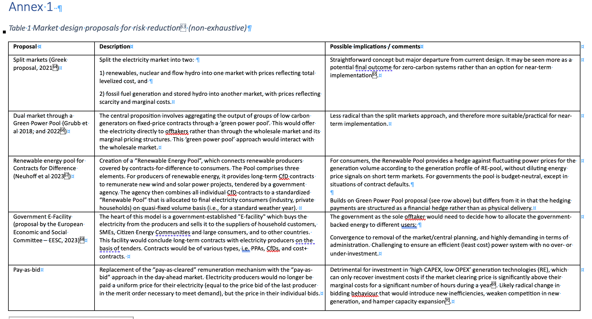
Annex 1

Slide 22
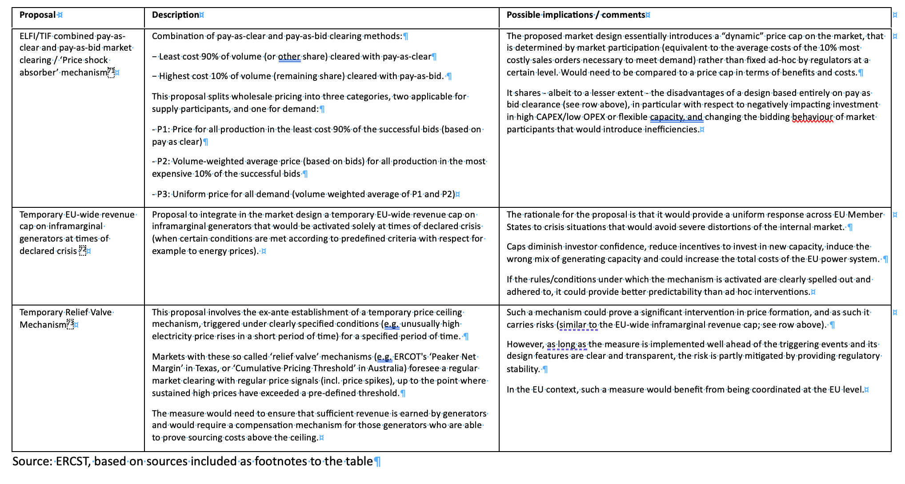
Annex 1

Slide 23
