Slide 1
Antonio A. Fernández
November 2022
(Carbon) Contracts for Difference
Brussels, November 28th, 2022
Notes:
It is a long slide show, so we’ll go quickly over background etc to have time to focus on the core issues!

Slide 2
Presentation Structure
Policy context at the EU level
Policy context at the Member State level + the UK
Different forms of support: two-sided CfDs, CCfDs, Fixed Feed-in tariff, Premium
Breakdown of some of the different elements that make up a (C)CfDs scheme
Guaranteeing a level playing field
Priorities and Next steps

Slide 3
Policy Framework at the EU Level
Hydrogen strategy (7/2020): Areas where a pilot scheme for carbon contracts for difference can be applied are to accelerate the replacement of existing hydrogen production in refineries and fertiliser production, low carbon and circular steel and basic chemicals, and ammonia in the maritime sector, and the deployment of synthetic low-carbon fuels in the aviation sector.
Updated EU Industrial Strategy (5/2021): The European Commission is considering, as part of the proposal for a revised ETS Directive, an EU approach to CCfDs using ETS revenue.
Fit for 55 package, EU-ETS revision proposal (2021):
(Explanatory memorandum) CCfDs are an important instrument to trigger emission reductions in industry. The range of measures that the Innovation Fund can support should be extended to provide support to projects through price-competitive tendering such as CCfDs.
Art 10a(8) establishes that in the case of support provided through competitive bidding, 100% of the relevant costs of the projects may be supported. (Relevant cost refers to the difference between the fossil reference case and the cost of the green alternative).
The Commission is empowered to adopt Delegated acts to supplement this Directive.
Annex 11 of the impact assessment provides further details. (see more)

Slide 4
Policy Framework at the EU Level
State Aid Guidelines for environmental protection and energy (12/2021): Aid for the reduction and removal of GHG emissions, including through support for renewable energy. Footnote: CfDs could also involve a reference price linked to the ETS – i.e. ‘carbon’ contracts for difference.
REPower EU Communication (05/2022): To support hydrogen uptake and electrification in industrial sectors, the Commission will roll out carbon contracts for difference and dedicated REPowerEU windows under the Innovation Fund. The aim is to support a full switch of the existing hydrogen production in industrial processes from natural gas to renewables and the transition to hydrogen-based production processes in new industrial sectors, such as steel production and basic chemicals.
DG Clima tender for assistance: Published in March 2022, on the analysis and set-up of a competitive bidding mechanism for contracts for difference, carbon contracts for difference and other comparable schemes under the Innovation Fund.
Workshop 1 on competitive bidding (28.10.2022). Workshop 2 (21.11.2022), Designing a competitive bidding tool to fund hydrogen innovation: stakeholder consultations.

Slide 5
Policy Framework at the European Level
The Netherlands: adopted SED ++ suport scheme, which will operate from 2020 until 2025 and will support a wide range of technologies, such as green H₂ and CCS.
Technology neutral (all included technologies and sectors compete for budget).
Focus on CO₂ reduction (subsidy is based on tonnes of CO₂ avoided instead of energy produced).
Long term predictability. Subsidy is paid for 12-15 years.
The UK business models:
CfDs for Power: main mechanism for supporting low-carbon electricity generation.
Dispatchable Power Agreement business model: based on CfDs and adapted for natural gas-fired power CCUS facilities. Will use both the CO₂ price and the gas price as reference.
Industrial Carbon Capture: The reference price will reflect the market carbon price under the UK ETS.
Engineered Greenhouse Gas Removals business model: Favours the use of negative emission CfDs.
Low Carbon Hydrogen business model: In a similar approach to CfDs it favours the use of a variable premium.
Germany: announced as part of its National Hydrogen Strategy the launch of a new pilot project, targeting mostly the steel and chemical industries.
German government is finalising the funding program for energy-intensive industries like steel, chemicals, glass, and cement by February 2023.
It is worth mentioning that it is very unlikely that the envisaged German CCfDs scheme will be based on auctins, which differs from the European Commission approach (competitive bidding).
France: The French Ministry for the Economy and Finance launched a public consultation which closed in April 2022, as part of France’s 2030 investment plan. The consultation document includes CCfDs as a potential support mechanism.

Slide 6
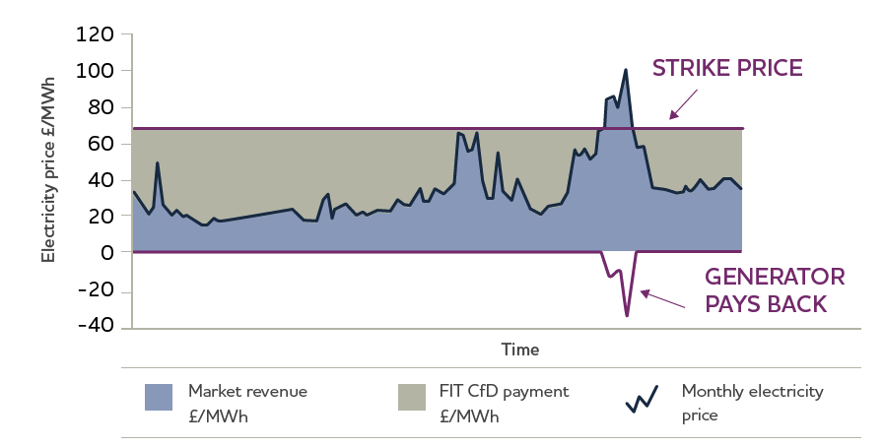
What are the different remuneration forms?
Contracts for difference: CfDs have their origin in the financial sector helping to hedge against volatile prices. CfDs have been used as an efficient solution to provide stability and predictability to future revenue streams.
Example of a supply side electricity generation CfD: long-term contract between an electricity generator and a third party. The contract enables the generator to stabilise its revenues at a pre-agreed level (the Strike Price) for the duration of the contract. Under the CfD, payments can flow from the third party to the generator, and vice versa.
When the market price for electricity generated is below the Strike Price set out in the contract, payments are made to the Generator to make up for the difference.
However, when the reference price is above the Strike Price, the CfD Generator pays the difference.
Source: UK Government white paper 2011

Slide 7
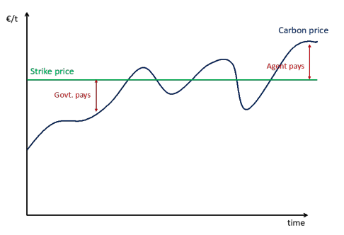
What are the different remuneration forms?
CCfD: CCfDs offset the difference between the market price for emissions allowances and the carbon avoidance costs. For example:
If the market price for emissions allowances is lower than the carbon avoidance costs, the state pays the difference.
If the market price for emissions allowances is higher than the carbon avoidance costs, the company pays the difference.
Source: EC 2021 Revision of the EU-ETS impact assessment
Source: Climate friendly materials 2020, their role in European industrial decarbonization

Slide 8
The rationale behind CCfDs
Even though EUA prices are very high, they are not triggering the switch to less polluting technologies for some industries.
To allow less polluting technologies to compete with cheaper “high carbon” alternatives, solutions are needed.
The upcoming investment cycle in energy-intensive industries presents an opportunity for decarbonization, but the right type of support is needed. (Carbon lock-in effect)
Between 30 and 53% of cement, steel and steam cracker plants in the EU-27 will require major reinvestments by 2030.

Slide 9
Fixed tariff / Fixed Premium / Sliding feed-in premium or CfD (one-sided)
Fixed Feed-in tariff: Fixed payments that are paid from the auctioner to the producer and cover most of the costs.
Feed-in Premium: Example of renewable electricity: electricity from renewable energy sources (RES) is typically sold on the electricity spot market and RES producers receive a premium on top of the market price.
FIP can either be fixed (i.e. at a constant level independent of market prices) or
Sliding, which is similar to one-sided CfD (i.e. with variable levels depending on the evolution of market prices)

Slide 10
Main differences and similarities CCfDs & CfDs
Similarities:
Based on the legal basis provided in the revision of the EU ETS, the award mechanism is competitive bidding (auctions).
Both can be supply and/or demand based.
Shared objectives: Cost efficiency in distributing financial support, price discovery and market formation, stability and
predictability for future revenue streams, all increase project bankability.
CfDs:
Hydrogen: better suited when there is no functioning market to facilitate the creation of offtake agreements.
Volume-based instrument with a market price as the reference (e.g. kg of H2 produced)
Reference price will be related to a product: different options are being considered for H2:
Electricity price index
Based on natural gas or grey hydrogen
Available commercial index
Individual offtaker price
Strike price: price determined by the auction (price of the product).
CCfDs:
Subsidy will be based on the emissions abated rather than on volumes produced.
Demand side, project based instrument.
Reference price: Carbon price.
Strike price: covers the abatement costs.

Slide 11
Breaking down the different elements for a (C)CfD scheme
Different elements that shape a (C)CfD scheme
Parties | Auction frequency | Techno-logical scope | Object of Aid, Strike Price | Reference Price | Limit of support | Allocation Process | Market side focus | Alternatives to (C)CfD
Public side: Government European Commission Private side: Individual Companies, Consortia, SPV (Project Finance) | Annual Biannual Biennial | Technology specific auctions Sector specific auctions Technology neutral auctions | Investment costs Operation costs Capital Expenditure Treatment of free allocation | EU-ETS Hydrogen: Electricity price Natural gas index Individual offtaker price | Temporal limit (contract duration) Project output Budgetary constraints | Competitive bidding process Direct award | Supply side Demand side Double-sided auctions | Carbon Price Floor CBAM + Export Rebates Consumption based Charges Public Procurement

Slide 12
Guaranteeing a level playing
State aid: CCfDs fall within the scope of State Aid Guidelines: under the current guidelines, subsidies can be granted to up to 100% of the net cost benefit difference between environmentally friendly and counterfactual investment in more polluting technologies.
This aid can apply to both investment and operating costs
Importantly, exceptions are based on the requirement of aid being granted based on a competitive bidding process
Interaction between European and national schemes?
EU industrial level playing field: EU Member States with reduced financial capabilities may be put at a disadvantage compared to other Member States that will put forward wide national schemes.
Cumulation with state aid (guaranteeing a level playing field in the auctions):
A Bidder that has already benefited from national support participates in an auction.
How should this additional support be treated to guarantee a level playing field in the auctions?

Slide 13
Priorities
Simplicity
Amount of regulation derived from the Fit for 55 is unprecedented. A simple design will favour acceptance and implementation.
Timely
First pilot for H2 coming next year, but when are others that do not necesarely rely on hydrogen as producers or consumers going to get the support?
Original (C)CfDs thinking (technological openness) vs. REPower EU focus
Important element to trigger emission reductions in industry vs. a more targeted instrument to facilitate the uptake of hydrogen and goals of REPower EU.
Focus on those sectors that will face the greatest exposure to targets
Ensure a level playing field
Make sure there is enough funding for the EU scheme
Address cumulation in a way that does not confer unfair advantages to companies from wealthier member states.
Effects on the EU-ETS
The EU-ETS also enhances price discovery and hedge risks. Are they working at cross purposes?

Slide 14
Antonio A. Fernández
Thank you for your attention
Questions: afernandez@ercst.org
Brussels, November 28th , 2022
Notes:
It is a long slide show, so we’ll go quickly over background etc to have time to focus on the core issues!

