Slide 1
Potential role for CCFDs
| COPYRIGHT © 2021
………………………………………………………………………………………………………………
PRESENTED BY:
Helen Bray
……………………………………………………………………………………………………………………………………………………………………………………………
COMPANY:
Carbon Engineering Ltd.
……………………………………………………………………………………………………………………………………………………………………………………………
DATE
April 2022
……………………………………………………………………………………………………………………………………………………………………………………………

Slide 2
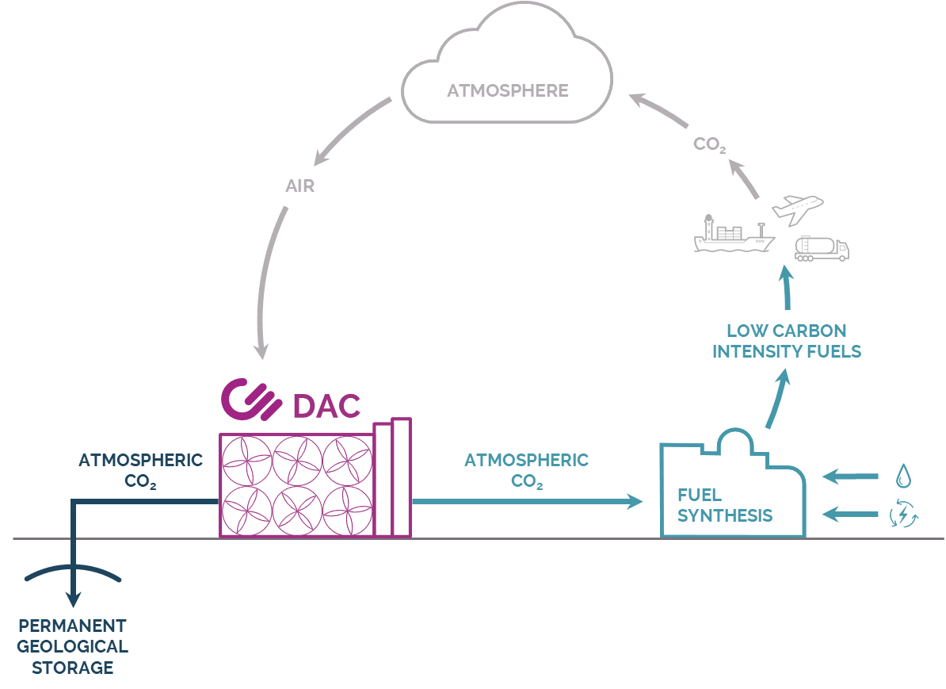
CE’s solutions bring…
Permanent carbon removal by removing CO₂ from the atmosphere.
Drop-in compatible fuels that can reduce the carbon intensity of transportation fuels by recycling atmospheric carbon.
2 CARBON ENGINEERING | COPYRIGHT © 2022
Atmospheric CO₂ can be permanently sequestered underground for negative emissions
Atmospheric CO₂ can be synthesized into low carbon intensity fuels using CE’s AIR TO FUELSTM technology
Permanent removal or near carbon-neutral fuels

Slide 3
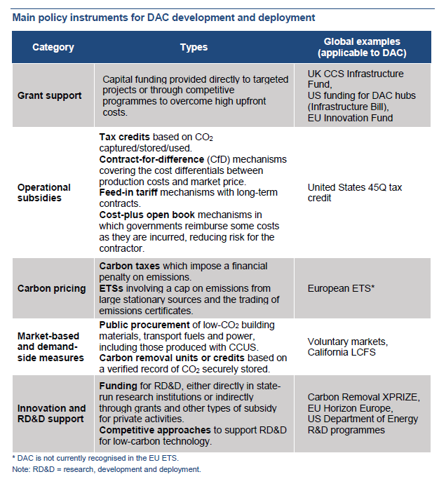
Business model for DACS
Target
Robust certification
Support for first of a kind plants (including Carbon Contracts for Difference)
Open access CO2 transportation and storage
Integration into compliance markets
IEA
Many policy instruments make up an investable policy framework

Slide 4
Potential business models to reduce merchant risk
Element Energy
Yearly support = (strike price - av. ETS price)*(ETS benchmark - actual em.) * annual production
Does this work for removals as well as reductions?

Slide 5
CCFDs are required to assure investors of minimising merchant risk associated with fluctuations of revenue from voluntary markets or compliance markets such as sustainable aviation fuel mandates
A CCFD reduces income risk and thus enable low-cost lending from banks or gov
CCFDs are the preferred method of support, but they alone will not build the business case for investment we need an enabling policy framework
CCFDs for both reductions and removals
Impact on the EU ETS need to be investigated and understood so it can be mitigated through policy design.
Potential role for CCFDs

Slide 6
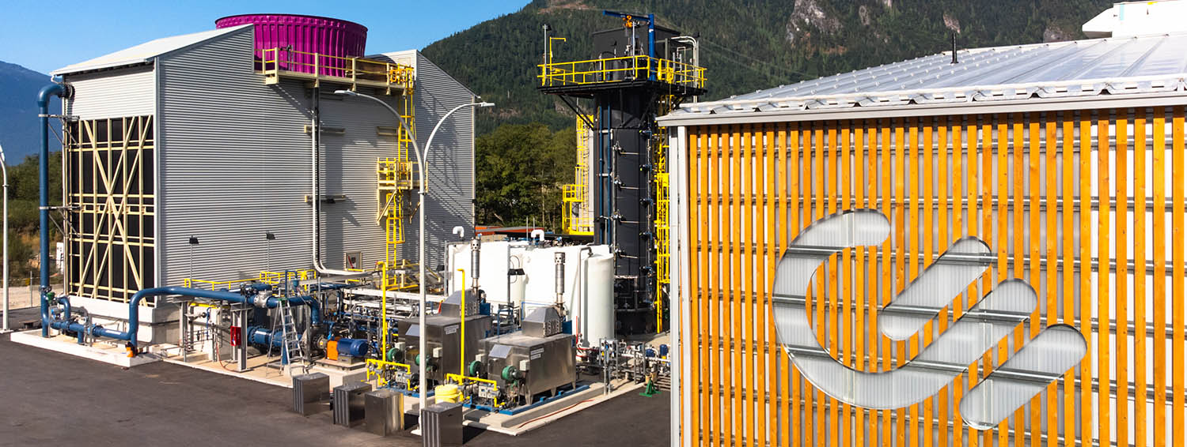
info@carbonengineering.com
COPYRIGHT © 2021 Carbon Engineering Ltd. All Rights Reserved.

