Slide 1
Using REPowerEU at its full potential:
the role of hydrogen and direct electrification in displacing fossil gas demand
16/03/2022

Slide 2
How to use renewable electricity to displace the most gas
Gas displaced in BCM per TWh of renewable electricity
Green H2 for electricity production
Green H2 replacing grey H2
Renewables directly on the grid
Heat pumps to replace gas boilers*
*Based on German average household

Slide 3
REPowerEU aims to nearly triple current renewable capacity in the next 8 years
All newly deployed Wind & PV combined in 2030 will be expected to produce a little over 1000 TWh of electricity per year.
That’s the equivalent of the current French and German demand combined.

Slide 4
How will the EU choose to use its 1000TWh of renewable electricity?
Current RePowerEU
plans
Maximising gas
phase-out
Maximise gas phase-out, while kick-starting H2 market
Produced with RePowerEU additional capacity

Slide 5
How will the EU choose to use its 1000TWh of renewable electricity?
Current REPowerEU plans
Maximising gas phase-out
Maximise gas phase-out, while kick-starting H2 market
Produced with RePowerEU additional capacity

Slide 6
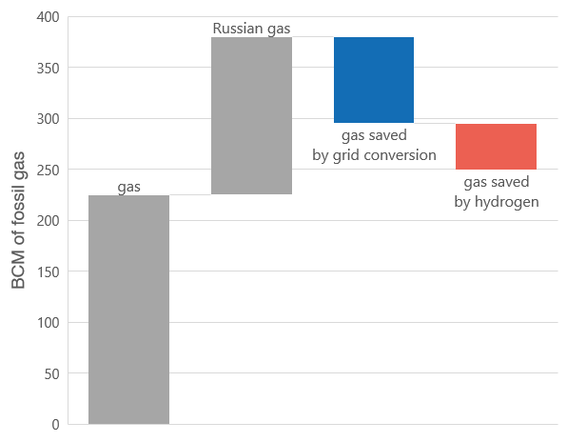
REPowerEU = Still 24 BCM of Russian gas needed

Slide 7
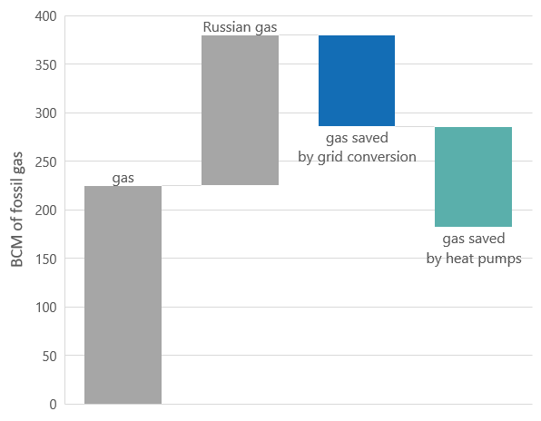
Maximising gas phase-out = No more RU gas + extra 43 BCM avoided

Slide 8
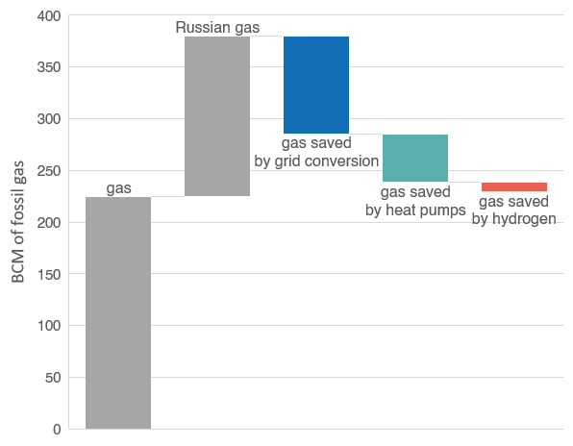
Mixed approach = total RU gas phase-out + deployment of H2 economy
Produced with RePowerEU additional capacity

Slide 9
Key Conclusions
Using renewable electricity can reduce gas use substantially if used effectively.
Direct electrification offers the biggest reduction to gas: heat pumps are particularly effective at displacing gas demand.
Natural gas cannot be replaced en mass by hydrogen, given the large amount of renewables needed to displace small amounts of gas.
Relying on hydrogen will leave the EU with more fossil gas in the system.
A future-proof strategy needs to both drastically reduce our dependence on fossil fuels while also deploying hydrogen in no-regret sectors where other decarbonisation pathways don’t exist.
Additional electricity deployed for hydrogen production must be dimensioned on the hydrogen targets: RePowerEU foresees 80 GW of capacity for hydrogen production, only enough to produce 2.8 Mt of hydrogen per year, 20% of the proposed RED target.

Slide 10
Get in touch!
Marta Lovisolo
Policy Advisor Renewable Energy Systems
marta@bellona.org
+32 (0) 489 638 862

Slide 11
Thank You!

Slide 12
EuroStat 2020 – Energy Statistics
Wind average utilisation – 27%
Solar average utilisation – 11%
80GW of additional RePower EU – 50% Wind, 50% solar
Gas Power (CCGT) efficiency – 60%
H2 electrolysis efficiency - 70%
Grey Hydrogen – 4.5 Nm³ of Natural Gas per kg of hydrogen
Heat Pumps – Assuming an average yearly heat pump consumption per household in Germany of 4993 kWh Schlemminger et al, 2022, Dataset on electrical single-family house and heat pump load profiles in Germany

