Slide 1
CBAM & indirect emissions – Our Assessment
ERCST
Wednesday, 2nd March 2022

Slide 2
Our Key Messages for Today
1
2
3
CBAM on indirects before 2030 will result in low-carbon European aluminium production being exposed to significant cost increase while imports will pay less or zero CBAM charge
CBAM on indirects would only make sense when mismatch between carbon costs in Europe’s power prices and CBAM charge on imports are even out
CBAM can work for direct emissions
But, we need a solution for exports, a testing phase for an orderly transition and to go as far down as the value chain as possible
CBAM on indirects will in total have negative climate effects due to resource shuffling
Will gradual happen by decarbonizing European power market post 2030
We support the expansion of CBAM to cover indirects as soon as the mismatch between carbon costs in Europe’s power prices and CBAM charge on imports are even out and an export solution is ensured

Slide 3
Why? - due to our electricty market design a CBAM on indirect emissions is ineffective for both climate and carbon leakage
CBAM on indirects very hard to implement due to Europe’s unique electricity market characteristics.
Indirect emissions vs Indirect costs*
Why?
The difference between embedded indirect emissions vs. CO2 costs in power caused by unique design of the pricing system in European electricity markets.
In this design, regardless whether a company consumes wind, solar or hydro-power, the electricity bill is set by the fossil-fuel power producer which has carbon costs embedded.
Physical indirects emissions in the power consumption
Actual scope 2 costs in the power bill.
Costs differences between Member States occur because of limited grid connections
Large variations in CO2 costs and emissions means indirect emissions should be exluded until EU electricty sector is more decarbonised.

Slide 4
Scope 2: Comparing the Main Options Under Discussion

Slide 5
CBAM & Scope 2: The 3 Main Options on the Table
1
2
3
The Commission’s leaked proposal
Would have taxed indirect emissions outside Europe while we face indirect costs in Europe.
Result would have been fossil fuel produced aluminium paying a lower tariff than European
The Chahim and centre-left approach
Chahim’s draft proposal rightly bases it on the marginal for exporters but...
with individual assessments it becomes completely ineffective; &
undermines the environmental basis of CBAM (all imports would be treated the same)
For now, maintain the current system of indirects compensation and exclude Scope 2
Given our unique electricity market design, the challenges to address indirect costs remain until the mismatch between indirect emissions and costs is reduced to a minimum
All accept that it doesn't make sense
Today, I am going to focus on comparing the pros and cons of the Chahim approach with maintaining the current system

Slide 6
The Chahim/Centre left proposal on indirects

Slide 7
Indirects | What Chahim has proposed
Main elements | Proposed Methodology (Amendment 125)
Include Indirect emissions in CBAM initial phase (amt 8, 15, 22, 33, 101, 122) Methodology for the COM to calculate indirect emissions via delegated acts (See next slide) (amt 125) CBAM should replace compensation for indirect costs (amt 3) He also says indirects compensation “weakens the price signal to decarbonize” (amt 3) We disagree. See slide on indirects compensation myths vs reality | Proposed methodology says it should be based on the marginal (amt 125) “[Indirect emissions are] to be calculated using the emission factor for electricity given in the implementing act pursuant to Article 7. Where offsite power is consumed, the annual average emissions intensity of the marginal or other price-setting generator in the relevant electricity market shall be used. Where such data are not available, the average emissions intensity of fossilfuel based generation plants in the relevant power market supplying the producing installation shall be used instead.” The Commission to further develop the methodology via delegated acts (amt 27)

Slide 8
Drawbacks of Chahim’s proposed Methodology
First attempt at addressing indirect costs instead of emissions. This is an improvement.
However, the methodology has major weaknesses;
1
2
3
4
An equivalent to EU “price setter” or “marginal producer” is non-existent most other countries, as they do no have integrated electricity markets the same way the EU does. Our market is rather unique
China, Russia, Canada either rely extensively on captive power and/or has regional power markets, creating large variances in potential factors even within countries.
Reduced possibility of individual assessments. This decreases the possibility of resource shuffling within a country. However, preventing individual assessments is not possible under WTO rules (See next slide for more details)
Since all importers to Europe will be treated the same, there would be no longer a climate justification
*See original texts in the annex here

Slide 9
Individual assessment – mandated under WTO?
COM proposal article 7(3) – the importer may choose
COM impact assessment (page 10) gives a clear climate justification for the possibility of individual assessments
COM impact assessment (page 11) provides the WTO justification → you cannot treat import products less favorable that domestic products
From this, we conclude that preventing individual assesments for indirects will not be possible (Not WTO compatible)

Slide 10
Indirects: CBAM import charge will differ from EU CO2 costs
Removal of CO2 compensation will significantly increase the costs for European plants

Slide 11
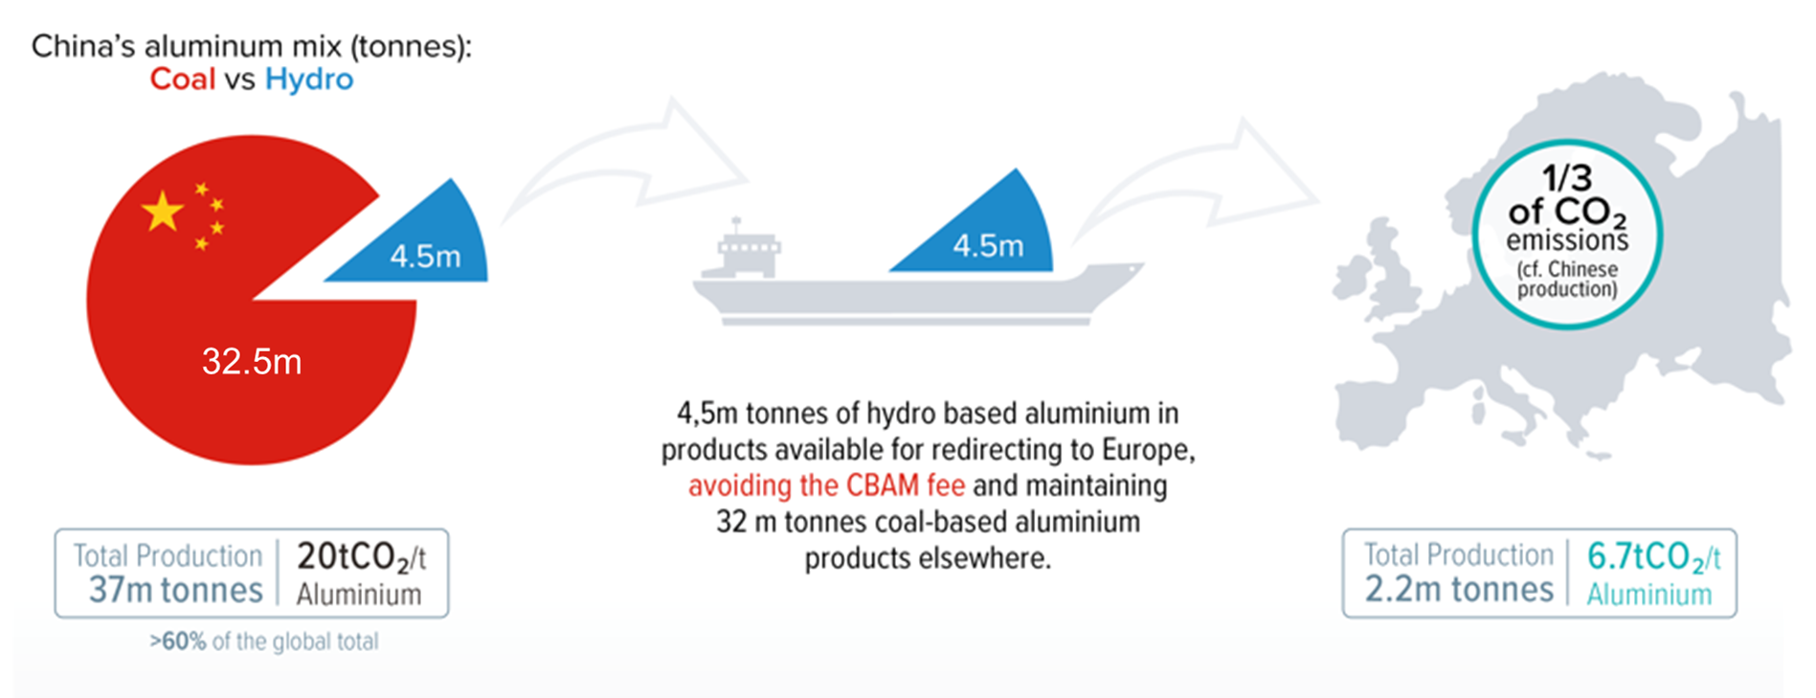
CBAM on indirect emissions will have negative climate impacts…
EU27 imports appx. 6 Mt of primary aluminium, whereof 1-1.5 Mt is not based on renewables. Sufficient low-carbon aluminium world-wide to fill this gap.
No CBAM charge on imports and low-carbon production in Europe will face higher cost burden due to removal of CO2 compensation - importers will look for cheapest source.
If no individual assessment, CBAM loses climate justification & WTO compatibility as all imports are treated the same.
…and European low-carbon aluminium will be undercut. Aluminium must not become the next “magnesium”

Slide 12
Conclusion

Slide 13
Our policy request
While European producers are the only ones to face indirect carbon costs, we request indirect emissions to be left out of CBAM.
The current State Aid scheme: (i) it has recently been agreed; (ii) it is dynamic to reflect the evolving reality of indirect cost pass-through factors; and (iii) it contains conditionality incentivizing ambitious decarbonization efforts.
DG COMP will review of the pass-through factors for indirects in 2025.
We propose that if the pass-through factors are still high, then compensation should be maintained since the gap between emission and costs is still high
If, on the contrary, the gap is low, then indirects could be covered by a CBAM
Looking ahead, given the excellent progress being made on the decarbonisation of power, we can expect indirect carbon costs to be much less an issue

Slide 14
Indirects Compensation: Myths vs Industry Reality
Indirect Costs Compensation Myths

Industry reality
Why?
Indirects compensation has no negative impact on the efficiency of the EU ETS
Power producers face the direct emission costs, ETS will incentivise further decarbonisation of the power sector, independent of any indirect compensation.
Aid weakens the price signal to decarbonize
Reduces incentive to switch from “grey to green” electricity
Large electro-intensive consumers cannot influence the electricity mix. The ETS should not seek to penalize industries which have no influence on the process of decarbonizing the power sector
The price is impacted by the markets. Emission passthrough of ETS even entering into RES PPAs
A centralized fund can replace the current system
We cannot see where the funding for such a fund would come from. There are no concrete proposals…
We are very open on this idea but…
Reduces the incentive for industry to improve efficiency
High energy costs & benchmarks already act as the incentives for continuous energy efficiency improvement
Reduced compensation will reduce financial resources for efficiency investments in electro intensive industry

