Slide 1
UK Emissions Trading Scheme (UK ETS) Cost Containment Mechanism
Dr Geraldine Satre Buisson geraldine.satrebuisson@beis.gov.uk
February 2022
Notes:
Cover style

Slide 2
Overview of UK ETS
In 2019 the UK was the first major economy to legislate for net-zero emissions, with a target of 2050.
The UK ETS was launched on 1 January 2021 to replace the UK’s participation in the EU ETS. The UK ETS will be among the first cap-and-trade markets aligned with net zero, and, in combination with other policy levers, will have a key role in achieving this goal.
The UK ETS covers a third of UK emissions. Sectors covered are power, energy-intensive industries, and aviation (UK domestic and UK to EEA countries). Gases covered are carbon dioxide, nitrous oxide and PFCs.
In addition to the UK ETS, power generators in Great Britain also pay the Carbon Price Support which is currently £18/tonne. This is levied on top of the UK ETS allowance price to create the 'Carbon Price Floor’ for power generators.
Ahead of COP26, the UK published a comprehensive Net Zero Strategy, which constituted the UK’s revised Long-Term Low Emission Development Strategy to the UNFCCC.
February 2022
Notes:
Main slide

Slide 3
Market Stability Mechanisms: Auction Reserve Price and Cost Containment Mechanism
There are two key market stability mechanisms in the UK ETS.
Auction Reserve Price which sets a minimum bid price at auctions of £22 (€26.35). Bids below this price are not accepted.
Cost Containment Mechanism which provides the UK ETS Authority with the option to intervene if prices are elevated for a sustained period of time.
February 2022

Slide 4
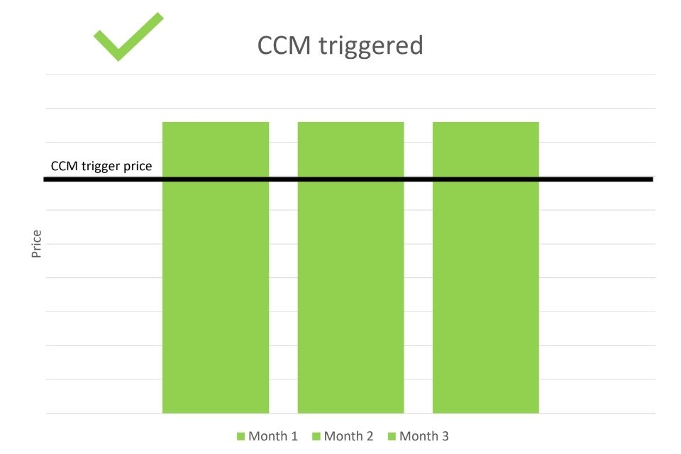
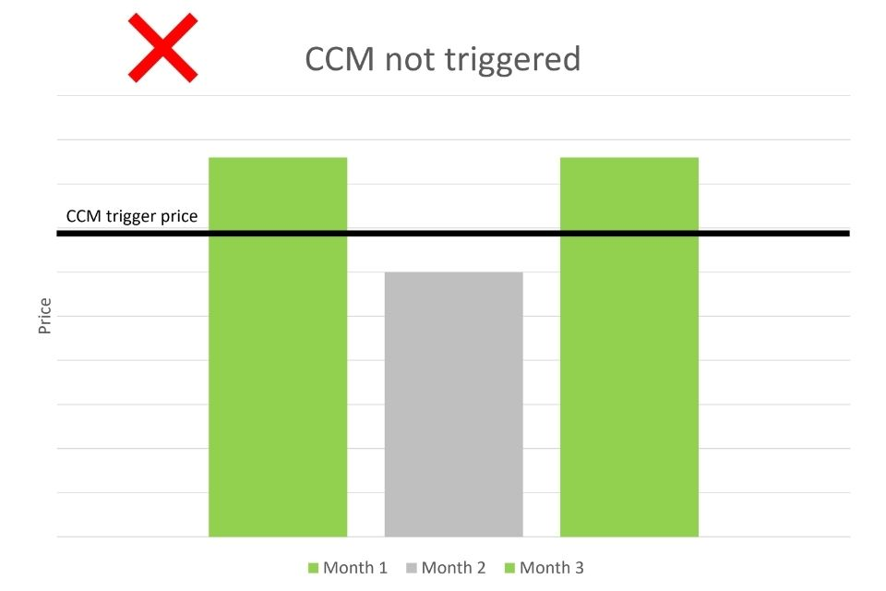
Cost Containment Mechanism: triggers
The CCM was designed to be more responsive in earlier years of the Scheme.
Until January 2022, the CCM was to be triggered if the average end of day settlement price of a UK allowance (UKA) December 2021 futures contract was more than double the average price for the preceding 2-year “reference period”, for 3 consecutive months (the “monitoring period”). This happened in December 2021 and January 2022.
From February 2022 until January 2023, the CCM will be triggered if the average end of day settlement price of the relevant UKA December futures contract is more than 2.5 times the average price for the reference period for the duration of the monitoring period. This currently cannot happen again until at least May 2022.
From February 2023 onwards, the CCM will be triggered if the relevant UKA futures contract is three times the average price for six consecutive months.
February 2022
Notes:
Main slide

Slide 5
Cost Containment Mechanism: intervention options
If the CCM is triggered for a given month, the Authority needs to decide whether it wants to intervene, and if so, choose among the following interventions:
Changing the distribution of allowances in the auction calendar
Bringing forward auctioned allowances from future years
Drawing allowances from industrial unallocated allowances
Drawing allowances from the Flexible Share
Auctioning up to 25% of the remaining allowances in the New Entrants Reserve for that year
February 2022

Slide 6
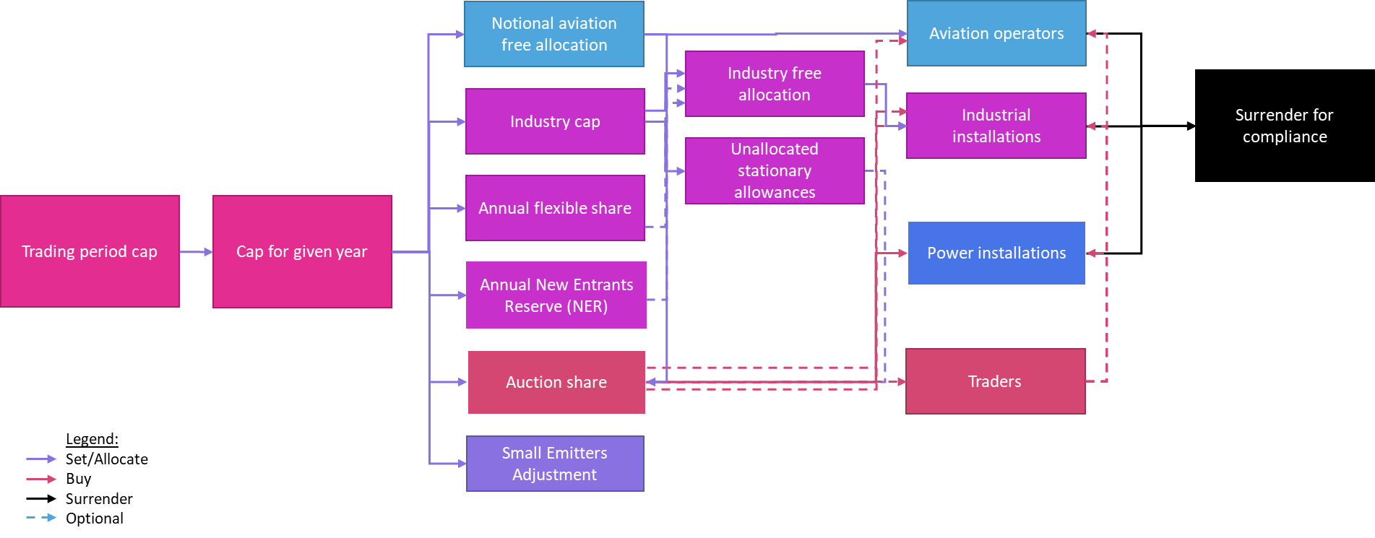
Cost Containment Mechanism: intervention options
February 2022

Slide 7
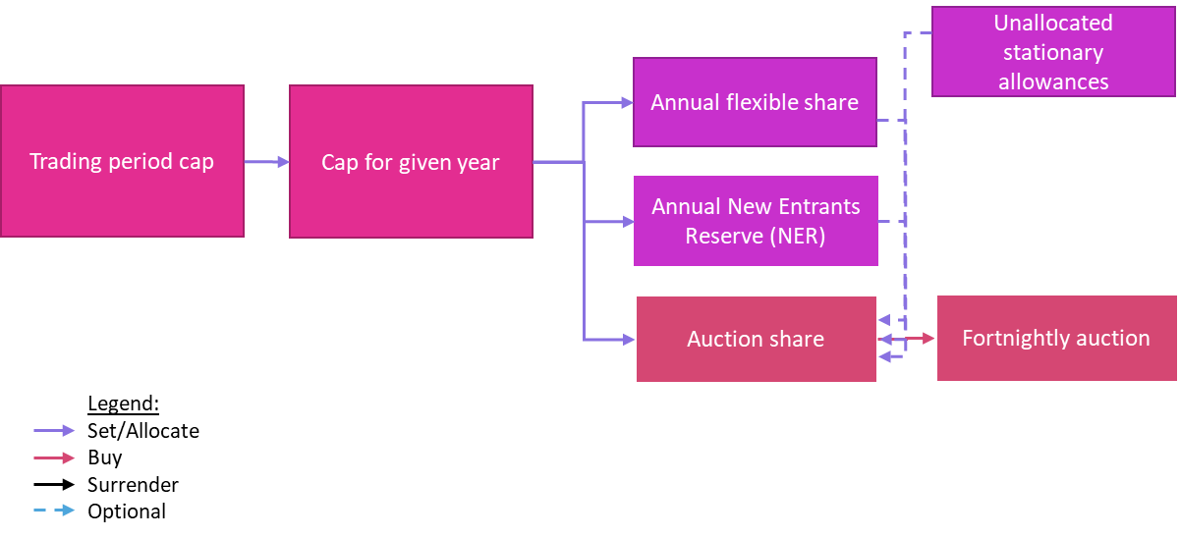
Cost Containment Mechanism: intervention options
February 2022

Slide 8
Q&A
February 2022

Slide 9
Glossary
Term | Definition
UK ETS Authority | The UK, Scottish, and Welsh Governments and the Northern Ireland Department of Agriculture, Environment and Rural Affairs.
New Entrants Reserve | A reserve of allowances within the cap to be given to New Entrants to the scheme or to distribute following Activity Level Changes.
Free allocation | The allocation of free UK ETS allowances to sectors at risk of carbon leakage to reduce their exposure to the carbon price.
Industry cap | The upper bound on the number of free allocations that can be issued to stationary installations in any given scheme year.
Unallocated stationary allowances | A surplus of allowances created if the total stationary free allocation for a given year is lower that the industry cap for that year.
Flexible share | The flexible share is a reserve of allowances that can be used if the industry cap is breached during the calculation of free allocation. This can happen because a cross-sectoral correction factor is applied to the calculation of free allocation for individual industrial installations. As a result, it is theoretically possible for the sum of free allocated allowances to be higher than the industry cap. The flexible share can be drawn from to bridge this gap.
February 2022
Notes:
Main slide

Slide 10
UK ETS Policy Development
During the course of 2022 we are exploring opportunities to develop the UK ETS including: ​
Net Zero consistent cap – the ETS will play a key role in contributing to UK net-zero goal. A consultation will be launched in the coming months, following CCC advice, to ensure alignment with our net zero commitments by January 2024.
Free Allocation review – to review possible future changes to take a fair, proportionate and considered approach to potential improvements. A call for evidence was published on 17 March 2021 and a consultation will follow in 2022.
Aviation - A review to determine how the Carbon Offsetting and Reduction Scheme for International Aviation (CORSIA) should interact with the UK ETS​.
Scope – We have committed to explore expanding the UK ETS to the two-thirds of uncovered emissions, including how the UK ETS could incentivise greenhouse gas removal technologies.
Cooperation - Now we have launched the UK ETS, we are interested to work with other systems globally, to see if there are areas where we can usefully exchange information or have forms of practical cooperation.
February 2022

Slide 11
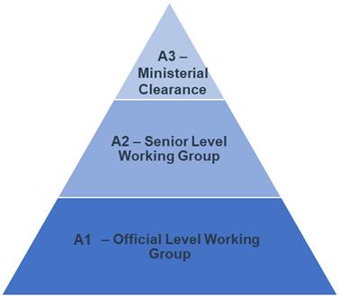
UK ETS Operation: Governance
To ensure effective operation of the scheme, governance is based upon the “The Authority”, a three-tiered oversight and decision-making structure comprising UKG and the three devolved administrations.
Except for decisions of key strategic importance, decisions and activities are delegated by Ministers to the appropriate level of the Authority.
These decisions and activities are set out in the Authority Workplan, which is agreed annually by the Senior Official Level Working Group (A2)
There are differing joint working groups (A1) focussed on different aspects of the scheme e.g. policy and legislation, operations, technical solutions, communications, etc.
The Resource Pool carry out the day-to-day activities needed for operating the scheme. Each member of the pool has a clearly defined role and responsibilities, to help ensure clear paths of accountability and effective performance.
Delegation and
conditions
Reporting and
assurance
Resource Pool
February 2022
Notes:
Main slide

