Slide 1
Andrei Marcu Antonio A. Fernández
HYDROGEN: NEEDS AND REALITY
Brussels, June 16, 2021
Notes:
It is a long slide show, so we’ll go quickly over background etc to have time to focus on the core issues!

Slide 2
Presentation Structure
Introduction
Binding classification for the different production processes
The role of the technology neutrality principle
What are the best ways to incentivize the hydrogen economy
What is in for hydrogen in the Fit for 55

Slide 3
Different views on hydrogen
ERCST needs and reality: This meeting will analyze key issues identified by ERCST that need further discussion and clarification.
ERCST experience: We have seen how key stakeholders in the production, transportation and the demand side of the market see hydrogen differently.
Supply: In the production side, discussions are mainly driven around the implications of a technology neutral approach to hydrogen, the different sorts of production processes and how to define them.
Demand & Transportation: See hydrogen as a low-carbon feedstock. Especially the demand side sees hydrogen more as a low carbon feedstock, being hydrogen purity, decarbonization, costs and incentives the key enablers. Market economy driven by regulation or application?

Slide 4
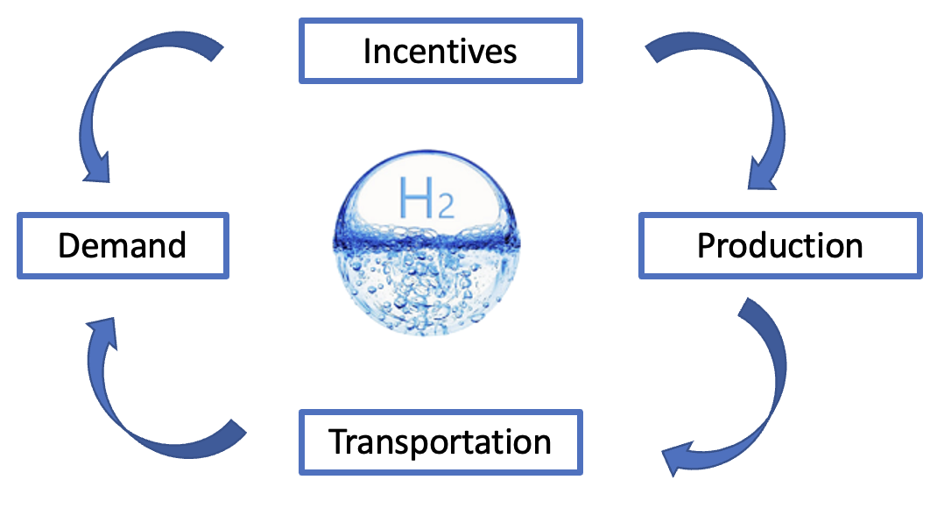
The hydrogen economy, key issues
Sustainable finance, demand quotas, CCfD, Recovery Funds, Other sorts of EU funding, State Aid, Taxoation, Technology neutraligy
Hydrogen Demand forecasts
Demand, the Market economy vs. Regulation
Hard to abate vs. other sectors
Technology neutrality
Classification of the different production processes;
Technology neutrality principle;
EU hydrogen imports vs. EU own production
Hydrogen Scarcity
Additionality principle
Pace for a hydrogen infrastructure development
Blending and Repurposing Technical & regulatory aspects

Slide 5
A binding definition for the different production
Processes
State of play: So far, there is not a binding or legal classification for the different hydrogen production processes. Are we going to see a definition based on the production technology or on emissions thresholds?
European Commission: The European Commission defined some of them based on the range of emissions, technologies, and energy sources. (Electricity based hydrogen, Renewable hydrogen, Clean hydrogen, Fossil-based hydrogen, Fossil-based hydrogen with carbon capture, Low-carbon hydrogen, Hydrogen-derived synthetic fuels).
European Parliament: Believes that the classification of the different types of hydrogen production should be determined stepping away from the commonly used colour-based approach; and should be based on the life cycle greenhouse gas emissions throughout hydrogen’s entire value chain.
Some Industries: Prefers to use a colour-based categorization.
Certifhy: Within the framework of the development of a GoO scheme Certifhy has provided a definition for green and low carbon hydrogen based on GHG emissions. Green hydrogen, if produced by renewables and low-carbon otherwise.
EU Taxonomy: Provides the closest to a definition and will define what is considered to be sustainable.
Why is a binding classification needed? Where are we going to see this classification?

Slide 6
The role of the technology neutrality principle
Technology neutrality principle: A technology neutral approach to a legal drafting, involves a description of the result to be achieved without to specifying the technology to be employed or regulated.
EGD Communication: It is essential to ensure that the European energy market is fully integrated, interconnected and digitalised, while respecting technological neutrality.
Parliament Resolution: Underlines, when talking about the decarbonization of the different sectors, the importance of the principle of technology neutrality for achieving a climate-neutral EU;
European Commission H2 Strategy: Does not take a technology neutral approach in the long term, (focus on renewable hydrogen) but support low-carbon hydrogen for the transition. As we do not have a clear definition for low-carbon hydrogen, we do not know to what extent the transition is going to be technologically neutral.
MSs Level: Focus on renewable H2 (GE, ES, IT), Focus on low-carbon as well (FR, NT, UK)

Slide 7
The role of the technology neutrality principle
Technology neutrality principle
Incentives
Classification of the different production proccesses
Demand
Production
GoOs
Transportation

Slide 8
Current regulatory framework for incentives
RED II: Under the RED II directives, mandates are laid out for the use of renewable fuels. Hydrogen and hydrogen-derived synthetic fuels therefore count towards the minimum targets laid out in the Directive, provided that GHG emissions are lower than 70% of fossil fuels and produced using additional renewable electricity.
CCfD: Although some member states have stablished support schemes for CCfD, there is not an EU wide CCfD approach for the moment. The industrial strategy announced it will come with the EU ETS revision.
CertifHy: CertifHy is the first EU-wide hydrogen GoO scheme. It covers either hydrogen produced from renewable energy - defined as ‘Green Hydrogen’ - or from non-renewable low carbon energy sources (nuclear, fossil with CCS).

Slide 9
Different types of incentives
Sector quotas & demand mandates.
Sustainable finance
EU Taxonomy DA: Producing hydrogen is sustainable as long as emissions are under 3 tons of CO2 per ton of hydrogen and complies with the DNSH principle.
These requirements make production processes other than from renewables hardly compliant.
Infrastructure: Conversion/repurposing of existing natural gas networks to hydrogen 100% substantially contributes to climate change mitigation.
Other EU funding Instruments:
ETS Innovation Fund, Next Generation EU, Invest EU, European Investment Bank financing. TEN-E (CEF)
State Aid
Revised guidelines for energy and climate: enable Member States to fund projects for environmental protection and energy. They are applicable until 31 December 2021 following a 1-year prolongation.
IPCEIs: Sets out the criteria under which State aid for the execution of important projects of common European interest may be considered compatible with the internal market pursuant to Article 107(3)(b) of the (TFEU).
Tax exemptions: E.g. Exempt the electricity used for electrolysis from taxes.
ETS extension and free allocations.

Slide 10
CfD and CCfD
CfD: CfD have its origen in the financial sector helping to hedge against volatile prices. CfD have been used as an efficient solution to address the uncertainty of revenues in the renewables sector. Broadly used in the UK since 2014.
In the case of RES, CfD cover all the revenue stream of the investment, while CCfD only address the carbon revenue stream.
CCfD: Offsets the difference between the market price for emissions allowances and the carbon avoidance costs. Oversimplified example:
If the market price for emission allowances is lower than the carbon avoidance costs, the State pays the difference.
If the market price for emissions allowonces is higher than the carbon avoidance costs, the company pays the difference.

Slide 11
CCfD and other incentives: Germany
Germany: Announced as part of its National Hydrogen Strategy the launch of a new pilot project targeting mostly the steel and chemical industries. (Klimaschutzvertrage)
Targeted number of sectors: Steel, cement, lime and ammonia.
Timeframe: Awarding of 10 years-contract for the pilot phase.
Operating costs: At least during the pilot phase the CCfD programme is intended to exclusively finance the differences in operating costs.
Technology neutrality: green hydrogen is the priority but will also cover bridge technologies in a limited manner.
Pending State Aid approval by the European Commission.
Other Incentives under consideration:
Exempt the electricity used for electrolysis from taxes, surcharges and levies.
Carbon prices in non-ETS sectors such as mobility and heating (already in place)
Sector specific quotas: Transport and Heating

Slide 12
CCfD and other incentives: The Netherlands
The Netherlands: Adopted SED ++ suport scheme, which will operate from 2020 until 2025 and will support not only renewable energy production but also other measures to reduce GHG emissions, such as green H₂ and CCS.
SED ++ defines a very similar support schame to CCfD for CCS.
The subsidy is calculated by multiplying the maximun annual tonnes of CO₂ avoidance by the difference between the maximun application ammount and the ETS price.
The Netherlands has awarded in May €2 bn to an offshore CCS Port of Rotterdam project channelled through a carbon contracts for difference (CCfDs) scheme.
The funding will be awarded over a 15-year period through a CCfD scheme, which will pay the ‘strike price’ between the EU carbon price plus the national carbon tax and the total abatement costs.
Other Incentives under consideration:
Exemption from RED II additionality requirements
Mandates to support the use of green Hydrogen
Pure hydrogen infrastructure investments and blending threshold to be increased.

Slide 13
CCfD and other incentives: The UK
The UK: Has not yet adopted a hydrogen strategy. It will be most likely published before Parliament summer recess on July 22.
There is not an stablished framework for incentives yet.
August 2020 Report commissioned by the UK Government on Business models for low carbon Hydrogen production, incentives can be included in four broad categories of business models:
Contractual payments to producers such as CfD or premium payments where the producer receives a subsidy which covers the incremental cost of low carbon hydrogen above the carbon-intensive alternative fuel.
Regulated return models such as Regulated Asset Base or Cap and Floor models.
Quotas for the production and consumption.
End user subsidies for carbon abatement.

Slide 14
What is in the “Fit for 55” for hydrogen
Binding classification
Additionality criteria
impots v. exports
RED III for Renwable Hydrogen and Gas Package for low-carbon. Taxonomy
Delegated act on ddditinality & RED II
Member States, CBAM.
Production
Hard to abate vs. other sectors
Hydrogen purity
Hydrogen scarcity
RED II, Energy Efficiency Directive, ETS Directive]
Secundary legislation
RED II, Gas Package, State Aid, Taxonomy.
Demand
Pace for infraestructure development
Blending
Repurposing
TEN-E, Gas Package, Taxonomy
TEN-E, Gas Package, Taxonomy
TEN-E, Gas Package, State Aid, Taxonomy.
Transportation
CCfD
Demand mandates
Tax rebates
Sustainable Finance
State AID
MSs Level, ETS Directive
RED II and Gas Packages
MSs Level
EU Taxonomy and Delegated Acts
State Aid Guidelines and IPCIs
Incentives

Slide 15
Questions
Do we need a binding classification for hydrogen production processes, why and based on what? Where are going to see a definition for low carbon H₂?
What is the role of the technology neutrality principle in the deployment of a hydrogen economy?
What are the best ways to incentivize hydrogen demand with a special focus on the hard-to-abate sectors? Should incentives be placed on the demand or the supply side of the market?
What is in the “Fit for 55” for hydrogen? Where are we going to see the regulation for low carbon H₂?

