Slide 1
ERCST Stakeholder event on the revision of the Energy Taxation Directive 24 September 2020 Katalin Dobranszky-Bartus (katalin.dobranszky@ecsa.eu)

Slide 2
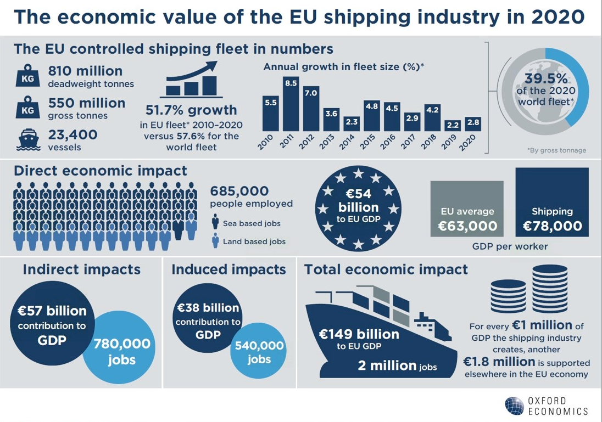
Notes:
About ECSA
The European Community Shipowners’ Associations (ECSA) is the voice of the European shipping industry. Founded in 1965, ECSA promotes the interests of 20 member associations of the EU, the U.K. and Norway. ECSA strives for a regulatory environment that fosters the international competitiveness of European shipping.
2. The importance of the shipping industry

Slide 3
The European shipping industry is dedicated to be at the heart of the green future
Choice and calibration of the right tools is key
The Energy Taxation Directive has the potential to support a technology neutral approach and thus to encourage towards transition
Notes:
Green future
The shipping industry is committed to becoming carbon neutral as soon as possible this century. New means of propulsion, new low carbon or fossil free fuels available worldwide and collaboration with partners in the supply chain are necessary to ultimately reach full decarbonisation. European shipowners cooperate with the shipbuilding sector, ports, equipment manufacturers and the research community in order to reach and implement as soon as possible innovative and sustainable solutions, which can drive the entire maritime industry towards a greener and more sustainable future, including in key areas such as air and GHG emissions, waste management, and do no harm to marine life. The European shipping industry embraces these challenges and is committed to taking the global lead for clean shipping.
Additionally, it is highlighted that in an unprecedented move, the international shipping community has recently announced plans to create the first collaborative shipping Research&Development (R&D) fund, intended to eliminate CO2 emissions from international shipping. The proposal includes core funding for R&D activities necessary to develop innovative and sustainable solutions from shipping companies across the world of about USD 5 billion over a 10-year period.
The industry completely endorses the approach that tax incentives should be used to enable the transition to a climate neutral EU and that the revision of the ETD should be considered in this light. It is clear that providing incentives for alternative fuels and use of electricity on board are the proper way forward. Below are the arguments in more detail why taxing bunker fuels in EU ports is not an effective way forward.
Technology neutral approach
The industry considers that the Directive should be updated with developments in new technologies that have been or are being developed such as renewables and low carbon fuels etc. The current Directive is not providing equal treatment of energy supplies to the shipping industry thus hampering investments in and the uptake of cleaner technologies, such as shore-side electricity, fuel cells, ammonia, methanol, etc. Therefore, the industry advocates for a technology neutral approach so that all energy supplied to sea going vessels including a.o. cargo vessels, ferries, dredgers and service vessels to enable it to operate should be subject to the same tax treatment, whether the energy is supplied as fuel or as electricity. Therefore, a mandatory EU wide taxation exemption for all energy carriers (i.e. fuels and electricity, including shore-side) would provide a level playing field which would help close the cost gap between traditional marine fuels and alternative fuels and electricity.
Currently according to the Commission’s interpretation only the electricity produced on board (through for e.g. diesel generators) is exempted from energy taxation under Article 14(1)(c). It considers that the current Directive does not cover electricity supplied to the ship. So for example electricity supplied to a battery-driven or a hybrid electric ship is normally subject to taxation. While we are aware that there are different possibilities to get a tax reduction or even a tax exemption for electricity, none of these options are specific to shipping or navigation.

Slide 4
Key points
International legal context and global competitiveness: the arguments for the exemption for fuel for navigation under article 14.1.c remain valid
Removing the disincentive for the greener option of using shore-side electricity: a mandatory tax exemption would facilitate ships to significantly reduce CO2 and other air emmissions as well as noise while in port
Electricity supplied to the ship as alternative fuel or as electricity: energy supplied to sea-going vessels enabling operation should be subject to the same tax treatment
Legal clarity on varying interpretations: al trips of merchant vessels being part of normal commercial operations should fall under the exemption defined in article 14.1.c
Notes:
The shipping industry considers that a revised Directive should take a technology neutral approach. Currently, it is not providing for the equal treatment of energy supplies to the shipping industry.
In view of the global nature of the industry and the importance of the move to greener shipping, a revised Directive should provide for a taxation exemption for all energy carriers (i.e. fuels and electricity) in order to close the cost gap between traditional marine fuels and alternative fuels and electricity.
The gap existing under the current Directive hampers investments in and the uptake of cleaner technologies and fuels, such as shore-side electricity, fuel cells, ammonia, methanol, etc.
1. International legal context and global competitiveness: the arguments for the exemption for fuel for navigation under article 14.1.c remain valid
Imposing tax on bunkers sold/bought in EU ports would significantly undermine the competitiveness of EU businesses in world markets.:
Fuelling outside Europe leads to competitive imbalance between deep sea and short sea shipping + decreased expected tax revenues
The capacity of ships’ bunker tanks varies depending on the trades for which the ship was designed – but, typically, a ship will be capable of carrying sufficient bunkers for several weeks. If the EU were to impose tax on bunkers supplied in European ports, the certain practical consequence would be that deep-sea shipping would even more bunker outside Europe and only short sea shipping will be faced with higher bunker fuel prices.
At the same time this reduces significantly the increase in tax income hoped for.
If the cost increase is not passed on to shippers, profit margins of short sea shipping operators will be reduced with less funds available for R&D for green technologies.
If the increased fuel costs are passed on to shippers, shippers will look at alternatives, mainly the much less efficient road transport leading to higher CO₂ emissions. Many European citizens living on islands will face higher transport costs, with a negative effect on the social cohesion of Europe. All this will negatively affect EU business and society – intra EU shipping, bunkering companies and EU ports.
This might also affect EU ports’ investments in LNG or shore power infrastructure. Besides, the EU would raise no new tax revenue. And most importantly, it will not incentivise the much needed shift to alternative fuels necessary to decarbonise the shipping industry.
It is, and always has been, standard practice all over the world for ships to be able to obtain their bunkers duty-free. This international norm is reflected in the International Convention on the Simplification and Harmonisation of Customs Procedures (the Kyoto Convention) 1999. The Convention stipulates, in chapter 4 of Annex J, that ships on international voyages shall be entitled to take on board fuel and lubricants, exempt from duties and taxes. Article 14 of the Energy Taxation Directive, provides the basis for the EU to conform to the global norm as stipulated in this international Convention. If it was decided to impose tax on ships’ fuel, the EU would be acting in defiance of global norms and Convention stipulations.
2. Removing the disincentive for the greener option of using shore-side electricity: a mandatory tax exemption would facilitate ships to significantly reduce CO2 and other air emmissions as well as noise while in port
The current procedures for favourable tax treatment for shore-side electricity under Directive 2003/96/EC are cumbersome. A lengthy procedure for application for authorisation submitted to the Commission and approved by the Council is required. The authorisation can only be for time-limited period of time, so renewal of authorisation would be required.
Running on electricity supplied from shore rather than on ships’ engines can significantly reduce the volume of CO₂, other air emissions and noise emitted by a ship while in port. It is perverse that the tax treatment of the greener option should be less favourable.
A permanent arrangement would ensure much needed legal clarity and certainty for port and ship operators about the tax measures applied for the purpose of promoting the use of shore-side electricity.
Therefore, in order to remove a disincentive for the greener option of using shore-side electricity, it would be important to create a mandatory tax exemption in a revised Directive.
3. Electricity supplied to the ship as alternative fuel or as electricity: energy supplied to sea-going vessels enabling operation should be subject to the same tax treatment
Currently according to the Commission’s interpretation only the electricity produced on board (through for e.g. diesel generators) is exempted from energy taxation under Article 14(1)(c). It considers that the current Directive does not cover electricity supplied to the ship. So for example electricity supplied to a battery-driven or a hybrid electric ship is normally subject to taxation.
While we are aware that there are different possibilities to get a tax reduction or even a tax exemption for electricity, none of these options are specific to shipping or navigation. All energy supplied to sea-going vessels to enable it to operate should be subject to the same tax treatment, whether the energy is supplied as fuel or as electricity One option e.g. would be to extend a tax reduction to the minimum level of taxation to electric or hybrid ships used for local passenger transport (Article 5 of the Directive). Another option would be for the ship to claim that it is energy-intensive business as defined in Article 17(1)(a) of the Directive, but it would have to meet the requirements stipulated thereof. If the electricity is from a renewable source of energy it can be exempted altogether (Article 15(1)(b)), etc.
There is the possibility for Member States to request an authorisation to apply a reduced rate or even an energy tax exemption for electricity supplied to a ship for the purpose of navigation on the basis of Article 19 of the Directive. The procedure is described in this provision.
4. Legal clarity on varying interpretations: al trips of merchant vessels being part of normal commercial operations should fall under the exemption defined in article 14.1.c
Allow us to mention that we have also been advocating that a revised ETD should provide clarity of interpretation of the exemption in view of varying interpretation due to case law. We advocate that all merchant vessels that are operating for consideration – whether transporting passengers or cargo or travelling to a yard for maintenance or to another country to pick up a charter there - so all trips of merchant vessels part of normal commercial operations should fall under the exemption in article 14.1.c and thus be tax free. Dividing the fuel into part being tax free and the part used for voyages for maintenance or empty voyages, being normal commercial operations, would also be not practically implementable and lead to no sufficient monetary gains to justify it.

