Slide 1
Andrei Marcu, ERCST Jean-Yves Caneill, ERCST Domien Vangenechten, ERCST
The EU ETS in the Commission’s 2030 Climate Target Plan
Webinar
This meeting is under Chatham House Rules
September 29, 2020

Slide 2
Structure of the meeting
15:00 Welcome A. Marcu, Director of ERCST
15:05 The 2030 Climate Target Plan – an overview - Hans Bergman, DG Clima
15:20 Stakeholder views on the 2030 Climate Target Plan - Wojciech Burkiewicz, Government of Poland - Outi Haanperä, Finnish Innovation Fund (Sitra) - Joachim Hein, BDI
16:10 Beyond the 2030 Climate Target Plan: EU ETS Impact Assessment and Review Presentation - Jean-Yves Caneill, ERCST - Domien Vangenechten, ERCST
Reactions - Milan Elkerbout, CEPS
- Cristina Rivero Fernandez, CEOE

Slide 3
2030 climate target plan (+IA): synopsis
Proposes an updated headline climate target of at least -55% by 2030
Provides insights into the sectoral policy options being considered, and their impacts on a wide range of factors

Slide 4
2030 climate target plan: impact assessment
Source: Commission impact assessment accompanying the 2030 climate target plan communication

Slide 5
2030 climate target plan: impact assessment
Source: Commission impact assessment accompanying the 2030 climate target plan communication

Slide 6
2030 climate target plan: impact assessment
 | BSL (baseline) | REG | CPRICE
% change 2030 GHG emissions versus 2015
CO2 emissions | -32.7% | -42.7% | -42.6%
Supply side | -50.3% | -67.3% | -67.5%
Power generation | -53.0% | -69.6% | -70.4%
Industry | -18.2% | -21.0% | -23.3%
Residential | -47.2% | -63.6% | -61.0%
Services | -48.7% | -53.5% | -60.4%
Agriculture energy | -30.5% | -37.0% | -37.4%
Transport | -12.5% | -17.6% | -15.6%
Of which Road Transport | -16.4% | -20.7% | -18.9%
Intra EU aviation & navigation | 23.5% | 11.6% | 14.4%
Non-CO2 emissions | -22.3% | -31.0% | -31.0%
Source: Commission impact assessment accompanying the 2030 climate target plan communication

Slide 7
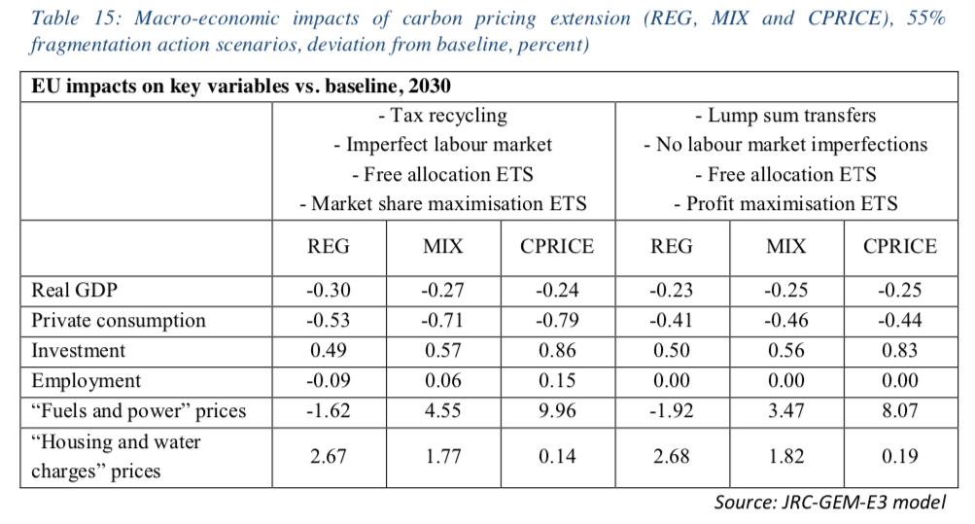
2030 climate target plan: impact assessment
Economic and social impacts | BSL (baseline) | REG | CPRICE
ETS price (€/ton) | 32 | 32 | 60
System costs incl. carbon pricing and disutilities ave. annual (21-30) as % of GDP | 10.9% | 11.4% | 11.6%
Investment expenditures (incl transport) ave. annual (21-30) vs (11-20), billion euros 2015 | 263 | 377 | 326
Energy expenditures (excl transport) of households as % of household income | 7.2% | 7.6% | 7.8%
Source: Commission impact assessment accompanying the 2030 climate target plan communication

Slide 8
2030 climate target plan (+IA): synopsis
Proposes an updated headline climate target of at least -55% by 2030
Provides insights into the sectoral policy options being considered, and their impacts on a wide range of factors
Does not make the ‘difficult choices’ yet, e.g.
Which of the policy options is preferred
What the preferred outcomes are in terms of impacts

Slide 9
Looking ahead: (inception) impact assessment
Inception impact assessment is expected to be published in the coming weeks – will have to define:
Problem the revision aims to tackle
Objectives of the revision
Policy options studied to reach the objectives
The impact assessment itself will be be published together with the proposal – expected June 2021

Slide 10
(inception) impact assessment: problem and objectives
Problem definition:
Current ETS framework not in line with 55% ambition
Current ETS framework not (sufficiently) driving emission reductions in covered sectors – is this a real issue for the institutions?
Objectives:
’Increased role for ETS’ – what does the Commission precisely mean with this?
Manage surplus and policy overlap
Provide ‘a story’ for the decarbonization of industry

Slide 11
From objectives to policy options – the ETS galaxy
Increased role for ETS
Level of ambition
Use of revenues
Scope extension
Ensure efficiency and effectiveness
Role of Domestic/international credits (incl. negative emissions)
Market Stability Reserve
Free allocation + BCAM
Rebasing of cap
Provide ‘a story’ for the decarbonization of industry
Manage surplus and policy overlap

Slide 12
Some key issues
How and when will the ‘difficult choices’ be made
Impact assessment highlights some potential trade-offs between the policy options, e.g.:
GDP; consumption; employment; household costs
Political issues: application of ESR or not; ETS vs. Energy Taxation?
Decisions will have to be made by June 2021. Are the coming 9months meant to discuss these issues among institutions and stakeholders?

Slide 13
Some key issues
How and when will the ‘difficult choices’ be made
Impact assessment highlights some potential trade-offs between the policy options
Decisions will have to be made by June 2021. Are the coming 9months meant to discuss these issues among institutions and stakeholders?
A clear pathway beyond 2030 – when does the EU ETS reach zero?
Starting year | Rebase of the cap? | Resulting LRF to reach 2030 | Year net-zero emissions is reached (if LRF continued)
2026 | No | 5.89% | 2037
 | - 250mt (ref. impact assessment) | 3.62% | 2041
Source: own calculations

Slide 14
Some key issues
How and when will the ‘difficult choices’ be made
Impact assessment highlights some potential trade-offs between the policy options, e.g.:
Decisions will have to be made by June 2021. Are the coming 9months meant to discuss these issues among institutions and stakeholders?
A clear pathway beyond 2030 – when is ‘net-zero’ achieved in the EU ETS?
Holistic vision to decarbonize industry
A lot of different tools are being discussed – how (and where) are they coordinated?
ETS, CBAM, hydrogen, consumption charges, contracts-for-difference, standards, etc.

