Slide 1
Andrei Marcu, ERCST Jean-Yves Caneill, ERCST Domien Vangenechten, ERCST
Preparing for the Review of the EU ETS
Brainstorm Session - Webinar
This meeting is under Chatham House Rules
September 4, 2020

Slide 2
Structure of the meeting
10:00 Welcome A. Marcu, Director of ERCST
10:05 The EU ETS review: State of Play and outline - J-Y. Caneill, ERCST - D. Vangenechten, ERCST
10:15 First Session - icebreakers and initial views - M. Pahle, PIK - W. Acworth, ICAP
Followed by roundtable discussion with participants
11:10 Second Session - icebreakers and initial views - A. Berman, IETA
- C. Maury, WWF
Followed by roundtable discussion with participants
12:00 Concluding remarks and next steps
House rules: ‘raise hand’ for questions/interventions | mute microphones when not speaking | put video on if possible

Slide 3
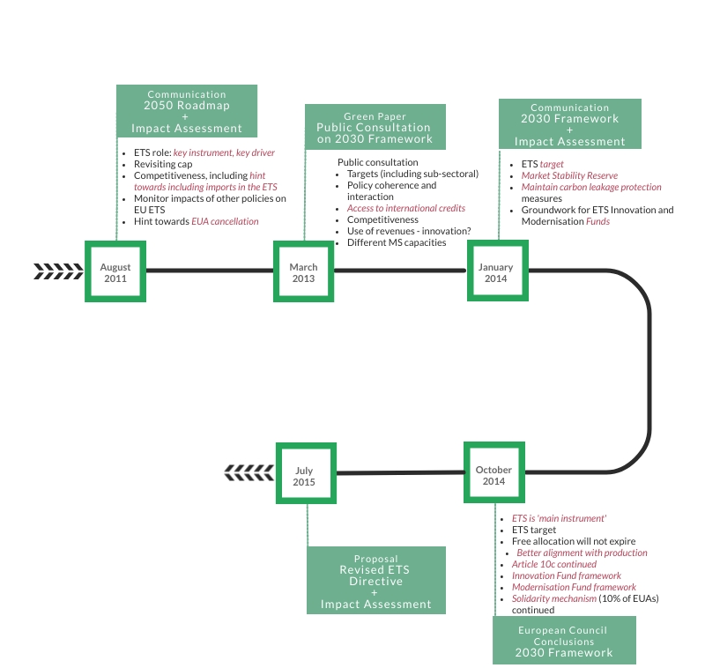
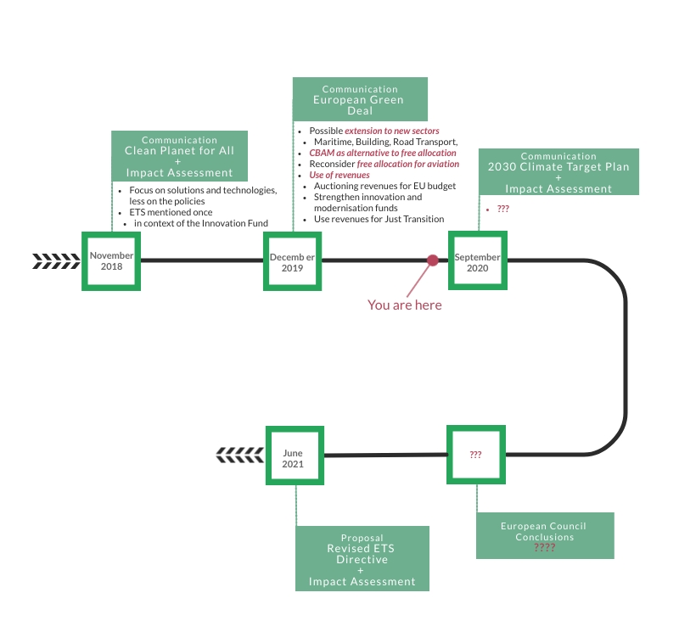
2030 climate and energy framework vs. the European Green Deal

Slide 4
What is already on the menu for the revision?
Revision of the target;
Mandated review of the Market Stability Reserve + possible revision;
Possible extension to other sectors;
Reconsider free allocation for aviation;
CBAM as alternative to free allocation;
Use of revenues;
For EU Budget (own resources)
Strengthened Innovation and/or Modernisation Fund
Just Transition?
Specials?
Source: CarbonPulse

Slide 5
Taking a step back: 2 key questions
Clearly define the objectives of the review
Little indication to the envisaged role of the ETS: cornerstone? driver? or …

Slide 6
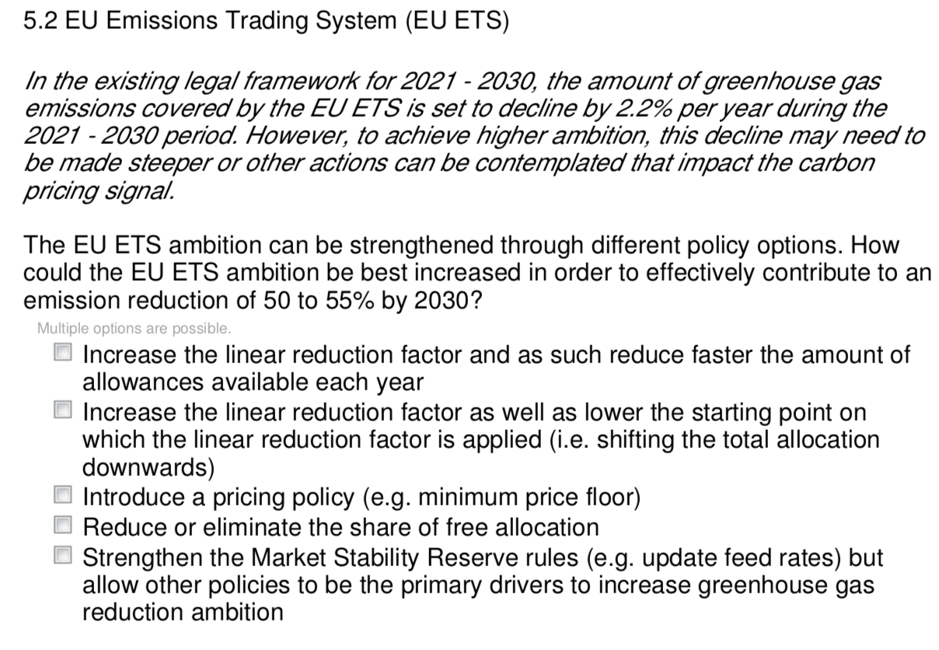
Taking a step back: 2 key questions
Clearly define the objectives of the review
Little indication to the envisaged role of the ETS: cornerstone? driver? or … safety net?
Just strenghten the ETS ambition, or also attempt to cure other ‘ills’?
What is the appropriate way to increase ambition?
Source: 2030 Climate Target Plan Public Consultation

Slide 7
Taking a step back: 2 key questions
Clearly define the objectives of the review
Little indication to the envisaged role of the ETS: cornerstone? driver? or … safety net?
Just strenghten the ETS ambition, or also attempt to cure other ‘ills’?
What is the appropriate way to increase ambition?
When does the EU ETS reach net-zero?
While it’s true that the LRF has no ‘sunset’… it’s updated value will depend on:
The 2030 target
A possible rebasing the cap
Start year of updated LRF
… and not on the long-term goal.
This long-term goal should be clarified, as currently ambiguity does exist (climate neutrality vs. Carbon neutrality)

Slide 8
2 additional dishes
Role of EU ETS in driving demand for negative emission credits
It is clear that removal technologies will be vital in order to deliver on our domestic and international ambition
The European Commission is currently exploring setting up a carbon removal certification mechanism
The ETS should play a key role in driving demand for these credits
Role of international cooperation
Role of international credits in the medium- to long-term should be explored
Prospects for linkage
Dependable on the outcome of Article 6 negotiations?

Slide 9
1 overarching theme
Provide a ‘story’ for industry
The in 2014 agreed 2030 Energy and Climate framwork seems to have been more focused on providing answers to the power sector
Current review is the moment to provide answers for (energy-intensive) industry, including through accompanying policies:
CBAM and/or ‘alternatives’ and complementing policies e.g. EUA financed contracts for difference?
Increased role for innovation fund?
Ensuring uptake of green products: creating a market for low carbon products
Hydrogen for hard-to-abate industry?

