Slide 1


l ERCST Informal Forum on Implementation of Article 6 of the Paris Agreement l
Article 6 Registries
24 June 2020

Slide 2

Approaches…
Understand the function of the Article 6 registries under the whole architecture of the Article 6 infrastructure
Identify gaps of the draft texts* to operationalize the Article 6 registries
(mainly A6.2 registries and infrastructure)
* COP25 Presidency Texts(ver.3 of 15 Dec. 2019)

Slide 3
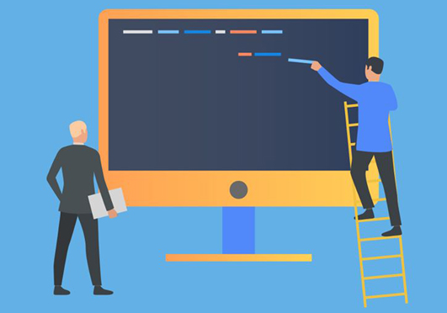
1. What is a registry?
A registry is a collection of all the official records relating to something, or the place where they are kept.
Registry
Source: Collins Cobuild Advanced Learner's English Dictionary
Article 6 registries
A basic system to avoid double counting by recording and tracking ITMOs.
To ensure accurate accounting when Parties assess the achievement of their NDC.

Slide 4
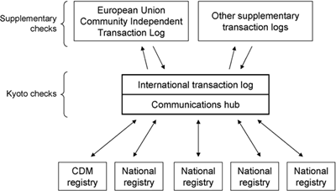
[Ref.] Registries under the Kyoto Protocol
National registry
(13/CMP.1, para 17)
To ensure the accurate accounting of the issuance, holding, transfer, acquisition, cancellation and retirement of ERUs, CERs, AAUs and RMUs and the carry-over of ERUs, CERs and AAUs by each Party included in Annex Ⅰ of the Convention
CDM registry
(3/CMP.1, Appendix D)
To ensure the accurate accounting of the issuance, holding, transfer and acquisition of CERs by Parties not included in Annex Ⅰ of the Convention
To verify the validity of transactions, including issuance, transfer and acquisition between registries, cancellation and retirement of ERUs, CERs, AAUs and RMUs and the carry-over of ERUs, CERs and AAUs
Source: https://unfccc.int/process/the-kyoto-protocol/registry-systems

Slide 5
2. A6.2 and A6.4 registry in the draft texts(1)
A6.2
A6.4
Focus on the function and interaction with other A6 infrastructure
Focus on accounts - “ownership”

Slide 6
2. A6.2 and A6.4 registries in the draft texts(2)
 | A6.2 |  | A6.4
Name/title | A registry (=A6.2 registry? or National Registry?) | International registry | Mechanism registry (=A6.4M registry)
Administrator | Party | Secretariat | Secretariat (in accordance with the relevant requirements adopted by the Supervisory Body)
Accounts | Having accounts as necessary (authorization, first transfer, transfer, acquisition, cancellation, use towards NDCs, authorizations for use towards other international mitigation purposes, voluntary cancellation) |  | at least a pending account, holding account, retirement account, cancellation account, account for cancellation for overall mitigation in global emissions and share of proceeds account, as well as a holding account for each Party and each public or private entity authorized by a Party that requests an account
Form | Not specified | Not specified | Not specified
Transaction verifier | Secretariat | Secretariat | Not specified

Slide 7

3. Article 6(6.2) infrastructure
Reporting
(Section Ⅳ)
Recording and tracking
(Section Ⅵ)
Review
(Section Ⅴ)
Initial report
(in conjunction with the next due BTR)
Registry
Article 6
technical expert review
Annual Information
(submit to the A6 database)
Providing infrastructure for reporting
Supporting
A6 TER
Annual Information
Article 6 database
Regular Information
(include in its BTR)
Centralized accounting and reporting platform

Slide 8
4. Structure of A6 infrastructure based on the draft texts
transfer/acquisition of ITMOs
Registry by Party A
Centralized accounting and reporting platform
(to publish information submitted by participating Parties)
A6 database
(to record and compile annual information submitted by participating Parties)
Registry by Party B
Registry by Party C
International registry
(for participating Parties that do not have/have access to a registry)
Information to be recorded and tracked
authorization
first transfer
transfer
acquisition
cancellation
use towards NDCs
voluntary cancellation
authorizations for use towards
other international mitigation purposes
with unique identifiers

Slide 9
5. Interaction between Recording and Reporting
transfer/acquisition of ITMOs
Registry by Party A
Centralized accounting and reporting platform
(to publish information submitted by participating Parties)
A6 database
(to record and compile annual information submitted by participating Parties)
Registry by Party B
Registry by Party C
International registry
(for participating Parties that do not have/have access to a registry)
How to report?
Direct data exchange between registries and A6 database is not specified in the texts
Report through the “Annual information” to A6 database

Slide 10
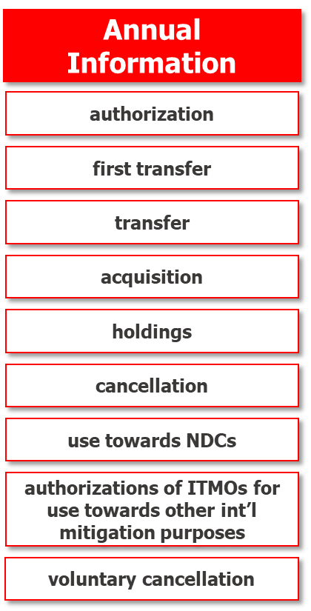
5. Interaction between Recording and Reporting
Registry by Party A
Centralized accounting and reporting platform
(to publish information submitted by participating Parties)
data extract
A6 database
(to record and compile information submitted by participating Parties)
Registry by Party B
data extract
reporting
Registry by Party C
data extract
reporting
International registry
(for participating Parties that do not have/have access to a registry)
data extract
How to report?
Direct data exchange between registries and A6 database is not specified in the texts
Report to A6 database through the “Annual information”

Slide 11

6. Fill the gap?
What should be recorded and tracked by the A6.2 registries?
How can we track the transactions between A6.2 registries and A6.4M registry?
Recording amount of ITMOs transferred/acquired
from each transaction
(by each participating Party)
Recording and tracking through serial numbers given to each tCO₂e of ITMO
Reporting net flows of ITMOs
(by each participating Party)
in annual information
Double-entry bookkeeping approaches
Transfer ≥ Use
Checking the consistencies of information reported by participating Party by the Secretariat

Slide 12
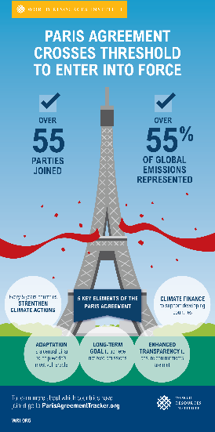

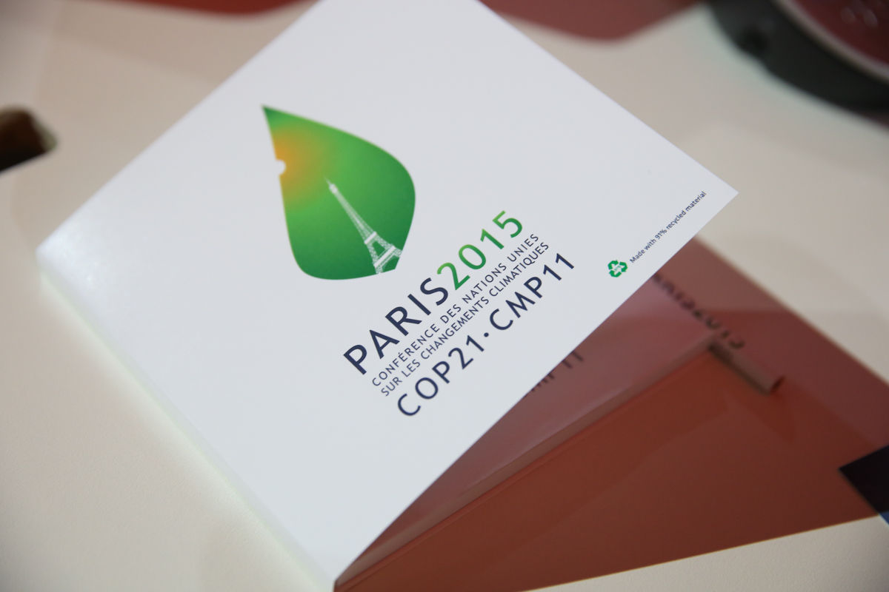


7. Is our work “on-track”?
COP26/CMA3
(Nov. 2021)
2020/2021
First implemention period of NDC
Adoption of the Paris Agreement
(Dec. 2015, COP21)
Fail to adopt
the A6 rulebooks
(Dec. 2018, CMA1-3)
Fail to adopt
the A6 rulebooks
(Dec. 2019, CMA2)
SBSTA52
(Oct. 2020)
Entry into force
(4 Nov. 2016)
SBSTA52 is the only chance to elaborate the texts while cleaning-up the cover decisions
⇨ (A6.2) Need to ensure consistencies based on interaction between infrastructure
⇨ (A6.2 & A6.4) Need complementary provision for transactions between the registries
We are behind the schedule!!!
⇨ Need technical protocol/standards to develop the registry(in particular for non Annex-Ⅰ Parties)
⇨ Intersessional work would be helpful to registry administrators
(e.g. Intersessional consultations on registry system in 2005)

