Slide 1
Choreographing the ballet: a case of too many prima ballerinas?
ERCST call, 6 May 2020
Amy Merrill Steen

Slide 2
Purpose of this presentation
Purpose
To provide some reflections on designing the transition of CDM activities and CERs to the 6.4 mechanism.
Caveat
Chatham House Rule
General presentation, focused on practicalities and not focused on addressing all positions/interests of Parties and groups
Presentation made on basis that Presidency texts are not agreed but what we have in them is focus for discussion today

Slide 3
Who is the prima ballerina?
Serious question – need consistent design logic for transition of CDM activities and CERs
There are bicameral and tricameral decision-making in UNFCCC but CDM activity/CER transition is temporary period of handover and not the main focus of the 6.4 mechanism
CDM activity transition process:
Not mandatory so transition is conditional invitation (host needs to agree, eligibility) from CMA - a “pull”
CMP takes decisions to support “handover”- a {gentle} “push”
6.4 supervisory body implements the “pull”
CDM Executive Board implements the “push”
DNA controls any transition – authority over the CDM and 6.4 in its own country
CER transition process:
As above but with actions needed from ITL and CDM registry and, possibly, 6.4 registry

Slide 4
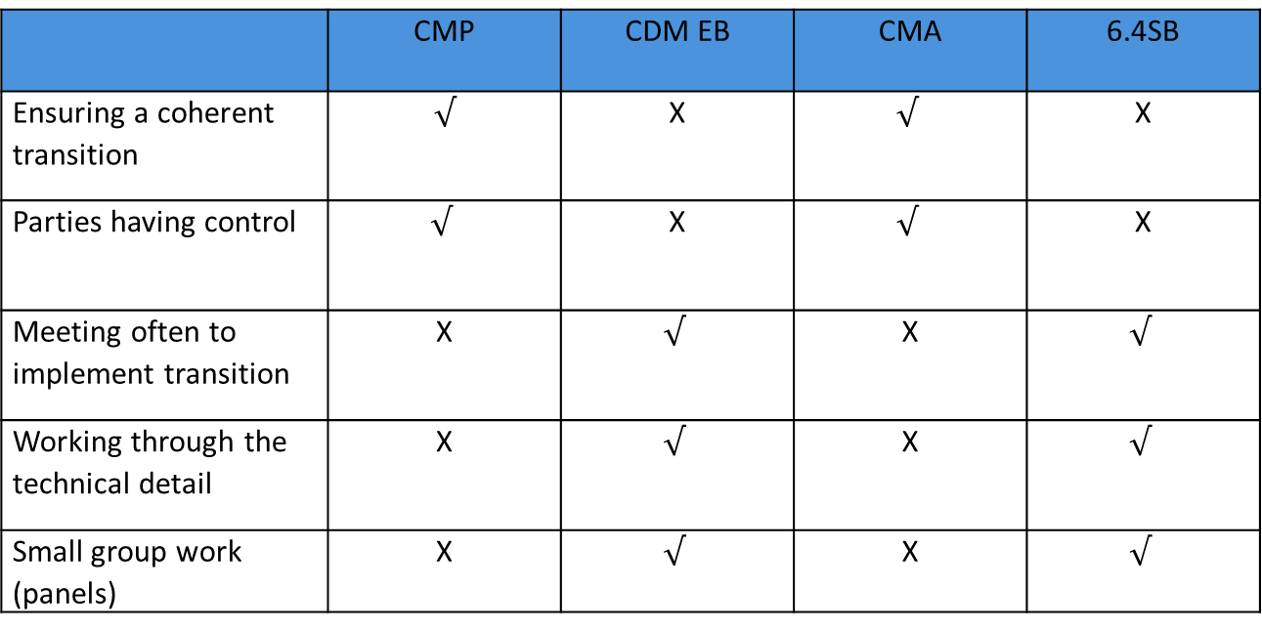
The level of decision-making
To get the transition done, Parties (in CMP or CMA) will need to be willing to take clear decisions and then trust the CDM EB/6.4 Supervisory Body to implement them. That trust was still missing in Madrid with still a lot of matters returned to the SBSTA.
 | CMP | CDM EB | CMA | 6.4SB
Ensuring a coherent transition | $$√$$ | X | $$√$$ | X
Parties having control | $$√$$ | X | $$√$$ | X
Meeting often to implement transition | X | $$√$$ | X | $$√$$
Working through the technical detail | X | $$√$$ | X | $$√$$
Small group work (panels) | X | $$√$$ | X | $$√$$

Slide 5
What might happen at the [next] CMP/CMA?

Slide 6
What might be the process at the activity level?

Slide 7
Summary reflections
Go lightly
Create “positive consequentials” (if A happens in 6.4, B is deemed to occur in CDM (or vice versa))
Avoid double governance (do not do it in two bodies when it can be done in just one)
Only regulate the essentials, leave space for efficiency to be found at administrative level
Minimize burden on Parties, secretariat, bodies AND stakeholders in the CDM activities that transition
When the decision on what to transition has been made, then focus on the needs of the collective clients: the project participants that have eligible CDM activities – make it easy for them.

Slide 8
The cooperative implementation webpage: https://unfccc.int/process/the-paris-agreement/cooperative-implementation

