Slide 1



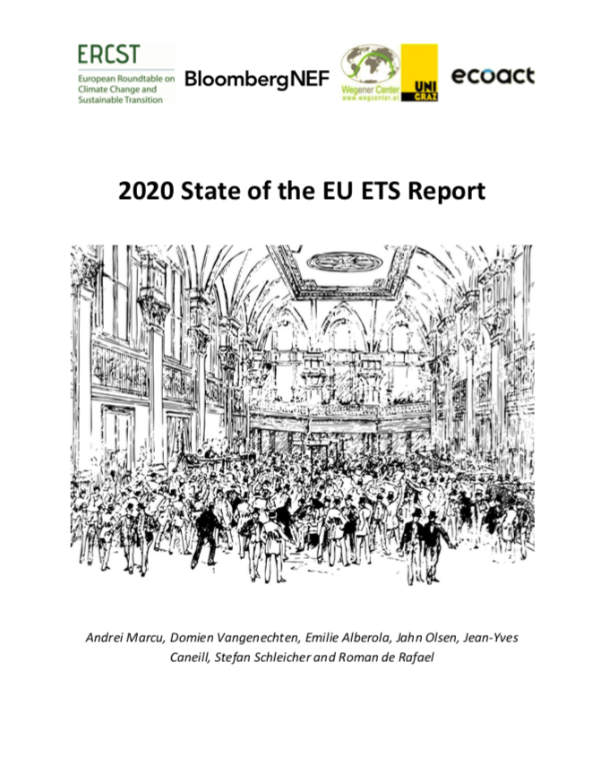
2020 State of the EU ETS Report
April 28 – Launch webinar

Slide 2
State of the EU ETS 2020– Outline
Chapters
  Background
  An EU ETS “fit for purpose”
  Impact of COVID-19 on the EU ETS
  Changes in regulatory environment
  Sentiment Market Survey
  Environmental delivery
  Economic delivery
  Market functioning
  The European Green deal
  Issues to monitor in the future

Slide 3
Background
2020 State of the EU ETS Report is meant to be a “snapshot”, providing policymakers and stakeholders with an overview of how the EU ETS is doing by April of each year, based on previous year data.
Context:
  Phase 4 review concluded in 2018
  Climate ambition momentum 2018-2019 : review of all CC and energy policy
  2020: COVID-19
    The process may need to be re-though and adapted
    Competition for resources and attention - resources are finite: priorities will have to be set, and choices to be made

Slide 4
EU ETS ‘fit for purpose’
What do we expect the EU ETS to deliver?
3 key deliveries
Environmental delivery. Does it deliver against absolute environmental targets?
Economic delivery. Macro-economic efficiency and cost effectiveness for compliance. Does it provide effective, and proportional, protection against the risk of carbon leakage? Is it a driver for change?
Market functioning. It is worth having a market only if it functions well and leads to good price discovery.

Slide 5
EU ETS ‘fit for purpose’
2 additional, implicit deliveries:
1. A long-term (competitive) advantage for Europe
Incentivize investments to accelerate the transition;
Address the socio-economic impacts associated with the transition to a low-GHG economy through revenue-recycling;
Contribute to the creation of a market for low-carbon products;
Incentivizing behavioural and system change.
2. A role for the EU ETS in being a pioneer and promoting carbon markets as a tool for addressing climate change
Leading by example/Carrot/Stick.
More ‘explicit’
Less ‘mature’

Slide 6
State of the EU ETS 2020– Outline
Chapters
  Background
  An EU ETS “fit for purpose”
  Impact of COVID-19 on the EU ETS
  Changes in regulatory environment
  Sentiment Market Survey
  Environmental delivery
  Economic delivery
  Market functioning
  The European Green deal
  Issues to monitor in the future

Slide 7
Impact of COVID-19 on the EU ETS
Severe economic implications …
  IMF projections: European Union GDP -7.1%
… which will be accompanied by the largest drop in emissions on record
  CarbonBrief: -5.5% (2000 MtCO2)
  Global Carbon Project: -6.8% (2500 MtCO2)

Slide 8
Impact of COVID-19 on the EU ETS
Short- to medium-term implications
Impact on the EU ETS – emissions and prices
First real ‘test’ for the Market Stability Reserve – can it handle the surplus within reasonable time?
Implications for Free Allocation post-2025 – calculation of ‘historical activity level’ includes 2020.

Slide 9
Impact of COVID-19 on the EU ETS
Long term implications…
… will largely depend on how the economic stimulus currently under preparation by the governments and central banks will be developed and used.
Many have called for the European Green Deal to be at the heart of the EU’s recovery plan (e.g. op-ed by Climate minsters; the ‘alliance for green recovery’)
Others have called for delays of the implementation of the EGD, and some even for the abandonment of current climate policy.
Resources are finite: priorities will have to be set, and choices to be made.

Slide 10
State of the EU ETS 2020– Outline
Chapters
  Background
  An EU ETS “fit for purpose”
  Impact of COVID-19 on the EU ETS
  Changes in regulatory environment
  Sentiment Market Survey
  Environmental delivery
  Economic delivery
  Market functioning
  The European Green deal
  Issues to monitor in the future

Slide 11
Changes in the regulatory environment
Europe became more ambitious:
  ’Green movement” in 2019
  European Elections: number of green leaning MEPs increased;
  European Commission: European Green Deal
  European Council: Endorsed Climate Neutrality goal
We did not see the same level of ambition internationally:
  The SG Climate Summit urged countries to enhance their NDCs, but no (large) countries have done this so far.
  COP 25 also did not deliver on Ambition, which was expected by some, nor did negotiators agree on a rulebook for Article 6 (the ‘markets’ article)
  After the ICAO decision in March 2020, the EU will assess the ambition of CORSIA to review or not the EU ETS coverage of the aviation sector.

Slide 12
Changes in the regulatory environment
Brexit – post-2020 uncertainties remain
  2019: Contingency plan - Free allocation and auctioning of EUAs by the UK
  was suspended
  2020: UK remains a full participant in the EU ETS, and can allocate/auction its
  2019 allowances.
  Beyond 2020: 4 options remain on the table – (1) Carbon tax; (2) Stand-alone
  ETS; (3) UK-EU linked ETS; (4) UK remains part of the EU ETS
Market Stability Reserve starts:
  Reduced the auctioning volume by 397m allowances in 2019 (including UK share)
  Review already planned in 2021.

Slide 13
State of the EU ETS 2020– Outline
Chapters
  Background
  An EU ETS “fit for purpose”
  Impact of COVID-19 on the EU ETS
  Changes in regulatory environment
  Sentiment Market Survey
  Environmental delivery
  Economic delivery
  Market functioning
  The European Green deal
  Issues to monitor in the future

Slide 14
‘Sentiment’ Market Survey
Survey Questions 2020
In its current architecture, including the revision for Phase 4
  The EU ETS governance will provide a stable and predictable framework for an investment signal.
  The EU ETS Phase 4 parameters will lead to price patterns in 2020-2030 which are commensurate with an investment trajectory necessary towards net zero emissions by 2050.
  The EU ETS will provide a first mover advantage for the EU business community.
  The EU ETS will require significant changes to the MSR in the 2021 review.
  The mechanisms in place in the EU ETS can address the impacts of MS policies that will overlap with the EU ETS.
  The EU ETS can drive EU climate change policy post 2030.
Notes:
- Do we keep both 4 and 5? New question?

Slide 15
Market Sentiment Survey
The EU ETS Phase 4 parameters will lead to price patterns in 2020-2030 which are commensurate with an investment trajectory necessary towards the updated 2050 climate target.

Slide 16
State of the EU ETS 2020– Outline
Chapters
  Background
  An EU ETS “fit for purpose”
  Impact of COVID-19 on the EU ETS
  Changes in regulatory environment
  Sentiment Market Survey
  Environmental delivery
  Economic delivery
  Market functioning
  The European Green deal
  Issues to monitor in the future

Slide 17
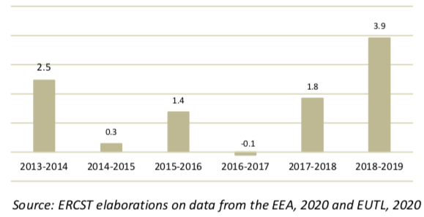
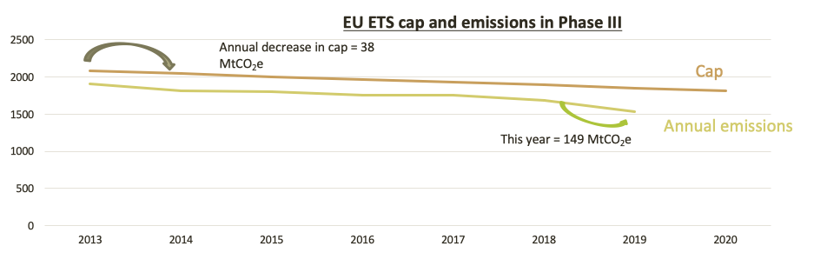
Environmental delivery against the current trading period target
2019 estimates
-8.9% Total emissions
-13.9% Power
-5% Industrial Heat
-1.8% Industry
In 2019, emissions decreased 3.9 times faster than the cap
Verified emissions are 17.8% below the cap in 2019

Slide 18
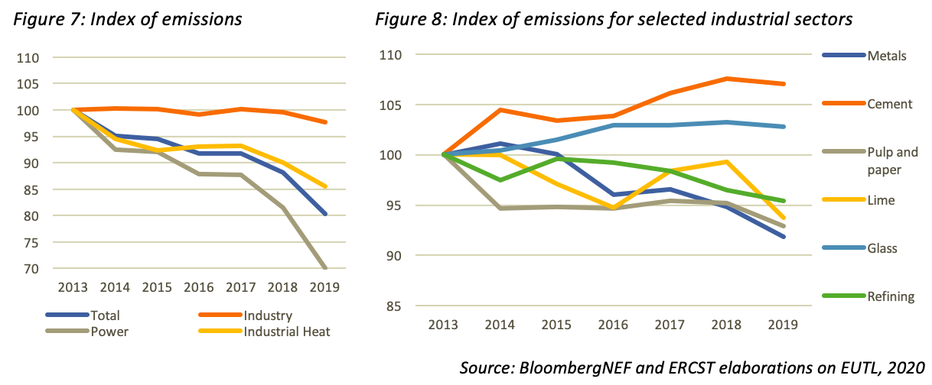
Environmental delivery: Emission and decarbonization trends
Emissions Index
Phase 3 – average yearly emissions reductions:
Power: -5.6%
Industrial heat: -2.5%
Industry: -0.4%

Slide 19
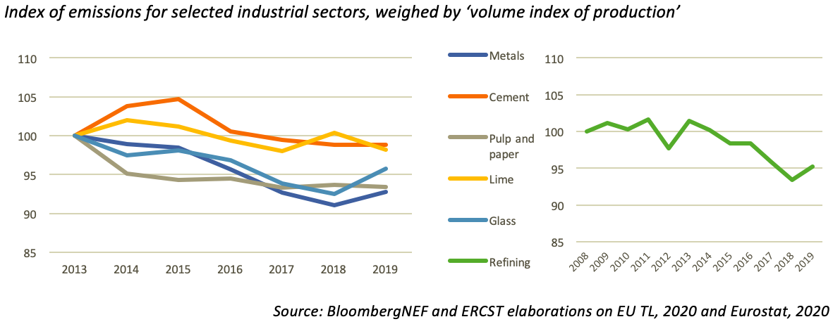
Environmental delivery: Emission and decarbonization trends
Proxy for carbon intensity
While intensity data is hard to come by, our proxy indicates modest carbon intensity improvements for most industrial sectors
Current pace of improvements is not fast enough to reach the long-term objectives.

Slide 20
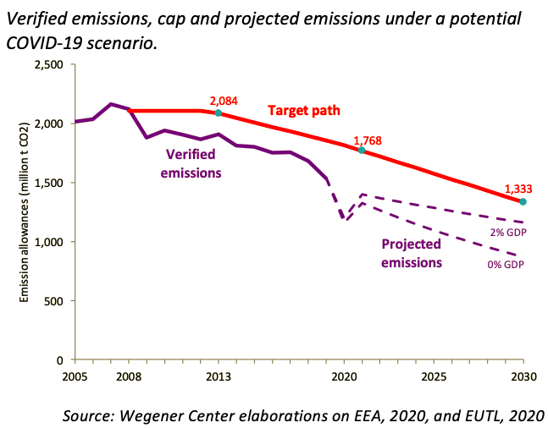
Environmental delivery: Phase 4 outlook
Actual emissions have been far below the target path.
COVID-19 Scenario: -20% drop in emissions in 2020, followed by a 95% recovery in 2021
Projected corridor based on GDP growth rates: emissions will stay well below the (current) cap
20

Slide 21
State of the EU ETS 2020– Outline
Chapters
  Background
  An EU ETS “fit for purpose”
  Impact of COVID-19 on the EU ETS
  Changes in regulatory environment
  Sentiment Market Survey
  Environmental delivery
  Economic delivery
  Market functioning
  The European Green deal
  Issues to monitor in the future

Slide 22
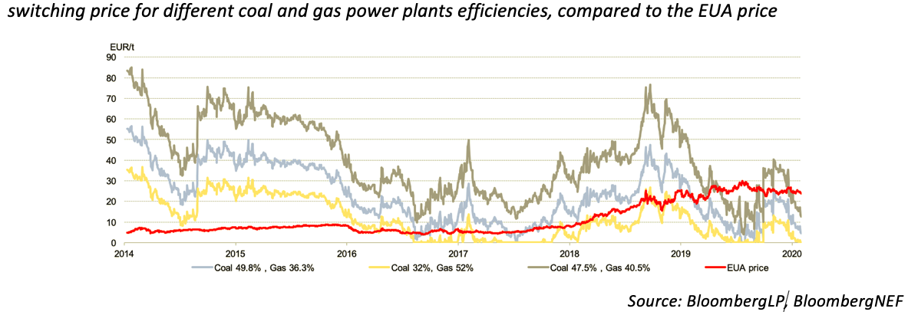
Is the EU ETS a driver for change?
Fuel switching

Slide 23
Is the EU ETS a driver for change?
Evidence of fuel-switching
-22%
Pattern fill = 2018
Solid fill = 2019
-33%
+84%
+19%
-66%

Slide 24
Economic efficiency
Power sector emission covered by EU ETS have so far decreased by almost 30% during Phase 3.
2019
  Fuel switching due to higher carbon pricing together with lower gas prices.
  A continuation of renewable penetration in the EU power mix;
  A strong output for renewable sources;
  A rather “warm” year, resulting in a decrease in overall consumption.
24

Slide 25
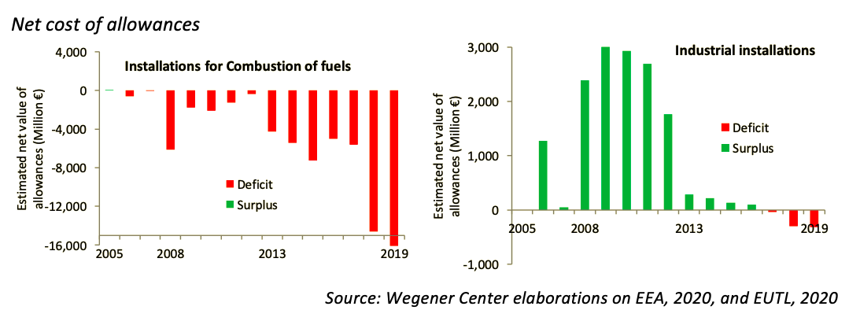
Monetary impacts and carbon leakage
Direct costs
Industrial installations historically received more free allocation than their verified emissions.
This trend has steadily been reversed over Phase 3.
In 2018 and 2019 free allocation covered 96.8% and 97,5% of industrial emissions, respectively, down from 98.8% in 2017.

Slide 26
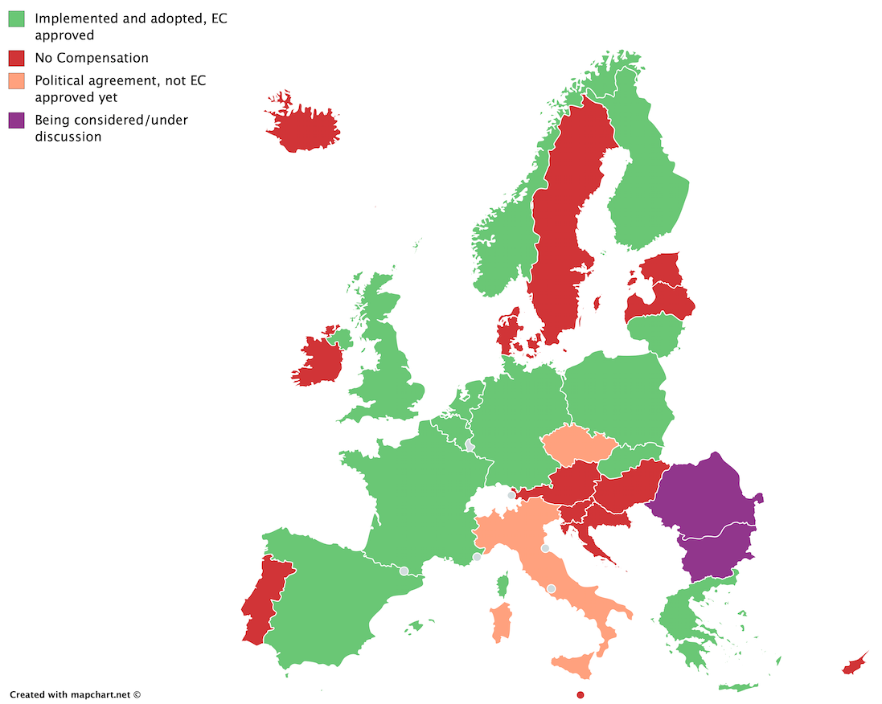
Monetary impacts and carbon leakage
Indirect costs
No harmonized approach in the EU
11 Member States + Norway compensated for indirect costs incurred in 2018
Subject to ’state aid guidelines’
Digressive compensation

Slide 27
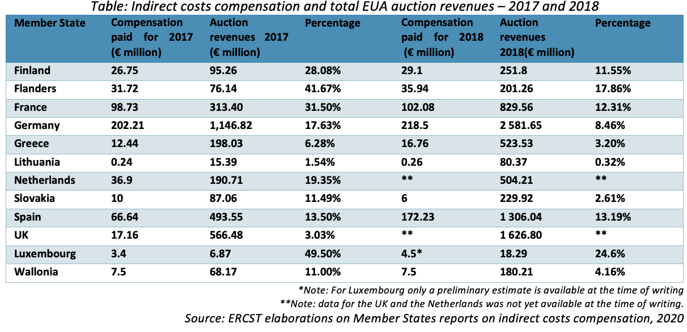
Monetary impacts and carbon leakage
Indirect costs

Slide 28
State of the EU ETS 2020– Outline
Chapters
  Background
  An EU ETS “fit for purpose”
  Impact of COVID-19 on the EU ETS
  Changes in regulatory environment
  Sentiment Market Survey
  Environmental delivery
  Economic delivery
  Market functioning
  The European Green deal
  Issues to monitor in the future

Slide 29
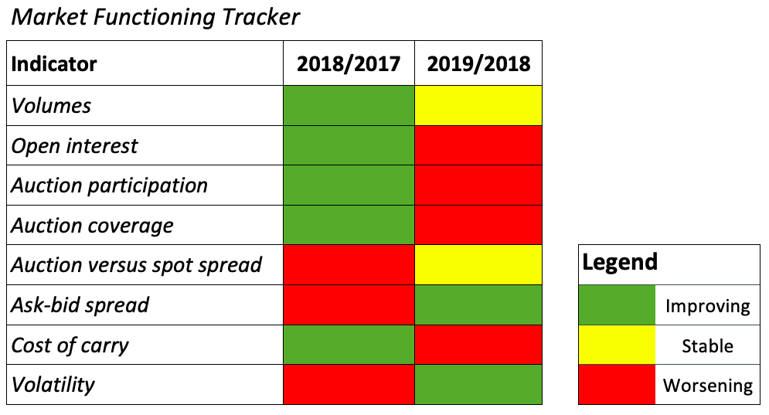
Market Functioning Tracker

Slide 30
Market functioning: volumes
Traded volume up 6% despite lower emissions and alleged exit of speculators

Slide 31
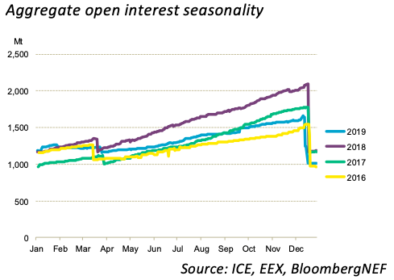
Market functioning: open interests
Open interest down year-on-year despite strong start to the year.
Utilities likely less active due to lower emissions. Allows them to roll hedges over into the future rather than entering the market
Lower open interest combined with higher traded volume hints that speculators with a shorter time-horizon have increased while compliance market actors might have limited their buying

Slide 32
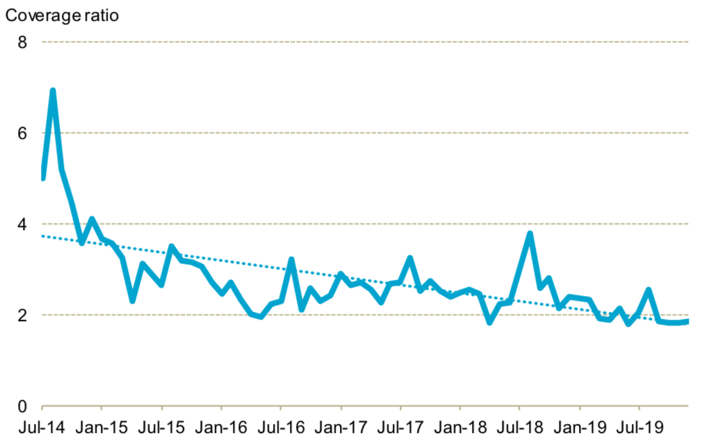
Market functioning: Auction coverage ratio
Source: BloombergNEF

Slide 33
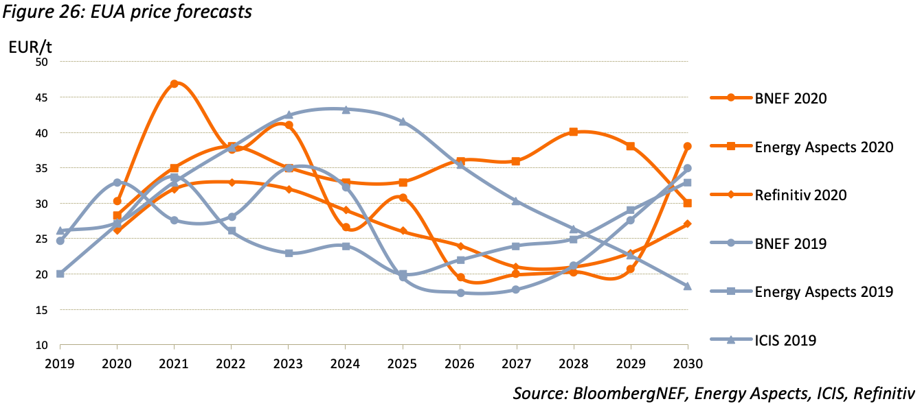
Price forecasts: pre-COVID19

Slide 34
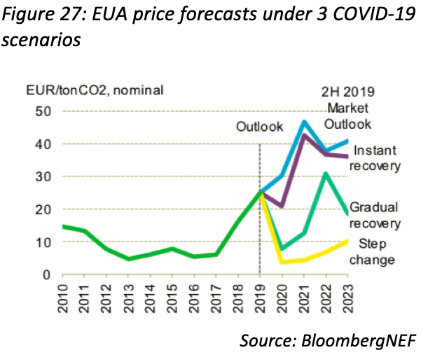
Price forecasts: post-COVID19

Slide 35
State of the EU ETS 2020– Outline
Chapters
  Background
  An EU ETS “fit for purpose”
  Impact of COVID-19 on the EU ETS
  Changes in regulatory environment
  Sentiment Market Survey
  Environmental delivery
  Economic delivery
  Market functioning
  The European Green deal
  Issues to monitor in the future

Slide 36
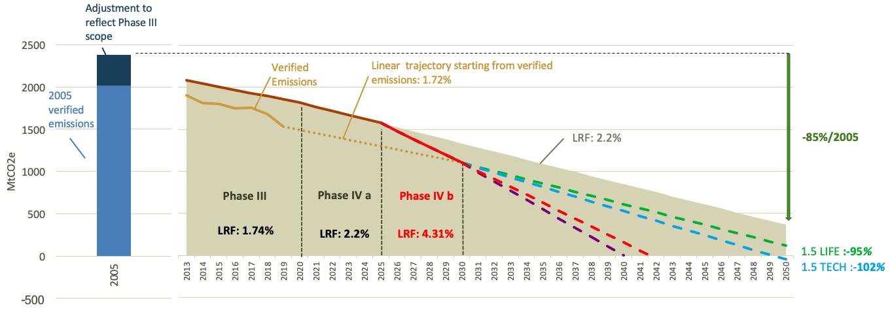
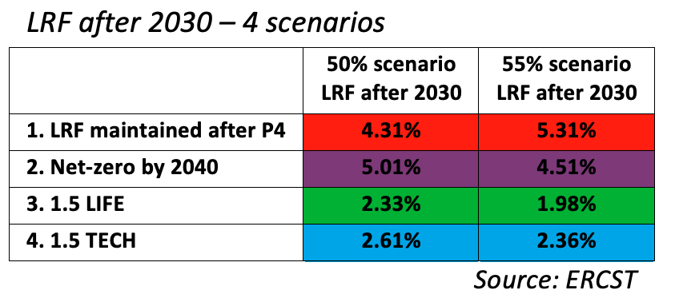
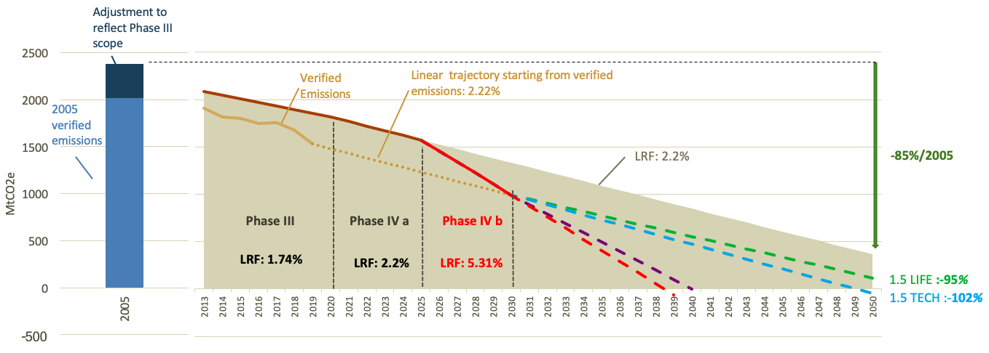
The European Green deal – targets
LRF necessary for reaching a 50% / 55% target + possible scenarios beyond 2030
Scenarios:
50%/55% target
Updated LRF in 2026
No rebase of the cap
Relative contribution from ETS vs. non-ETS constant

Slide 37
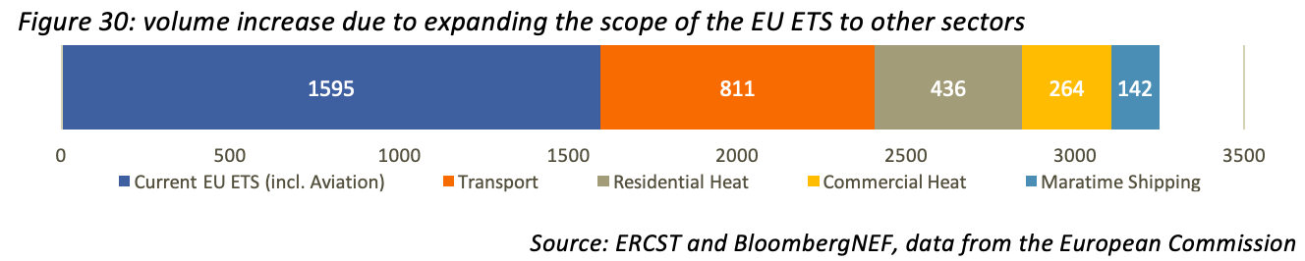
The European Green deal – Scope increase?
The European Green Deal opens the door for inclusion of a number of sectors:
  Maritime shipping
  Road transport
  Buildings
Inclusion of maritime shipping seems most likely:
  Repeatedly mentioned by the European Commission;
  Currently being considered by the European Parliament (ENVI committee) as an amendment to the maritime shipping MRV regulation.

Slide 38
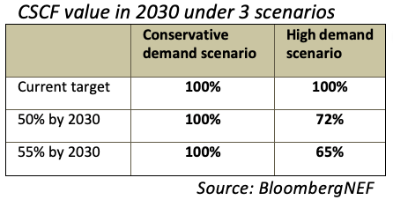
The European Green deal – Free Allocation
Free allocation could ‘run out’ under certain scenarios.
Alternative to Free allocation:
a carbon border adjustment measure (CBAM)?
Poses many questions that need to be answered

Slide 39
2020 State of the EU ETS Report
April 28 – Launch webinar

